Slide 1
Spinal Cord Injury
Rachel Garvin, MD
October 20, 2014

Slide 2
Diving Drunk
22 yo M presents as transfer from OSH
Dove into shallow pool while intoxicated
Patient amnestic to the event but currently GCS 15
VS on arrival to ED show HR 80, BP 89/55, RR 26 sats 95% on 2L NC
Patient reports feeling “numb” all over
Notes:
HPI:22 year-old male transferred from OSH in Laredo after jumping/falling into a pool and losing consciousness. Patient does not remember the events surrounding the accident. Patient was intoxicated at outside hospital. He was transferred to UH after finding C5 teardrop fracture with bilateral lamina fractures and posterior arch encroaching the spinal canal. Per report, the patient was able to move all extremities also displayed no deficits to sensation throughout. Pt arrrived in UH ED with no motor function in BLE and weakness in bilateral grips and triceps. He denies decreased sensation throughout. pt now in c-collar complaing of pain in his neck.

Slide 3
Diving Drunk
On neuro exam, sensation intact throughout
Motor exam shows 4+ C5 bilaterally, otherwise 0
Absent rectal tone
Complains of pain in neck

Slide 4
MRI T1 MRI T2
Notes:
1. Abnormal increased T2 signal within the spinal cord from C4
through C6 is compatible with contusion likely with hemorrhagic
elements.
2. Fracture of the C5 vertebral body with anterior compression and
resultant mild retrolisthesis of C5 with respect to C4 and C6.
3. Suspected injury of the anterior longitudinal ligament and
interspinous ligaments at the C5 level.

Slide 5
Diving Drunk
Orders written by neurosurgery:
Admit to ICU
Q1 neuro checks
Continue c-collar at all times
Log roll only
Blood pressure control

Slide 6
Lecture Objectives
SCI statistics
Review of Anatomy
Pathophysiology
Grading of SCI
Mechanisms of SCI
Respiratory Dysfunction
Treatment of SCI

Slide 7
Statistics
Incidence of about 10-12,000 per year
Young males 20-30 most commonly
Mechanisms: MVC, falls, violence, sports
Cervical spine most often injured over T/L/S combined
Annual cost of SCI in the US >$7 billion
Leading cause of death: pneumonia, PE, sepsis
Notes:
4x more likely in men than women
MVC 50%, falls 26%, violence 15%, sports 7% -- falls most common in those >60

Slide 8
Anatomy
Notes:
Cervical and lumbrosacral enlargement of cord
Brachial plexus off cervical

Slide 9
Anatomy
Notes:
Ventral roots – motor fibers
Dorsal root - sensory

Slide 10
Ligaments

Slide 11
Vascular Supply
Notes:
Central and peripheral systems of vascular supply.. ASA supplies 2/3. No precapillary connections but terminal branches overlap in spots. Pial artery plexus from ASA/PSA. Posterior half of posterior horns only supplied by PSA. The blood supply is more direct hand compensatory in cervical and lumbar than in thoracic regions
Artery of Adamkiewicz is largest artery that reaches cord and supplies 14 of cord in 50% of people, mostly btwn T9-T12

Slide 12
Vascular Supply
Notes:
Extensive capiilary network within the gray matter

Slide 13
Neurons

Slide 14
Function

Slide 15
Innervation
Notes:
Descending vasomotor sympathetic pathways originating in the hypothalamus, pons, and medulla are located in the spinal cord in the intermediolateral and dorsolateral regions of the lateral funiculus in humans [32 , 33 ]. Efferent preganglionic sympathetic fibers exit the cord at T1–L2 via the ventral root and terminate in the sympathetic ganglia. The degree of hemodynamic instability is proportional to the severity and rostral position of the SCI. Complete injuries to the spinal cord disrupt these sympathetic pathways and reduce pre- and post-ganglionic release of catecholamines, leading to systemic (T1–L2) and pulmonary vasodilation (T1–T6), bradycardia (T1–T4), and adrenomedullary dysfunction (T1–T9) After cervical and upper thoracic SCI, unopposed parasympathetic pathways predominate and worsen hemodynamic control systems both acutely and chronically. The biochemical mechanisms involved include an initial increase followed by a prolonged, chronic decrease
in circulating catecholamines, impaired vascular responses to vasopressin, and increased nitric oxide-mediated vasodilation[18 , 37 –40 ]. Chronic changes in alpha-adrenergicreceptor sensitivity have also been recognized and, alongwith other mechanisms, may predispose patients to lifethreatening episodes of autonomic dysreflexia
Lesions above T6 – loss of supraspinal control over heart and splanchnic blood vessels both of which are needed for long and short term BP regulation

Slide 16
Pathophysiology and Types of Injury

Slide 17
Pathophysiology of SCI
ASA and PSA usually intact
Disrupted arteries constrict
Gray matter venules get leaky
Microhemorrhages occur in capillaries at gray/white border → disruption of BSCB
Within 30-60 minutes, gray matter clearly damaged
4 hours from injury mostly perfusion only to peripheral half of white matter
Notes:
Destroyed white matter = no transmission of information, Segmental loss of gray matter is functionally tolerated b/c only small pool is represented.

Slide 18
On a cellular level. . .

Slide 19
Autoregulation
Blood flow in the SC is about ½ of brain
Partial pressure of tissue oxygen same
Animal studies show autoregulation between 40-135mm HG
Requires intact SNS and BSCB
Notes:
Tissue oxygen levels 35-40mmHg
Same effects of PCO2 on blood vessels as in the brain
Hitchon on lmabs 40-100mmHg
Kobrine monkeys50-135; PCO2 50-90 caused CBF to increase
Sympathectomized cats show no autoregulation with BP changes – linear relationship

Slide 20
Change in Autoregulation
Notes:
Animal studies show the more severe the injury, the more variation in SCBF
Lohse et al looked at different levels of trauma and intitial increase in MAP and then significant decreased (<50% of pretrauma values) after.
Decreased SCBF will increase vascular resistance

Slide 21
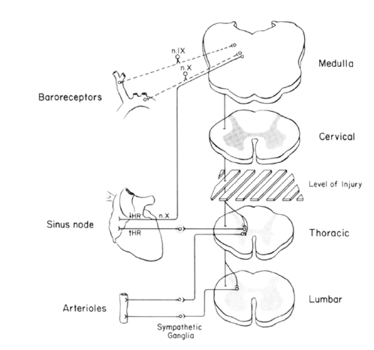
Baroreflex
Negative feedback
High and low pressure systems
Combines with pulmonary afferents and chemoreflex
Decreased stretch →decrease firing → SNS activation
Notes:
Carotid bulb → CNIX → medulla
Aortic arch → CN X → medulla
Low pressure system of stretch receptors in heart and lungs that transmit to augment sympathetic outflow in response to low flow/volume state
High pressrue system receptors in aortic arch and carotid bulbs. Transmite via CN IX and X to medulla by solitary tract. Fast response system
Increased BP = Increased vagal tone
Inspiration decreases vagal response. Hypoxia resets baraoreceptors to higher BP
In SCI, descending sympathetic pathways are disrupted → reductions in vasomotor tone below the lesion
Decreased vagal response in SCI from arterial stiffening from inactivity

Slide 22
Hypotension Related to Injury Level
High T and C-spine injuries
Loss of sympathetic outflow
Relative hypovolemia
Notes:
Sympathetic supply to heart T1-T4 level

Slide 23
How Common is Hypotension?
Lehmann showed 68% with hypotension
71 consecutive patients with acute SCI
48 cervical; 31 complete
Levi et al: complete cervical cord injury 5.5x more likely
Nakao et al 45% had hypotension
Retrospective study of 172 cervical SCI patients
Half of the patients were complete quadriplegia
Notes:
Nakao ½ of the patients also experience hyponatremia. Descending renal sympathetic pathway located 2-3mm ventrolateral to dorsolateral sulcus. Increases renal sympathetic acitivty → vasocontriction → RAAS → reabsorb free water
Lehmann: 48 cervical patients ( 31 severe cervical),68% hyptension 11 needed pressors, 71% with bradycardia <45. 23 thoracolumbar, none needed pressors
Levi: 50 cervical patients, 41 needed pressors

Slide 24
Types of Injuries
Axial Compression
Compression or burst type fractures
Least associated with SCI
Flexion/Distraction or Hyperextension
Usually an unstable injury
Increased risk of SCI
Rotational
Almost always associated with SCI

Slide 25
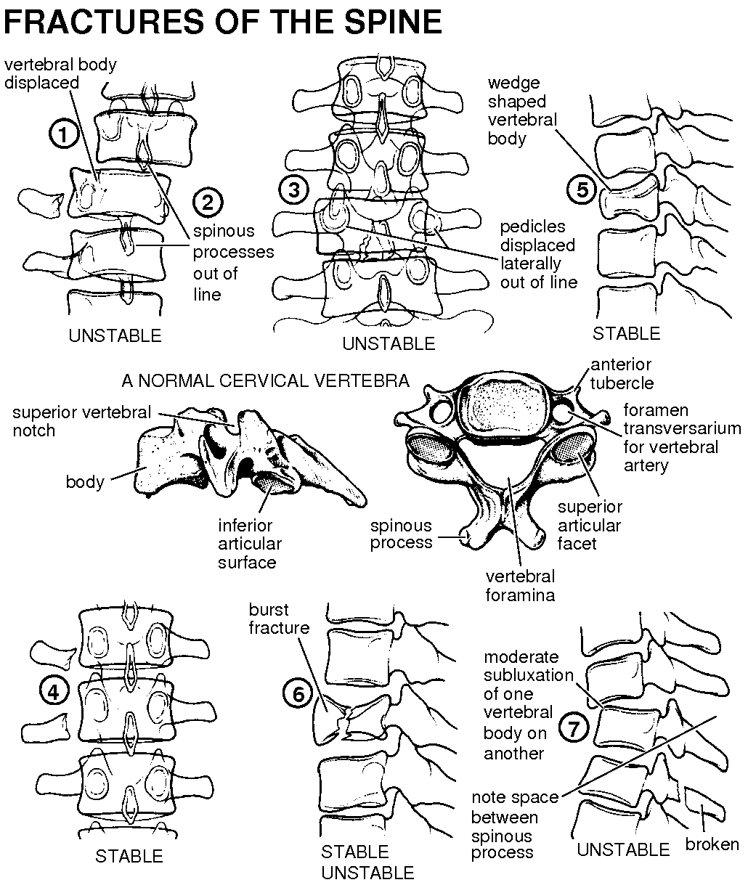

Slide 26
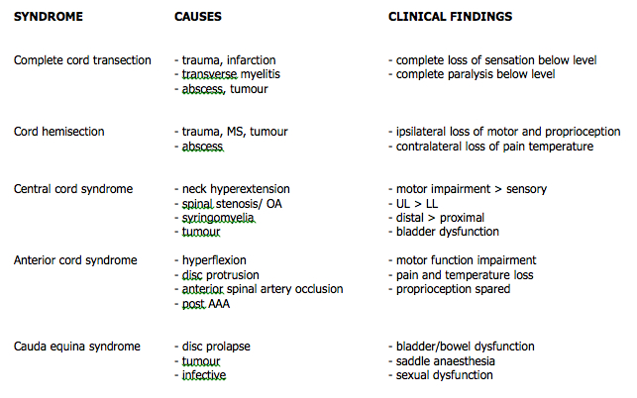
Spinal Cord Syndromes

Slide 27
Knowing Your Anatomy

Slide 28
Sensory and Motor
Sensory: 0-2
0 = sensation absent
1 = sensation impaired
2 = sensation normal
Motor: 0-5
0 = complete paralysis
1 = palpable or visible contraction
2 = active movement w/gravity eliminated
3 = active movement against gravity
4 = provides some resistance
5 = normal resistance

Slide 29
Motor Scoring
J Am Acad Orthop Surg 2009;17:
756-765

Slide 30
ASIA Scoring
J Am Acad Orthop Surg 2009;17:
756-765
Notes:
Max score 100
Defines the most caudal level that has intact motor and sensory function on both sides of the body
For central cord, UE have 10 pt difference in weakness

Slide 31
http://www.scientificspine.com/images/ASIA2006_front.jpg

Slide 32
Central Cord Syndrome
Most common type of incomplete SCI
Trauma most common cause
Older patient with spondylosis with hyperextension injury
Often times no acute bony injury
Notes:
Up to 60% have fx-subluxations
Spondylolysis is a defect of the lumbar vertebra in the spinal column. The lumbar vertebra consist of a body, pedicle, lamina, pars interarticularis, transverse process, spinous process and superior articular facets, which form joints that link the vertebrae together.

Slide 33
Central Cord Syndrome
J Am Acad Orthop Surg 2009;17:
756-765

Slide 34
Diagnosis
Complete neurologic assessment
Pertinent history
CT c-spine
MRI
Notes:
Sacral sparing important in identifying incomplete injury as it indicates partial continuity between cortex and conus
MRI: T2 and STIR. STIR can look for edema while excluding hemorrhage

Slide 35
Recovery
Motor function returns caudad to cephalad
Recovery usually less complete in UE
Hand dysfunction is most common longer term disability

Slide 36
Respiratory Dysfunction in SCI

Slide 37
Muscles of Respiration
http://bedahunmuh.files.wordpress.com/2010/05/muscles-of-respiration.jpg
Notes:
Muscles involved in respiration: diaphragm, IC, accessory and abdominal and bulbar
Some Pec major function intact C5 and below

Slide 38
http://sig13perspectives.pubs.asha.org/data/Journals/ASHASASD/928509/4.jpeg

Slide 39
Active vs Passive
http://www.buzzle.com/images/diagrams/human-body/diaphragm-movements.jpg
Notes:
In SCI, diaphragm contracts and moves down, but external IC not able to pull up and abdomen pushed out causing paradoxical chest wall movement.
When pt upright, abdomen pulls diaphragm down
RSB → more time spent inspiration and more deap space develops → decreased maximal EF = decreased ability to cough/clear secretions → atelectasis → harder to ventilate → V/Q mismatch → failure

Slide 40
http://flexiblelearning.auckland.ac.nz/medsci205/15/11/images/lungvolumes.jpg
Notes:
As level of injury ascends, TLC decreases. Increased RV but decreased FRC → decreased expiratory reserve (increased dead space) . This is d/t loss of abdominal muscles that help forced exhalation
Quadraplegic patients have better pulmonary mechanics supine → abdomen pushes back causing diaphragm to push up and decrease RV
Failure often doesn’t happen right away but can take up to 3-5 days from injury

Slide 41
Complicated Pulmonary Dysfunction
84% of high c-spine with pulmonary complications
Decreased lung expansion
Impaired cough
Impaired elastic recoil of diaphragm/lung
Increased secretions
Often pulmonary edema
Notes:
Pulm complication: vent failure, atelectasis, PNA
Incrs secretions d/t unopposed parasymp
Pulm edema from aggressive resusciation

Slide 42
5 year retrospective review (80 patients)
Injury characteristics and outcomes of pts with SCI on MV
80% men
Mean age 39
46% had cervical level injury
Cervical injury pts had overall lower ISS
Mean time to extubation 5.5 +/- 5.8 days
Of 31 total failed wean attempts, 71% were cervical
Notes:
Time to extubation did not vary based on level of injury
C-spines pts → 51% ASIA A; higher rate of no attempt at extubation in ASIA A but >50% were able to be successfully weaned and extubated
Failed wsean = need to return to AC mode from PS mode
Failed extubation = reintuation within 96 hours

Slide 43
Failed Weaning and Extubation by Level of Injury
Notes:
61% who failed initial wean attempt or initial extubation attempt were able to be successfully extubted

Slide 44
Reasons for Extubation Failure
Notes:
NIF did not differ significantly between those success or not
Spirometry not done consistently
Pulmonary toilet not outlined in study

Slide 45
Retrospective, single center study 1998-2011
256 patients
Median ISS 17
SCI C1-T3
Readiness for extubation: RSBI <110 with “adequate airway and adequate oxygenation”
Failure to meet criteria in 7-10 days = trach
Trach 30%
Notes:
Excluded TBI (blood on CT) and death within 24 hours
ISS similar to other study

Slide 48
Treatment
High Vt ventilation
IPV
Cough assist
MIE
Bronchodilators: ipratropium vs albuterol
Sustained intubation/trach not always needed
Notes:
b/c of flaccid respiratory muscles, Ppeak not usually problem
Hard for patients to exhale against PEEP
IPV = intrapulmonary percussive ventialtion (high freq vent with intrapulm percussion, humidity, aerosols)
MIE = mechanical insufflation/exsufflation. Applies gradaul PP and then NP (+40/-40) as a rapid shift in pressure → produces high exp flow
Bronchodilators promote production of surfactant. Ipratropium is atropine analogue → may block release of surfactant from type II cells
Academy of spinal cord injury professionals purport almost all pts can be weaned to extubation if bulbar muscles ok

Slide 49
“The inspiratory and expiratory muscles can be completely supported noninvasively such that even patients with no ventilator or EPP/DP-free breathing ability (VFBA) and 0 ml of vital capacity (VC) have used noninvasive intermittent positive pressure ventilation (NIV) for decades, as long as 58 years for one of our patients…”
Notes:
EPP= electrophrenic pacing
DP = diaphragmatic pacing

Slide 50
Autonomic Dysreflexia

Slide 51
Severity of AD

Slide 53
Treatment
Avoiding hypotension
Spine stablization
Early surgery vs late vs none
Pulmonary support
Early DVT prophylaxis
NO STEROIDS
Rehab

Slide 54
Questions?

