Slide 1
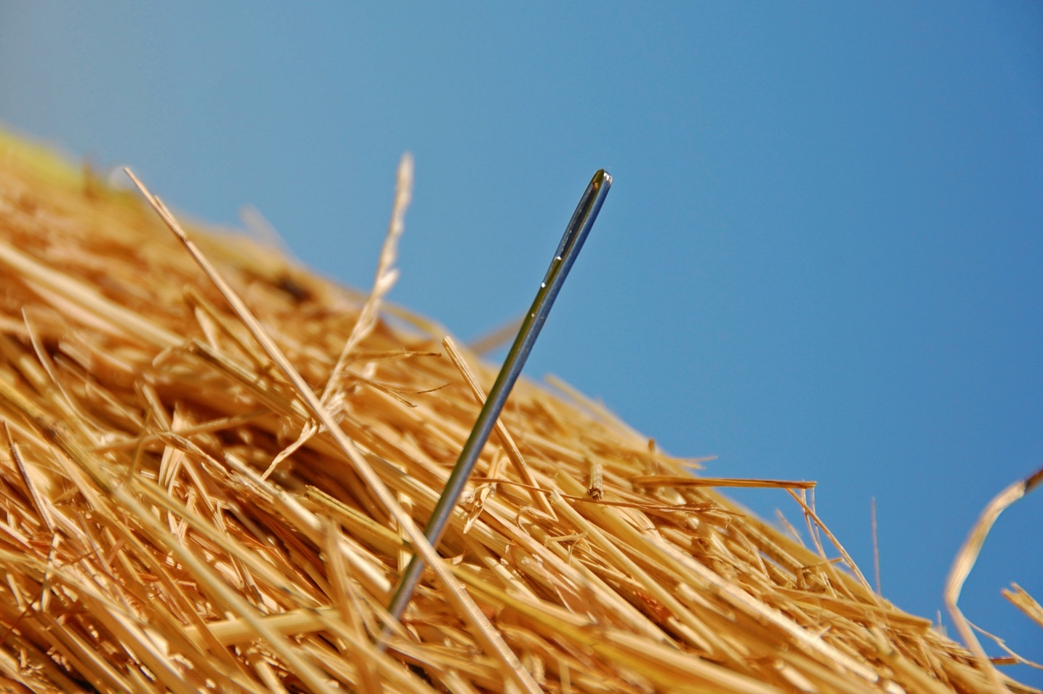

What is proteomics?
Richard Mbasu and Ben Richards

Slide 2
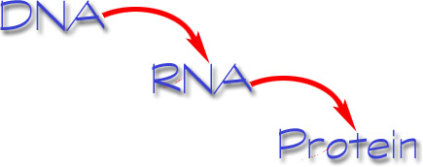
Introduction
Transcription
Translation

Slide 3
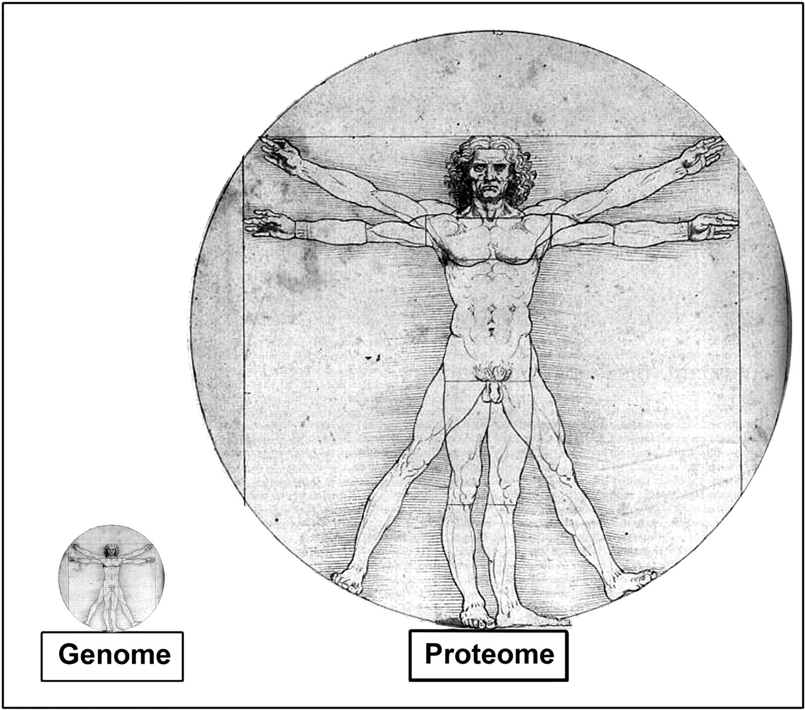
Fact
Genome ~ 26,000-31,000 protein encoding genes
Human proteins ≥ 1 million
Zimmermann J and Brown LR. (2001)
Notes:
Whereas there are ∼26,000–31,000 protein-encoding genes (14), the total number of human proteins, including splice variants and essential posttranslational modifications, has been estimated to be close to one million (76, 254). The area of the circle that is within the reach of Leonardo da Vinci's Vitruvian Man corresponds to these images.

Slide 4
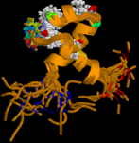
Proteomics and the proteome
Proteomics is the study of the proteome, the full protein complement of organisms e.g. plasma, cells and tissue.
Understanding the proteome allows for:
  Characterisation of proteins
  Understanding protein interactions
  Identification of disease biomarkers

Slide 5
Advantages of proteomics
Unlike related fields like genomics, proteomics allows for the study of post-translational modifications and interactions.
This facilitates the study of:
  Splice variants
  PTMs
  Phosphoproteomics
  Differential expression: biomarkers

Slide 6
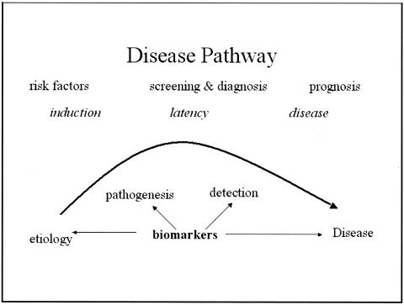
Biomarkers
Biomarkers are biological indicators of a disease.
They are useful both
for diagnosis, prognosis and
response to therapy
2 major types; biomarkers of
exposure and biomarkers of
disease
Notes:
Molecular alterations that are measurable in biological media such as human tissues, cells or fluids
There are two major types of biomarkers: biomarkers of exposure, which are used in risk prediction, and biomarkers of disease, which are used in screening and diagnosis and monitoring of disease progression.

Slide 7
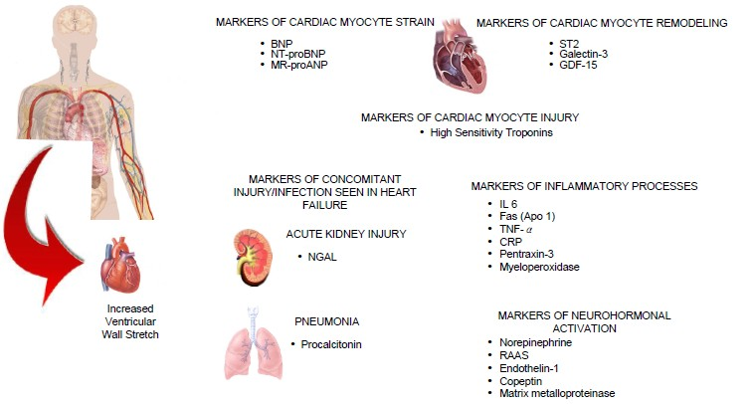
Existing biomarkers

Slide 8
Abundant proteins
Avoiding contamination
Patients plasma (comorbidity)
Reliable quantitation
Maximising number of confidently assigned proteins
Experimental design
Challenges
Throughput
Normalisation
Protein degradation
Large data files
Maintaining system performance over a long period of analyses
What to do with low confidence proteins
Data archiving and management

Slide 9
Workflow
Sample prep.
Immunoaffinity depletion
Sample analysis
Spiking with internal standard
Bioinformatics
Identification & quantification using
Digestion of proteins
Blind run for protein loading estimation
Analysing samples in triplicate
BCA protein assay
Concentration
Expression analysis
ProteinLynx Global Server

Slide 10
Sample Preparation

Slide 11
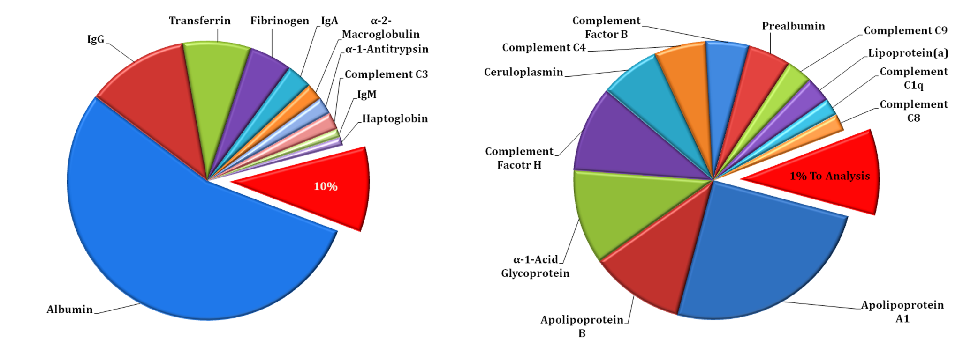
Sample Preparation
Plasma Protein Fact- >90% High abundant proteins
Plasma total protein
10% of the plasma protein

Slide 12
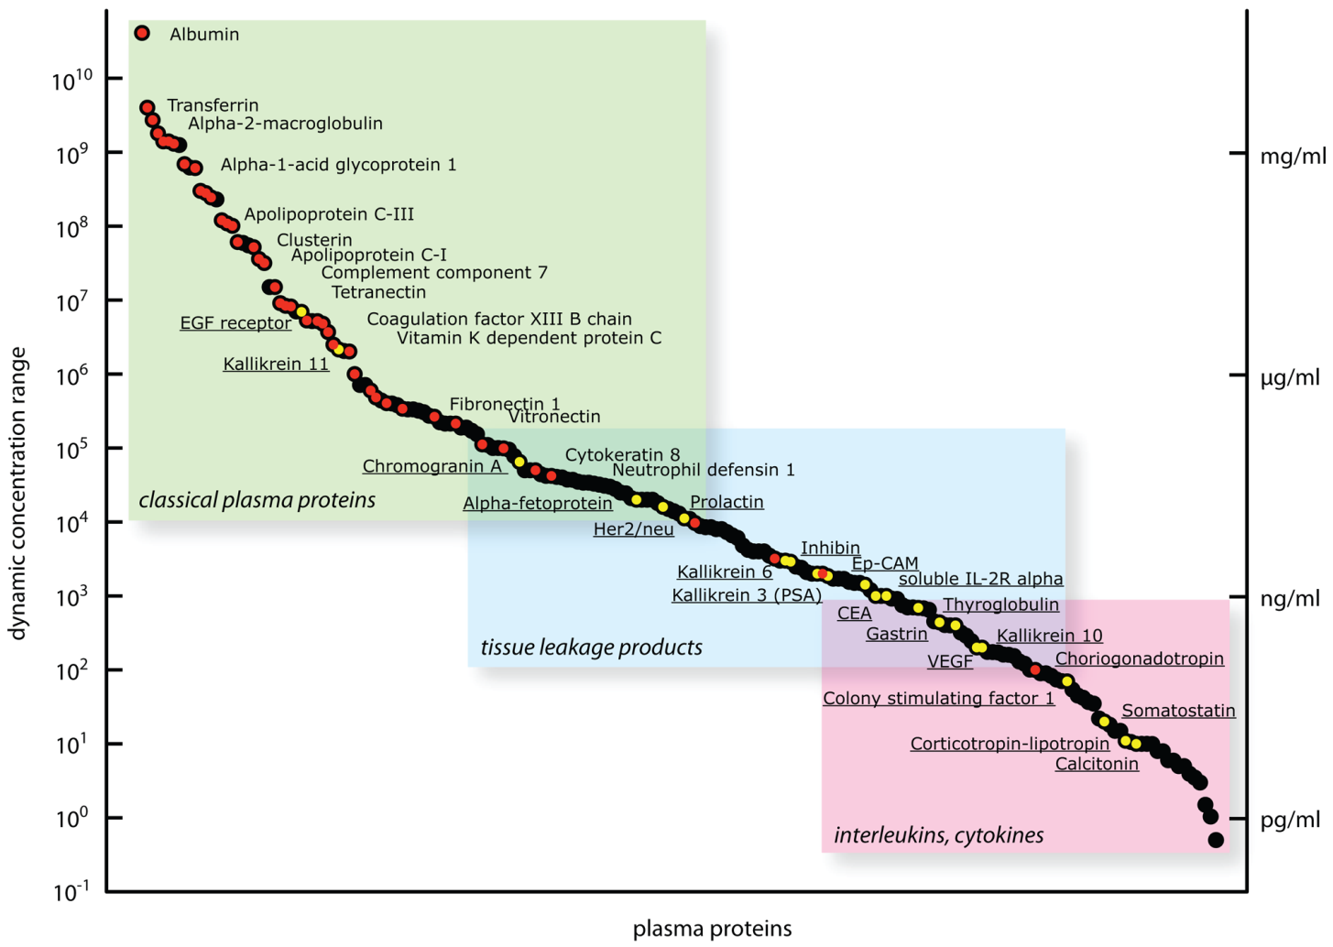
Sample Preparation (Cont.)
Plasma protein dynamic range
High abundant proteins
Accessible Proteins
Mass Spectrometry capability
Schiess R. et al. , 2009. Targeted proteomics strategy for clinical biomarker discovery,
Molecular Oncology, 3( 33–44)

Slide 13
Sample Preparation Cont.
Protein Depletion
Sigma Immunoaffinity Kit (Proteoprep 20 or Multiple affinity removal column HU 14)
Depletes up to 99% of high-abundance proteins
Albumin | α-2-Macroglobulin | Apolipoprotein A1 | Complement C4
IgGs | IgMs | Apolipoprotein A2 | Complement C1-q
Transferrin | α-1-Antitrypsin | Apolipoprotein B | IgDs
Fibrinogene | Complement C3 | Acid-1-Glycoprotein | Prealbumin
IgAs | Haptoglobin | Ceruloplasmin | Plasminogen

Slide 15

Other techniques
2D-Gel electrophoresis, Sample enrichment (Beads, Affinity Matrix)
BCA Assay
Shot gun proteomics
(Tryptic digestion- easy to work
with peptides)
Solid-phase extraction

Slide 16
Sample analysis

Slide 17
Mass Spectrometry
A mass spectrometer is an instrument that measures the masses of individual molecules that have been converted to ions; i.e., molecules that have been electrically charged.

Slide 18
How is a mass spectrometer used?
A mass spectrometer is used to help scientists:
Identify molecules present in solids, liquids, and gases
Determine the quantity of each type of molecule.
Determine which atoms comprise a molecule and how they are arranged

Slide 19
How does a mass spectrometer work?
Mass spectrometry has three specific steps:
  Ionisation
  Analysis
  Detection
Analytes must be both charged and in the gas phase.
S²⁺
S
S
S²⁺
S²⁺
S
S⁺
S³⁺
S
S²⁺
S⁺
S³⁺
m/z

Slide 20
Mass spectrometry and Proteomics
Large macromolecules like proteins and peptides were traditionally very difficult to vaporise.
Many traditional ionisation techniques lead to unpredictable fragmentation of analytes, complicating identification.
The advent of Electrospray ionisation (ESI) and matrix assisted laser desorption ionisation (MALDI) allowed for the gentle vaporisation and ionisation of large biomolecules.

Slide 21
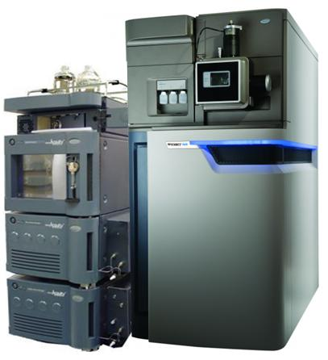
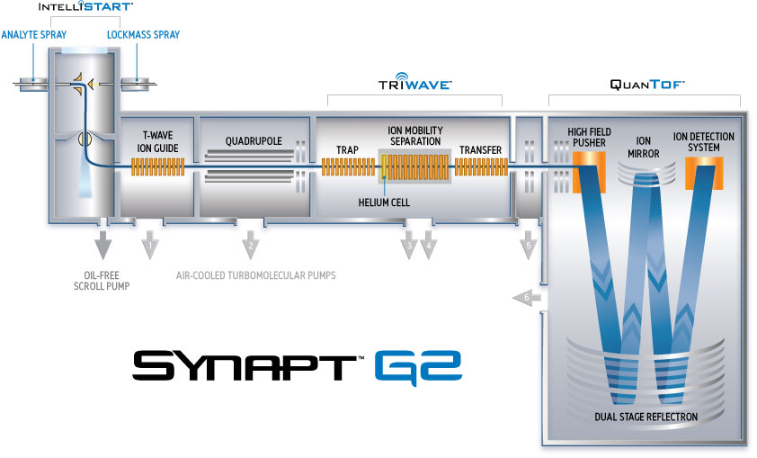
Sample Analysis
Ionisation
Analysis
Detection
Nano-Acquity UPLC-Synapt G2 HDMS

Slide 22
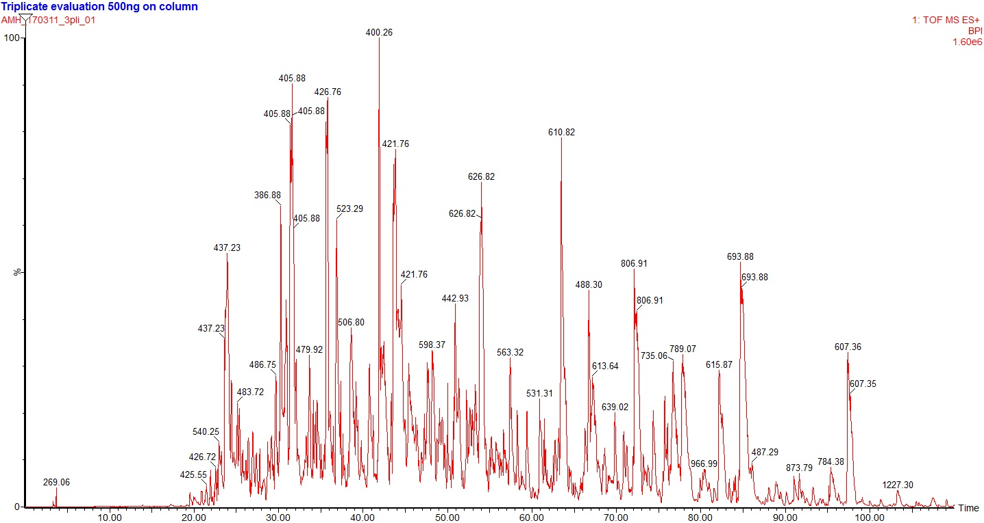
Sample Analysis Cont.
Chromatogram produced by MS

Slide 23
Bioinformatics

Slide 24
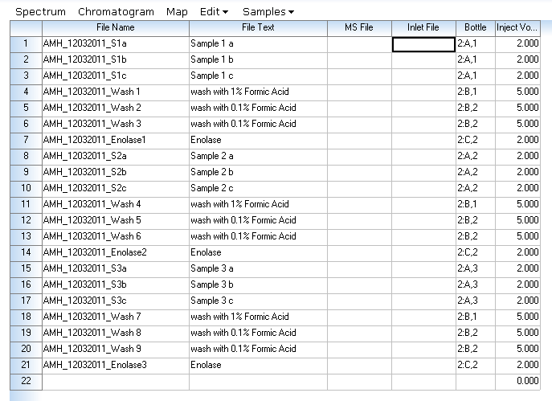
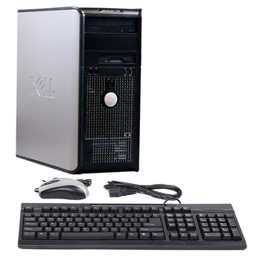
Bioinformatics lab
7 super Computers
  4 TB HDD- Storage
  64GB Ram- Speed
  Xeon Dual CPU= 24 CPU cores
  GPU with 64 CPU cores installed in it – PLGS uses all the CPUs
Process time per file (10GB) – 2 hours
Data processing software's
  Protein identification and quantification- PLGS, Proteome Discoverer, Progenesis and Mascot
  Post processing analysis- MaxQuant, Protein Centre, isoQuant and Scaffold
approximately 7 hours/sample

Slide 25
ProteinLynx Global server (PLGS)
Data processing
Prepares data in a manageable form ready to search against database.
(Collection of ion spectra).
Database searching
Searches through a number of database while applying many filters and rules to the peptides.
(Database creation, searches assuming complete digestion/miss cleavages).
Protein Details
Protein ID and Quantification.

Slide 26
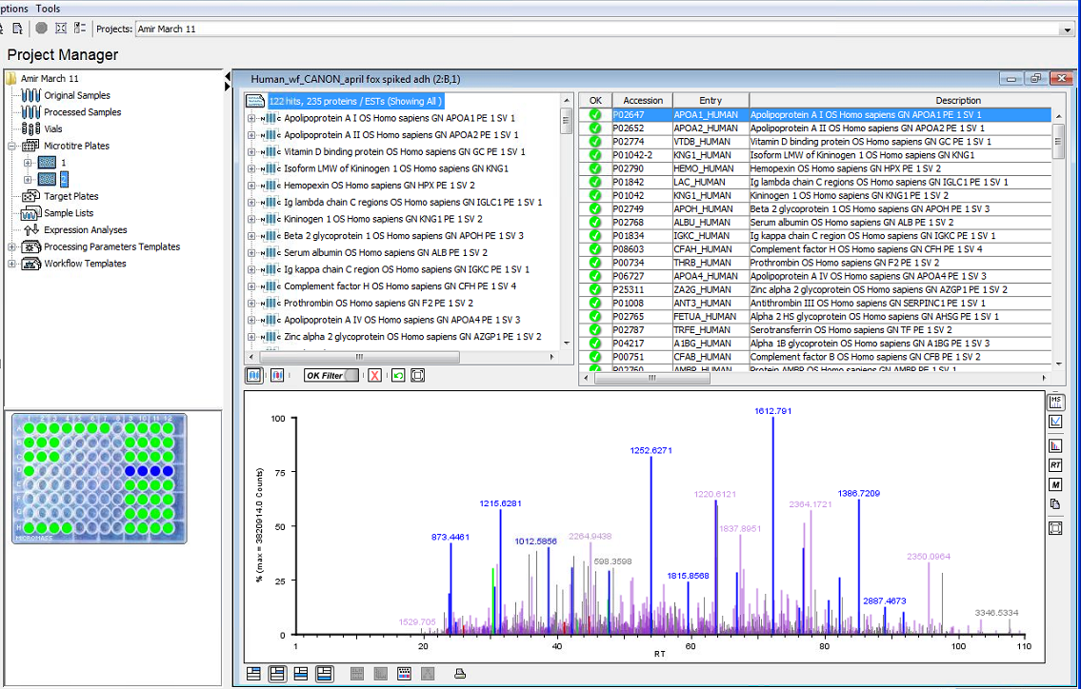
Bioinformatics
Identity^{E} Results from PLGS

Slide 27
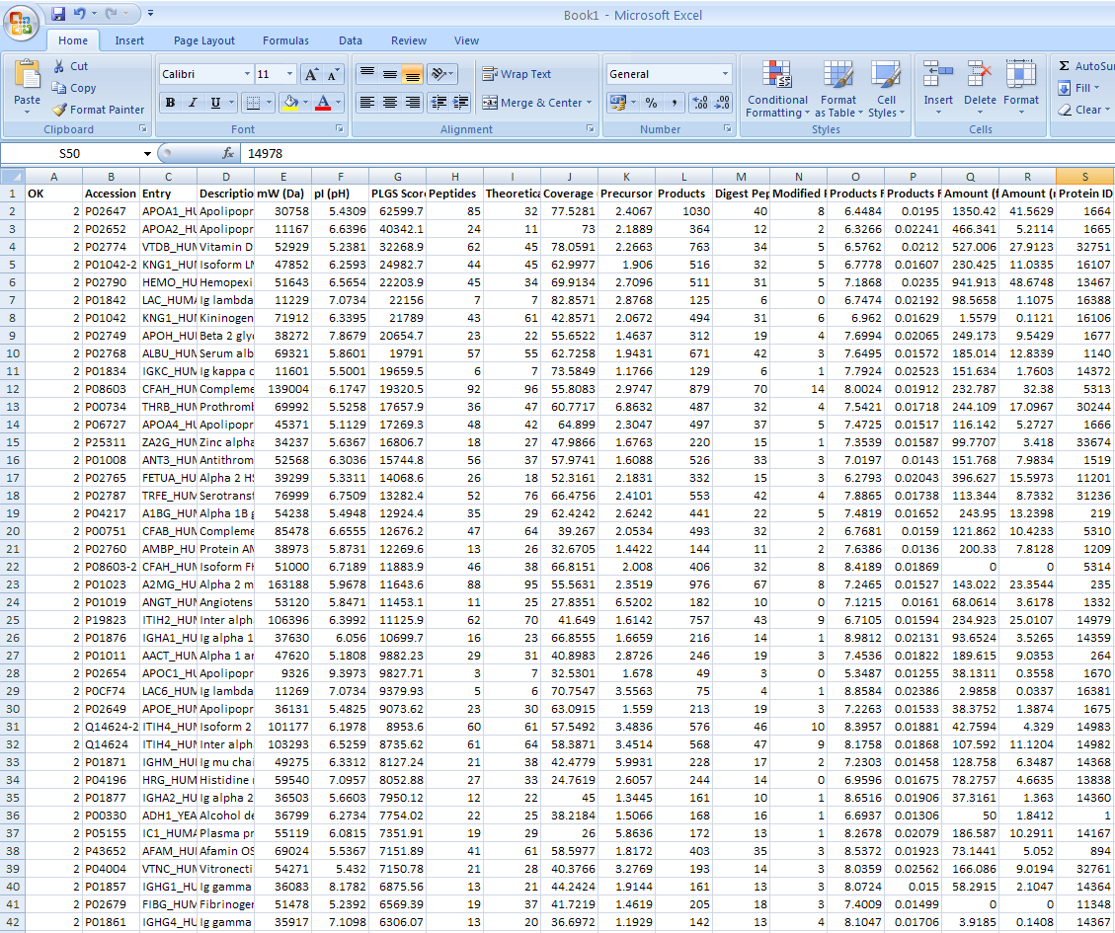
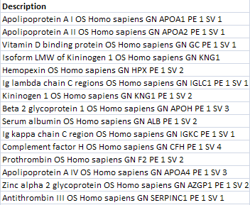
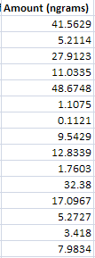
Bioinformatics Cont.
List of all identified proteins with quantification

Slide 28
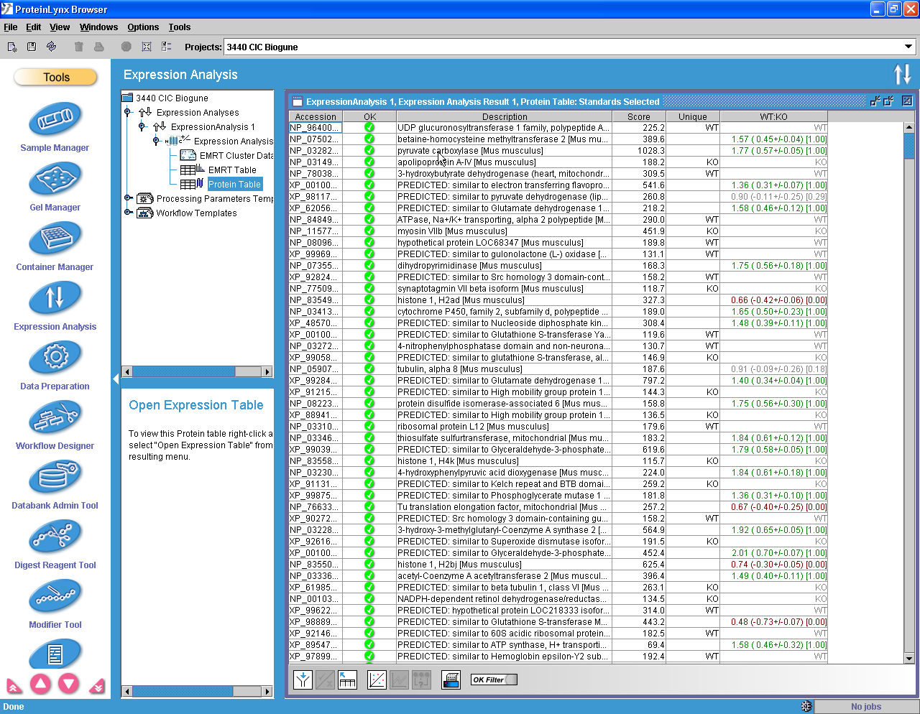
Bioinformatics Cont.
Expression analysis results

Slide 29
Biomarker discovery pipeline
Discovery
Quantification
Verification
Validation
  Identify candidate biomarkers
  Quantify expression levels
  Assess specificity and sensitivity
  Clinical assay development
>10
>10
1-2
Biomarkers
10-100
>100
>1000
Samples

Slide 30
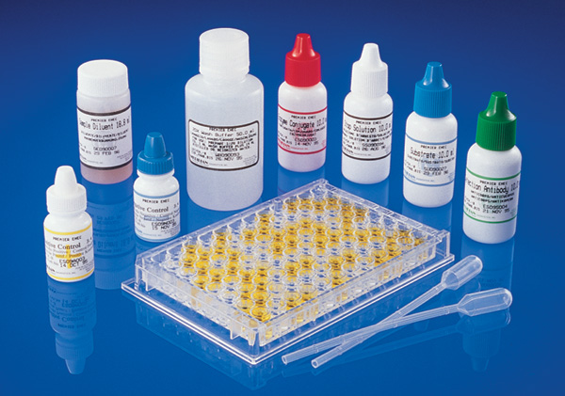
Potential biomarker
Validation
Immunoassay
Western blot
Multiple Reaction Monitoring (MRM)

Slide 31
Thank you
Any Questions?

