Slide 1
Diabetes Basics

Slide 2
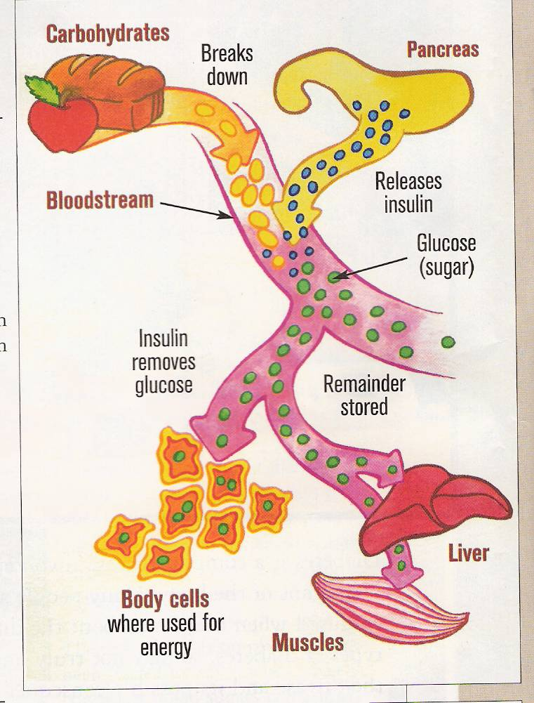
Understanding Diabetes
Complex disease
Digestion breaks down carbohydrates → sugar (glucose)
Sugar →bloodstream
Insulin moves sugar into cells for energy
Notes:
Diabetes is chronic, progressive metabolic disorder that can cause a child to develop long term complications of the eyes, kidneys, feet and circulation. If blood sugars are not kept in a specific range these complications can start developing quickly.
Abnormalities to break down carbs, fat and protein leading to hyperglycemia (high blood sugar)

Slide 3
Definition of terms
“blood sugar” = “ blood glucose”
you may it hear it used interchangeably

Slide 4
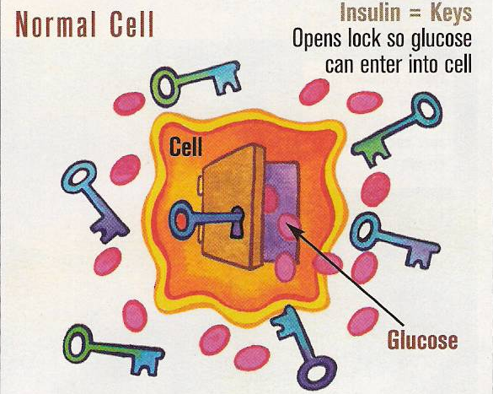
Body Function Without Diabetes
Notes:
So lets talk about diabetes
In people without diabetes, glucose (sugar) enters the cells and the blood glucose level remains in a stable range of about 70-99 mg/dl fasting (or when they have not eaten anything.) Insulin (released from the pancreas) is the key that opens the doors to the cells and lets the cells use the glucose (sugar) for energy and activity.
Insulin controls the rise in the blood glucose level following eating by:
1. stimulating the glucose to go into the cells and the tissues thus “lowering the blood sugar” and
2. preventing the liver from putting out into the blood stream, extra glucose that has been stored there in another form
3. preventing the pancreas from putting out glucagon which would lower the blood sugar

Slide 5
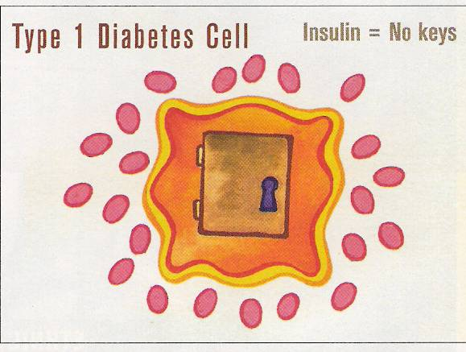
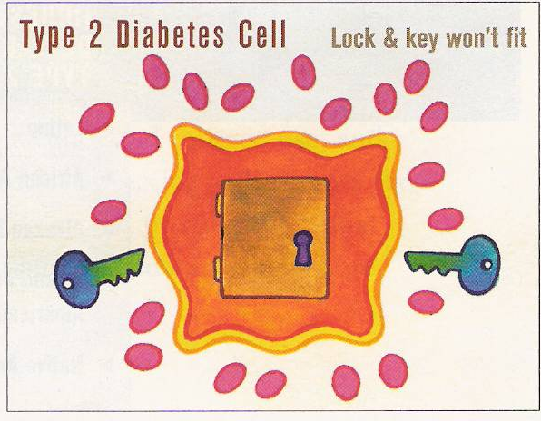
Type 1 vs. Type 2 Diabetes
No insulin (key) means that sugar cannot enter the cell.
Insulin (key) cannot unlock the cell door. Insulin resistance or inability of body to use insulin.
Notes:
There are some major difference between Type 1 and 2 diabetes:
In Type 1 Diabetes the body does not make or doesn’t make enough insulin so that glucose can be used for energy and activity
Type 1: Must have insulin to survive!!!!! So, individuals with diabetes have to have their “insulin” provided through another route.
At this current time the only route of administration of insulin is by an injection (shot) or by an insulin pump that gives insulin constantly in varying doses.
Type 2: Insulin can and is often used to manage, but life style changes of meal plan, activity level or oral medications are used.

Slide 6
Type 1 Diabetes
Insulin-producing cells are destroyed
Daily insulin replacement necessary
Age at onset: usually childhood, young adulthood
Most common type of diabetes in children and adolescents
Notes:
Type 1 Diabetes
The pancreas can no longer produce enough insulin, so people with type 1 diabetes need multiple daily administrations of insulin to live.
Type 1 diabetes can occur at any age, but the disease develops most often in children and young adults.
Type 1 diabetes accounts for about 5 to 10 percent of diagnosed diabetes in the United States.

Slide 7
Type 1 Diabetes
Onset of diabetes: can happen relatively quickly
Symptoms: increased urination, tiredness, weight loss, increased thirst, hunger, dry skin, blurred vision
Cause: uncertain, both genetic and environmental factors
Notes:
Symptoms. The symptoms of type 1 diabetes usually develop over a short period of time. They include increased thirst and urination, hunger, weight loss, dry skin, and sometimes blurred vision. Children may also feel very tired all the time. If not diagnosed and treated with insulin, the person with type 1 diabetes will eventually develop a life-threatening condition known as diabetic ketoacidosis (KEY-toe-asi-DOE-sis) or DKA. This will be discussed later in the educational session.
Risk factors. Though scientists have made much progress in predicting who is at risk for developing type 1 diabetes, they do not know exactly what triggers the immune system’s attack on beta cells. They believe that type 1 diabetes is due to a combination of genetic and environmental factors.

Slide 8

Management Goal
Diabetes is managed but does not go away
Goal is to maintain a target glucose range
Notes:
Diabetes is managed with medication, nutrition, physical activity and glucose monitoring, but there is NO cure at this time.
When the body doesn’t produce insulin, it must be obtained from another source. All people with type 1 diabetes must take insulin by injection to live.
Many people with type 2 diabetes take glucose-lowering medications which can be taken orally or by injection. Many youth with type 2 diabetes take insulin, often in addition to other glucose lowering medications. People with either type of diabetes also need to manage their diet and physical activity.
Neither insulin nor other medications, however, are cures for diabetes: they only help control the disease.
With either type 1 or type 2 diabetes, the goal of effective diabetes management is to control blood glucose levels by keeping them within a target range that is individually determined for each child.
Optimal blood glucose control is essential to:
Promote normal growth and development and allow for optimal learning.
Prevent the immediate dangers of blood glucose that is either too high or too low.
Additionally, research has shown that maintaining blood glucose levels within the target range can:
Prevent or delay the long-term complications of diabetes such as heart attack, stroke, blindness, kidney failure, nerve disease, and amputations of the foot or leg.*
*While it is important for school personnel to be aware of the potential for these serious life-limiting or life threatening complications, it is not appropriate for school personnel to discuss risks for complications with individual students.

Slide 9

Diabetes Management
Making Diabetes a Part of Life
Insulin/Medication
Physical Activity
Food Intake
Other Factors
Notes:
Maintaining good blood glucose control is a juggling act, 24 hours a day, 7 days a week.
The key to optimal diabetes control is a careful balance or balancing of food, physical activity, and insulin and/or oral medication.
As a general rule:
Insulin/oral medication and physical activity makes blood glucose levels go down.
Food makes blood glucose levels go up.
Several other factors, such as stress, illness or injury, also can affect blood glucose levels

Slide 10
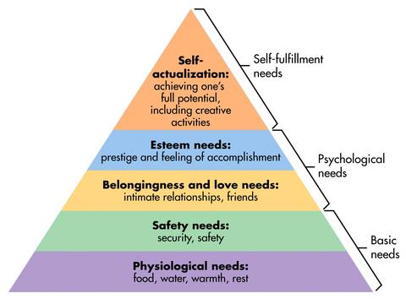
What a Child Needs?
Notes:
Students like adults all have basic needs that must be met in a certain order. We must meet the need for food, water, sleep (physical needs) before emotional or learning needs can be met.
Diabetes interferes with the normal progression of all these needs.

Slide 11
What a Child Deals With?
Everything that every child deals with
+
Diabetes
Notes:
A student with diabetes has the same needs, hopes and dreams as all other students.

Slide 12

Hypoglycemia Unawareness
Their body can not tell the child the blood sugar is low
“I just feel funny”
The child might simply be distracted
You know a child is just not acting right
Notes:
Young children, younger then 6-7 years of age have bodies that can not tell them when the blood sugars are dropping (immature counter-regulatory mechanisms)
Any child may not always have the mental awareness because of low blood sugar, to tell someone their blood sugar is dropping or to even respond without assistance to the change in their blood sugar.
A child may only know that he/she may “feel funny”

Slide 13
Honeymoon Phase
Not all newly diagnosed individuals experience the Honeymoon Phase
Can last for weeks up to 2 years
We can not let our guard down
Notes:
The Honeymoon Phase is where the pancreas begins to produce insulin (after the diagnosis of diabetes) and some individuals are able to decrease the amount of insulin they take. This can lead the child/teen/parent and us to think the “diabetes has been cured” or there was a child/teen who was mis-diagnosed. Because of this sense of “there’s not much wrong”, there may be a decreased attention to meal planning, eating correctly and checking of blood sugars. We can not let our guard down!!!!!!!!

Slide 14

Example of Target Range For Type 1 Diabetes
Preschool and Kindergarten (3-5 yrs.)
Before meals, blood sugar range 100mg/dl-180
The target range is always “ordered” by Health Care Provider
School Age (6-12 yrs.)
  Before meals, blood sugar range 90mg/dl-180mg/dl
  The target range is always “ordered” by the Health Care Provider
Notes:
Target ranges are very specific to the child and age. Based upon the Diabetes Medical Management Plan (DMMP) established by the health care provider. When the Health Care Provider fills out the DMMP plan, they will specify the target blood sugar range for the student.
You can refer to the DMMP to verify the target range and then if needed, you should contact the designated school health provider, the school nurse.

Slide 15

Management Priorities
Preschool –Middle School (3-12 yrs.)
Adult involvement
Allow for participation in school/peer activities
Student learning based on benefits of optimal control
Notes:
This slide depicts the behavioral activities for the 3-12 year olds
Blood sugar/glucose Management Priorities
Maintaining adult involvement in insulin and blood glucose monitoring tasks while allowing for independent self-care
Making diabetes regimen flexible to allow for child’s participation in school/peer activities
Student learning must be focal point and is of a short and long term benefit of optimal control
Be aware that bedtime/overnight blood sugar range is usually 100 mg/dL-180mg/dL. Upon arrival at school, be aware that some children may not have eaten breakfast or taken their medication before arriving. You may see either highs or lows in their glucose level.

Slide 16

Example of Target Range For Type 1 Diabetes
Adolescents and young adults (13-19 yrs.)
  Before meals 90mg/dL-130mg/dL
  Always Health Care Provider Ordered
The Art and Science of Diabetes Self-Management Education Desk Reference, 2011

Slide 17
Management Priorities
Early Adolescence 13-15 years
Renegotiating adult/teens role in diabetes management
Learning coping skills to enhance self management
Monitoring for signs of depression, eating disorders, risky behaviors
Later Adolescence 16-19 years
Begin discussion of transition to a new diabetes team
Integrating diabetes into new lifestyle
Supporting the transition to independence
Notes:
This slide depicts the kinds of behavioral challenges that begin to appear during these age ranges.
Early Adolescence 13-15 years
Managing increased insulin requirements during puberty becomes a challenge because of hormonal changes
Diabetes management and blood glucose control become more difficult
Wt. and body image concerns become an issue for this age group
Renegotiating adult/teens role in diabetes management
Learning coping skills to enhance self management
Monitoring for signs of depression, eating disorders risky behaviors
Later Adolescents (16-19 years)
Begin discussion of transition to a new diabetes team as child is moving into adulthood
Integrating diabetes into new lifestyle and broadening social activities
Supporting the transition to independence

