Slide 1
Chemical structure and antioxidant activity of antioxidants
Presented by:
Shubhangi Pant

Slide 2
WHAT ARE ANTIOXIDANTS?
An antioxidant is a molecule that inhibits the oxidation of other molecules.
Oxidation is a chemical reaction that can produce free radicals, leading to chain reactions that may damage cells.
Antioxidants terminate these chain reactions.
Antioxidants are electron donors.
They can break the free radical chain reaction by sacrificing their own electrons to feed free radicals, but without turning into free radicals themselves.

Slide 3
WHICH ALL FOODS HAVE ANTIOXIDANTS?
Apart from the Antioxidants produced by our body such as Glutathione, Alpha-Lipoic Acid (ALA), CoQ10 (Ubiquinone), Resveratrol, Carotenoids, Vitamin C, Vitamin E, etc., most of the important ones are found in:
Fresh, organic vegetables: Especially the green leafy ones. For example, Sprouts, pea, etc.
Fruits: Fresh berries like blueberries, blackberries, cranberries, and raspberries.
Nuts: Pecans, walnuts, and hazelnuts.
Herbs and spices: They are an abundant source of antioxidants.
Organic green tea: This antioxidant-rich drink contains epigallocatechin-3-gallate (EGCG), a catechin polyphenol and one of the most powerful antioxidants known today.

Slide 4
COMMON TERMINOLOGIES:
REACTIVE OXYGEN SPECIES (ROS):
All highly reactive, oxygen-containing molecules including free radicals. Types of ROS are hydroxyl radical, hydrogen peroxide, superoxide anion radical, nitric oxide radical, etc.
They react with membrane lipids, nucleic acids, proteins and enzymes and other small molecules.
OXIDATIVE STRESS:
Unbalance between pro-oxidants and antioxidant mechanisms.
It results in excessive oxidative metabolism which might lead to the damage of proteins, DNA, etc.

Slide 5
COMMON TERMINOLOGIES:
FREE RADICALS:
Contain an unpaired electron
They are unstable and reach out to capture electrons from other substances in order to neutralize themselves.
This initially stabilizes the free radical but generates another in the process (gives rise to a chain reaction)
Free Radicals are a highly reactive species

Slide 6
IMPORTANT BENEFITS OF ANTIOXIDANTS :
Prevents Oxidative Stress
Slows down aging
Repairing damaged molecules
Blocking metal radical production
Stimulating gene expression and endogenous antioxidant production
Providing a "shield effect"
Treatment of cancer

Slide 7
HOW DO ANTIOXIDANTS WORK?

Slide 8
MECHANISMS FOR ANTIOXIDANT ACTIVITY
Free Radical Scavenging:
Antioxidants scavenge free radicals of foods by donating hydrogen to them, and they produce relatively stable antioxidant radicals with low standard reduction potential.
Metal Chelating:
Oxidative stress is reduced by reducing the formation of Reactive Oxygen Species Chelating metal ions.
Metal chelating usually targets the reduction of previously oxidized ions, their reaction with hydrogen peroxide and generation of hydroxyl radicals.

Slide 9
Why are they used in foods?
To control Lipid Oxidation:
ROS attack unsaturated fatty acids which contain multiple double bonds and methylene groups.
Antioxidants scavenge radical and terminate chain reaction.
To minimize protein modification:
ROS cause protein modification by nitration or chloration of amino acids.
Antioxidants scavenge O^{2-.} And inhibit the formation of radicals causing nitration and chloration.

Slide 10
CLASSIFICATION OF ANTIOXIDANTS
CATEGORY | EXAMPLES
ENZYMES | SOD, Catalase, etc.
CARTENOIDS | Lycopene, β-carotene
GLUTATHIONE | Glutathione
HORMONES | Melatonin, Oestrogen
LIPID ASSOCIATED CHEMICALS | Ubiquinol-10,N-acetyl cysteine, lipoic acid
PHENOLICS | Flavonoid, Phenolic Acids
VITAMINS | α-tocopherol, Ascorbic acid
MINERALS | Zinc, Selenium, Copper
SAPONINES, STEROIDS | Cortisone, Estradiol, Estriol

Slide 11
CARTENOIDS
Cartenoids are natural pigments which are synthesized by plants.
They give bright colors to various fruits and vegetables.
Most contain 40 carbons arranged from eight isoprene units, with four units facing each other.
This arrangement produces an electron-rich, alternating, double bond structure, making carotenoids susceptible to electrophilic attack.
Number of double bonds play an important role in its antioxidant activity(more the number of double bonds, better the activity).
Isoprene

Slide 12
1) Beta-carotene
Beta-carotene is made up of eight isoprene units, which are cyclized at each end.
Beta-carotene is usually used for controlling lipid-oxidation.
Beta-carotene has 11 double bonds in its structure.
It shows modest antioxidant activity in foods.
Beta-carotene has two beta-ionone rings (not present in Lycopene).
A Beta-carotene molecule:

Slide 13
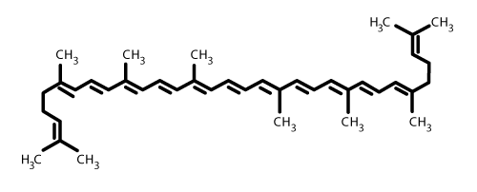
2) Lycopene
Lycopene is an acyclic isomer of Beta-carotene.
It has 13 double bonds (11 of them are conjugated).
Lycopene is one of the best carotenoids in terms of anti-oxidation.
It is used for controlling DNA and lipid oxidation.
A Lycopene molecule:

Slide 14
PHENOLIC ANTIOXIDANTS 1) Flavonoids/Flavonols/Flavones
Flavonoids are a class of plants and fungus metabolites
Flavones and Flavonols are all-ketone containing compounds
Flavonols contains non-Ketone Hydroxyl groups
A typical structure of a flavonoid where:
Flavonols: X= OH
Flavones: X = H

Slide 15
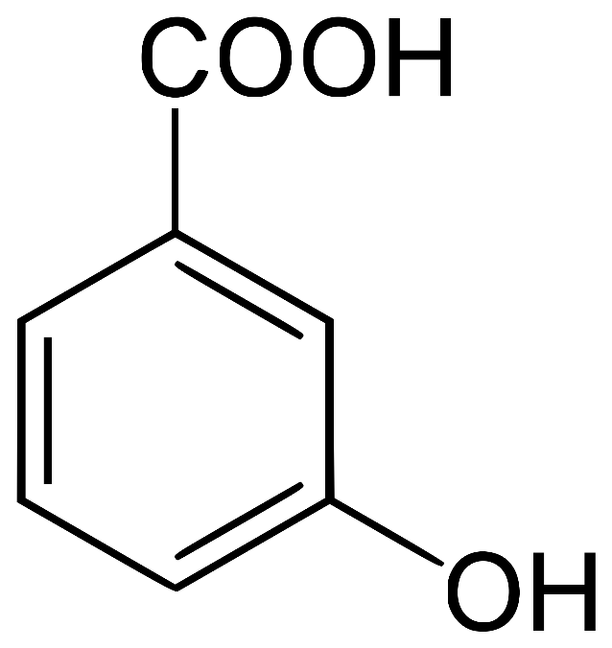
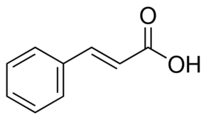
2) Phenolic Acids
Hydrobenzoic Acid: Cinnamic Acid:
4-Hydroxybenzoic acid is a They have Hydrogen or electron popular antioxidant in part donating capacity.
because of its low toxicity.

Slide 16
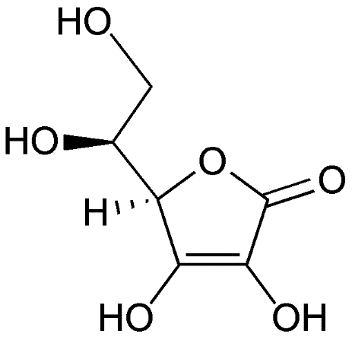
VITAMINS
1) Ascorbic Acid (Vitamin C):
It has a structure of the lactones and two enolic hydroxyl groups and a primary and secondary alcohol group. Such a structure motivates antioxidant behavior in the food.
2) Alpha tocopherol (Vitamin E):
It is a peroxyl radical scavenger.

Slide 17
CONCLUSION
Reaction mechanisms and the type of natural antioxidants in foods, tocopherols, ascorbic acid, carotenoids, flavonoids, amino acids, phospholipids, and sterols have different reaction kinematics and thermodynamics.
They inhibit the oxidation of useful food components by inactivating free radicals, chelating pro-oxidative metals, and quenching singlet oxygen.
Understanding the working of anti-oxidants, thus, becomes very important for food processing, research and development.

Slide 18
REFERENCES
Al-Saqer JM, Sidhu JS, Al-Hooti SN, Al-Amiri HA, Al-Othman A, Al-Haji L, Ahmed N, Mansour IB, Minal J. 2004. Developing functional foods using red palm olein. IV. Tocopherols and tocotrienols. Food Chemistry
Di Mascio P, Kaiser S, Sies H. 1989. Lycopene as the most efficient biological carotenoid singlet oxygen quencher. Arch Biochemistry Biophysics
Ou P, Tritschler HJ, Wolff SP. Thioctic (lipoic) acid: a therapeutic metal-chelating antioxidant? Biochem Pharmacol. 1995
Gurer H, Ozgunes H, Saygin E, Ercal N. Antioxidant effect of taurine against lead-induced oxidative stress. Arch Environ Contam Toxicol. 2001
Mortensen A, Skibsted LH, Truscott TG. The interaction of dietary carotenoids with radical species.Arch Biochem Biophys. 2001
Machlin LJ, Bendich A. Free radical tissue damage: protective role of antioxidant nutrients. The FASEB J. 1987

Slide 19
Thank you! Questions??

