Slide 1
Epilepsy
By Oumaer Akther (FY1 Warwick)

Slide 2
Objectives
To define seizures and epilepsy
To differentiate between other causes of seizures/unconsciousness
Classify epilepsy subtypes
Investigate a first seizure
Understanding of management strategies
Manage status epilepticus

Slide 3
Statistics
Epilepsy is the most common serious neurological disease.
5% (1 in 20) people will experience an epileptic seizure at some point in their lives!
Males and females similarly affected
Commonest ages are childhood/adolescence (congenital causes) and in the elderly (cerebrovascular & neurodegenerative)
Over 40 different types of seizure
Two main categories: Focal/Partial and Generalised

Slide 4
Definitions:
Seizure: Sudden onset, transient disturbance in neurological function associated with abnormal/excessive neurological discharge.
Epilepsy: Recurrent seizures in the absence of an acute cerebral insult/immediately identifiable cause.

Slide 5
Aetiology
Idiopathic (60%)
Structural
Trauma
Infection
Stroke
Genetic
Epilepsy as primary consequence
Complicated multiallele inheritance
SYN1 mutation
Disorders which cosegregate with epilepsy
Autism
Tuberous sclerosis

Slide 6
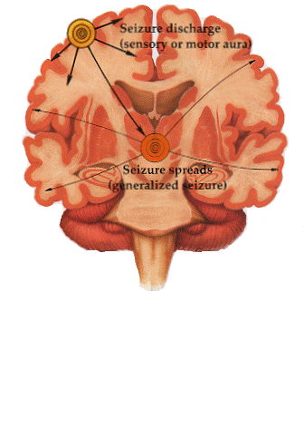
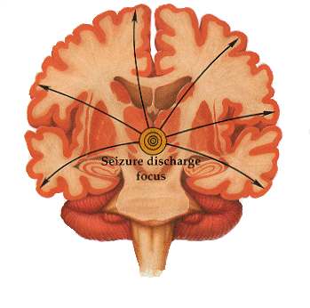
Aetiology
Changes in neuronal excitability
Reduction in GABA
Increase in Ach transmission
Increase in NA⁺ transmission
Decrease in K⁺ transmission
Notes:
GABA acts at inhibitory synapses in the brain by binding to specific transmembrane receptors in the plasma membrane of both pre- and postsynaptic neuronal processes. This binding causes the opening of ion channels to allow the flow of either negatively charged chloride ions into the cell or positively charged potassium ions out of the cell. This action results in a negative change in the transmembrane potential, usually causing hyperpolarization.
Examples of GABA receptor ligands are barbiturates and benzodiazepines

Slide 7
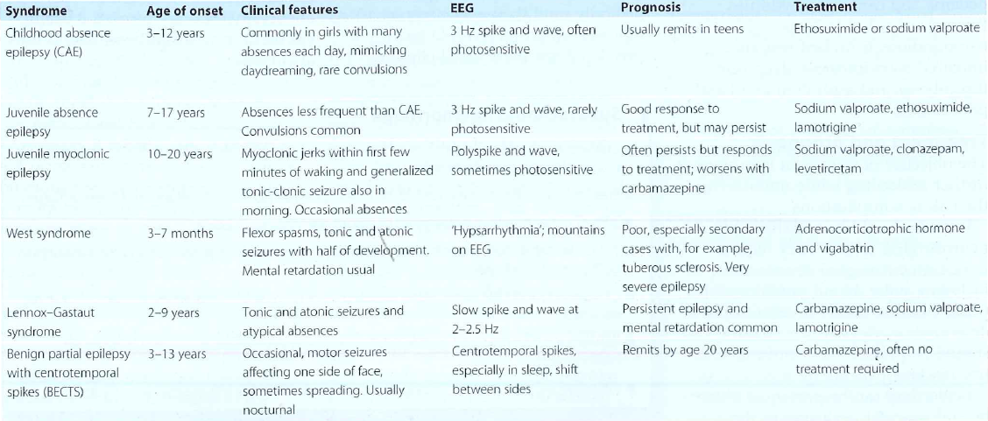
Common Epilepsy syndromes:

Slide 8
Other causes of seizures:
Febrile convulsions (33% recurrence; 2% epilepsy risk)
Breath holding attacks
Reflex anoxic seizures
Cardiac Arrythmias
Trauma
Electrolyte abnormalities
Hypoglycaemia
Sepsis
Alcohol and alcohol withdrawal (DTs)
Tumour

Slide 9
Classification:
Partial (focal)
Simple (no impared consciousness)
Complex (impaired consciousness)
Secondary generalised
Generalised
Tonic-clonic (also Tonic, clonic)
Absence
Myoclonic

Slide 10
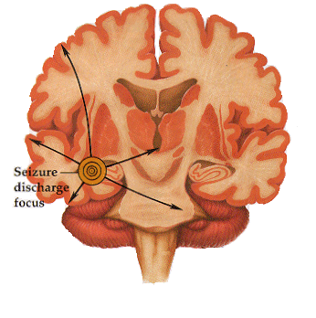
Simple Partial Seizures
Simple partial seizure, patient conscious and aware
Temporal foci often associated with auras and hallucination
Frontal foci ‘motor seizures’, stiffness/jerking in limbs, if this spreads known as ‘Jacksonian seizure’
Parietal foci ‘sensory seizures’, tingling/warmth on ipsi side
Occipital foci generally preceded by visual hallucinations light/colour
L_{CP}
R_{CO}
Normal Seizure

Slide 11
Complex Partial Seizures
Altered consciousness, but may seem fully aware
Symptoms: automatisms (chewing, swallowing, repeated displacement behaviour)
Prior to onset may experience sense of déjà vu/jamais vu, perceptual changes, auras
Generally temporal lobe in origin, can progress to generalised
L_{FT}
R_{FF}
Normal Seizure

Slide 12
Generalised Tonic-Clonic (grand mal)
Easiest to diagnose, but no warning of onset
Whole brain involved
Symptoms:
Tonic phase - whole body stiffness, breathing may stop (cyanosis), loss of bladder control
Clonic phase – muscle jerks
Followed by unconsciousness, muscle relaxation, slow regain of consciousness, sleepy, headaches and aching limbs, no recall of episode
L_{FC}
R_{FC}
Normal Seizure

Slide 13
Absence Seizure (petit-mal)
Part of the generalised seizure spectrum
Rare in adults, generally starts between 4-8 yrs
Girls > Boys
Transient LOC – often with open, blinking eyes or twitching mouth movements
Duration: < 30secs
EEG: Typically 3Hz spike & wave abnormality
L_{FC}
R_{FC}
Normal Seizure

Slide 14
Primary or Secondary generalised?
presence of an aura or observation of any focal feature, e.g. twitching of one extremity, aphasia, tonic eye deviation
presence of a post-ictal - post-seizure - focal neurologic deficit - Todd's paralysis

Slide 15
Investigations
Bedside – BMs, ECG, Urine dip
Bloods – FBC, U&Es, LFTs, CRP, Calcium, Mg, PO4, Glucose
Imaging – CT head, MRI
Special tests – EEG

Slide 16
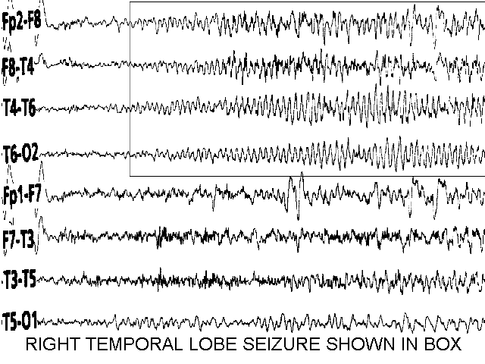
Electroencephalography (EEG)
Done only to support a diagnosis of epilepsy in patient in whom the clinical history suggests that the seizure is likely to be epileptic in origin
Useful to differentiate between epilepsy syndromes
Should not be used in isolation to diagnose epilepsy
Consider sleep-deprived EEG to decrease false positives

Slide 17
Mechanism of action of AEDs
AEDs redress the balance between neuronal excitation and inhibition
3 major mechanisms
Modulation of voltage gated ion channels
Enhancement of GABA mediated inhibitory neurotransmission
Decrease of glutamate mediated excitatory neurotransmission

Slide 19
First line AEDs and seizure types
Generalized onset seizures
Partial onset seizures
Myoclonus Absence Gen tonic-clonic
Simple/Complex secondary generalized
Partial tonic-clonic
1st line: Valproate
Alternatives: Lamotrigine
Topiramate
Levetiracetam
1st line: Carbamazepine
Lamotrigine
Alternatives: Topiramate
Levetiracetam

Slide 20
General Principles
use 1 AED
low and slow
titrate to seizure control or SE
no response add 2nd AED
(check compliance – ask pt/drug levels)
if responds to 2nd AED, consider withdrawal 1st AED
A degree of trial and error involved

Slide 21
Carbemazepine (Na Blocker)
Sedation
Amnesia
Ataxia, diplopia
Hyponatraemia
Myelosuppression
Decrease effect of OCP (2x dose)
Lamotrigine (increase glutamate)
Cerebellar probs
Skin reactions (SJS)
Hepatotoxicity
Phenytoin
Hypotension
Arrythmias
Agranulocytosis
Skin reactions
PCOS
Valproate
Wt gain
PCOS
Pancreatitis
Hair Loss
Hetotoxicity

Slide 22
Prognosis in epilepsy
60% will be well controlled on one drug
47% on 1st monotherapy
13% on 2nd monotherapy
3-15% will be controlled on 2 drugs
Kwan P and Brodie MJ, NEJM 2000
Guidelines suggest that if two standard AEDs fail, epilepsy surgery should be considered where appropriate

Slide 23
Clinical Scenario:
A 62 year old man presents to A&E after his wife called an ambulance when he woke her up having what appeared to be a fit. He was shaking and jerking all over his body, would not respond to her and had soiled himself. He was brought to A&E and despite the paramedics giving 10mg of IV diazepam (there is no IV lorazepam) he is still fitting.
How would you manage this gentleman acutely?

Slide 24
Status epilepticus
Seizures lasting >30 minutes or repeated seizures without intervening consciousness.
Prolonged seizures can cause permanent brain damage due to hypoxia, hypotension, cerebral oedema and neuronal injury.
Damage is proportional to seizure duration, with mortality rates of 15-30%
Good prognosis:
Patients with epilepsy and metabolic disturbances
Bad prognosis:
Global hypoxia, structural damage or infective lesions

Slide 25
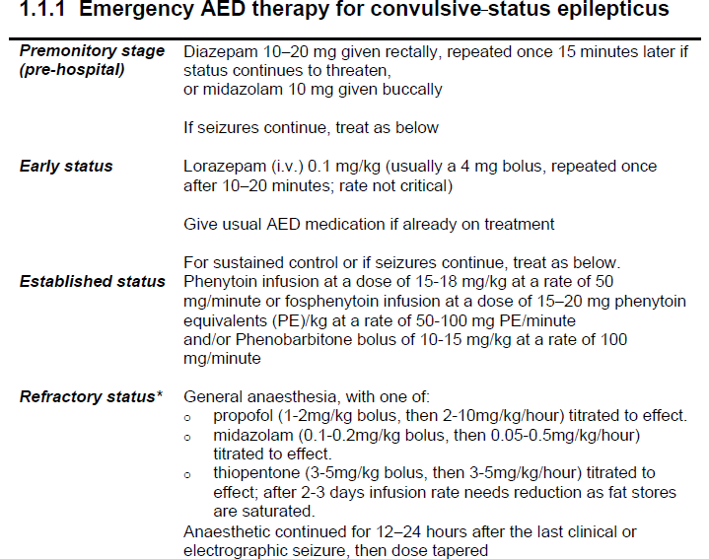

Slide 26
Afterwards...
He is managed by the acute medical team and his seizures terminate. He is drowsy and post ictal. You obtain history from his wife that he has been complaining of a headache for the last few weeks and the last 2 days has had some blurred vision. He went to bed early last night after he vomited. His wife tells you he seemed more confused yesterday and she was worried but he refused to see his GP. Normally fit and well. No regular mediations and no allergies. Examination when he is more alert is mostly unremarkable except for an element of subtle left sided weakness and inco-ordination.

Slide 27
Questions:
What are your differentials for this gentleman? (make sure these include all important differentials that must be ruled out)
How would you investigate this man?
What would your long term management plan be for him?
What is the classification system for epilepsy?
What is the current DVLA advice on driving with epilepsy?

Slide 28
Driving and Epilepsy...
Cit is illegal to drive a motor vehicle if any form of seizure or any episode of unexplained LOC has occurred during previous year.
If suffered epileptic attack whilst awake no driving licence to be issued for 1 year post attack
If suffered epileptic attack whilst asleep, must refrain from driving for 1 year unless has attacks exclusively whilst asleep for past 3 years.
For UK Group 2 drivers (vocational & truck drivers)
Must be free of attacks for > 10years
Must not have taken anticonvulsants during this time.

