Slide 1
Stress and Strain

Slide 2
Stress
Force/Area
Pressure is one form of Stress
Units: Pascals (1 bar = 1 atm = 100,000 Pa)
Normal Stress: Perpendicular to surface
Compression vs. Tension
Shear: Parallel to Surface

Slide 3
Stress
Hydrostatic Stress (usually compressional)
Uniform in all directions.
A scuba diver experiences hydrostatic stress.
Stress in the earth is nearly hydrostatic.
The term for uniform stress in the earth is lithostatic.
Directed Stress
Varies with Direction

Slide 4
Stress Sign Conventions
Positive = In Positive Coordinate Direction
Tension = Positive
Mostly used in Math and Engineering
Geological: Compression is Positive
Most geological stresses are compressional

Slide 5
Friction
Downward Force Exerted by Object = gm
It generally takes less force to push the object sideways
Pushing Force/Downward Force = Coefficient of Friction
Static vs. Kinetic Friction
Static Friction usually greater

Slide 6
Coefficient of Friction
Teflon on Teflon: 0.04
Steel on Steel, Lubricated: 0.16
Steel on Steel, Dry: 0.8 (Check your oil!)
Tire on Concrete: 1.7
Geologic: 0.5+/-
Some situations like thrust faulting seem to require much less

Slide 7
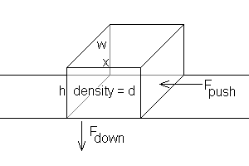
Coefficient of Friction

Slide 8
Friction
F_{down} = (whx)dg
F_{push} = (whx)dg * N
σ_{push} = (whx)dg * N/wh = xdgN
Note h disappears!

Slide 9
Thrusting a Thrust Fault
σ_{push} = xdgN
x = 20 km, d = 2700 kg/m³, g = 9.8 m/sec², N=0.5
σ_{push} = 20,000 * 2700 * 9.8 * 0.5 = 264 Mpa
Most rocks fail below this
Joints make rocks weaker
Many thrust sheets are wider than 20 km

Slide 10
So Just How do Thrusts Move?
Gravity sliding
Reduce friction
Lifting with pressurized fluids
Piecemeal motion (Adjusting a mattress)
Many thrust sheets are on the edge of failure
Internal breakup (duplexing)
Confining pressure increases strength (thicker sheets stronger)

Slide 11
Strain
Dimensionless (a ratio)
Deformation/Original Dimension
Longitudinal = Does not Change Direction of a Line
Compression or Tension
Shear = Changes Direction of a Line
Infinitesimal: Less than a few per cent
Permits convenient approximations
Finite: Larger than a few per cent

Slide 12
Strain
Homogeneous Strain
Uniform strain.
Straight lines in the original object remain straight
Parallel lines remain parallel
Circles deform to ellipses
Note that this definition rules out folding, since an originally straight layer has to remain straight.
Inhomogeneous Strain
How real geology behaves
Deformation varies from place to place
Lines may bend and do not necessarily remain parallel.

Slide 13
Behavior of Materials
Elastic Material deforms under stress but returns to its original size and shape when the stress is released. No permanent deformation.
Brittle Material deforms by fracturing (Glass)
Ductile Material deforms without breaking (Metals)
Viscous Deform steadily under stress (Fluids, Magma)
Plastic Material does not flow until a threshold stress has been exceeded.
Viscoelastic Combines elastic and viscous behavior. Models of glacio-isostasy frequently assume a viscoelastic earth: the crust flexes elastically and the underlying mantle flows viscously.

Slide 14
Elastic Deformation
Analog: A Spring
Hooke’s Law: Deformation = k x Force
Young’s Modulus: E = Stress/Strain
Longitudinal Strain
Units = Pascals
Stress to produce 100% Strain
Typically 50-150 Gpa for Crystalline Rocks
Strain roughly 10⁻⁶/Bar
Elastic Strain generally infinitesimal

Slide 15
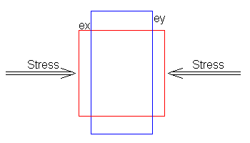
Poisson’s Ratio
Ratio of Shear Strain to Longitudinal Strain
For most rocks, ranges from ¼ to 1/3
Usually symbolized by Greek letter nu (ν), sometimes by sigma (σ)

Slide 16
Other Elastic Parameters
There are really only two independent variables
Shear Modulus
G = shear stress/shear strain
G = E/2(1 + ν)
Since ν ranges from 1/4 to 1/3 for most rocks, G is about 0.4 E.

Slide 17
Bulk Modulus
K = pressure/volume change
K = E/(3(1 - 2ν))
Since v ranges from 1/4 to 1/3 for most rocks, K ranges from 2/3E to E.

Slide 18
Viscous Deformation
Analog: Dashpot (Leaky piston)
Door closer
Access door openers
Shock absorbers
Viscosity N = (shear stress)/(shear strain rate)
Units = Pascal - Seconds

Slide 19
Plastic Deformation
Analog = Sliding Block
Stress has to reach a threshold
Power Law Creep
Strain Rate = C (Stress)^{n} exp(-Q/RT)
C = scaling constant
n = Strain rate goes up much faster than stress
Q = activation energy

Slide 20
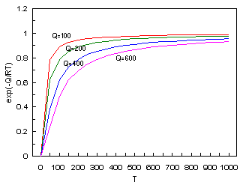
Power Law Creep

Slide 21
Familiar Examples
Shear Thinning
Mayonnaise
Ball Point pen ink
Shear Thickening
Cornstarch and water
Liquid Armor

Slide 22
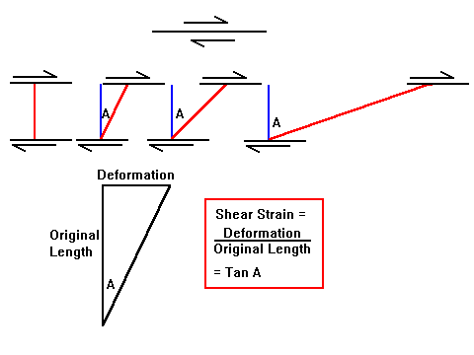
Shear Strain

Slide 23
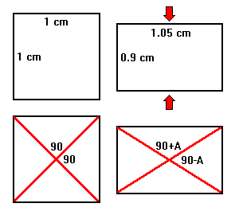
Pure Shear

Slide 24
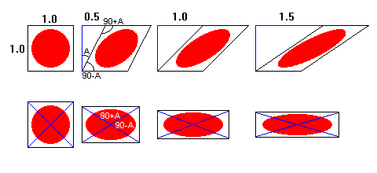
Pure and Simple Shear

Slide 25
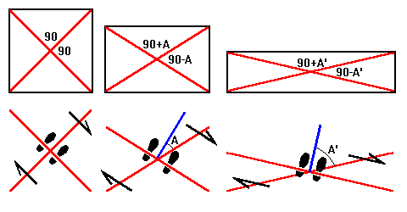
Pure and Simple Shear

Slide 26
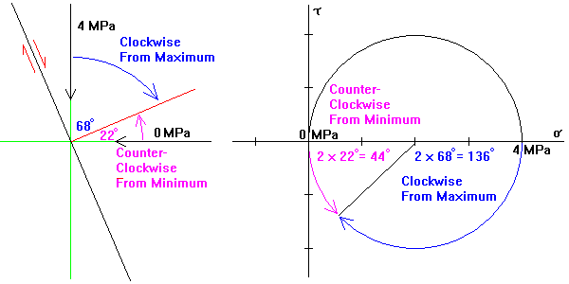
Mohr Circles

Slide 27
Mohr Circles and Real Space
Measure angles from the pole to the plane
All Mohr angles are twice real world angles
All angles are measured in the same sense in real space and Mohr space

Slide 28
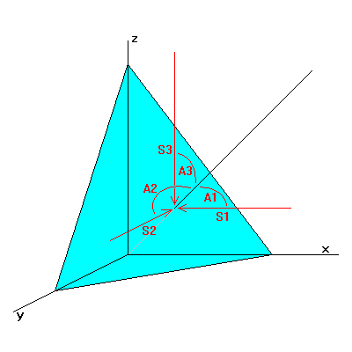
Stresses in Three dimensions
cos²A1 + cos²A2 + cos²A3 = 1
These are called the direction cosines of the line
Proportional to 1/intercepts of the plane

Slide 29
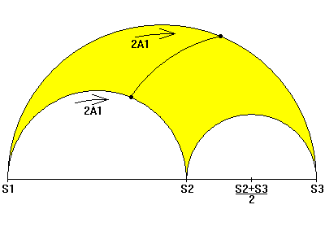
Mohr Circles in Three Dimensions

Slide 30
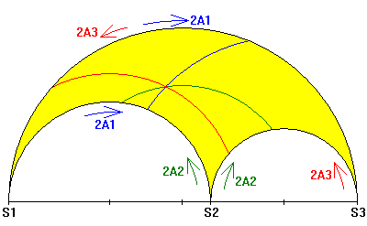
Mohr Circles in Three Dimensions

