Slide 1
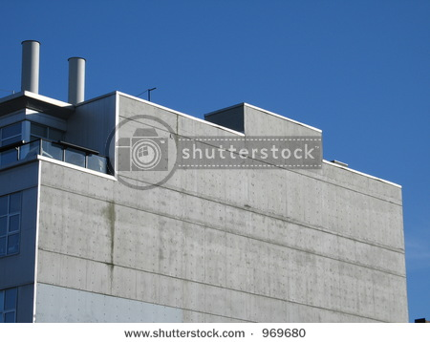
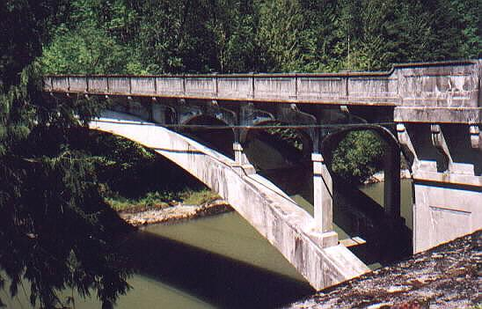
Concrete

Slide 2
Concrete
The word “concrete” originates from the Latin verb “concretus”, which means to grow together.

Slide 3
Concrete As A Material
Concrete, literally, forms the basis our modern life:
Roadways/transportation systems
Airstrips
Infrastructure (bridges, dams, buildings)
Harbor protection (breakwalls)
Water distribution (pipes & conduit)

Slide 4
Concrete has deep roots in history: Wall at Palestrina, Italy, 1st Century BC

Slide 5
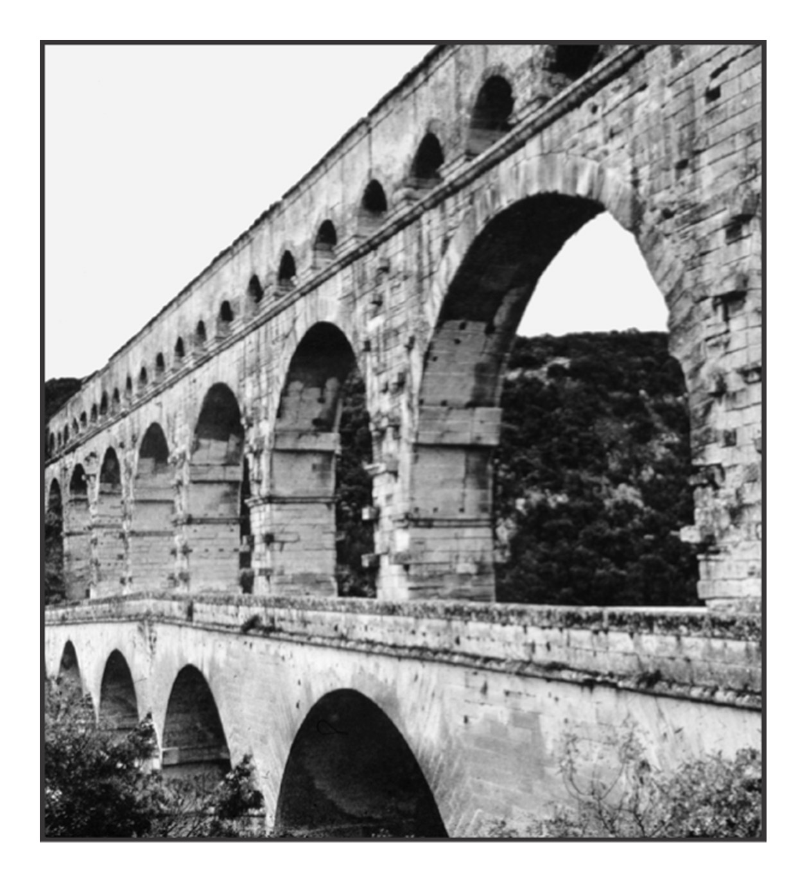
Roman Aqueduct & Pantheon

Slide 6
Sculptural Qualities of Concrete at Chapel at Ronchamp (France)

Slide 7
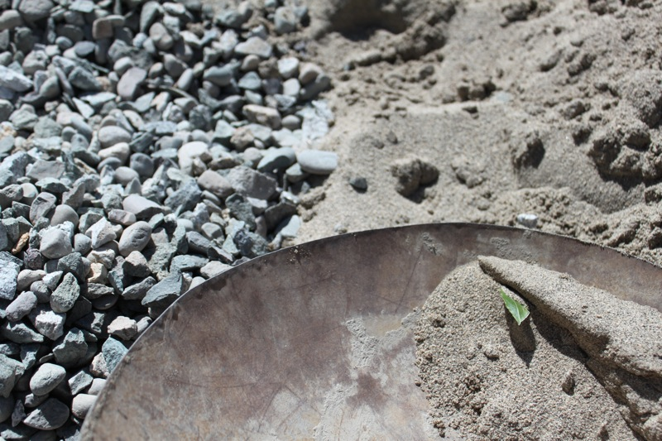
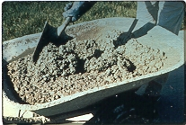
Concrete is a composite construction material composed primarily of aggregate, cement, and water.

Slide 8
Concrete Microstructure

Slide 9
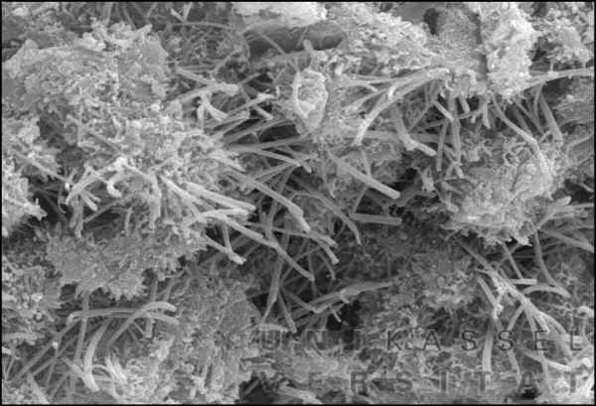
The Cement Matrix
Cement:
produces a crystalline structure
binds aggregates together
Water
causes chemical reaction to occur
water/cementitious “react”
produces workability

Slide 10
Advantages
Ability to be cast
Economical
Durable
Fire resistant
Energy efficient
On-site fabrication

Slide 11
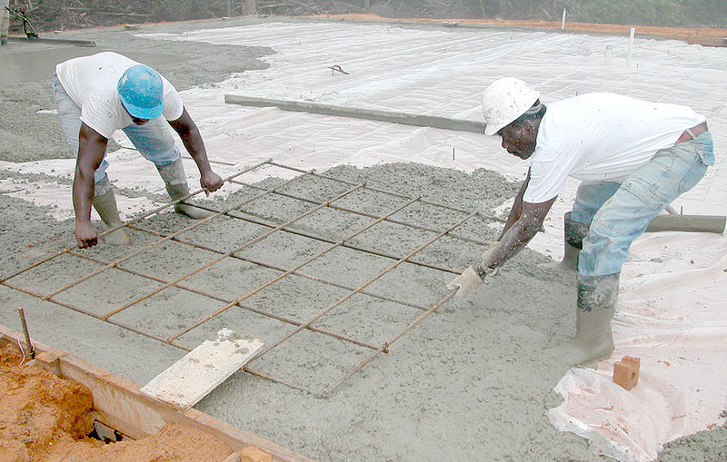
Disadvantages
Low tensile strength
Low ductility
Low strength to weight ratio

Slide 12
Aggregate: the inert filler materials, such as sand or stone, used in making oncrete

Slide 13
Constituents
Cement
Water
Fine Agg.
Coarse Agg.
Admixtures

Slide 14
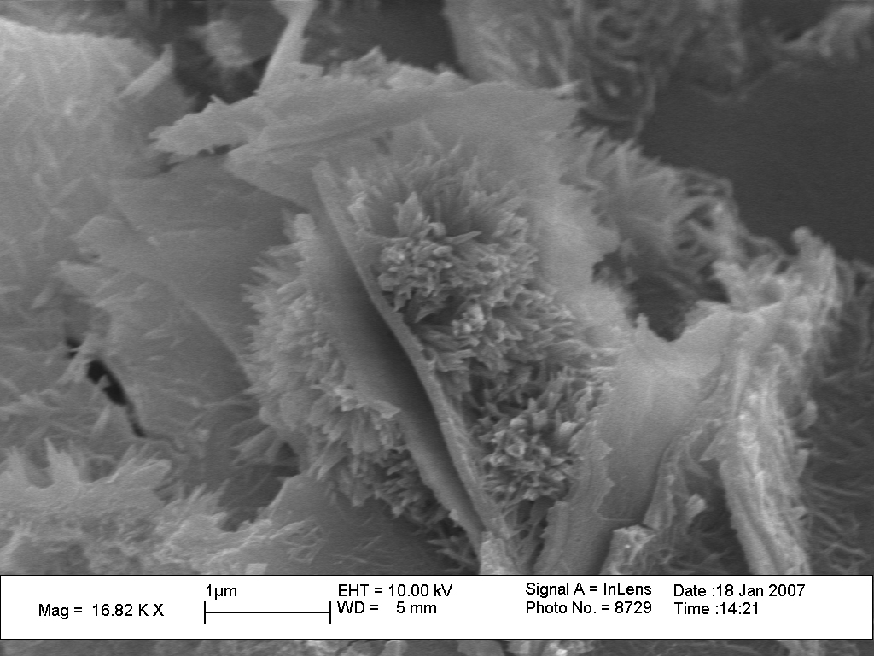
Hydration
Portland cement becomes cementitious when mixed with water
This reaction is referred to as hydration.
During hydration, a crystalline structure grows to form bonds
Hydration begins as soon as water meets cement
Rate of hydration increases with increased cement fineness

Slide 15
In Fact…….
Concrete does not gain strength by “drying out”
Concrete must have continuous free access to water to achieve its ultimate strength!!

Slide 16
PROPERTIES OF FRESH CONCRETE
Workability
Consistency
Segregation
Bleeding
Setting Time
Unit Weight
Uniformity

Slide 17
WORKABILITY
It is desirable that freshly mixed concrete be relatively easy to transport, place, compact and finish without harmful segregation.
A concrete mix satisfying these conditions is said to be workable.

Slide 18
CONSISTENCY
Consistency is the fluidity or degree of wetness of concrete.
It is generally dependent on the shear resistance of the mass.
It is a major factor in indicating the workability of freshly mixed concrete.

Slide 19
Slump Test

Slide 20
10 cm
30 cm
20 cm
The slump cone is filled in 3 layers. Every layer is evenly rodded 25 times.
Measure the slump by determining the vertical difference between the top of the mold and the displaced original center of the top surface of the specimen.

Slide 21
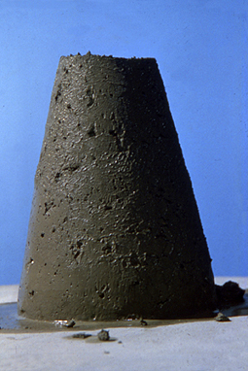

Slide 22
SEGREGATION
Segregation refers to a separation of the components of fresh concrete, resulting in a non-uniform mix
The primary causes of segregation are differences in specific gravity and size of constituents of concrete. Moreover, improper mixing, improper placing and improper consolidation also lead to segregation.

Slide 23
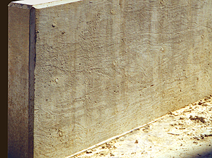
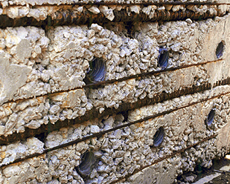

Slide 24
SEGREGATION
Some of the factors affecting segregation:
Larger maximum particle size (25mm) and proportion of the larger particles.
High specific gravity of coarse aggregate.
Decrease in the amount of fine particles.
Particle shape and texture.
Water/cement ratio.

Slide 25
BLEEDING
Bleeding is the tendency of water to rise to the surface of freshly placed concrete.
It is caused by the inability of solid constituents of the mix to hold all of the mixing water as they settle down.
A special case of segregation.

Slide 26
Types of Concrete
Lean Cement concrete (M5 to M8)
Plain cement concrete (M10 to M20)
Reinforced cement concrete (M15 to M35)
Prestressed cement concrete (M35 to M60)

Slide 27
Grade of concrete | Mix proportions | Uses
M10 | 1:3:6 | Construction of foundations
M15 | 1:2:4 | Construction of slabs & beams
M20 | 1:1.5:3 | Construction of water tanks & columns.
M25 | 1:1:2 | Construction of pile foundations

Slide 28
Uses of concrete
Foundation concrete – residential or public buildings
beams, columns and slabs
bridge and dam constructions
pipes for drains
Cement concrete roads
Docks, Harbour and Airport constructions

Slide 29
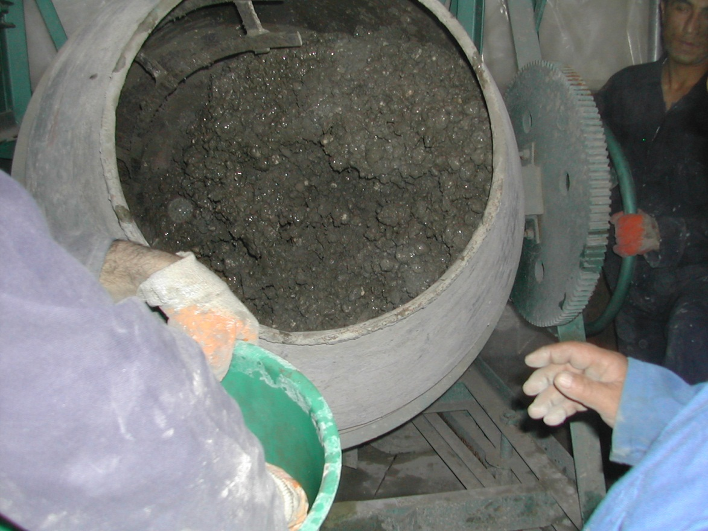
Mixing at Site

Slide 30
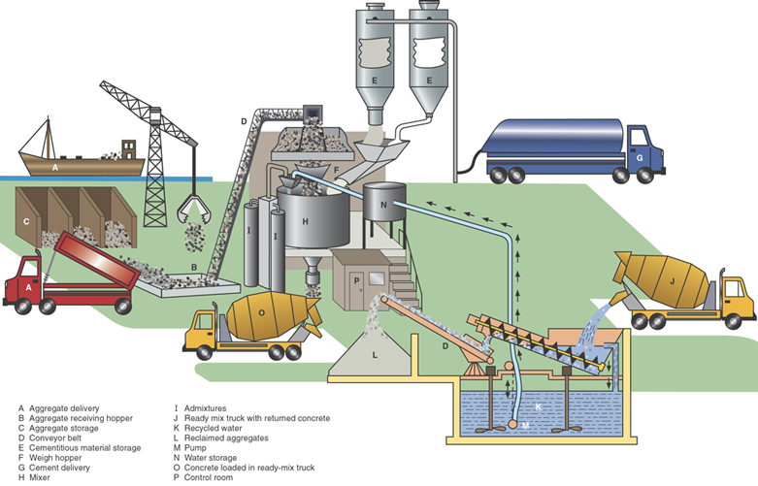
Ready Mix Concrete
Notes:
Fig. 10-5. Schematic of a ready mix plant.

Slide 31
Types of concrete
Mud concrete – good quality of clay, water, coarse aggregate
Lime concrete
Cement concrete
Polymer or special concrete

Slide 32
TYPES OF CONCRETE
Some common and main types of concrete are:
Normal concrete
High Strength Concrete
High Performance Concrete
Air Entrained Concrete
Light Weight Concrete
Self Compacting Concrete
Shotcrete
Pervious Concrete
Roller Compacted Concrete

