Slide 1
Smart Buildings Initiative
Zach Brown, UM
Blake Bjornson, MSU

Slide 2
Objectives
Control utility costs -> Control cost of education
Good for the state, good for the student
Address deferred maintenance and comfort issues
Safety concerns and efficient operation
Reduce energy consumption
Accomplish strategic goals
Notes:
MUS – instruction + academic support + student services at least 70% of total expenditures
UM – climate neutrality by 2020
MSU -

Slide 3
Four Steps
Install smart metering equipment
Develop metrics and set goals
Implement conservation projects
Reinvest savings
Notes:
This is not entirely new – campuses have created strategic utility plans before. This is new b/c it seeks to involve students more and it takes a look at MUS as a whole.

Slide 4
Install Smart Metering Equipment
Measures utility inputs into a building
Outputs this data to real-time monitoring system
Information is used to identify “energy hogs” and problem areas
Measure results and see improvement and degradation
Control systems based on demand
Approximate cost/building
We are on our way! (MSU, UM, MSU-B et al.)
Notes:
Examples of smart metering – lights at Bobcat Stadium, electricity in boxes at Griz stadium
Control Systems: Based on demand response – effectively and dynamically manage the load – smart grid
Approximate cost/building: $10-15k

Slide 5
Energy CAP
Monitoring system used by DEQ
Energyusage.mt.gov
Current data is based on energy bills
Input data could be from smart meters

Slide 6
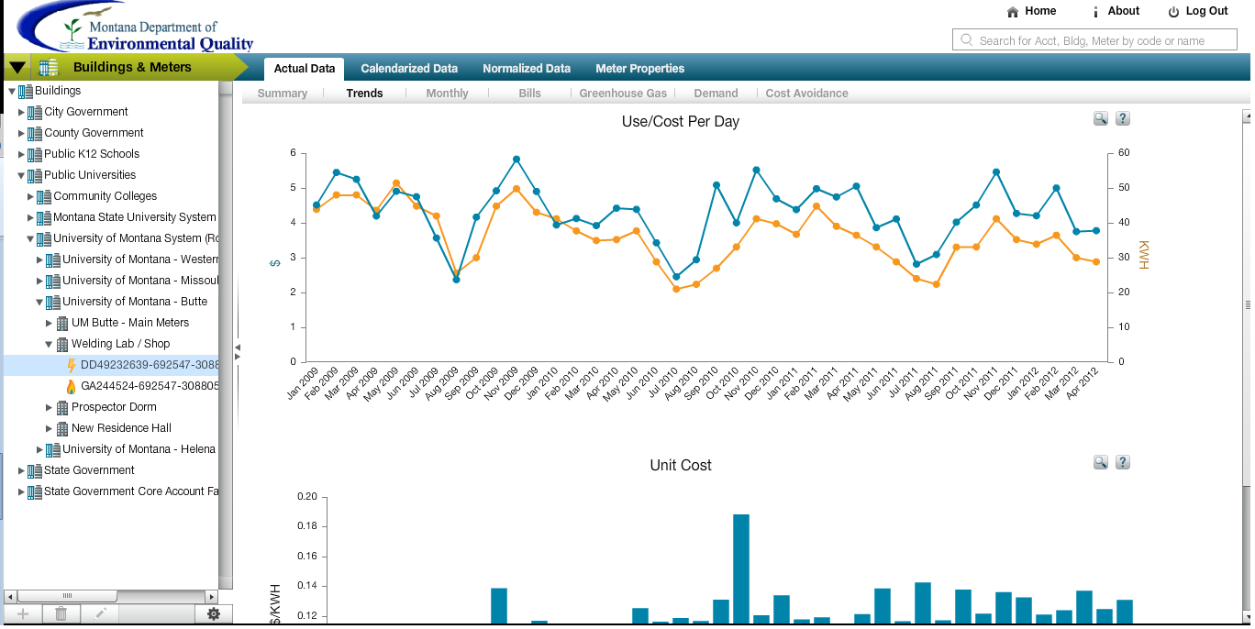
Notes:
Welding Lab at Tech

Slide 7
Four Steps
Install smart metering equipment
Develop metrics and set goals
Implement conservation projects
Reinvest savings

Slide 8
Develop Metrics and Set Goals
Metrics and goals should be campus specific
Electric and Gas Metric: Btu/sq.ft.
A similar metric can be set for water consumption
Goals—LEED certification
New buildings
EBOM
State Code: High Performance Building Standards
Notes:
Campus specific because of different missions – research institutions will naturally consume much more
COB is shooting for 35 Btu/sq ft, current buildings average is 80-100
New buildings LEED – per sq. ft. consumption is lower than old buildings

Slide 9
High-performance building standards
MCA 17-2-213 states that:
“The department (of administration), in collaboration with the Montana university system and other state agencies, shall adopt high-performance building standards”
In developing these standards, the department shall consider:
integrated design principles to optimize energy performance, enhance indoor environmental quality, and conserve natural resources;
cost-effectiveness, including productivity, deferred maintenance, and operational considerations;
environmental, economic, and social sustainability of materials and components; and
building functionality, durability, and maintenance.
LEED is a framework used around the world
Notes:
Passed by the 2009 legislature
LEED – don’t reinvent the wheel
Push State A&E to implement

Slide 10
Four Steps
Install smart metering equipment
Develop metrics and set goals
Implement conservation projects
Reinvest savings

Slide 11
Implement Conservation Projects
2 categories:
Engineering projects
Behavior change and building management

Slide 12
Engineering Projects
Facilities-intensive projects
Funding could include:
DEQ State Building Energy Conservation Program
Energy Performance Contract
LRBP
General Fund budgets
Inclusion of students important, but minimal
Technical internships
Feasibility/design studies
Notes:
DEQ program - working with the Fed’s to get more money in this pool
General fund projects – major maintenance, deferred maintenance
Internships – school credit, funding; Governor’s Energy Intern

Slide 13
Behavioral Projects
Student/faculty/staff driven
Change must come from within
Develop technical working groups, outreach through classes (MSU Architecture)
“Smart Buildings Initiative” behavior change groups—classes?
Energy internships—Governor’s Energy Intern program

Slide 14
Four Steps
Install smart metering equipment
Develop metrics and set goals
Implement conservation projects
Reinvest savings

Slide 15
Savings Reinvestment
Utility spending can be separated between state and tuition
Savings can be separated proportionally
Tuition savings can be reinvested in campus
Instruction, Academic Support, Student Services
Tuition Control
Energy Conservation
Decided by campus

Slide 16
Recommendations
Establish metrics and goals
Btu/sq.ft.
High-Performance Building Standards
Invest in the infrastructure
Continue to support utility savings projects
Push for behavioral change – provide framework for cultural change
Reinvest tuition savings to make campus better

Slide 17
Thank you – Questions?
Zach Brown
Zachary.Brown@hotmail.com
Blake Bjornson
Blake.Bjornson@gmail.com

