Slide 1
Water Treatment
Houston, TX
Tyler Gentry – Fall 09

Slide 2
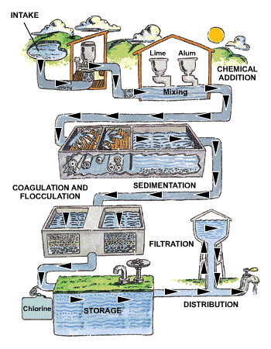
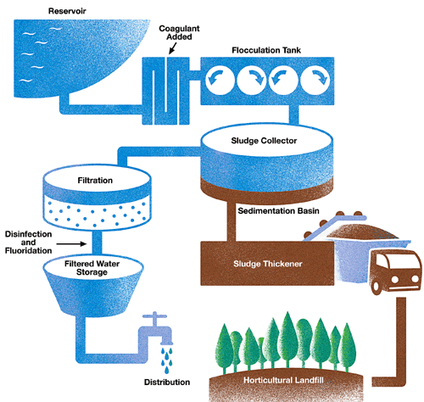

Slide 3
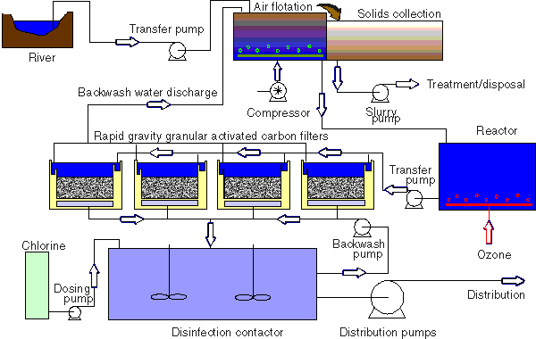

Slide 4
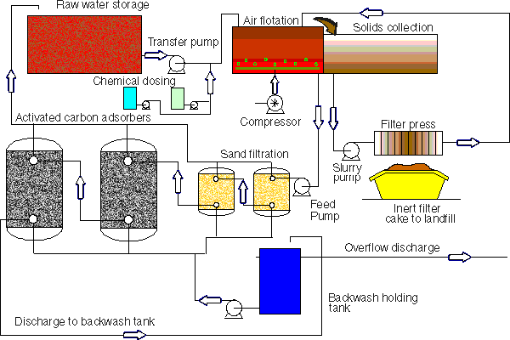

Slide 5
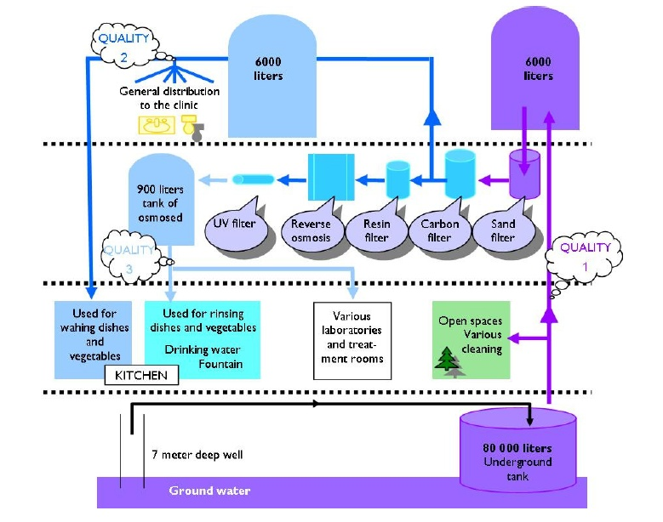

Slide 6
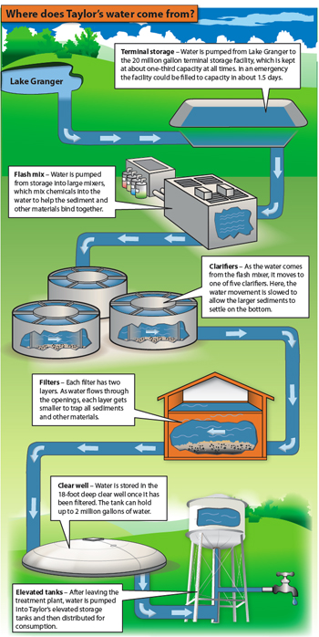

Slide 7
Today the City of Houston has plenty of water and has won awards for its water quality accomplished through water treatment plants, according to city officials.
Jeff Taylor, Houston’s Public Works director(2006), says the emphasis is on water quality rather than water supply in Houston because the city receives about 50 inches of rainfall a year and has a 30 to 50 year supply. However, Jim Adams, general manager of the San Jacinto Water Authority and chair of Region H Water Planning Group (Region H includes Houston), says by 2060, Houston will require three billion gallons of water a year. “We are going to have to reuse water and we are going to have to conserve,” says Adams. “Water is not as plentiful as it use to be.”
Houston as a Model City: Meeting the challenges of an environmental crisis The Future of Water by Vicki Wolf, April 2006
(Cont’d)

Slide 8
Rives Taylor, research scientist with Houston Advanced Research Center’s Energy and Buildings Solutions Group and sustainability leader for Gensler Architecture, says these forecasts are optimistic as the population of Texas grows and droughts are more common.
He believes in three years we will have concerns. The water that Houston uses includes the Trinity River and the San Jacinto River, both downstream from areas with rapidly growing populations. Also, Texas is experiencing the longest dry spell since the drought of record in the 1950s with low precipitation levels forecast through this summer. Global warming may bring more droughts in the future.
Also, use of ground water, pumping water from aquifers below the ground, is causing the land to sink. To prevent further subsidence, Houston is moving from ground water as the predominant source of water to surface water – lakes and reservoirs storing water that comes from rivers.

Slide 9
Capturing rainwater and storing it in cisterns is an effective way to reduce runoff and conserve the public supply. Rainwater without chemical treatment can be safely used for flushing toilets and washing clothes. It can be used for drinking when properly treated.
Considering that up to 60 percent of city water is used for landscaping, moving toward sustainability requires collecting and using rainwater for landscape and garden irrigation. Selecting native and adapted plants, and designing landscape and gardens to capture water and prevent runoff also help save water. Garden beds, shrubs and mulching are better conservation choices than growing grasses.
Planting vegetation similar to the diverse prairies and forests that covered Houston before it was paved over for development can be planted across the city, even on rooftops, to help cool the city and prevent runoff during heavy rains.

Slide 10
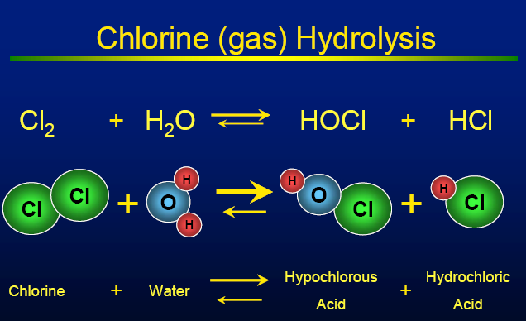
Understanding Chlorination Process

Slide 14
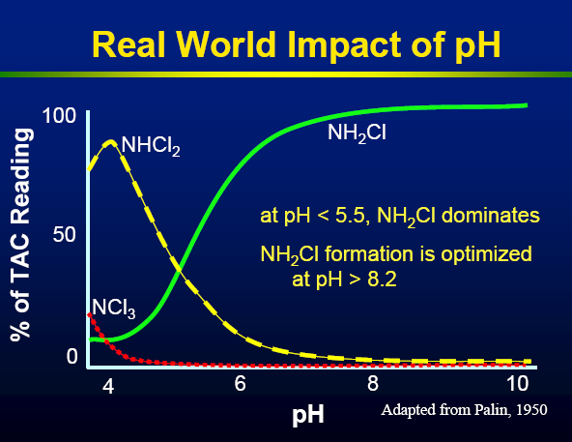

Slide 16
Groundwater Reduction Plan (GRP)
Dated May 28, 2003
The NHCRWA will build its primary water transmission lines from the COH delivery points to its boundary in two construction phases.
One transmission line will be constructed initially to satisfy the 2010 through 2019 conversion requirements.
A second transmission line will be constructed to meet the requirements for 2020 through 2030. Other entities may pay a pro-rata share for capacity in the NHCRWA’s transmission pipe.
The Central Harris County Water Users Consortium and the West Harris County Regional Water Authority have been identified as possible participants at this time.
The NHCRWA requested its primary water distribution system be sized and designed to provide all wholesale customers water at system pressure (55 to 65 pounds per square inch). Rates of water consumption vary widely throughout the year. Since the NEWPP will supply water at a comparatively constant rate, peaking requirements of wholesale customers will be provided from water sources within the NHCRWA Service Area.

Slide 17
NHCRWA
The 2020 and 2030 conversion areas will spread outward from the initial area. The estimates of probable costs for 2020 and 2030 are $402.1 million and $29.1 million, respectively, and $612.7 million total for all three decades, excluding interest, financing costs and water capacity purchase. The above estimates of probable costs were developed using Region H Water Planning Group 1999 unit values.
The NHCRWA anticipates that water reuse and early/over conversion may generate credits against the total amount of surface water that must be used to achieve compliance. The NHCRWA reserves the right to submit for consideration an amended GRP in the future discussing these concepts along with a methodology of applying credits.

Slide 18
Entities Involved
Houston Area Water Corp.
North Harris County Regional Water Authority (NHCRWA)
Turner, Collie, and Braden
Arcadis
Harris-Galveston Coastal Subsidence District
City of Houston (COH)
Northeast Water Purification Plant (NEWPP)
American Water Works Association (AWWA).
Central Harris County Water Users Consortium
West Harris County Regional Water Authority
San Jacinto River Authority (SJRA).

Slide 19
NHCRWA
The NHCRWA has 160 political subdivisions that include:
Cities
Municipal Utility District’s (MUD),
Public Utility District’s (PUD),
Water Control and Improvement District (WCID),
Utility District’s (UD),
And more (collectively referred to as MUDs) as well as independent well owners that combined have a total of 1,612 groundwater wells within the NHCRWA. The total year 2000 well pumpage within the NHCRWA as reported to HGCSD was over 25 billion gallons.

Slide 20
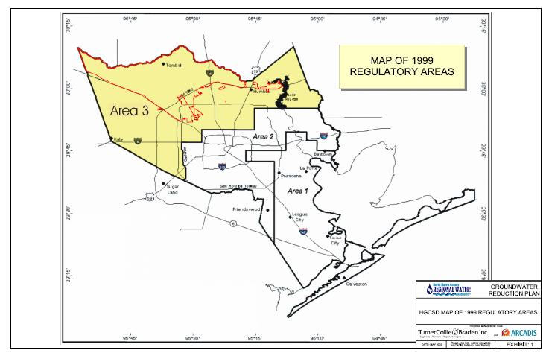

Slide 21
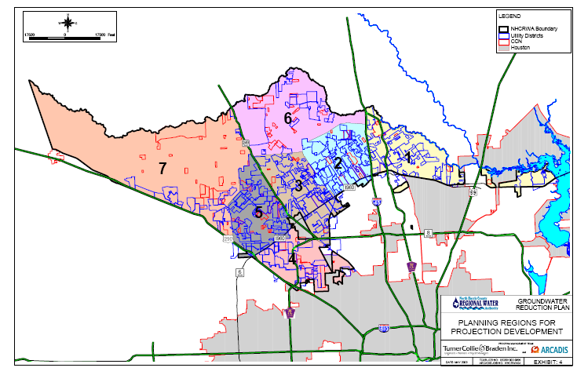

Slide 22
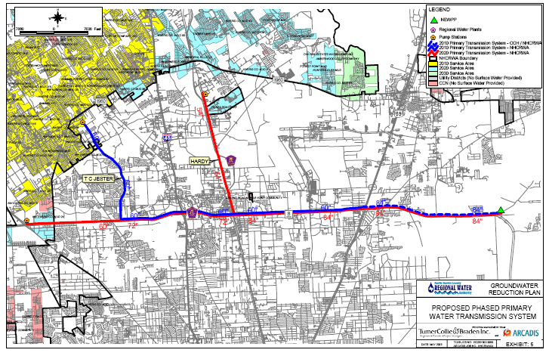

Slide 23
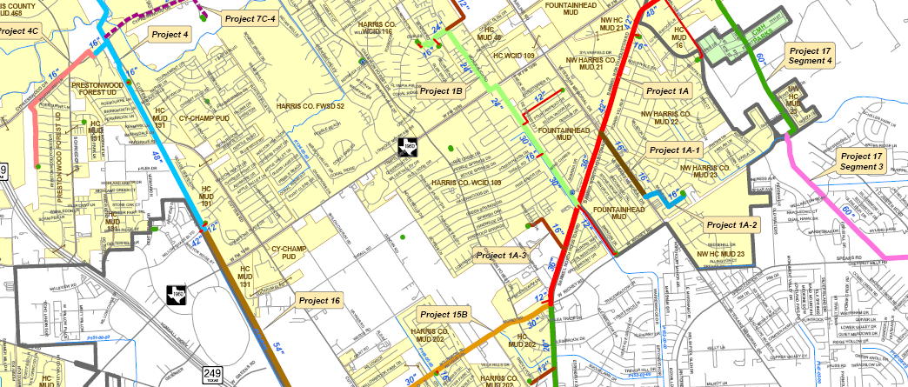
Project map Example

Slide 24
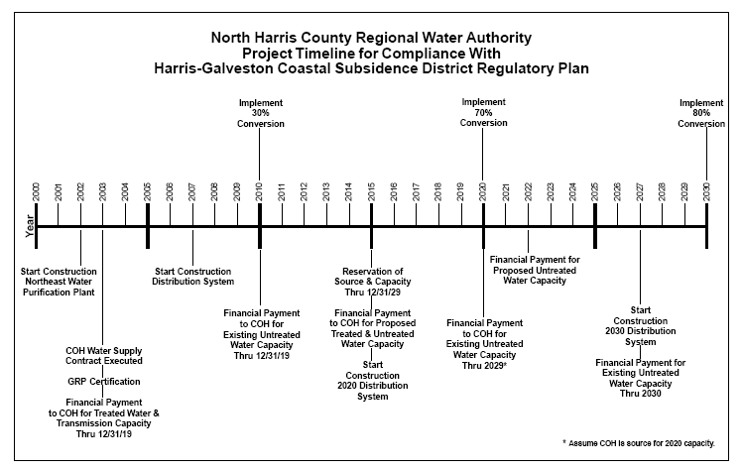

Slide 25
Altivia Applications
Along with the products ALTIVIA manufactures and distributes, they offer a variety of site-specific service solutions to meet your water treatment and chemical management needs. Their chemists and engineers can analyze your requirements and design the most cost-effective solution possible. Services include:
Technical Evaluations
FLEXTREAT™
Regulatory Compliance
Safety Training
Inventory Management

Slide 26
Northeast Water Purification Plant
Grand Opening on June 23, 2004
PBS&J provided owner’s representative services for the design, construction, and operation of the Houston Area Water Corporation 40-mgd northeast water purification plant located on the west shore of Lake Houston in Harris County, Texas.
This project is unique, in that it is the first of its kind in the Houston area to be constructed using the design/build/operate method of delivery.
The plant uses a conventional treatment process of coagulation, flocculation, sedimentation, filtration, and disinfection.
It has the potential for expansion to 80 mgd, and the plant site can accommodate a facility with a capacity of approximately 360 mgd.

Slide 27
NHCRWA Population and Water Demand Data

Slide 28
Waste Dumped into bayou
In downtown Houston along Buffalo Bayou at Allen's Landing is where you see the sewage problem. Ever since the hurricane, a number of the city's waste water treatment plants went without power. As a result, the city was forced to actually dump raw sewage straight into the bayous.
There are 39 wastewater treatment plants in the city of Houston. So far, 31 are back up and running, and treating sewage. (This is after the hurricane)

Slide 29
Important Facts to Consider
Up to 60% of Houston water use is for landscape irrigation.
Pumping water is becoming less of an option for consideration.
Reservoirs and Lakes are limited resources.
Water must be stored for Houston use.

Slide 30
What do we do with the water?
50% of captured water shall be used for greywater, treated only as required for storage
50% of captured water shall be sent for treatment and then to end users.
If tanks reach capacity and the tentacles end points are still under water, the float activator will still cause them to retract water to the tanks. The tanks will then need to overflow. This overflow must be in areas that are not prominent to flood, allowing that water to slowly reach the bayou system.

Slide 31
Resources
http://www.cleanhouston.org/living/better_world/houston3.htm
http://houston.bizjournals.com/houston/stories/2003/10/13/story4.html?page=1
http://abclocal.go.com/ktrk/story?section=weather/hurricane&id=6407411
http://altivia.com/company_who_we_are.aspx
http://www.impactnews.com/southwest-austin/recent-news/5652-city-panel-to-evaluate-water-treatment-plant-proposal
www.twdb.state.tx.us/publications/reports/RainHarv.pdf
http://www.naymz.com/institution/houston/area/water/corporation/1496
http://www.nhcrwa.com/
http://www.tceq.state.tx.us/assets/public/permitting/watersupply/ud/forms/jack.pdf
http://www.nhcrwa.com/grp/GRP_online_1-2005.pdf
http://www2.prnewswire.com/cgi-bin/stories.pl?ACCT=104&STORY=/www/story/04-11-2006/0004338302&EDATE=
http://www.pbsj.com/Our_Businesses/Consulting/Services/Engineering/Drinking_Water/Pages/DBO_Services_Northeast_Water_Purification_Plant.aspx
http://www.nhcrwa.com/maps/2010_system/2009/website2009-Oct.pdf
http://altivia.com/default.aspx
http://abclocal.go.com/ktrk/story?section=weather/hurricane&id=6407411
http://www.thewatertreatments.com/wp-content/uploads/2009/02/water-treatment-process.gif
http://www.greeleygov.com/Water/WebImages/treatment.gif
http://www.activated-carbon.com/images/oulu.gif
http://washtech.files.wordpress.com/2009/02/shechen-water-treatment1.jpg
http://www.activated-carbon.com/images/cg1.gif
http://impactnews.com/images/stories/GHT/2008/08/19-water.jpg

