Slide 1
STEAM CONDENSERS AND COOLING TOWERS
Marks-16

Slide 2
C404.5-Evaluate condenser performance and select for proper application.

Slide 3
DALTONS LAW OF PARTIAL PRESSURE
“The total pressure exerted by mixture of gases or a mixture of gas and vapors (which have no chemical action on each other) is equal to the sum of the partial pressures of the constituents of the mixture, if it occupies the volume of mixture at temperature of mixture”.

Slide 4
DALTONS LAW OF PARTIAL PRESSURE
The total pressure in the condenser is the sum of the partial pressure of steam and air.
Pressure of mixture= partial pressure of steam + partial pressure of air
So according to Daltons law total pressure in the condenser is,
Pc = Ps + Pa
Where , Pc= total pressure in condenser
Ps= partial pressure of steam
Pa= partial pressure of air.

Slide 5
DALTONS LAW OF PARTIAL PRESSURE
Pc
Ps
Pa
Steam + air
steam
Air

Slide 6
Steam condenser
A steam condenser is a closed vessel in to which the steam is exhausted, and condensed after doing work in an engine cylinder or turbine.
A steam condenser has the following two object:
1) the primary object is to maintain a low pressure (below atmospheric pressure) so as to obtain maximum possible energy from steam and thus to secure high efficiency.
2) the secondary object is to supply pure feed water to the hot well, from where it is pumped back to boiler.

Slide 7
Classification of steam condenser
The steam condensers may be broadly classified in to the following two types, depending upon the way in which the steam is condensed.
1) jet condensers or mixing type condensers
Parallel flow jet condenser
Counter flow jet condenser
Barometric or high level jet condenser
Ejector condenser.
2) surface condensers or non mixing type condensers.
A) Down flow surface condenser
B) central flow surface condenser
C) Regenerative surface condenser
D)evaporative condenser

Slide 8
Surface condenser
A surface condenser has a great advantages over the jet condenser, as the condensate does not mix up with cooling water.
As a result of this whole condensate can be reused in the boiler.
This type of condenser is essential in ships which can carry only a limited quantity of fresh water for the boilers.
Fig . Shows a longitudinal section of a two pass surface condenser.

Slide 9
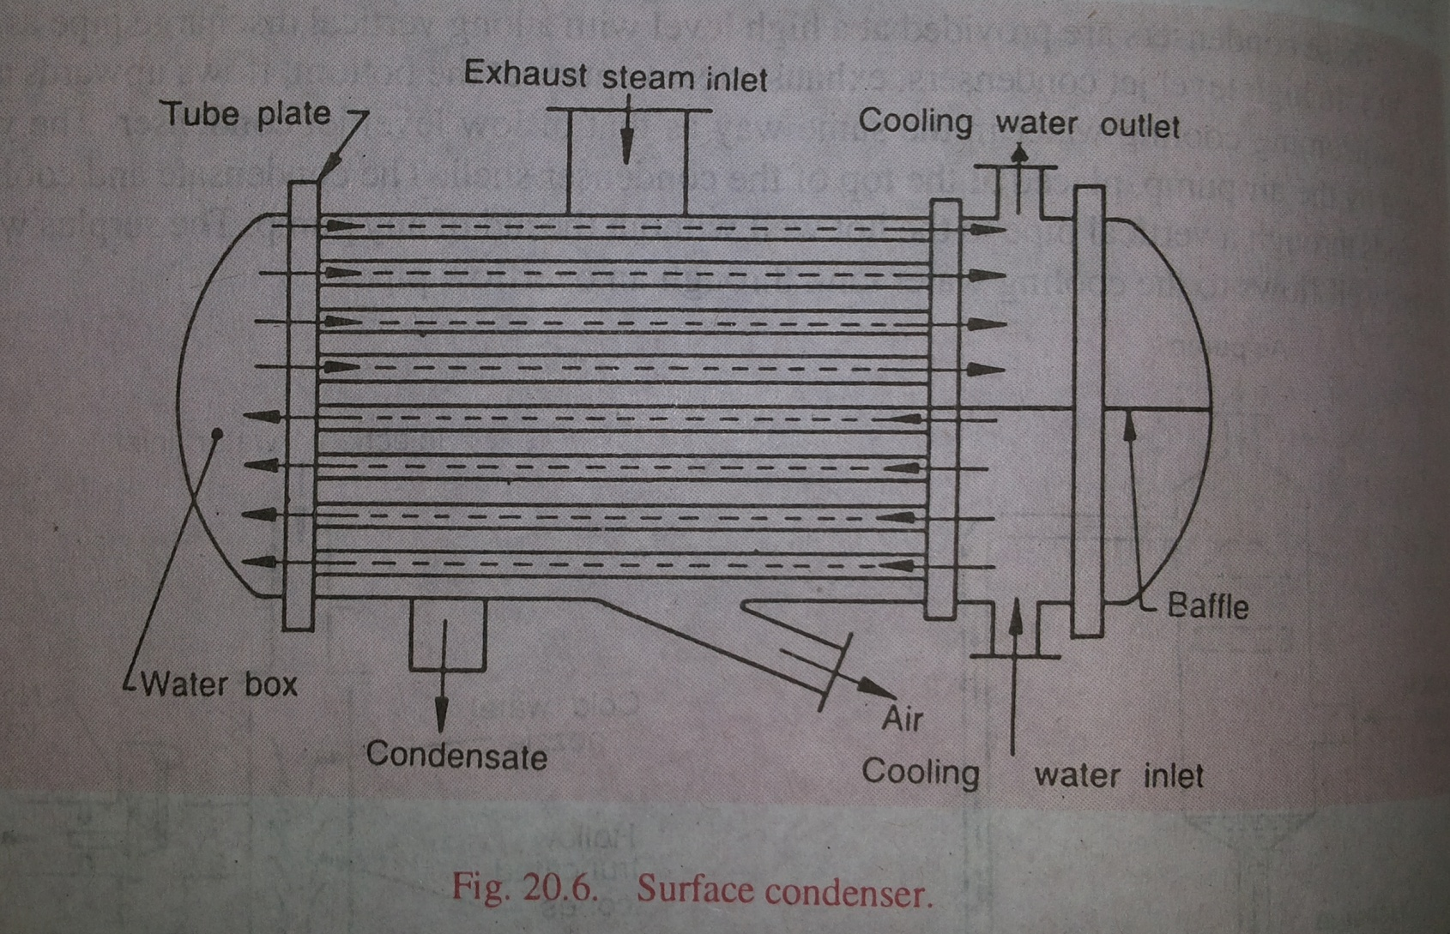
Surface condenser

Slide 10
Surface condenser
It consist of a horizontal cast iron cylindrical vessel packed with tubes, through which the cooling water flows.
The end of the condensers are cut off by vertical perforated types of plates in to which water tubes are fixed.
This is done in such a manner that the leakage of water into the centre condensing space is prevented.
The water tubes pass horizontally through the main condensing space for the steam.

Slide 11
Surface condenser
The steam enters at the top and is forced to flow down words over the tubes due to the suction of the extraction pump at the bottom.
The cooling water flows in one direction through the lower half of the tubes and returns in opposite direction through the upper half.

Slide 12
Source of air leakage
The following are main sources through which the air may enter in to the condenser:
The dissolved air in the feed water enters in to the boiler, which in turn enters in to the condenser with exhaust steam.
The air leaks in to the condenser, through various joint, due to high vacuum pressure in the condenser.
In case of jet condensers , dissolved air with the injection water enters in to the condenser.

Slide 13
Effect of air leakage
It reduces vacuum pressure in the condenser.
Since air is poor heat conductor, particularly at low densities, it reduces the rate of heat transmission.
It requires a larger air pump. Moreover, an increased power is required power is required to drive the pump.

Slide 14
Condenser efficiency
The condenser efficiency may be defined as the ratio of temperature rise of cooling water to the vacuum temperature minus inlet cooling water temperature.
ᶯc = temperature rise of cooling water/(vacuum temperature- inlet cooling water temperature)
ᶯc = (to – ti ) / (tv-ti)
Where, to= outlet temperature of cooling water.
ti= inlet temperature of cooling water.
tv= vacuum temperature

Slide 15
Vacuum efficiency
The minimum absolute pressure (also called as ideal pressure) at the steam inlet of a condenser is the pressure corresponding to the temperature of the condensed steam.
The corresponding vacuum (called ideal vacuum) is the maximum vacuum that can be obtained in a condensing plant, with no air present at that temperature.
The pressure in the actual condenser is greater than the ideal pressure by an amount equal to the pressure of air present in the condenser.
The ratio of the actual vacuum to the ideal vacuum is known as vacuum efficiency.

Slide 16
Vacuum efficiency
ᶯv= actual vacuum /ideal vacuum
Actual vacuum= barometric pressure- actual pressure
Ideal vacuum = barometric pressure- ideal pressure

Slide 17
Cooling tower
The main application are in power plants and refrigeration plants.
Its function is to cool the hot water from the condenser by exposing it to the atmospheric air, so that the cold water may be used again for circulation.
The cooling towers are used in steam power plants where there is a limited supply of cooling water.
It is placed at a certain height (at about 9 meters from the ground level).

Slide 18
Cooling tower
The hot water falls down in radial sprays from a height and the atmospheric air enters from the base of tower.
The partial evaporation of water takes place which reduces the temperature of circulating water.
This cooled water is collected in the pond at the base of the tower and pumped in to the condenser.

Slide 19
Types of cooling tower
1) Natural draught cooling tower
The circulation of air is produced by the pressure difference of air inside and outside the cooling tower.
2) Forced draught cooling tower
The circulation of air is produced by means of fans placed at the base of tower.
3) Induced draught cooling tower
The circulation of air is provided by means of fan placed at top of tower.

Slide 20
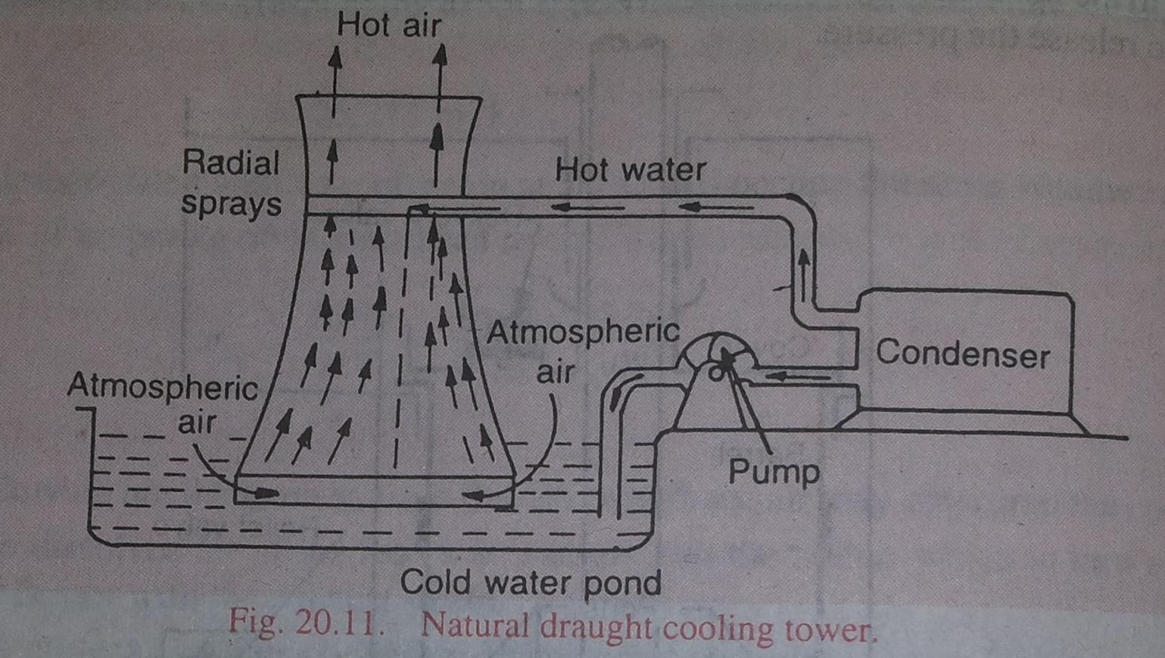
Natural draught cooling tower

Slide 21
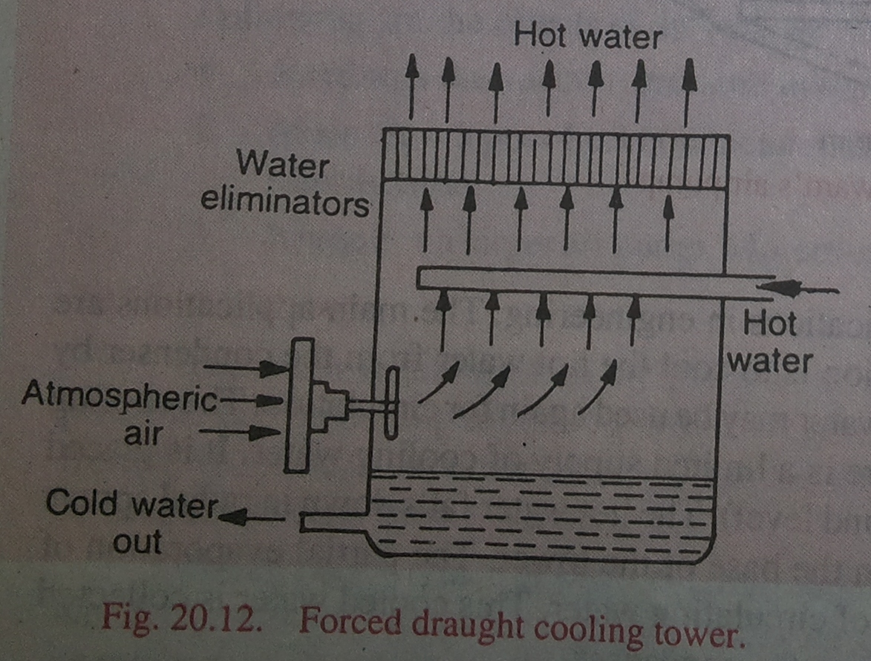
Forced water cooling tower

Slide 22
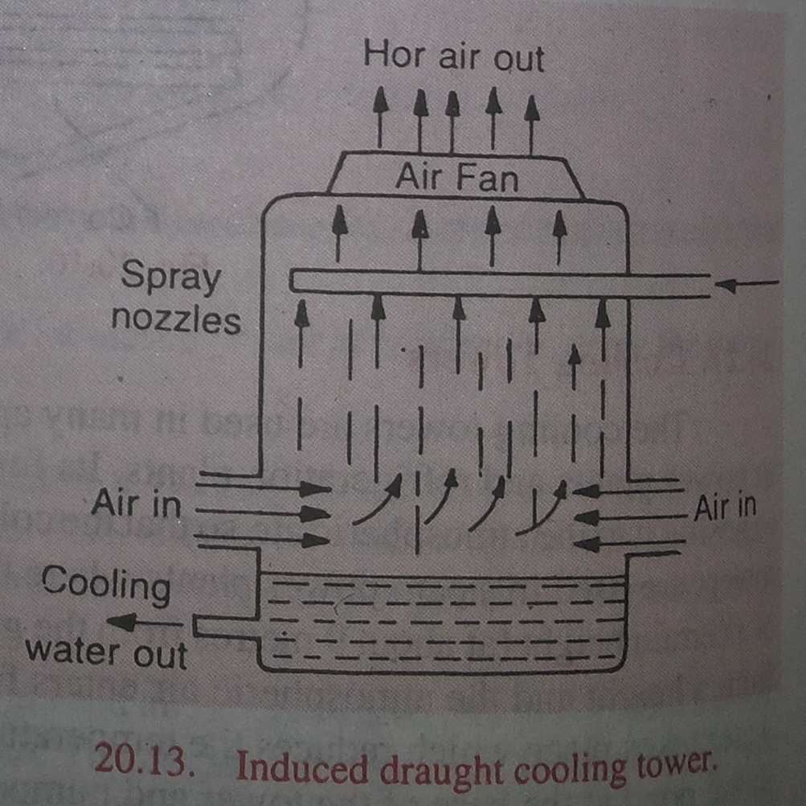
Induced draught cooling tower

