Slide 1
Sand Casting
Alexander DeCarli
Kevin Shaw
Katie Gaffney
SRJC Engr 45
12/08/10

Slide 2
Early History
The oldest known cast in existence is a copper frog from 3200 BCE in Mesopotamia.
Other early casts from around 3000BCE like weapons and cult objects were discovered in the Middle East and India.

Slide 3
Early History
The earliest known sand mold came from China in 645 BCE
In 233 BCE, cast iron plows were cast in China.
In the year 500, cast crucible steel was first produced in India.
This process was lost until 1750 when an Englishman named Benjamin Huntsman rediscovered it.

Slide 4
Advancements in Sand Casting
In 1924, the Ford automobile company set a record production of 1 million cars, consuming the casting industry.
Experiments were conducted with types of clay to improve strength in molding sand, updating cupola furnaces to electric and moving the traditional foundry to a factory setting improved process.
Now, sand casting is a fully automated factory system.

Slide 5
What is Sand Casting?
Sand Casting is a process in which a cast is formed from a molten metal in a sand mold.
Can be used to produce a range of sizes from a fraction of an ounce to hundreds of tons.

Slide 6
Why We Use Casting
Advantages
Disadvantages
Capable of large sizes
Capable of holding detail
Useful for metals with low ductility
Most economical type of fabrication
Minimal waste
Empty spaces can weaken metal
Poor surface finish
Small parts hard to remove
Additional hardening usually needed

Slide 7
General Sand Casting
Two-piece casting flask
top is cope, bottom is drag
Sand packed around pattern of intended shape
Gating system for metal flow and escape
trimming necessary
Often used with automotive parts and piping
Iron, steel, bronze, aluminum, lead, tin, zinc

Slide 8
Types of Sand
Green sand most common
Silica sand, water, clay
Named for moisture, not color
Sand must maintain certain properties
i.e. strength, thermal stability, collapsibility, reusability
Compressed with hydraulic pressure
Sometimes different layers of different qualities

Slide 9
The Project
Sand casting acorns for TEC project decoration.
Two different methods
Traditional sand casting
Lost wax casting
Zinc used because of it’s low melting temperature
420°C or 788°F

Slide 10
Traditional Preparation
Heated oven to 900°F to melt the Zinc.
Made pattern of acorn out of wax.

Slide 11
Traditional Preparation
Used tin cans as frame for the mold.
Poured sand in layers and enclosed pattern between the two halves.

Slide 12
Traditional Preparation
Carefully separated two halves with a knife.
Made pouring spout and chimney in the mold.
Reattached two halves of the mold and we were ready to pour!

Slide 13
Traditional Casting
Poured molten Zinc and let sit.
Cast acorn then removed and set to cool.
Cleaned up edges with file.
Cast was very close to the original pattern.

Slide 14
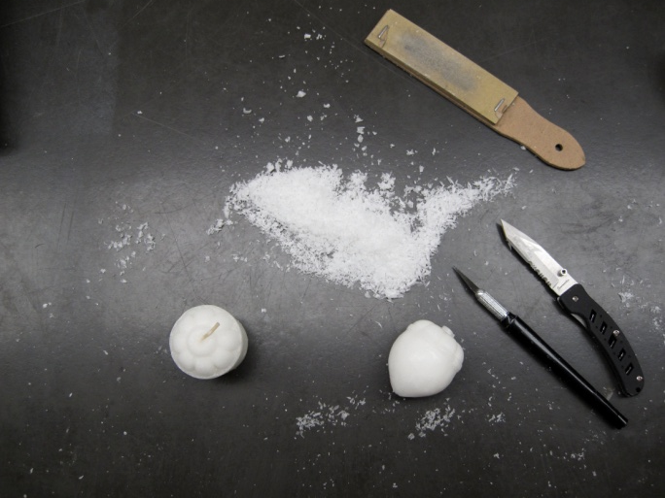
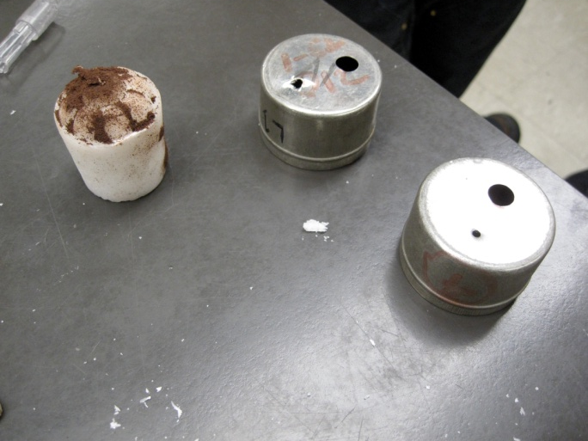
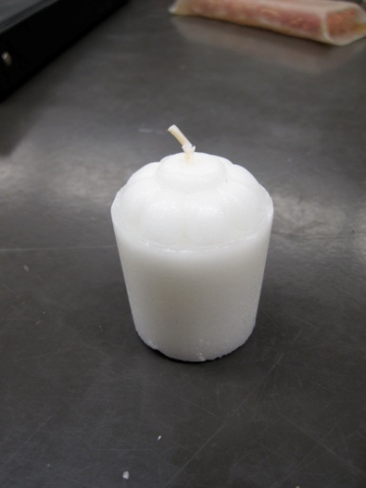
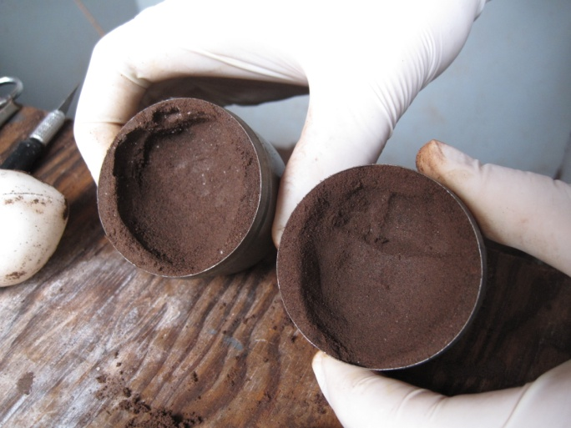
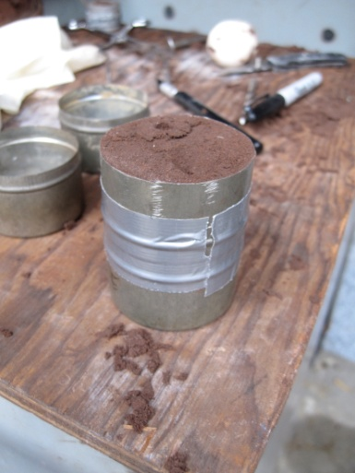
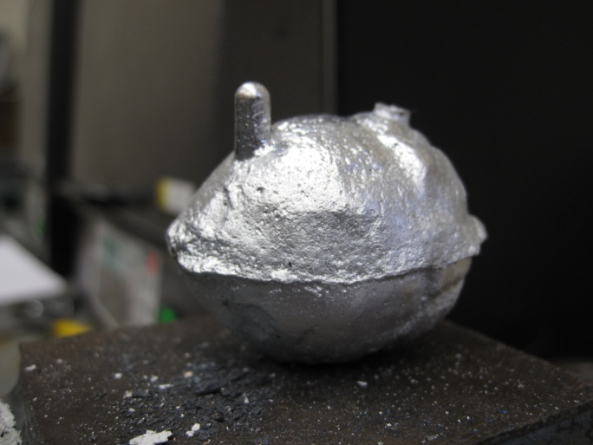
Results

Slide 16
Lost Wax Preparation
Extra Zinc is heated to melt
Reused acorn pattern for casting flask
Same steps to create mold
Wax pattern left in mold

Slide 17
Lost Wax Casting
Poured molten Zinc into mold
Wax started to melt out
Zinc cooled prematurely, trapping wax
Cast acorn removed
Not much of an acorn this time
Combination of Zinc and wax

Slide 18
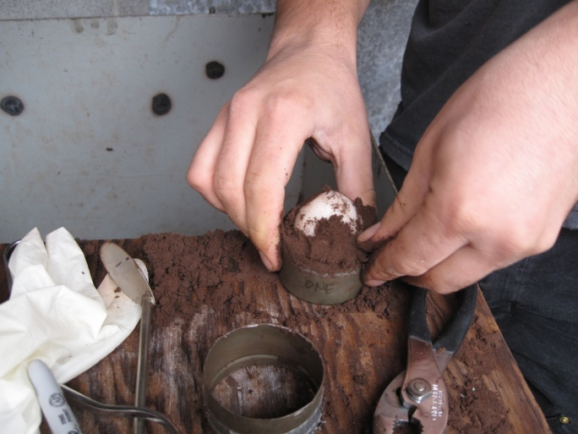
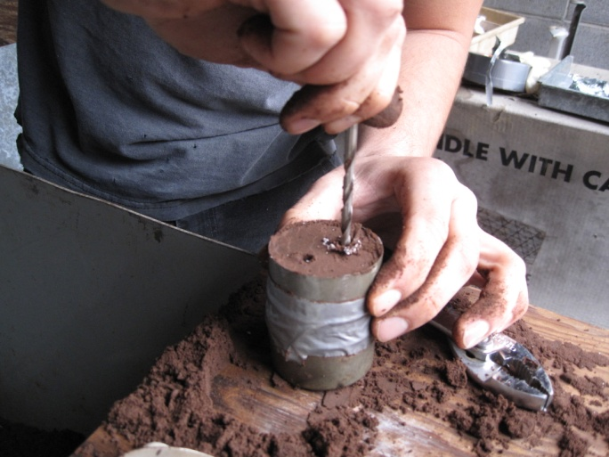
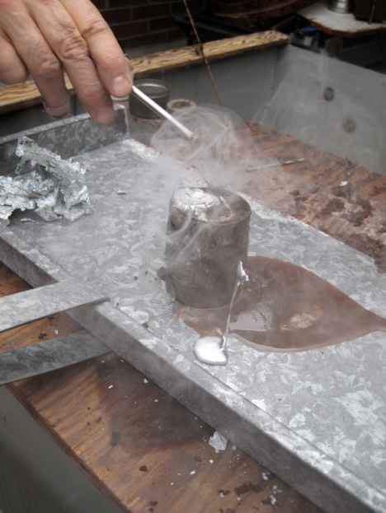
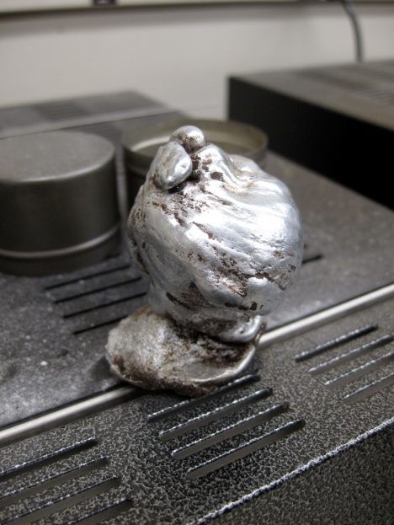
Results

Slide 20
References
http://www.industrialmetalcasting.com/sand-casting.html
http://www.efunda.com/processes/metal_processing/sand_casting_intro.cfm
http://en.wikipedia.org/wiki/Sand_casting
http://www.substech.com/dokuwiki/doku.php?id=sand_casting
Callister, Materials Science and Engineering
http://www.mk-technology.com/geschichtemetallguss.html?L=2

Slide 21
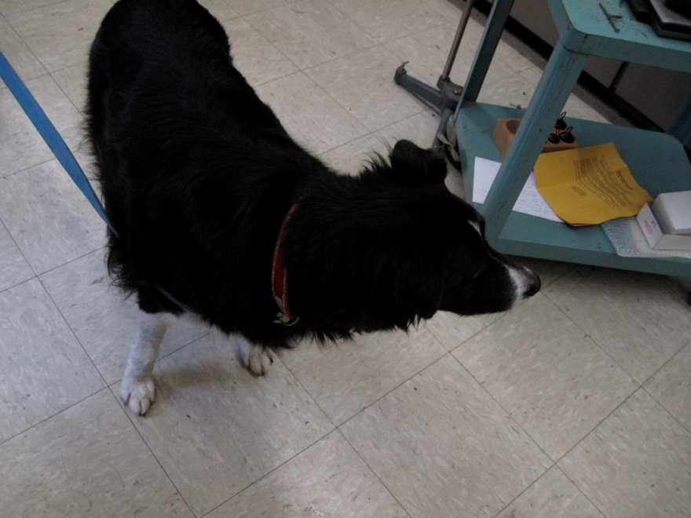
Special Thanks
M. Maselli and Son for supplying Zinc
Younes’ dog

