Slide 1

BASICS OF A GOOD ROAD
ASPHALT AND AGGREGATES
Gerry Huber
Heritage Research Group

Slide 2
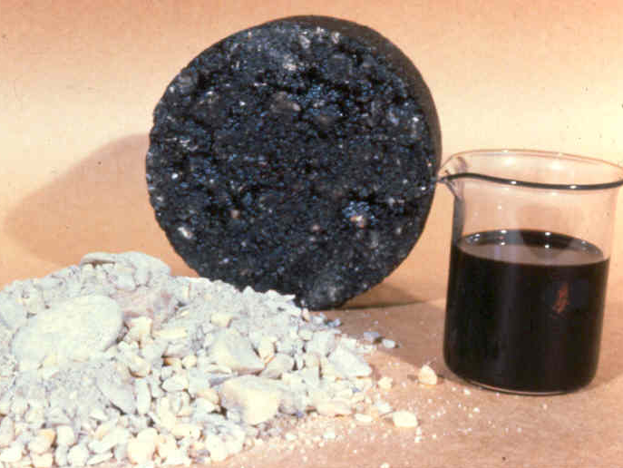

Slide 3
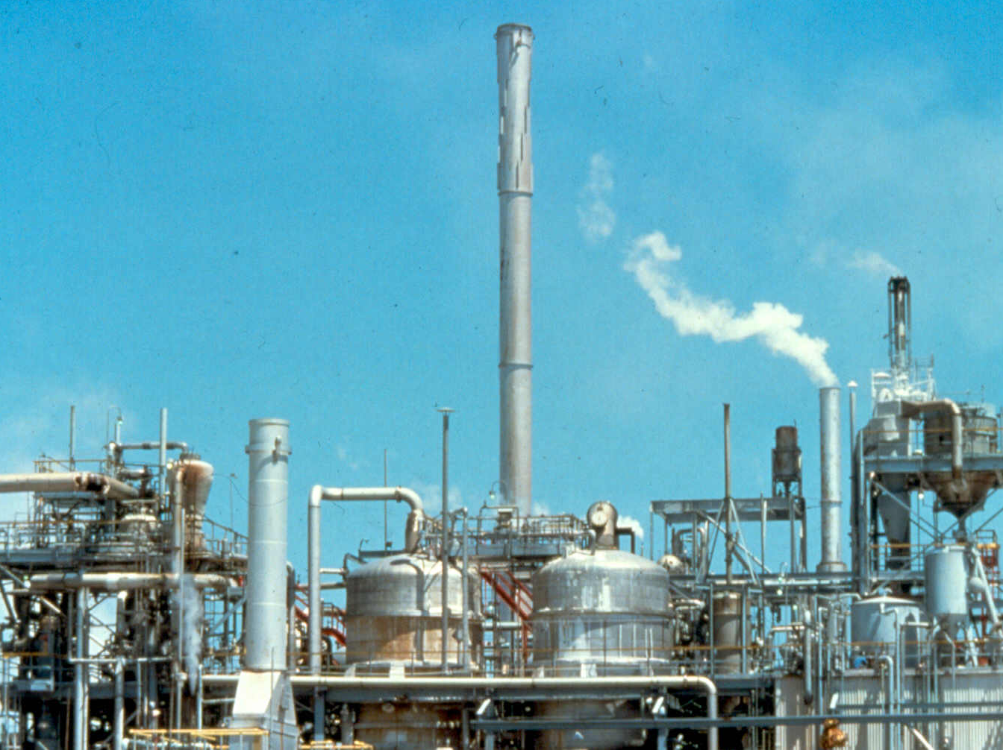

Slide 4
Refinery Operation
LIGHT DISTILLATE
PUMPING
STATION
MEDIUM DISTILLATE
FIELD STORAGE
HEAVY DISTILLATE
TOWER
DISTILLATION
REFINERY
RESIDUUM
PROCESS
UNIT
STORAGE
TUBE
HEATER
CONDENSERS
AND
COOLERS
OR
ASPHALT
CEMENTS
GAS
PETROLEUM
AIR
BLOWN
ASPHALT
FOR PROCESSING INTO
EMULSIFIED AND
CUTBACK ASPHALTS
SAND AND WATER
AIR
STILL
Notes:
Distillation is used to separate the various crude fractions by boiling point ranges. The crude oil is heated in a large furnace to about 343 ºC and partially vaporized. The remaining material is transferred to a distillation tower. Different fractions reach their boiling point ranges at various heights in the tower. When the temperature is reduced, each material condenses on a tray and is drawn off at each level.

Slide 5
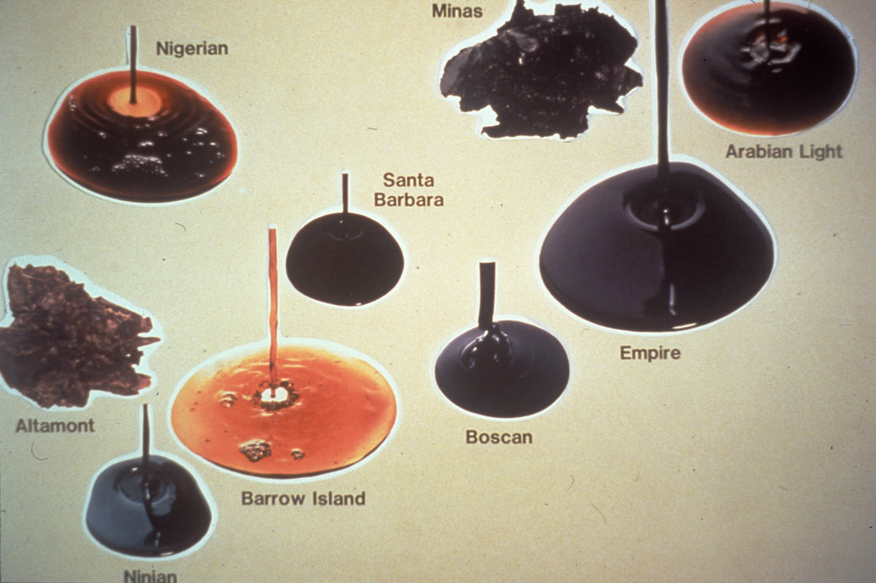
Not All Crude is the Same

Slide 6
How Asphalt Behaves
Behavior Depends on
  Temperature
  Time of Loading

Slide 7
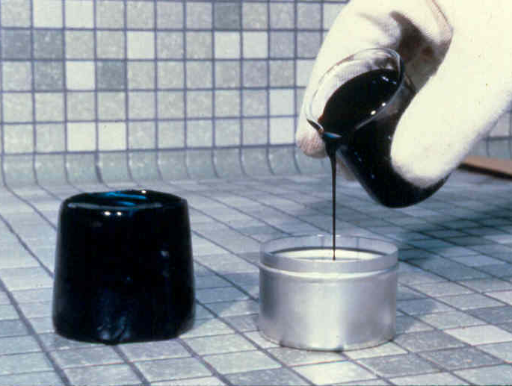
Effect of Temperature

Slide 8

How hard is
the water?

Slide 9
SUPERPAVE Asphalt Binder Specification
Grading System
Based on Pavement Temperatures
(Summer) (Winter)
PG 64-22
Performance
Grade
Max pavement
design temp
Min pavement
design temp

Slide 10
Asphalt Binder Tests
- 20 20 60 135
Temperature, C
Done at different temperatures

Slide 11
Temperature Grades
High Temperature
  58
  64
  70
  76
Low Temperature
  -22
  -28
Rule of 90

Slide 12
Temperature Grades
Unmodified
Asphalt
  58-28
  64-22
Modified
Asphalt
  64-28
  70-22
  70-28
  76-22
Rule of 90

Slide 13
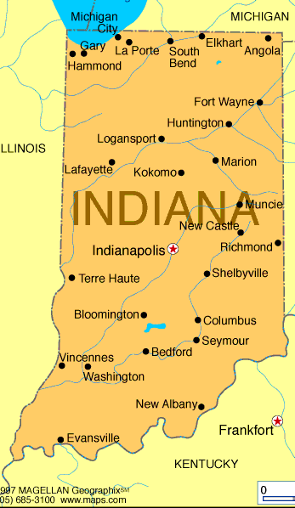
Base Grade
PG 64-22
or
PG 58-28
PG 64-22

Slide 14
Changing Base Grade
Bumping Grade
For heavy truck traffic, stopped condition
  Increase 2 high temperature grades
  64-22 to 76-22
Dropping Grade
For high RAP or Shingle use
(+25% asphalt replacement)
  Decrease one high and low temperature grade
  64-22 to 58-28

Slide 15
Aggregates

Slide 16
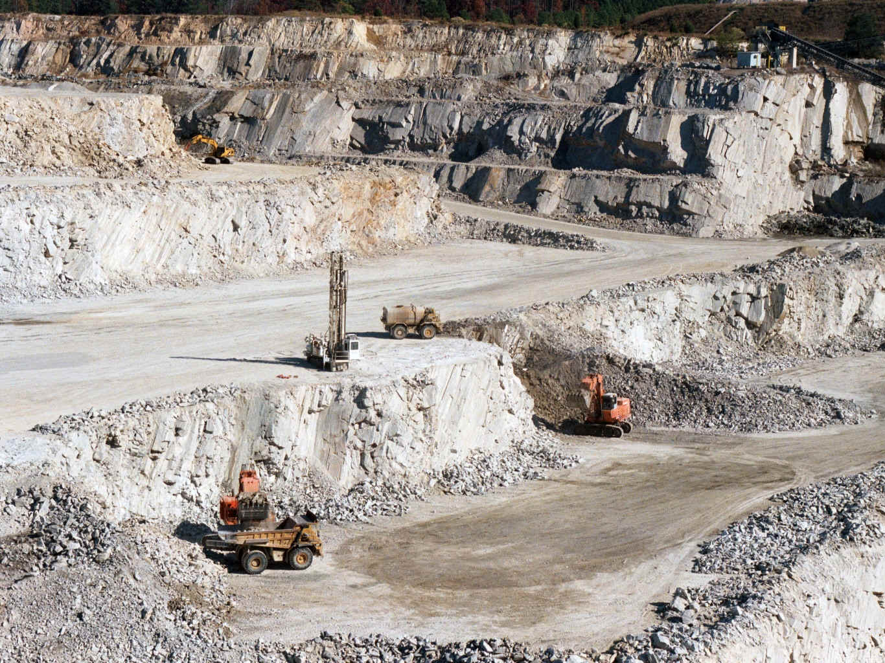
Quarry

Slide 17
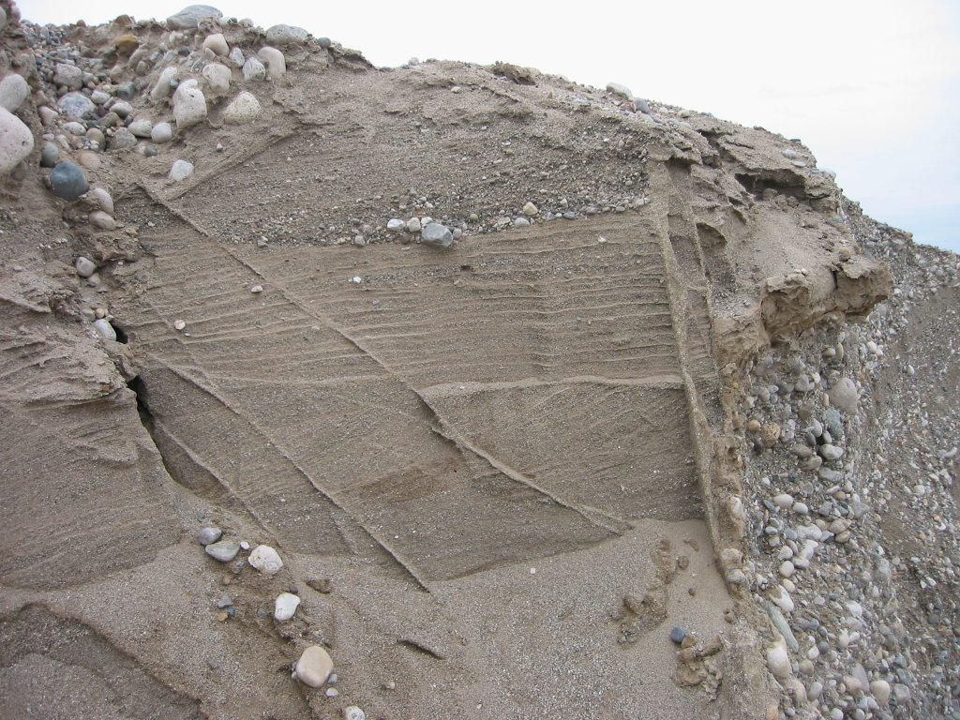
Gravel Pit

Slide 18
Aggregate Properties
Crushed Faces
Fine Aggregate Angularity
Gradation
Notes:
Source aggregate properties are those properties which are measured for the aggregate as-stockpiled and are commonly used for aggregate source acceptance control. These properties are toughness, soundness, and deleterious materials. In addition, the gradations of individual stockpiles may be evaluated.

Slide 19
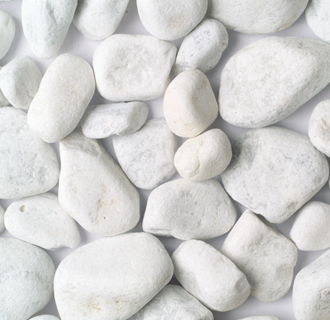
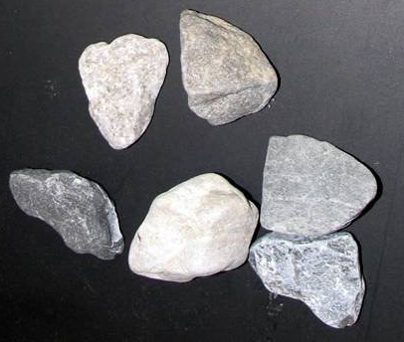
Percent Crushed Particles
0% Crushed 100% with 2 or More
Crushed Faces
Aggregate shape influences
  strength
  compactability

Slide 20
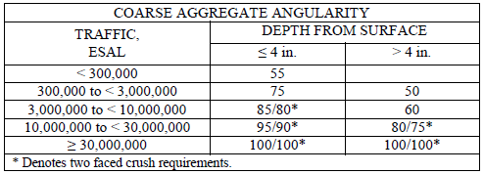
Coarse Aggregate
Crushed Faces

Slide 21
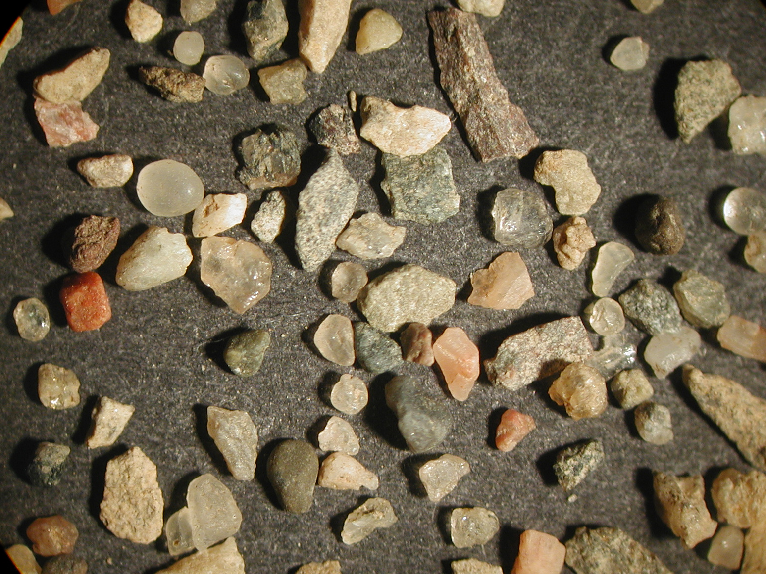
Fine Aggregate

Slide 22
Fine Aggregate Angularity
Natural sands: typically 37 to 44
Manufactured sands: typically 42 to 52

Slide 23
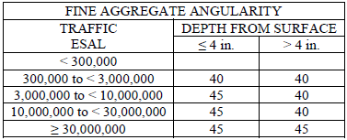
Fine Aggregate Angularity

Slide 24
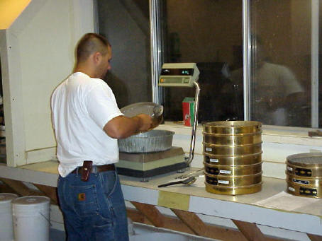
Gradation

Slide 25
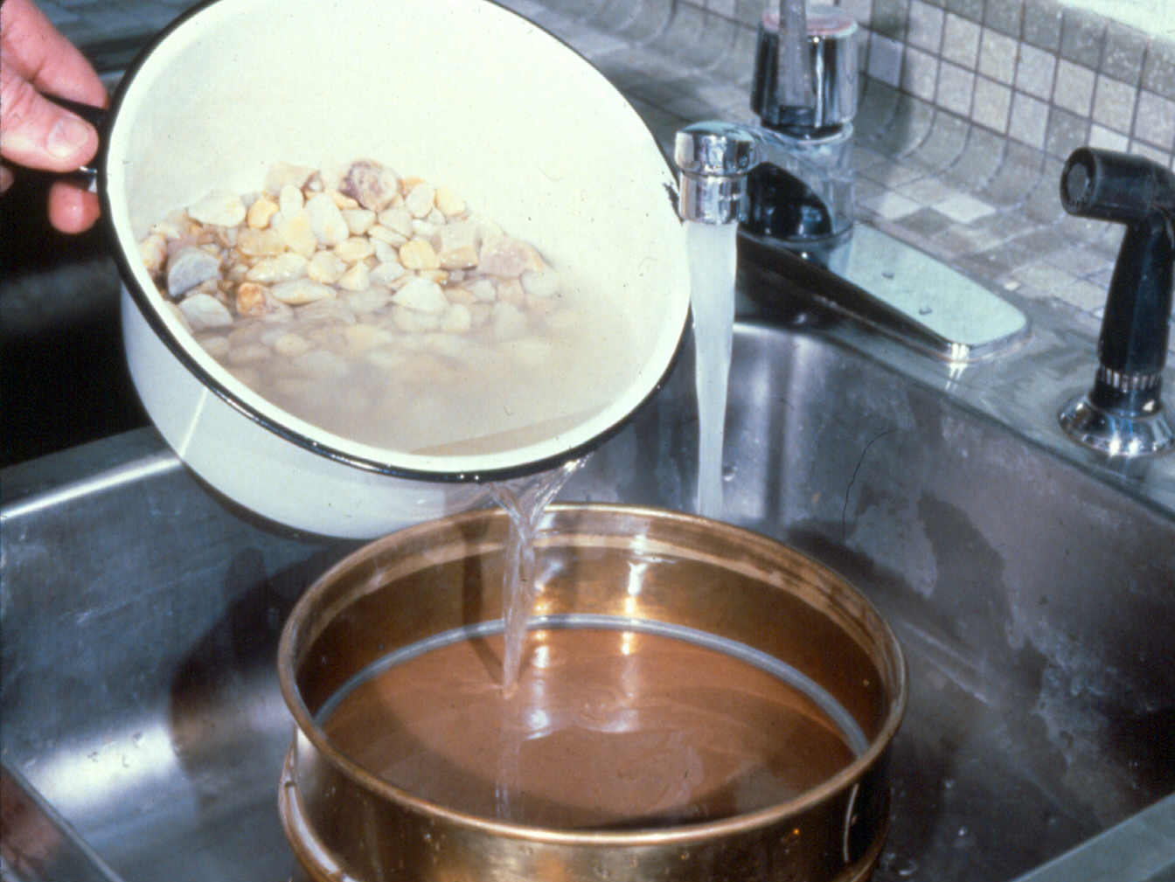
Washed
Gradation

Slide 26
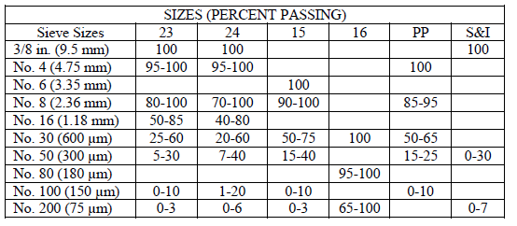
INDOT Fine Aggregate Sizes

Slide 27
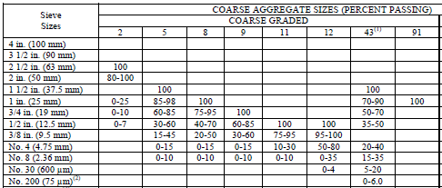
INDOT Coarse Aggregate Sizes

Slide 28
Percent Passing
100
max density line
Primary control sieve
control point
nom
max
size
max
size
0
.075 .3 2.36 4.75 9.5 12.5 19.0
#200 #8 #4 3/8 1/2 3/4
Sieve Size (mm) Raised to 0.45 Power

Slide 29
Mix Size Designations
By Nominal Maximum Sieve
By Gradation
e.g. 12.5 mm, coarse graded
Sizes
  25.0 mm 1 in
  19.0 mm ¾ in
  12.5 mm ½ in
  9.5 mm 3/8 in
  4.75 mm #4
Coarse
Fine

Slide 30
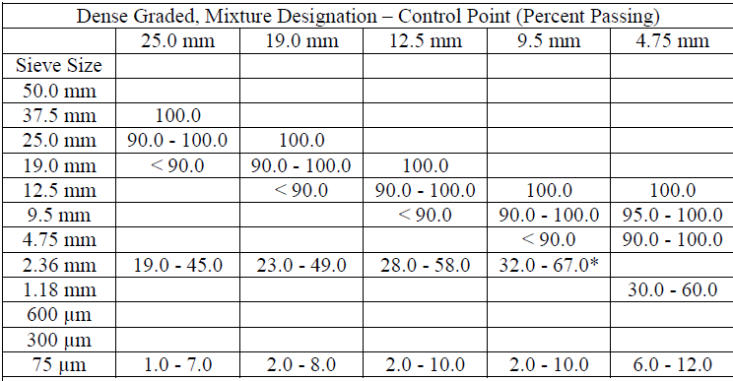
Hot Mix Gradation

Slide 31
Asphalt Mix Design

Slide 32
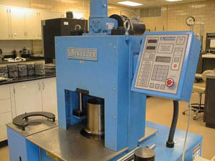
Asphalt Mixture Design
Superpave Mix Design
  Gyratory Compactor
Volumetric Properties
  Asphalt content for durability
  Air Voids
    Upper limit to control aging
    Lower limit for traffic densification

Slide 33
Mixing
Place pre-heated aggregate in bowl and add hot asphalt
Notes:
Pour the heated binder into a bowl with the heated aggregate. Typically the temperature for this is about 275 to 325 C.

Slide 34
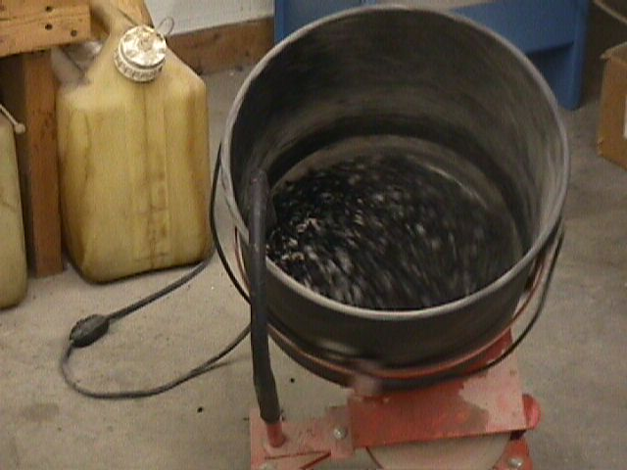
Mixing
Mix until aggregate is well-coated
Notes:
The mixture is typically mixed in a mechanical mixer. The mix should be observed to insure that the aggregate and asphalt are thoroughly mixed.

Slide 35
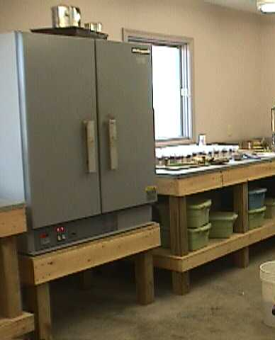
Short Term Aging
Simulate Construction
Oven Aging
  2 hours at 275°F

Slide 36
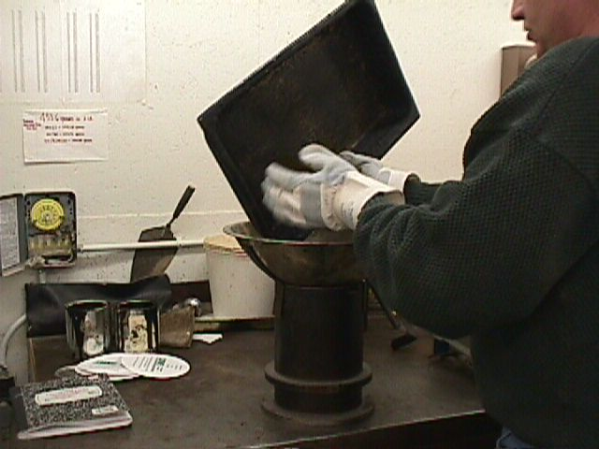
Compaction
Place funnel on top of mold and place mix in mold.

Slide 37
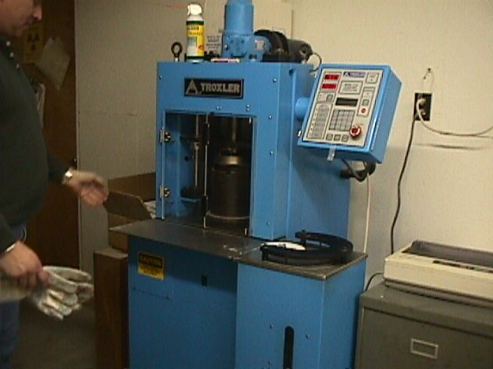
Compaction
Gyratory Compactor.

Slide 38

Compaction
Gyratory compactor
  Shearing action
  150 mm (6 inch) diameter molds
    Aggregate size up to 1.5 inches
    Measure height during compaction
Ram pressure
600 kPa
(90 psi)
1.25º

Slide 39
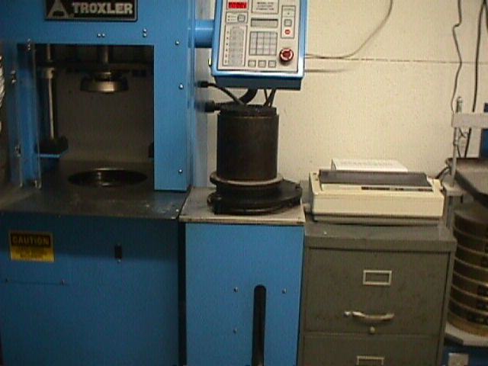
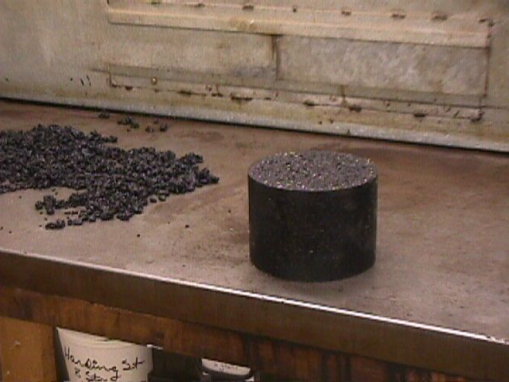

Slide 40
Selection of Design Asphalt Binder Content
V_{a}
VMA
% binder
Blend 3
% binder
VFA
DP
% binder
% binder
%G_{mm} at N_{ini}
%G_{mm} at N_{max}
% binder
% binder
Notes:
The properties are plotted verses the binder content and the proper AC content is obtained.

