Slide 1
Geotechnical Aspects of Dam Safety
William Empson, PE, PMP
Senior Levee Safety Program Risk Manager
U.S. Army Corps of Engineers
Risk Management Center
William.B.Empson@usace.army.mil
Dam Safety Workshop
Brasília, Brazil
20-24 May 2013

Slide 2
Geotechnical Aspects of Dam Safety
Topics
Concrete Dams
  To be presented by Structural Instructor
Earth and Rock Fill Dams
  Failure modes
  Seepage
  Filters
  Stability
Emergency Spillways
  Erosion
Notes:
Giving general overview of key aspects.
Concrete Dams-
Type
Causes of Failure
Failure Mechanics
Foundation Improvements
Embankment Dams-Type, Causes of Failure
Seepage
Slope Stability
Spillway Erosion

Slide 3
Geotechnical Aspects of Concrete Dams
Failure Modes
Foundation Leakage, Piping 11
Overtopping 9
Deterioration 6
Flow Erosion 3
Gate Failure 3
Sliding 2
Deformation 2
Faulty Construction 2
*Lessons From Dam Incidents, ASCE/USCOLD 1975
Notes:
Foundation issues-piping, sliding, liquefaction, subsidence, settlement
Characteristics of consolidated foundations-hardness and strength, discontinuities (openings and fractures), weathering, and solutioning.
Static failure can be divided into two broad categories: sliding and overturning. Primary failure mode.
Seismic events:
Can open foundation and abutment joints that can reduce foundation strength.
Can increase infiltration of water along bedding planes and lead to erosion of shear zone material by piping.
Induces liquefaction, which transforms loose cohesionless foundation soil into a fluid mass. Such liquefaction lowers bearing capacity, and induces settlement and or overturning.
In Arch Dams, seismic failure occurs in the abutments.

Slide 4
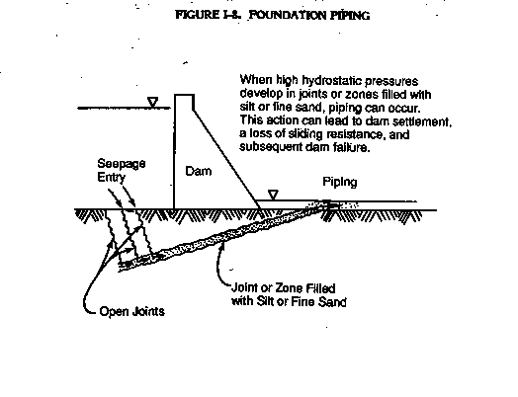
Geotechnical Aspects of Concrete Dams-Foundation Piping
Notes:
Infiltration of water along bedding planes can lead to erosion of joint filler or shear zone material by piping.
The process can cause strength reduction as well as lead to sliding, settlement or overturning due to undermining of the dam.

Slide 5
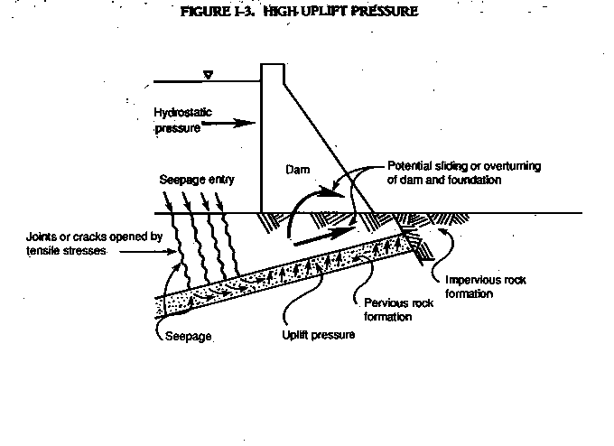
Geotechnical Aspects of Concrete Dams-Uplift Pressure
Notes:
Without proper means to relieve water seepage induced by the reservoir, it can literally caused the dam to float.
During an earthquake excessive movements can open up faults and cracks in the foundation, which result in increased seepage and a corresponding rapid increase in uplift pressure.

Slide 6
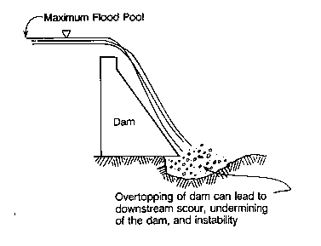
Geotechnical Aspects of Concrete Dams-Flow Erosion
Notes:
Flow erosion undermines the structure and can causes sliding and overturning.

Slide 7
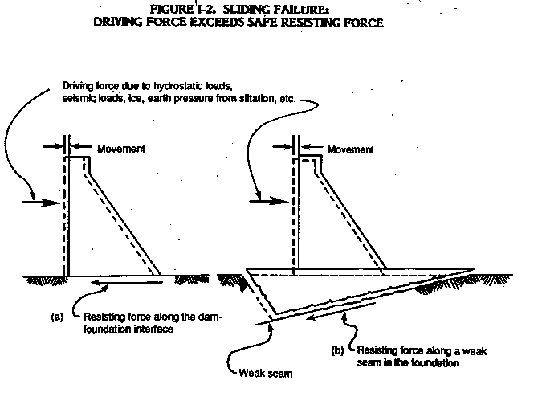
Geotechnical Aspects of Concrete Dams-Sliding
Notes:
Hydrostatic loads push the dam downstream, inducing shear failure along the concrete-rock contact or within the rock foundation.
Sliding failures often result from deficiencies in the foundation.
Low foundation strength.
Bedding planes and joints containing weak materials.
Seams of pervious material, if seepage through them is not controlled to prevent detrimental uplift.
Infiltration of water along bedding planes due to open cracks and fissures can cause reduced foundation shear strength.
Faults and shear zones.

Slide 8
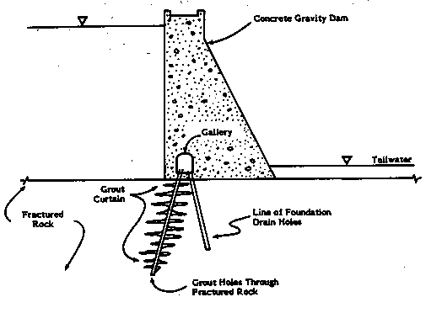
Geotechnical Aspects of Concrete Dams-Foundation Improvements
Notes:
Add grout curtains to reduce uplift pressures.
Add foundation drains to reduce uplift pressures.
Add grout blankets (consolidation grout) to improve bearing and resistance to overturning. It also seals joints and reduces seepage.
Add rock anchors to reduce overturning and sliding.
Add a buttress to the toe to resist sliding.
Add toe reinforcement to prevent flow erosion.
Add relief wells

Slide 9
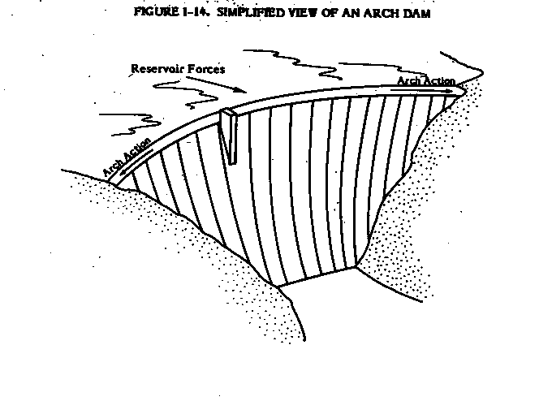
Geotechnical Aspects of Concrete Dams-Arch Dam Abutments
Notes:
Concrete arch dams are usually high in relation to their length, and their safety depends on the competence of the abutments.
Failure is frequently induced by displacement of the foundation or abutment or by the erosion of the foundation or abutment when the dam is overtopped.
Sliding along the foundation or high uplift pressures can induce bending, tension, and then cracking on the downstream face.
An earthquake can induce tensile stresses in the rock causing cracking.
An initial break usually develops into a complete failure of a dam.
St. Francis Dam, NPR specials, 75th anniversary of failure.

Slide 10
Geotechnical Aspects of Dam Safety
Types of Embankment Dams
  Earth Fill
    Hydraulic Fill
    Homogenous Rolled Fill
    Zoned Rolled Fill
  Rock fill
    Diaphragm Rock Fill
    Central Core Rock Fill
Notes:
Earth Fill-Contains 50% or more fines to gravel size material.
Rock Fill-Contains 50% or more cobble size or larger material
Embankments dams can be built on either rock or soil foundations, because the rock foundation and abutments required to support the loads of a concrete dam are not necessary.
Embankment dams are a preferred choice for sites with wide valleys and difficult foundation conditions because of their flexibility. However, soil is a difficult engineering material because of its three-phase nature, diverse composition, and our incomplete understanding of its behavior. Soil behavior under load is nonlinear, time dependent, and strain softening.
Embankment dams are built from materials excavated at or near the dam site, usually with only minimal processing. This type of construction is considerably less costly than construction involving production of mass concrete.
Principal disadvantage of an embankment dam is that it will be damaged or even destroyed by water erosion if insufficient height or spillway capacity allows overtopping.

Slide 11
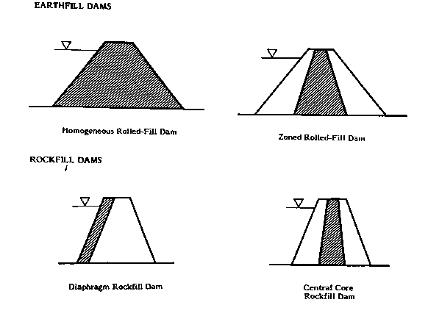
Geotechnical Aspects of Dam Safety
Types of Embankment Dams
Notes:
Four kinds.

Slide 12
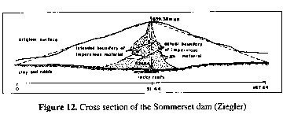
Geotechnical Aspects of Earth Dams- Hydraulic Fill Dam
Notes:
Hydraulic fill dams were constructed by using water for transporting embankment material to its final position in the dam.
In this method of construction, the material is discharged from pipes along the outside edges of the fill. Coarser material is deposited soon after discharge, while the fines are carried into the central portion of the fill. The result is a zoned embankment with a relatively impermeable core.
Several problems are inherent to this type construction. Because of the slow drainage of water from the core, considerable settlement over a long period of time is expected. Also, this type construction leaves a relatively loose soil structure that is subject to liquefaction.
Hydraulic Fill construction was economical prior to the advent of large earth moving and compaction equipment.
The advent of this equipment made practical the construction of modern rolled-fill embankments.

Slide 13
Geotechnical Aspects of Earth Dams
Failure Modes
Cause Failures Incidents Total
Embankment Piping 23 14 37
Foundation Piping 11 43 54
Overtopping 18 7 25
Flow Erosion 14 17 31
Sliding 5 28 33
Deformation 3 29 32
Slope Protection Damage 0 13 13
Deterioration 2 3 5
Gate Failure 1 3 4
Earthquake Instability 0 3 3
Faulty Construction 0 3 3
Notes:
Historical Data of Embankment Dam Failures and Accidents to 1979 for Dams of Heights to Feet or Greater.
Source-Development of Dam Engineering in the US by E. B. Kollgaard and W. L. Chadwick, 1988.

Slide 14
Geotechnical Aspects of Earth Dams
Failure Modes (Cont.)
Piping
  Along outlet conduits
  Through cracks across the impervious core
  Inadequately compacted core material at contact with uneven surfaces
  In zones susceptible to erosion within the foundation
Overtopping
  Inadequate spillway capacity
  Large, rapid landslides in the reservoir
  Too little freeboard
Notes:
A Dam as a sloping ground surface wants to move downward and outward under the influence of gravity, i.e. sag.
Often rapid failures are preceded by a period of slow movements. Therefore, it pays to review the instrument data periodically to recognize a stability problem in the early stages of its development.
Failures due to subsurface erosion are catastrophic. They occur with little warning, usually at full reservoir, and occasionally many years after the reservoir is first put into operation.

Slide 15
Geotechnical Aspects of Earth Dams
Failure Modes (Cont.)
Slope Failure
  Design deficiencies
  Neglected remedial actions
Instability
  Excessive deformations
  Excessive stresses
  Excessive loss of materials due to erosion
Notes:
Design deficiencies-upstream slope too steep for sudden drawdown; crest width too narrow, inadequate seepage control and collect; poorly compacted soils.
Neglected remedial actions-drainage features, vegetation, animal borrows.
Earthquakes can cause sloughing (flow like movements) and loss of freeboard which increases chance for overtopping.
Landslides along the reservoir rim can cause waves which may overtop the dam. Vaiont Dam, Italy.
Transverse cracking allows water to flow through can lead to dam failure by erosion.
Poor compaction along conduits or open joints in conduits allows flow that can induce erosion.

Slide 16
Geotechnical Aspects of Earth Dams
Failure Modes (Cont.)
Earthquake conditions
  Excessive deformation
  Excessive pore pressure buildup
  Sudden densification of loose, saturated, non-cohesive soils that causes rapid build-up of pore fluid pressures
Notes:
Mentioned EQ aspect discussed by Joe Koester.

Slide 17
Geotechnical Aspects of Earth Dams
Technical Requirements
Dam and foundation must be sufficiently watertight and have adequate seepage control for safe operation
Must have “sufficient spillway and outlet capacity” as well as “adequate freeboard” to prevent over topping by the reservoir
Must be stable under all loading conditions
Notes:
The structural safety of an embankment dam is dependent primarily on:
the absence of excessive deformation and pore fluid pressure build-up under all conditions of environment and operations,
the ability to safely pass flood flows,
and the control of seepage to present migration of materials and thus preclude adverse effects on stability.

Slide 18
Geotechnical Aspects of Earth Dams Seepage
Seepage through the foundation or abutments causing piping or solutioning of rock
Seepage through embankments, along conduits, or along abutment contacts causing piping or internal erosion
Notes:
2
Water stored behind a dam always seeks to escape or flow along a path of least resistance.
There are four basic seepage problems, all which can lead to failure. (Intergranular seepage-flow thru pores.)
Piping-Intergranular seepage that results in erosion (low or non-plastic soils.
Piping occurs when water moving through pores of the soil exerts a tractive force on the soil particles through which it is flowing sufficient to remove them at the exit point.
The removal of soil moves progressively upstream, forming the characteristic pipe from which the phenomenon derives its name.
Internal erosion-Flow thru cracks that result in erosion (plastic soils)
Solutioning of soluble rock
Internal pressure and/or saturation
Most common causes:
Poor construction
Inadequate compaction
Failure to provide or meet filter criteria
Lack of adequate treatment at the contact between the dam and foundation abutments.

Slide 19
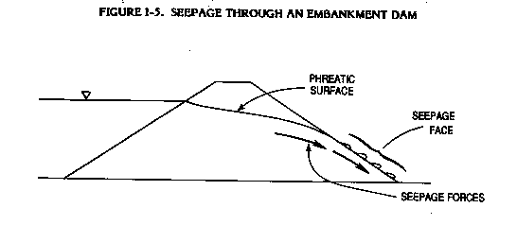
Geotechnical Aspects of Earth Dams Through Seepage
Notes:
Example of phreatic surface.

Slide 20
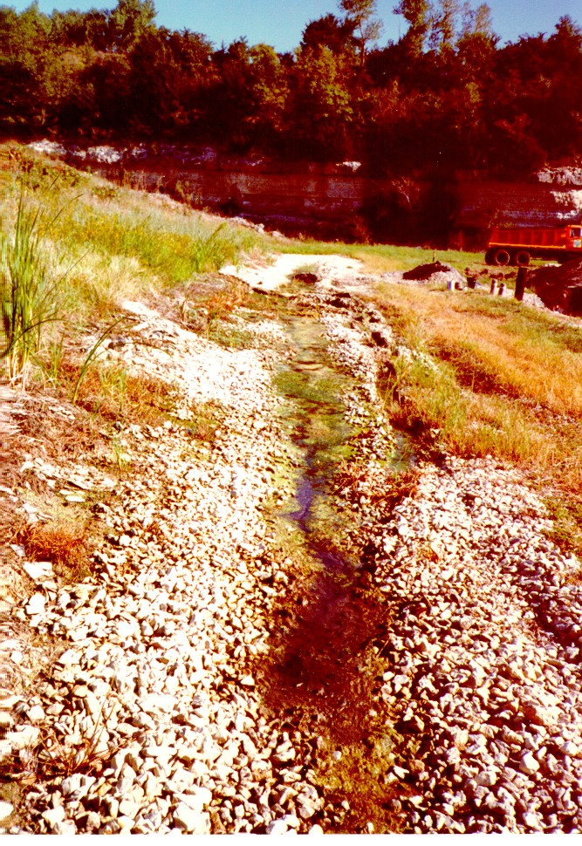
Geotechnical Aspects of Earth Dams Milford Dam, KS
Notes:
Picture stretched in horizontal direction.

Slide 21
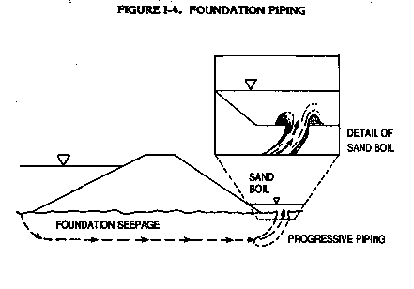
Geotechnical Aspects of Earth Dams Foundation Seepage
Notes:
Schematic of boil mechanism. Prominent in low/non-plastic soils. Common in levees along Mississippi and American Rivers.

Slide 22
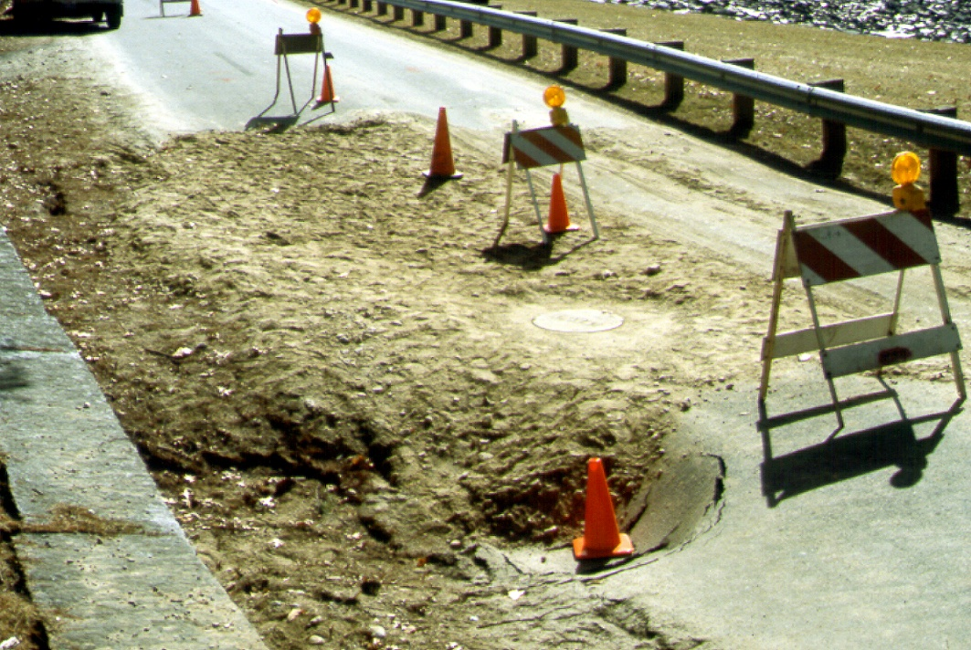
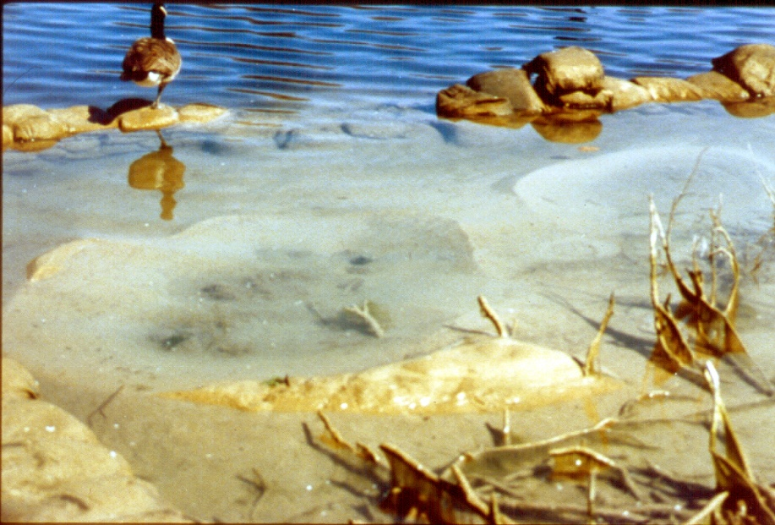
Geotechnical Aspects of Earth Dams- Hodges Village Dam - Seepage

Slide 23
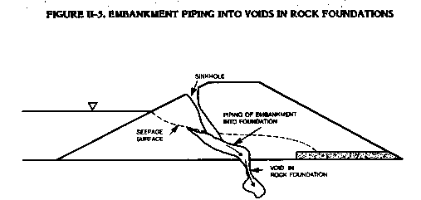
Geotechnical Aspects of Earth Dams
Piping Into Voids
Notes:
The type of seepage illustrated above is difficult to detect since nothing is visible until the embankment starts to collapse, or until a vortex appears in the reservoir.
A vortex is the rotational movement that will appear as the water rapidly enters the foundation, same action as pulling the plug in the bathtub.
If you happen to be in a boat, get out of there.

Slide 24
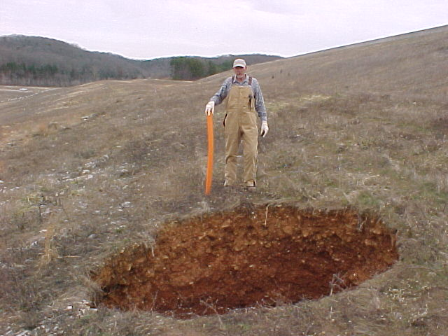
Geotechnical Aspects of Earth Dams
Sink Hole, Clearwater Dam, MO

Slide 25
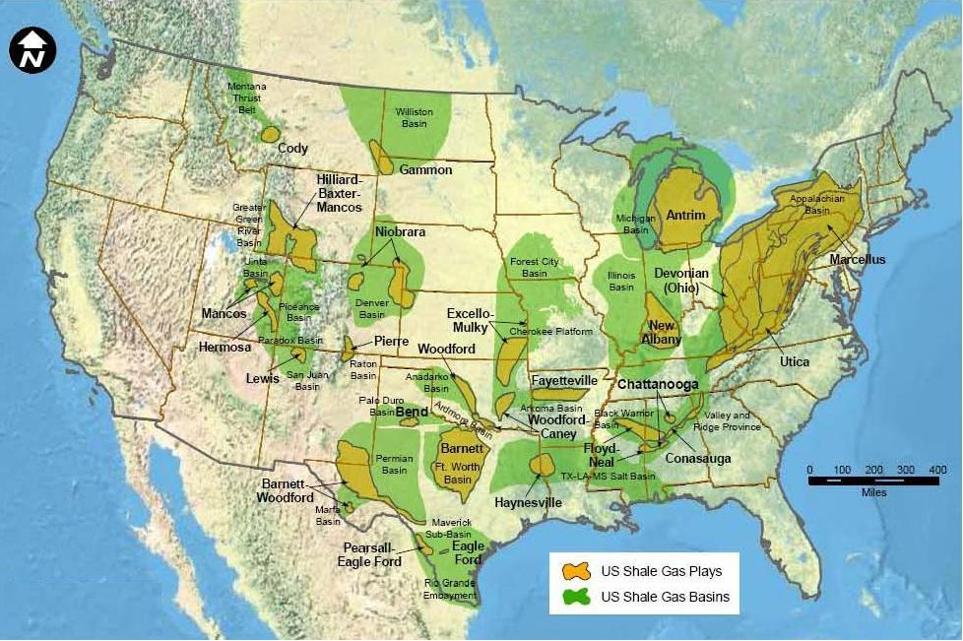

Slide 26
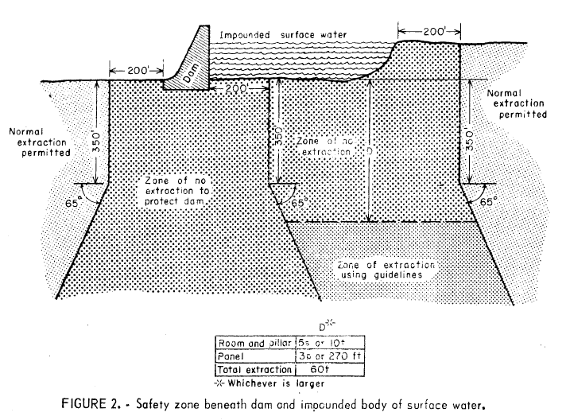

Slide 27
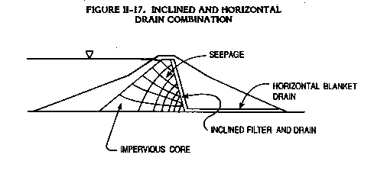
Geotechnical Aspects of Earth Dams
Internal Drains
Notes:
Example of internal chimney and blanket drain.

Slide 28
Geotechnical Aspects of Earth Dams Blanket Drain Exit
Embankment
Gravel swale
Blanket Drain
Foundation
Proper configuration – facilitates free drainage
Notes:
Emphasize the need to keep open and functioning.

Slide 29
Geotechnical Aspects of Earth Dams
Blocked Drain Exit
Embankment
Swale
Blanket Drain
Foundation
Improper configuration – blocks drainage
Notes:
Example of neglected maintenance or remedial repairs.

Slide 30
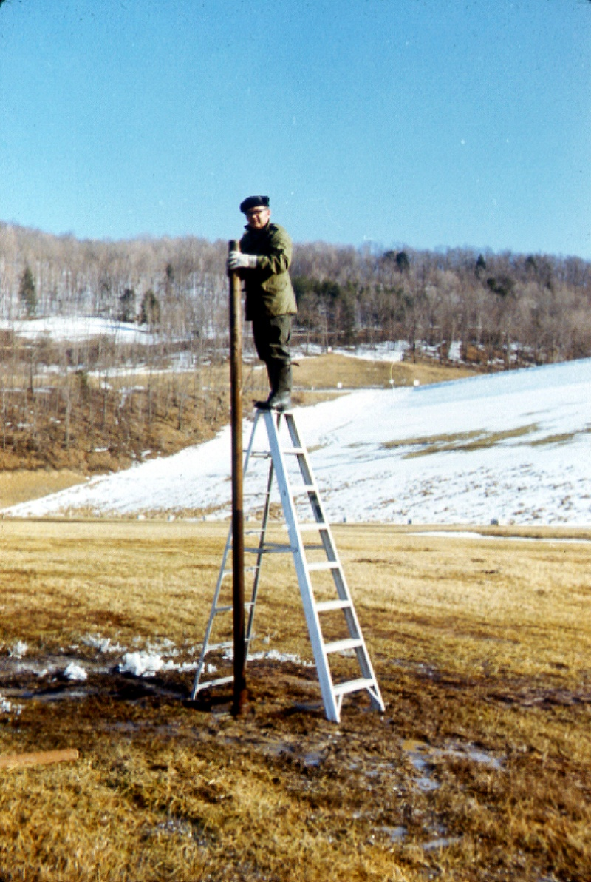
Geotechnical Aspects of Earth Dams- Uplift in Rock and Seepage
Notes:
Curwensville Dam, PA

Slide 31
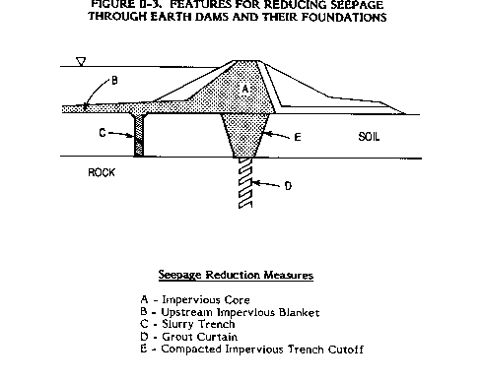
Geotechnical Aspects of Earth Dams Seepage Reduction Measures
Notes:
Go down list o measures to control leakage.
Add toe trenches and relief wells-see next slide.

Slide 32
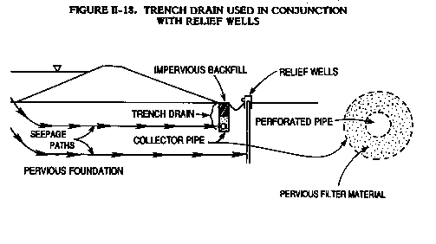
Geotechnical Aspects of Earth Dams
Toe Drains and Relief Wells

Slide 33
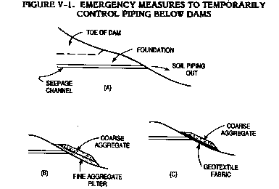
Geotechnical Aspects of Earth Dams
Emergency Repairs
Notes:
Example of how to treat seepage exiting an embankment. Mention heroic measures.
Fabric for short term solution only. Clog.

Slide 34
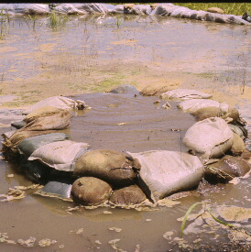
Geotechnical Aspects of Earth Dams Emergency Repair for Boils
i = h / l
Notes:
2
Example of emergency treatment for boil.
Sand bag to contain sediment and increase downstream pool elevation. Reduces head driving the boil.

Slide 35
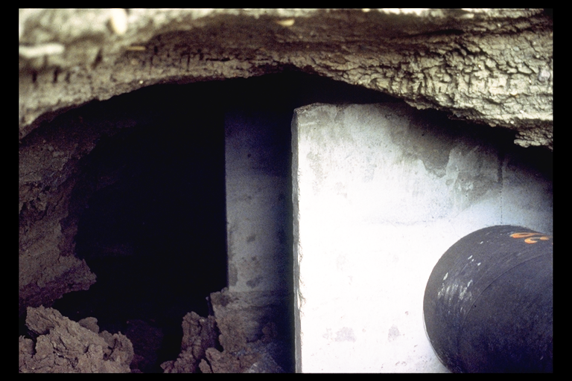
Geotechnical Aspects of Earth Dams Conduits
Seepage collars – designers thought they would stop seepage
Notes:
2
Prior to 1970, seepage collars were used on several projects. Experienced problems with inadequate compaction and or inadequate drainage
Guidance to eliminate seepage collars and add appropriate filters and drainage - 1971

Slide 36
Geotechnical Aspects of Earth Dams
Filter Design
Facilitates the controlled flow of water and prevents movement of soil particles
  Collection and control
  Adequate carrying capacity
  Prevents migration of fines
Criteria
  Permeability
  Stability
Notes:
2
Filters retain protected material, allow relatively free movement of water, and have sufficient discharge capacity.

Slide 37
Geotechnical Aspects of Earth Dams
Slope Stability
Type slopes
  Embankment slopes
  Cut slopes
  Reservoir rim slopes
Failure modes
  Shallow Slide
  Deep Slide
  Wedge (Block) Slide
Notes:
2
Review type slopes
Failure modes in following slides.

Slide 38
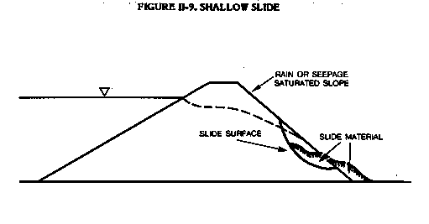
Geotechnical Aspects of Earth Dams Shallow Slide
Notes:
Within the slope.

Slide 39
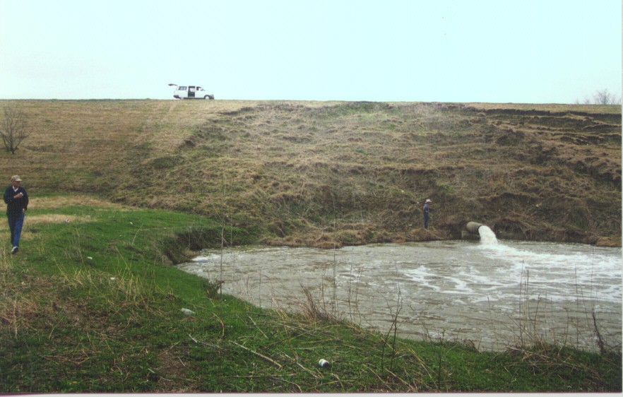
Geotechnical Aspects of Earth Dams
Shallow Slide
Notes:
2
Example of shallow slide.

Slide 40
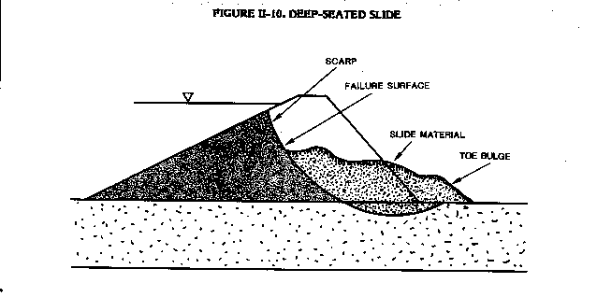
Geotechnical Aspects of Earth Dams
Deep Slide
Notes:
Extends into the foundation.

Slide 41
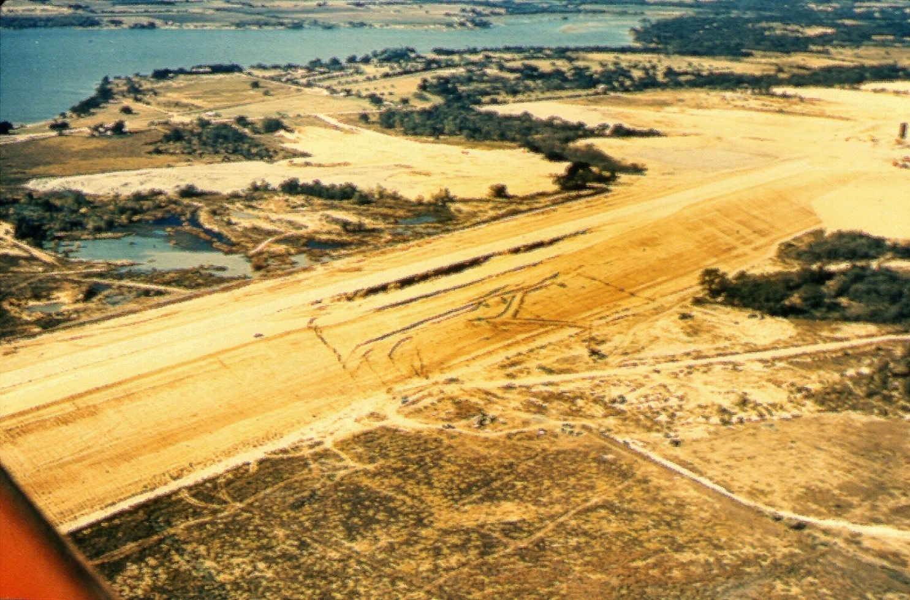
Geotechnical Aspects of Earth Dams Waco Dam, TX
Notes:
Example of deep slide. Looks the same, but note displacement in downstream area.

Slide 42
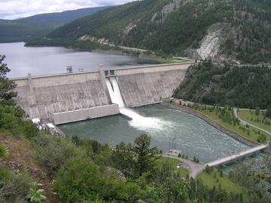
Geotechnical Aspects of Earth Dams
Abutment Slide, Libby Dam, MT
Reservoir Rim Slides
Notes:
Example of abutment/reservoir rim slide.

Slide 43
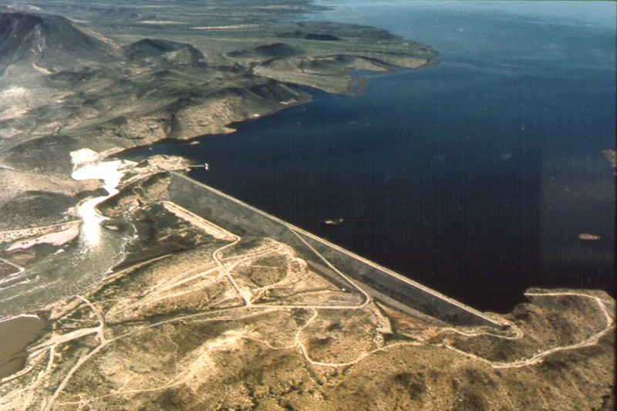
Geotechnical Aspects of Earth Dam
Spillway Erosion
Painted Rock Dam, AZ
Notes:
Example of spillway erosion, February 1993.
Recent Texas floods, erosion block downstream area causing floodwaters to back-up.

Slide 44

Earthquake Aspects of Dam Safety

Slide 45
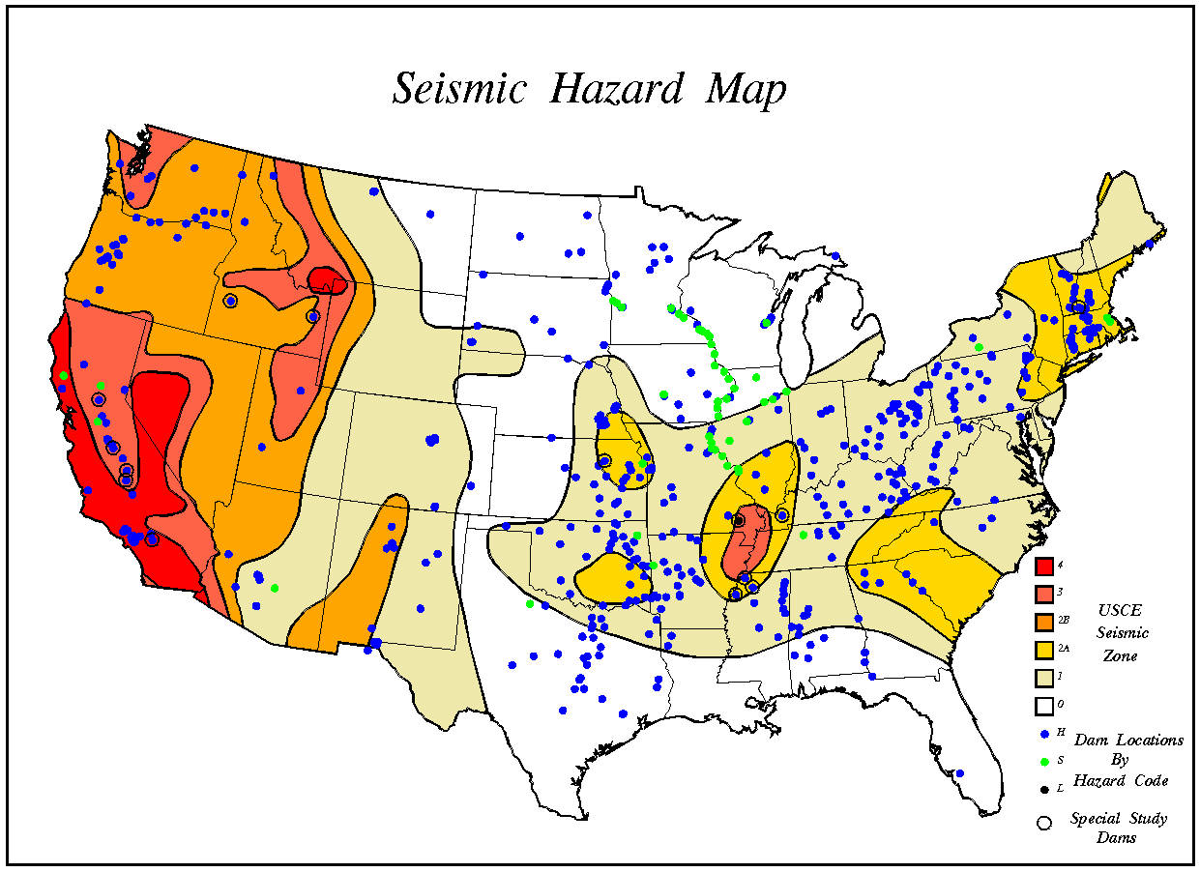
Earthquakes & Dams
162 COE dams in high seismic areas (2 and above) subject to damage
Most built in 1940’s and 1950’s with no seismic design
Seismic design for liquefaction came into practice in the late 1970’s early 1980’s
4
3
2
1
0
Location of Embankment Dams
Low hazard to life & property
Seismic Zones
High hazard to life & property

Slide 46
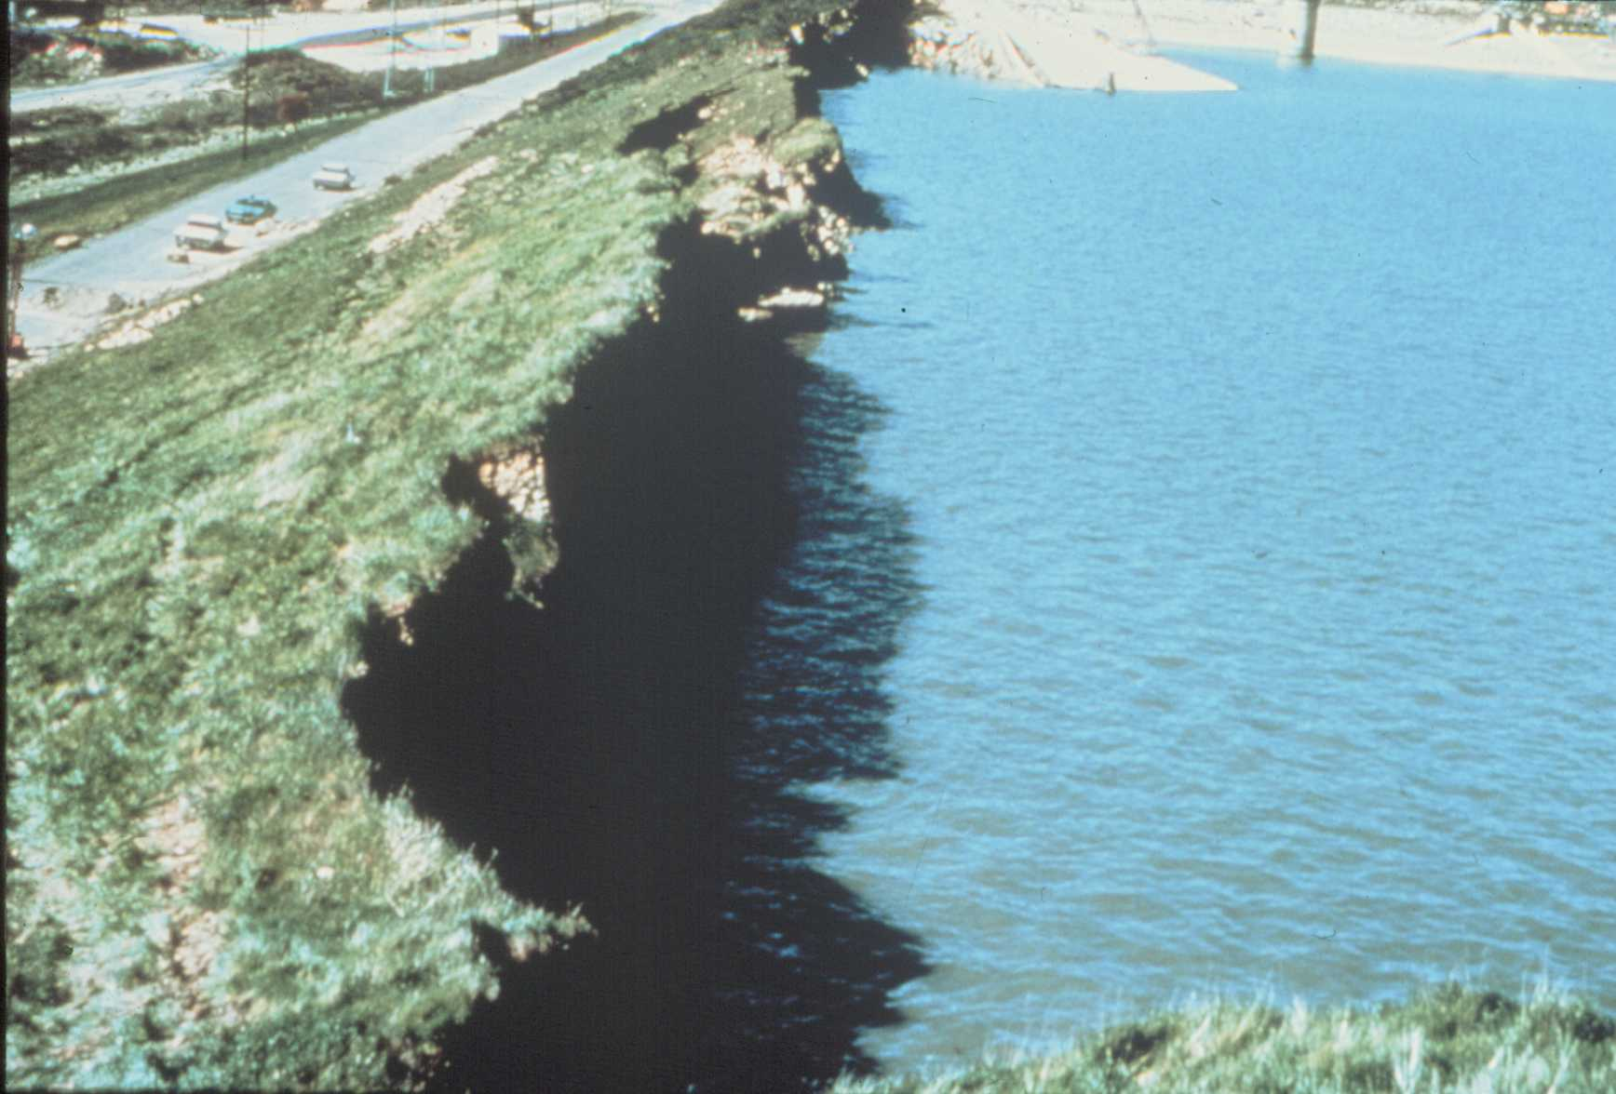
Earthquake Engineering
Seismic dam safety
becomes a priority
Near failure of Lower San Fernando Dam
San Fernando Earthquake - 1971

Slide 47
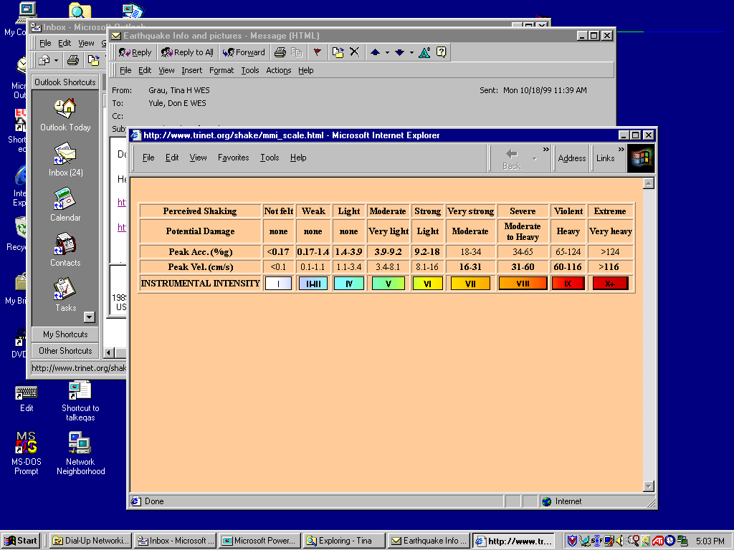
Earthquake Size
Intensity Scale Damage based
Modified Mercalli I-XII
Magnitude Scales (Instrumental) Energy based
Richter M 1-9
Local ML
Surface Wave Ms
Moment Mw

Slide 48
Comparison of earthquake energy release to the seismic energy yield of quantities of the explosive TNT
Richter TNT for Seismic Example
Magnitude Energy Yield (approximate)
-1.5 6 ounces Breaking a rock on a lab table
1.0 30 pounds Large Blast at a Construction Site
1.5 320 pounds
2.0 1 ton Large Quarry or Mine Blast
2.5 4.6 tons
3.0 29 tons
3.5 73 tons
4.0 1,000 tons Small Nuclear Weapon
4.5 5,100 tons Average Tornado (total energy)
5.0 32,000 tons
5.5 80,000 tons Little Skull Mtn., NV Quake, 1992
6.0 1 million tons Double Spring Flat, NV Quake, 1994
6.5 5 million tons Northridge, CA Quake, 1994
7.0 32 million tons Hyogo-Ken Nanbu, Japan Quake, 1995; Largest Thermonuclear Weapon
7.5 160 million tons Landers, CA Quake, 1992
8.0 1 billion tons San Francisco, CA Quake, 1906
8.5 5 billion tons Chilean Quake, 1960
10.0 1 trillion tons (San-Andreas type fault circling Earth)
12.0 160 trillion tons (Fault Earth in half through center)
160 trillion tons of dynamite is a frightening yield of energy. Consider, however, that the Earth
receives that amount in sunlight every day.

Slide 49
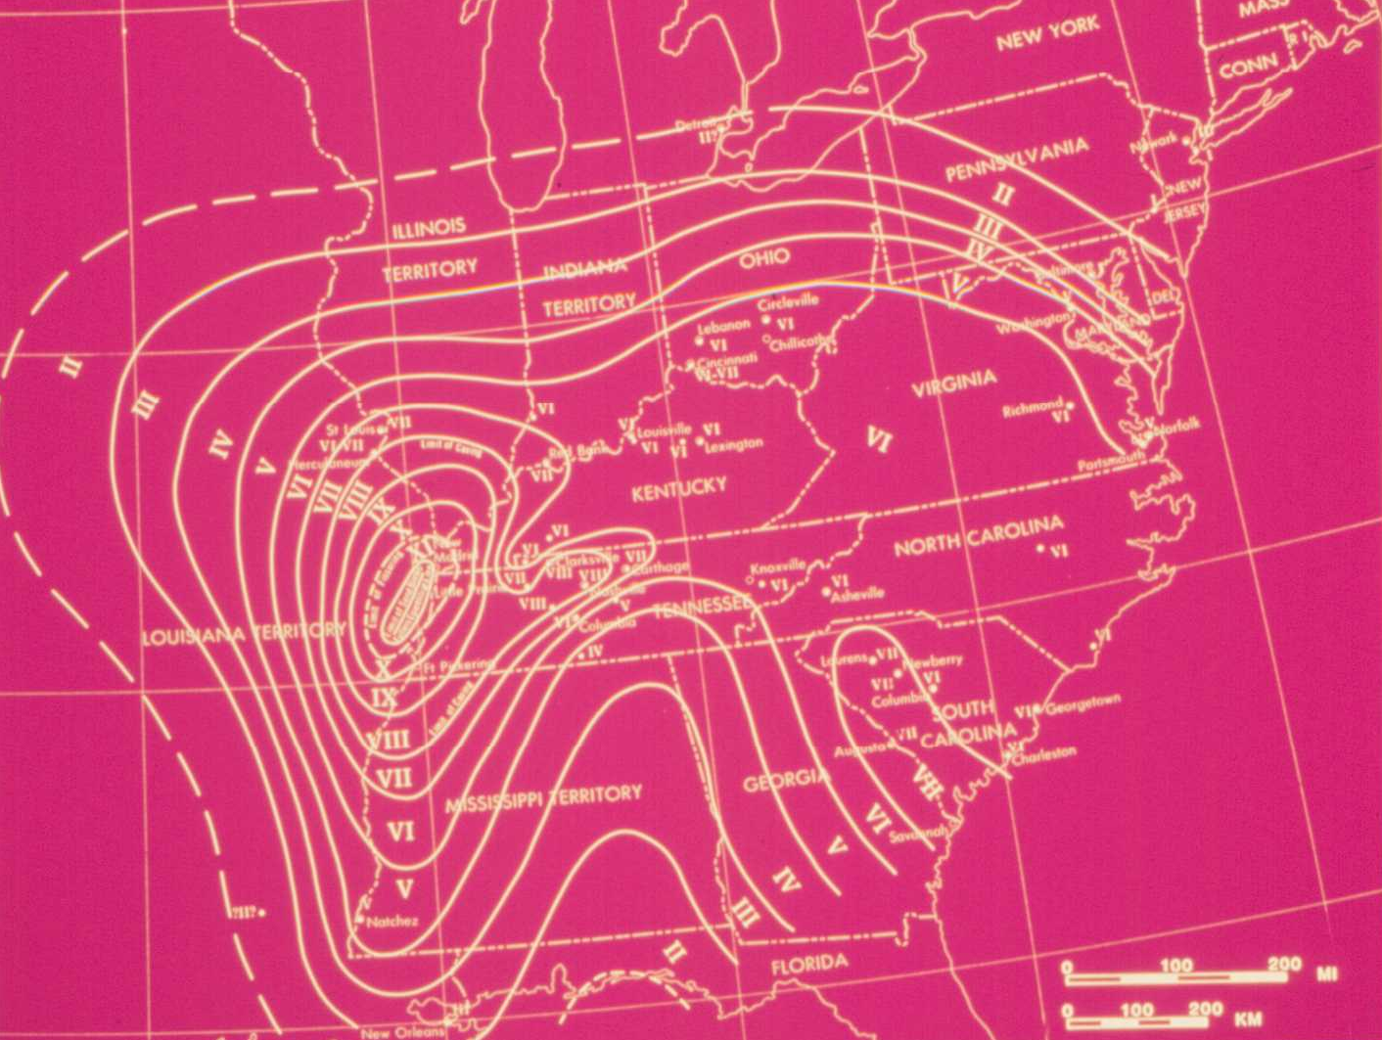
New Madrid Earthquakes, 1811-1812 (Isoseismals)

Slide 50
Earthquake Effects
Transient loading or shaking
Changes material properties
Settlement
Liquefaction
Permanent ground displacement
Dynamic response
  Each thing has it own shaking response

Slide 51
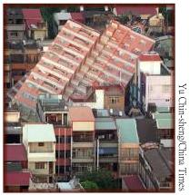
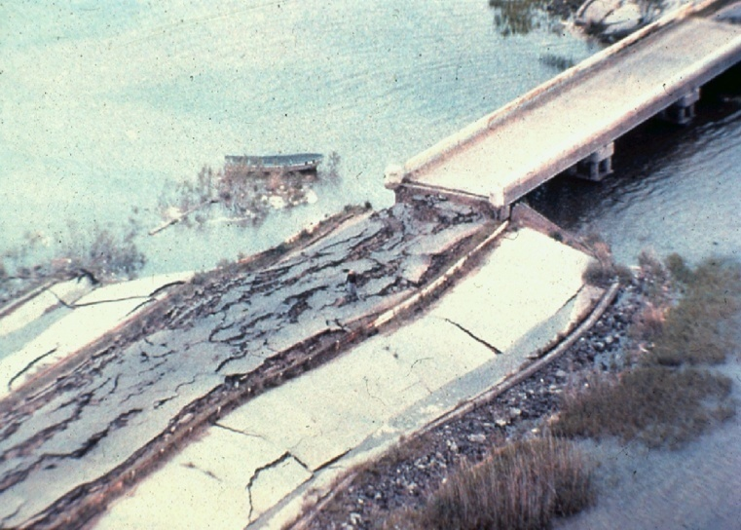
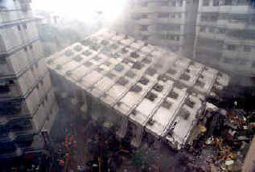
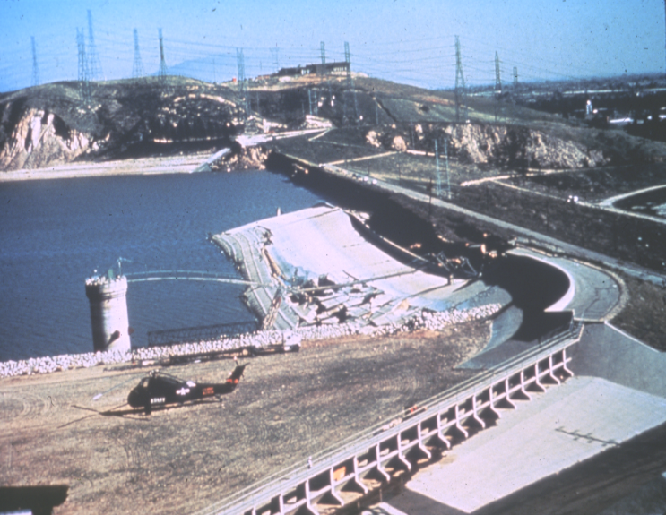

Problem: Earthquake Induced Liquefaction Causes Failures
Buildings
Bridges
Slide in Lower San Fernando Dam - 1971
Dams

Slide 52
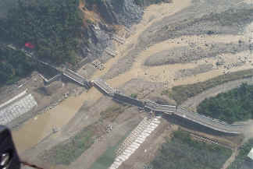
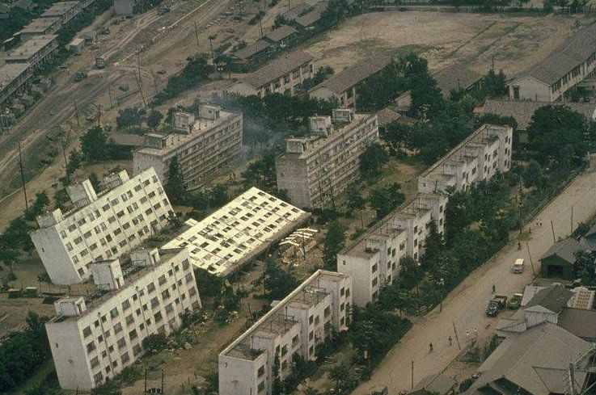
Earthquake Effects
Liquefaction
  Sand boils
  Settlement
  Slope failures
Alluvial valleys often involve liquefiable materials

Slide 53
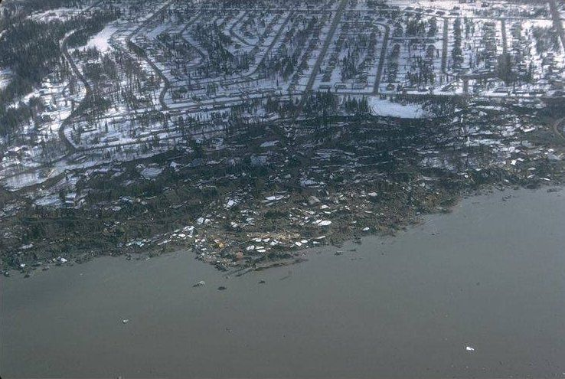
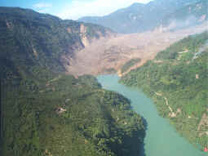
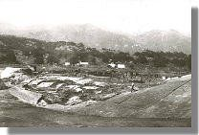
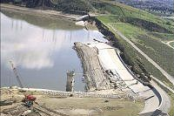
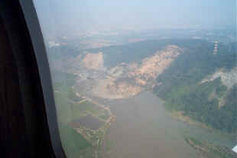
Earthquake Effects
Liquefaction
  Sand boils
  Settlement
  Slope failures

Slide 54
Seismic Failure Mechanism

Slide 55
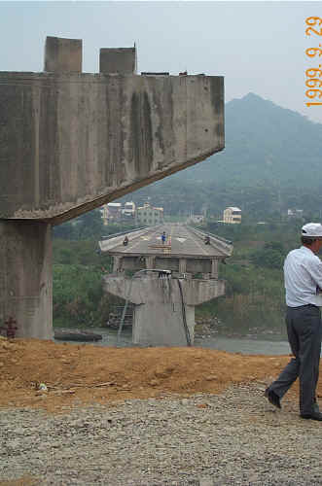
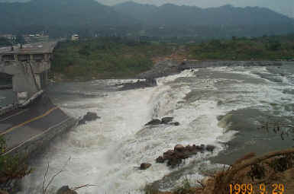
Earthquake Effects
Permanent Ground Displacement
>15 ft of thrust faulting created this waterfall and destroyed the bridge (Chi Chi Earthquake, Taiwan, 1999)

Slide 56
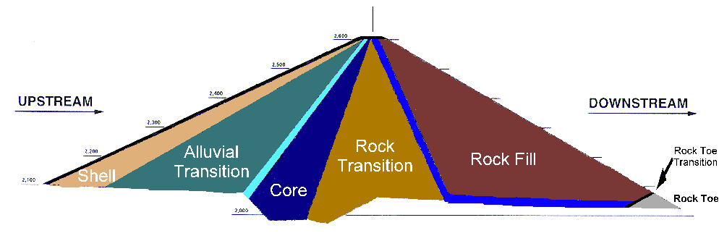
Seismic Considerations in Dam Design
Freeboard design pools, analysis -> design geometry
Crack stoppers filters, transition zones, drains, material properties
Seepage & pore relief well, weep holes
pressure control
Foundation stability siting, in situ: replacement, improvement
Embankment stability deformation and dynamic material properties

Slide 57
Possible Earthquake Induced Modes of Failure
Disruption of dam/levee by fault movement in foundation
Loss of freeboard due to settlement or differential tectonic ground movements
Slope failures induced by ground motions
Sliding of dam/levee on weak foundation materials
Piping failure through cracks induced by ground movements
Overtopping of dam/levee due to seiches in waterway
Overtopping of dam/levee due to slides or rockfalls into waterway

Slide 58
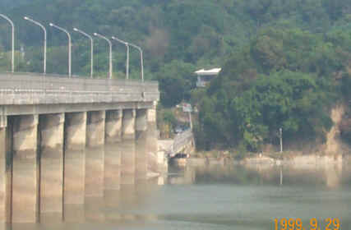
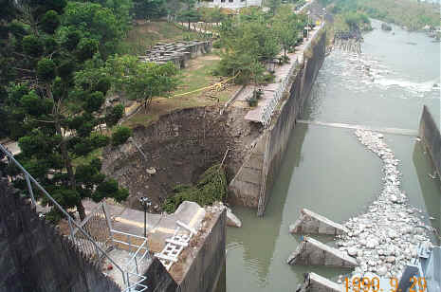
Dams Damaged by Earthquakes
Taiwan earthquake

Slide 59
Dams Failed by Earthquakes
Sheffield Dam, CA
  Santa Barbara Eqk 1925, M=6.3 @ 7 mi distance
  Slide failure induced by liquefaction
Izu Tailings Dams, Japan
  Earthquakes in 1978, M=7 and 5.7
  Slide failures induced by liquefaction
World Total: 3 Dams

Slide 60

Earthquake Performance of Dams
Well built dams usually survive strong earthquake loading
- Kirazdere Dam
100 m height dam
10 km from epicenter, M=7.4
Izmut Turkey Eqk 1999

Slide 61
Vulnerability Assessment
(Phased approach, to be detailed in upcoming new EM 1110-2-6001)
Seismic vulnerability of levees and dams are similar and are evaluated as such
  Liquefaction triggering analysis
  Seismic slope stability analysis
  Post-earthquake stability analysis
  Deformation analysis, if warranted

Slide 62
Inspection After Earthquake
(paraphrased from USSD Guidelines for Inspection of Dams After Earthquakes, 2003)
If an earthquake is felt at or near the dam (levee), or has been reported to occur, with:
  M ≥ 4.0 w/in 25 miles,
  M ≥ 5.0 w/in 50 miles,
  M ≥ 6.0 w/in 75 miles,
  M ≥ 7.0 w/in 125 miles, or
  M ≥ 8.0 w/in 200 miles, …immediate inspection is indicated.

Slide 63

Thank You !

