Slide 1

Dam Construction Alternatives
Site Specific Matrix
Jason Butler
3/4/2011

Slide 2
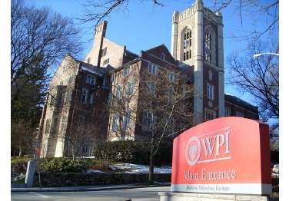
Worcester Polytechnic Institute
Civil & Environmental Engineering
Major Qualifying Project (MQP)
Stantec Project Center
  Project Advisors:
    Professor Frederick Hart
    Professor Suzanne Lepage
  Stantec Consulting Service Inc. mentors
    Daniel Gilbert
    Greg Yankey
    Brad Smiley

Slide 3

Project Scope
Develop an understanding of dam construction alternatives:
  Concrete-Filled Cellular Sheet Pile Cells
  Float-In
  Roller Compacted Concrete
Develop a user friendly site specific matrix for selection of appropriate dam construction alternative

Slide 4

Project Deliverables
Overview of three dam construction alternatives
Capstone Design Project
  Design a site specific dam construction matrix
  Calibrate matrix at previous dams built
  Apply matrix to future dam projects

Slide 5
Concrete-Filled Cellular Sheet Pile Cell Construction
In-the-wet construction
Permanent cofferdam structure
Tremie concrete pour
Cost and schedule saver
Accommodates to irregular rocklines
Suitable for volatile rivers

Slide 6
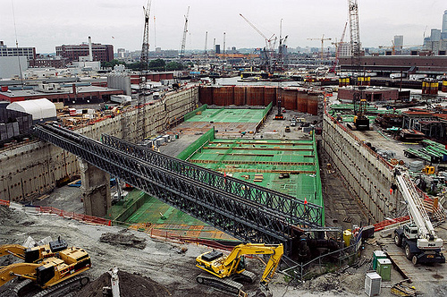
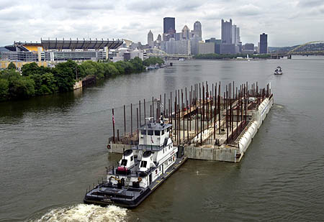
Float-In Construction
In-the-wet construction
Prefabrication of dam segments created at offsite location
Casting basin or launch facility
Large construction equipment
Extensive underwater diver work

Slide 7
Roller Compacted Concrete Construction
In-the-dry construction
Temporary cofferdams
Dewatering required
Rapid placed concrete
Construction completed in stages
Optimize dams geometry

Slide 8
Matrix

Slide 9
Calibration of Matrix
Kentucky River Lock and Dam No. 9 (Cell)
Braddock Dam (Float-In)
McAlpine Dam (RCC)

Slide 10
Application to Future Projects
Kentucky River Lock and Dam No. 8
  Currently under design process approval
Matrix Results:
  Concrete-Filled Cellular Sheet Pile Cells

Slide 11
Application of Matrix
Gain basic knowledge about dam construction
Useful for clients to choose appropriate dam construction technique to use at specific location
Entry-level engineers can use as a reference to get on board with the project quicker
Serves as useful information on dam construction topics to allow clients and engineers to be on the same page

Slide 12

Questions?

