Slide 1
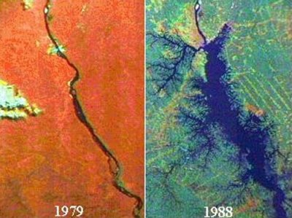
Land-use and Land-cover Change Issues Related to Dams
Tucurui
Stephanie Bohlman and Michael W. Binford
Department of Geography
University of Florida
Image source: http://www.internationalrivers.org/
Notes:
Tag-team: Stephanie made me do this. I’ll be very brief, but cover a lot of material very superficially. My main point is that there is an astonishing lack of research about how creation of dams and reservoirs affects land-use and land-cover. There is a lot of anecdote but few systematic studies.
Hadn’t paid attention to this for over a decade, then was astonished to find out that big dams were still an issue.
World Bank by mid-1990’s had adopted environmental and social regulations and done economic analyses that indicated that large dams were not a great way to spur general national development. THE WB Slowed or even stopped funding them.
As recently as 2002 academics were saying that the era of big dams was over – reduced international funding, environmental and social impacts too great, all of the “head” was used up.
Didn’t count on the economic rise of many countries to the point that they could finance their own. Shouldn’t have been such a surprise because mega projects were envisioned many years ago – e.g. Three Gorges in China first proposed during Mao Zedong’s day.
At any rate, from studies done on hundreds of cases of large dam building in all parts of the world, we know an enormous amount about what happens, but little about how the land is actually changed.
The next few minutes will be a very rapid tour through the land-use and land-cover consequences of building large dams, including something about how the land-use/land-cover changes influence the effectiveness of the dams and reservoirs.

Slide 2
Land-use/Land-cover Change
Notes:
The touchstone paper about LULCC in the tropics –
This indicates to me that
Lambin, E., H.J. Geist, E. Lepers. 2003. Dynamics of land-use and land-cover change in tropical regions. Annu. Rev. Environ. Resour. 28:205–41
Three references to « dams », none as real case studies.
Scholar Google: Since then, 36 papers with « dam » or « reservoir » in the text have cited Lambin et al. 2003. (of over 600).
One of these papers directly studied the effect of dam/reservoir on LULCC – people were attracted, forest was cleared in Chiapas, Mexico (Sandoval et al. 2007 Biol. Conserv.).

Slide 3
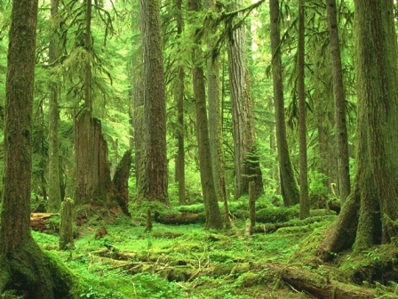
Land Cover Definition
(Bio)physical description of the earth's surface. For example: vegetation (trees, bushes, fields, lawns), bare soil, hard surfaces (rocks, buildings) and wet areas and bodies of water (watercourses, wetlands).
Directly observable

Slide 4
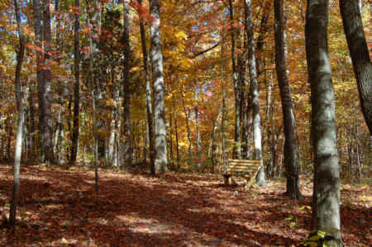
Land Use Definition
The socio-economic description (functional dimension) of areas: areas used for residential, industrial or commercial purposes, for farming or forestry, for recreational or conservation purposes, etc.
Not directly observable, but can sometimes be
inferred from land cover.
http://forestry.tennessee.edu/ORForest.html
Notes:
Row crops land cover = agriculture land use.

Slide 5
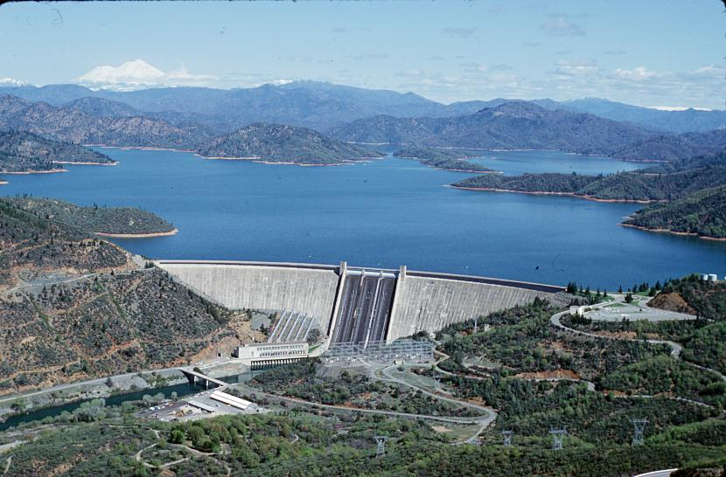
One More Issue of Terminology
http://www.asianews.it/news-en/Chinese-dams-on-the-Brahmaputra-threaten-lives-of-Indians-and-Bangladeshis-21869.html
Dam: the structure across a river that retains water.
Reservoir: artificial lake created by a dam.

Slide 6
“Large ” Dam Definition
Large dams have embankment height of more than 15 meters or storage volume exceeding 3 million m³.
A mean depth of 10 m in the reservoir suggests minimum surface area of 300,000 m² covered by water, or less than 1 km².
ICOLD definition

Slide 7
Global Database of Dams
http://sedac.ciesin.columbia.edu/theme/land-use/maps/gallery/set/grand-v1-dams-rev01
Notes:
400,000 km² surface area in reserviors
Should be no surprises – this is an enormous amount of experience and has been contested
Also, note big gaps.

Slide 8
Purposes of Dams
48% are for irrigation
17% for hydropower, mostly hydroelectric
13% for water supply
10% for flood control
5% for recreation
<1% for navigation and fish farming.
ICOLD http://www.icold-cigb.net/GB/Dams/Role_of_Dams.asp
ALL OF WHICH HAVE LU/LC IMPLICATIONS!

Slide 9
What Happens to Land when a Dam Is Built?
People who live in area that will be covered by the reservoir must move - resettlement.
Owners in good land-tenure countries are compensated and move elsewhere, usually to nearby cities.
Inhabitants in rural areas or informal settlements in most countries are either evicted or resettled.
Resettlement programs have been conducted for decades, some successfully
Future dams will probably spur more rural-urban migration, already underway for several generations
Land cover in reservoir area cleared (seldom)
Construction sites and housing built for workers and support populations
When reservoir is filled, people are attracted to water
Transportation
Agriculture – irrigation, access to markets (large corporations)]
Subsistence – Haiti – upstream settlement -> deforestation -> reservoir sedimentation
Recreation – infrastructure and access
Full reservoir inundates former floodplains and riparian areas
Inundates fertile bottomland soils
Removes riparian corridor for organism movement, sediment/biogeochemical function
Formerly terrestrial land is inundated, either permanently or intermittently
Afforestation – some nations have programs in upstream parts of the basin to reduce erosion
Downstream:
flow moderated, people plant or build in previous floodplains
Fertile soils in former floodplain
Subject to catastrophic flooding – dam failure happens!
Flow moderated, earlier livelihood methods based on flooding can be lost (Egypt, Cambodia)
Drought mitigation (Egypt, Thailand)
Flood mitigation (Vietnam Mekong Delta)
MORE
Notes:
It doesn’t take much imagination to think through all the things that happen when a dam and reservoir is built.
All of these events are described in the literature.
But, there is NO systematic study of any of these from a land-use/land-cover perspective, except for the resettlement issues.
Many studies of water quality in reservoirs
(Tony said 2 successes, Scudder actually described 3 successes – 50% more than Tony said).

Slide 10
Resettlement
Notes:
To date, over 400,000 km² of the earth have been flooded due to damming
People who live in area that will be covered by the reservoir are moved.
Owners in good land-tenure countries are bought out and move elsewhere, usually to nearby cities.
Inhabitants in rural areas or informal settlements are either evicted or resettled.
Resettlement programs have been conducted for decades
Future dams will probably spur more rural-urban migration, already underway for several generations

Slide 11
Resettlement
New land allocated to resettlement
Rural inhabitants to other agricultural lands?
China Three Gorges – 42.7% rural of 1.3 million (6 million?) displaced
Deforestation upstream cause of increased flooding, so agricultural resettlement could not be upstream (Tan and Yao 2006) but must be distant.
Informal resettlement
Migration to urban areas
Notes:
Three Gorges, China: 1.3 million people, 42.7% rural (Tan and Yao 2006).
It was not until 1998 that the Chinese government appreciated that deforestation in
the upper reaches of the Yangtze was one of the principal causes of the serious
floods in the Yangtze catchment in 1998. Subsequently, the Government determined
that opening up land in these areas to accommodate resettlement must be prohibited.

Slide 12
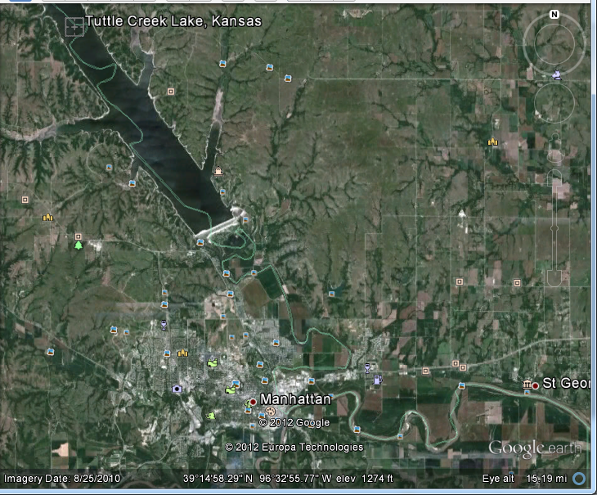
Downstream
Flow moderated, people plant or build in previous floodplains
Fertile soils in former floodplain
Tuttle Creek Reservoir, near Manhattan, KS

Slide 13
Downstream
Flow moderated, people plant or build in previous floodplains
Subject to catastrophic flooding

Slide 14
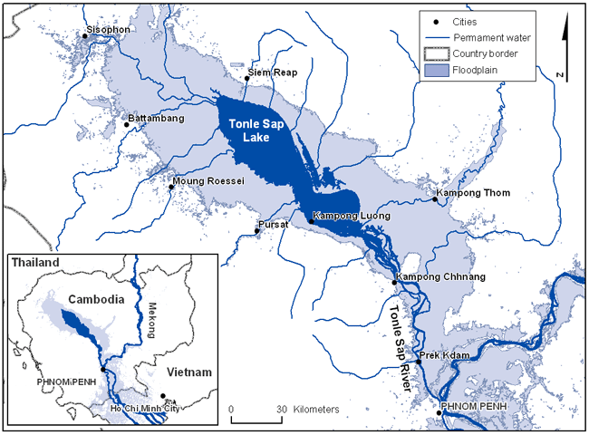
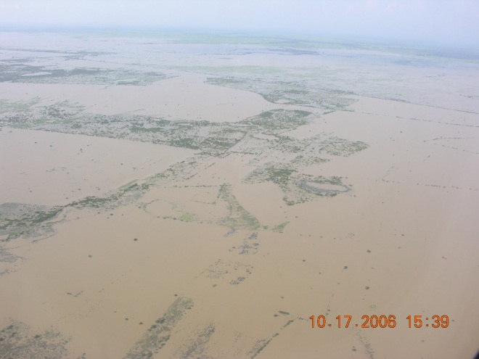
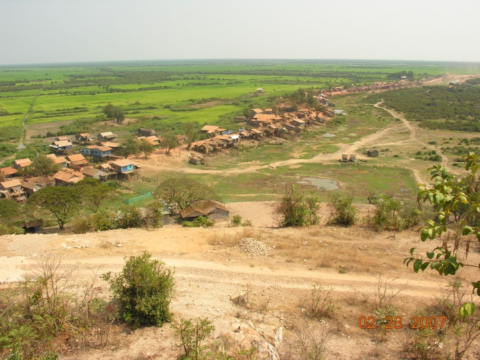
Downstream
Flow moderated, earlier livelihood methods based on flooding can be lost (Egypt, Cambodia)
Tonle Sap Lake and Mekong
http://www1.american.edu/ted/ice/mekong-china.htm
Notes:
Case studies
The Manatali reservoir formed by the Manantali dam in Mali intersects the migration routes of nomadic pastoralists and destroyed 43000 ha of savannah, probably leading to overgrazing and soil erosion elsewhere. Further, the reservoir destroyed 120 km² of forest. The depletion of groundwater aquifers, which is caused by the suppression of the seasonal flood cycle, is damaging the forests downstream of the dam.^{[9]}
In the case of the Lower Omo River, Ethiopia, hundreds of thousands of nomads will be affected because the flood recession agriculture on which their livelihoods are based would disappear once the Gibe III dam will be completed.
After the closure of the Kainji dam, Nigeria, 50 to 70 per cent of the downstream area of flood-recession cropping was lost.^{[10]}
SO, in the Amazon, how has the riparian or floodplain system adapted to seasonal hydrological fluctuation? We know a lot about the seasonal cycle – how will the dams alter downstream flows and systems, including human?

Slide 15
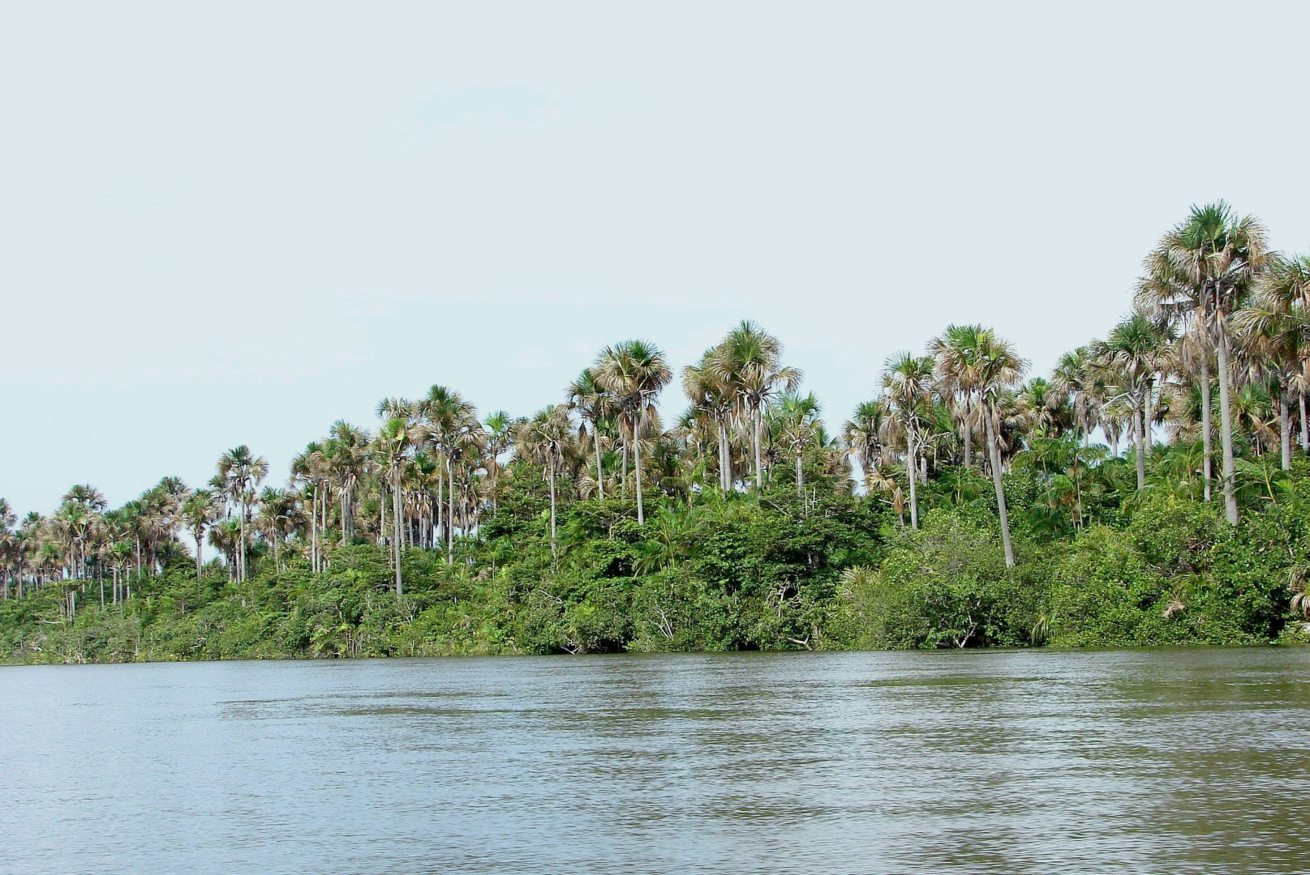
Downstream
Amazon: Flooded Forest?
Notes:
Case studies
The Manatali reservoir formed by the Manantali dam in Mali intersects the migration routes of nomadic pastoralists and destroyed 43000 ha of savannah, probably leading to overgrazing and soil erosion elsewhere. Further, the reservoir destroyed 120 km² of forest. The depletion of groundwater aquifers, which is caused by the suppression of the seasonal flood cycle, is damaging the forests downstream of the dam.^{[9]}
In the case of the Lower Omo River, Ethiopia, hundreds of thousands of nomads will be affected because the flood recession agriculture on which their livelihoods are based would disappear once the Gibe III dam will be completed.
After the closure of the Kainji dam, Nigeria, 50 to 70 per cent of the downstream area of flood-recession cropping was lost.^{[10]}
SO, in the Amazon, how has the riparian or floodplain system adapted to seasonal hydrological fluctuation? We know a lot about the seasonal cycle – how will the dams alter downstream flows and systems, including human?

Slide 16
Rivers, Dams, and Land Use: Still Stuck on Basic Research Questions
How does the creation of big dams and reservoirs affect change in LULC?
Direct
Indirect
In and near reservoir
Far from reservoir
How does LULC affect reservoirs?
More well-studied
Notes:
Should be readily studied – hundreds of fairly well-documented case studies.
Opportunity to watch the events unfold – a bit politically incorrect.

Slide 17
On To Stephanie

