Slide 1
Evaluation And Redesign of the Water and wastewater Distribution Network of Burqa Village
Prepared By :
Osama amr
Qutayba mElhim
Under supervision of :
Dr. Abdelhaleem Khader

Slide 2
Outline
Introduction.
Objectives and significance of the project.
Study area.
Methodology.
Modeling , Analyzing and design.
Results and conclusions.

Slide 3
Introduction
Water is the most important component in the human life which forms 70% of human body.
An important element like water should be available in high level of accessibility, safe, clean, and in adequate quantity
Water used in the home for flushing, bathing, laundry, cleaning dishes, floor drainage .And water used by industry, this produce wastewater so we need to method to disposal from this waste, its called sewage system.

Slide 4
Objectives
Evaluating the existing water network in Burqa village.
Redesign efficient water distribution network for Burqa village to overcome the growing population for the next 30 years.
Design sewer network for Burqa village.

Slide 5
Significance of work
The water network in Burqa doesn’t work efficiently or effectively, since it has high percentage of loss which reaches 30% of water supply.
In this project we will evaluate and redesign Burqa network to improve it’s efficiency and to minimize the loss in order to cover the future needed of water as much as possible.
The residents of Burqa dispose their sewage using cesspits. Cesspits have many environmental problems. Accordingly, we have to design a wastewater collection network for Burqa.

Slide 6
Study area
Burqa (Arabic: برقة) is a Palestinian village in the Nablus Governorate, located 10.7 km northwest of Nablus City, in the northern West Bank .
The total area of Burqa village consists of approximately 18.174 dunums which is divided as:
(Area A:27%, Area B:29%, Area C:44%).
Water resources :
main sources of water is MAKAROT (an Israeli company).
4 wells.

Slide 7
Methodology
Selection of the study area
Data Collection
Data analysis
Giving recommendations
Evaluation and Redesign

Slide 8
Data collection
Structural map.
Contour map.
Road network.
Existing network map.
Structural map (Houses distribution).
Population of our study area.

Slide 9
Data collection
Pipes diameter and it's type: which was found as Galvanized Iron with diameter of 2, 3 and 4 in.
Reservoir location.
Boundary of study area.
demand per capita.
Monthly Demand

Slide 10
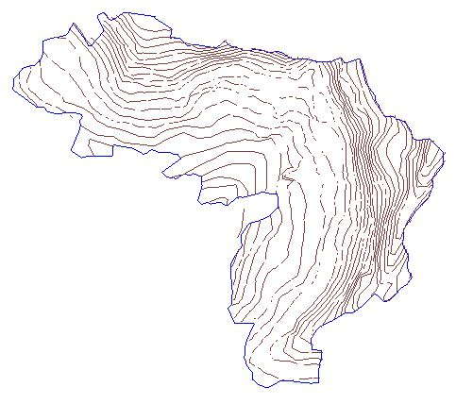
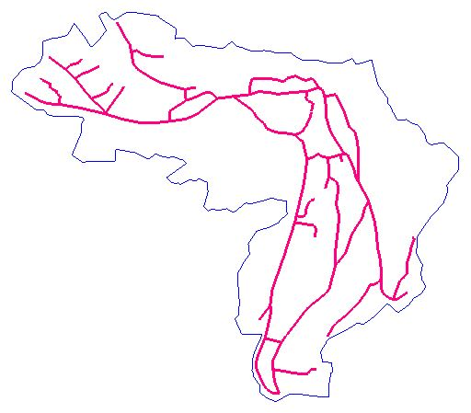
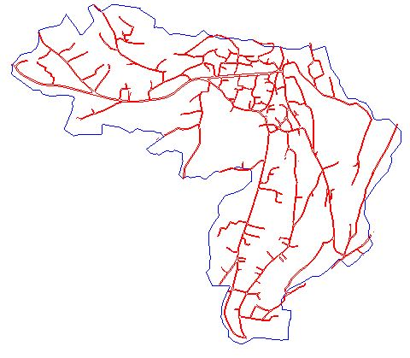
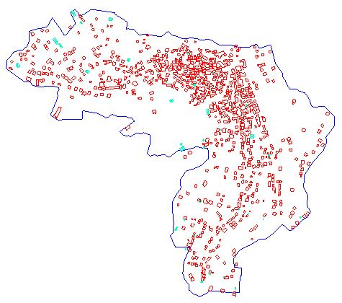

Slide 11
Monthly Demand
Demand (m³) | Month |  | Demand (m³) | Month
9007 | July |  | 7729 | January
9489 | August |  | 6358 | February
7787 | September |  | 6136 | March
7714 | October |  | 8094 | April
7503 | November |  | 9002 | May
6127 | December |  | 8785 | June

Slide 12
Water Distribution network
(Analyzing ,evaluating, Designing and modeling)

Slide 13
Data analyzing
Population forecasting
Our design period is 30 years, by using "constant growth rate with compounding" method
F= P (1 + r)^{n}
F₂₀₁₅ = 3009× (1 + 0.019)¹⁸ = 4223 persons. (For evaluation)
F₂₀₄₅ = 3009× (1 + 0.019)⁴⁸ = 7427 persons. (For design)

Slide 14
Data analyzing
Demand forecasting
The maximum demand per month was in August which is 9489 m³.
Current demand per capita is
9489×1000 / 31× 4227 = 72.5 L/c-d.
In the evaluation process the demand per capita per day that will be used is 72.5 L/c-d. While in the design process the demand per capita per day that will be used is 120 L/c-d.
Q _{evaluation} = 9489/31 = 306 m³/day.
Q _{design} = (Future population) * L/c-day * hourly factor
= 7427 * 120 * 3
= 2674 m³/day.

Slide 15
Designing
Design considerations
Velocity : The minimum and maximum allowable velocities are 0.3 and 3.0 m/s .
Pressure :The value of the pressure on each junction should be between “20 – 100” mH2O.

Slide 16
Modeling
Evaluation modeling :
Evaluation modeling with current demand (2015).
Evaluation modeling with future demand (2045).
Design modeling.

Slide 17
Evaluation modeling
Evaluation modeling with current demand (2015):
Inserting the data that we collect to WaterCAD.
Allocation of junctions and reservoir.
Drawing pipes and entering the properties.
Add contour file to determine the elevations of junctions and reservoir and length of pipes using TRex tool.
Determine the number of houses that each junction served it and after that multiplying number of houses for each junction with house consumption in order to get junctions demand.
Inserting the values of junctions demand.
Run the model.

Slide 18
Evaluation modeling
This evaluation model have 54 junctions and 62 pipes.

Slide 19
Total number of houses = 983.
The population during 2015= 4227 persons.
Current demand per capita per day = 72.5 L/c.d.
Demand for one house
(4227/983)*72.5=311.75 L/day.
Determine the number of houses that each junction served it and after that multiplying number of houses for each junction with house consumption in order to get junctions demand .then
Inserting the values of each junction demand.

Slide 20
Results
Pipes table

Slide 21
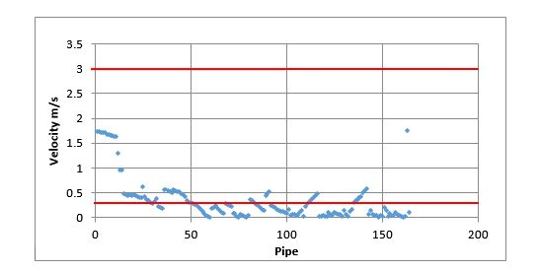
Results
Velocities :
Velocities between 0.01 and 1.8 m/s .
some of it located out of the range (0.3 to 3 m/s).
Distribution of velocities in the pipe

Slide 22
Results
Junctions table

Slide 23
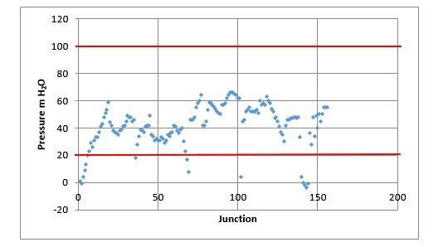
Results
Pressures :
The pressure found to be between -4 and 70 m H₂O.
Some of it located out of the range (20 to 100 m H₂O).
Distribution of the pressures at junction

Slide 24
Evaluation modeling
Evaluation modeling with future demand (2045):
Inserting the data that we collect to WaterCAD.
Allocation of junctions and reservoir.
Drawing pipes and entering the properties.
Add contour file to determine the elevations of junctions and reservoir and length of pipes using TRex tool.
Apply Thiessen polygon theory to determine the service area of each junction.
Adding the total demand using load builder tool.
Run the model.

Slide 25
Results Pipes table

Slide 26
Results
Velocities :
Velocities between 0.06 and 16 m/s .
some of it located out of the range (0.3 to 3 m/s).
Distribution of velocities in the pipe

Slide 27
Results Junctions table

Slide 28
Results
Distribution of the pressures at junction
The pressure found a high negative pressure.

Slide 29
Design modeling
Inserting the data that we collect to WaterCAD which include contour map, road map, houses distribution map and the boundary of our study area.
Allocation of junctions and reservoir.
Drawing pipes and entering there properties.
Add contour file to determine the elevations of junctions and reservoir and length of pipes using TRex tool.
Apply Thiessen polygon theory to determine the service area of each junction.
Adding the total demand using load builder tool.
Run the model.

Slide 30
Design modeling
Many models were developed by changing the diameter of pipes and decreasing or increasing number of junction. However, many problem came to surface like the velocity in some pipes out of the range (0.3 to 3 m/s ) and some junction had negative or high pressure, but we select model with least cost most efficient and less energy consumption. This model has 84 junctions with 96 pipes and with two pumps, the first one have 41m head and the second 22 m head.

Slide 31
Results Pipes table

Slide 32
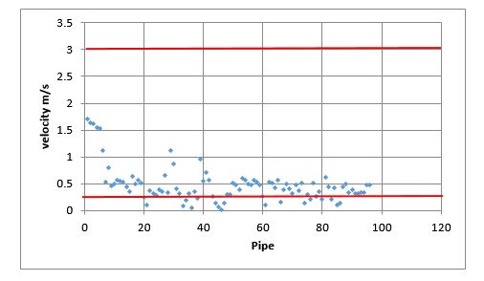
Results
Velocities
Velocities between 0.02 and 1.7 m/s .
Distribution of velocities in the pipe

Slide 33
Results Pipes table

Slide 34
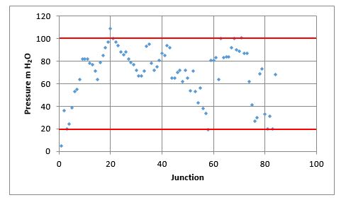
Results
Pressure
the pressure found to be between 5 and 109 m H2O.
Distribution of the pressures at junction

Slide 35
Wastewater Collection network
(Analyzing , Designing and modeling)

Slide 36
Data analyzing
Population forecasting
Our design period is 15 years, by using "constant growth rate with compounding" method
F= P (1 + r)^{n}
F2030 = 3009× (1 + 0.019)33
= 5706 persons.

Slide 37
Data analyzing
estimation of the waste water generation per capita .
Wastewater generation rate is 80%.
Peak factor is 4.
Infiltration rate is 20% from consumed water.
We calculated the waste water generation per capita as follow.
WWG/capita-day = 0.8* water consumption L/c-day * (hourly factor + infiltration percent)
WWG/capita-day = 0.8*120*(4+0.2)
= 403.2 L/capita-day.

Slide 38
Designing
Design considerations
Average velocity
A 3 m/s maximum velocity .
A 0.6 m/s minimum velocity .
Slope
The slope of the sewer is the difference in the sewer invert elevations per sewer length.
A minimum slope of 1%.
A maximum slope of 15%.
Cover
The minimum cover should at least be 1 m.
The maximum cover should not exceed 5 m.

Slide 39
Designing
Design considerations
The flow in conduit is partially flow has percentage 75%.
Sump depth is zero.
Manning coefficient is 0.013
Steady state condition.
Outfall type is free outfall.
Diameter of manhole is 1 m.
The material of conduit is circular uPVC.
Ground elevation is equal Rim elevation.

Slide 40
Design modeling
Add data for SewerCAD software “Contour Map, Building layout, road layout".
Allocate the location of manholes and outfall.
Tracing conduit between manholes.
By using Trex tool determine the ground elevation for manholes and length of conduit.

Slide 41
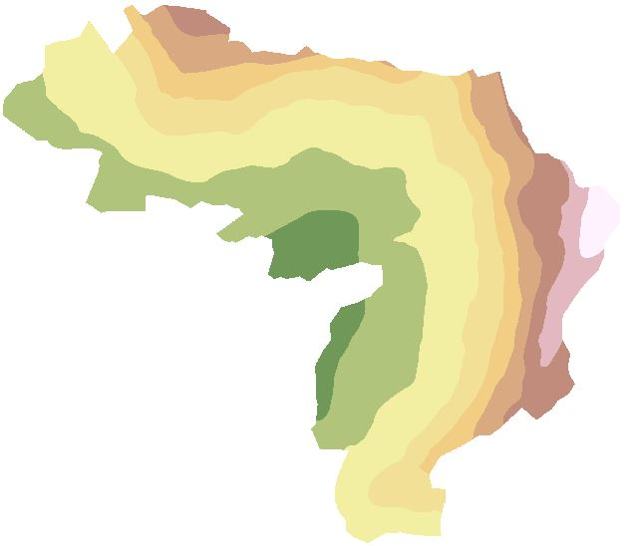
Design modeling
By using ArcMap do digital elevation model for study area

Slide 42
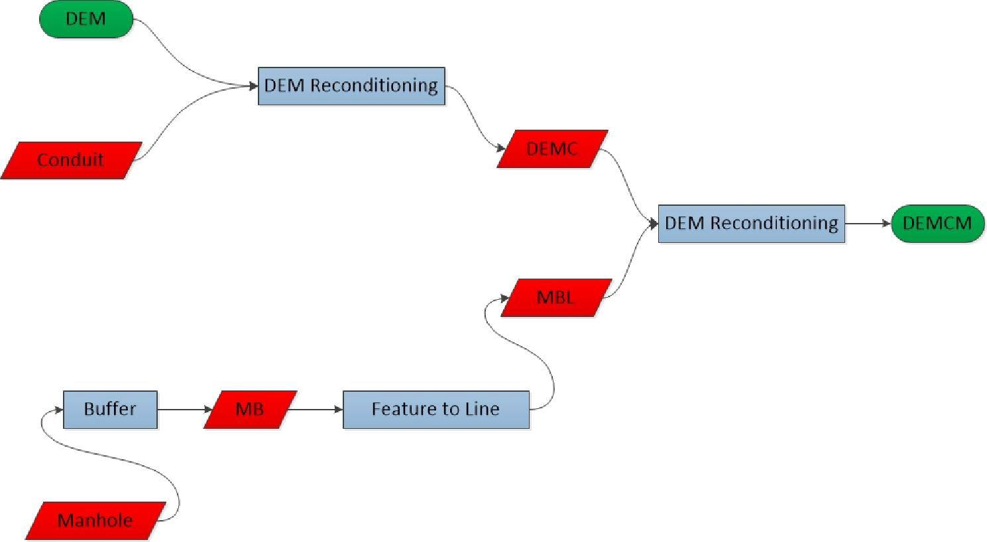
Design modeling
By using ArcHydro determine served area for each manhole.

Slide 43
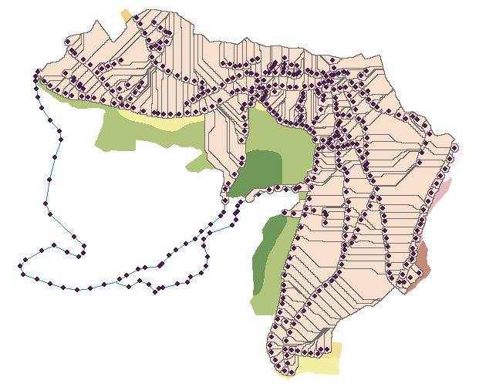
Design modeling

Slide 44
Design modeling
To determine the design load on each manhole we need the following data :
Served area by each manhole (determined using ArcHydro).
Population density .
WWG/capita-day

Slide 45
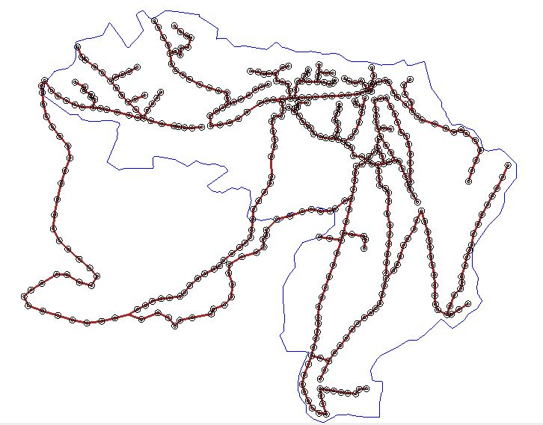
Results

Slide 46
Results Conduit table:

Slide 47
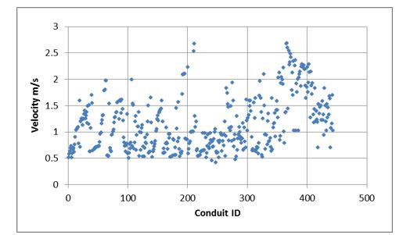
Results
Velocities
Velocity values in wastewater conduits

Slide 48
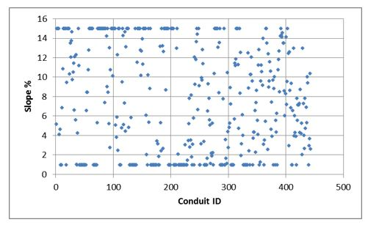
Results
slope
Slope values for wastewater conduits

Slide 49
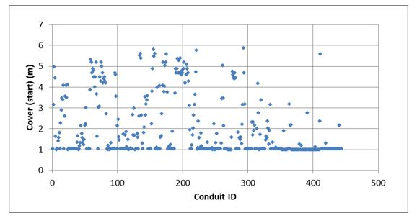
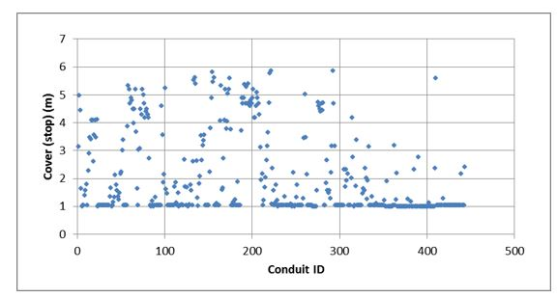
Results
Conduit cover
Covers at the start of conduits
Covers at the stop of conduits

Slide 50
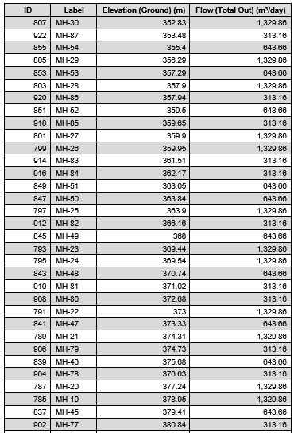
Results Manholes table:

Slide 51
Results Outfall table:

Slide 52
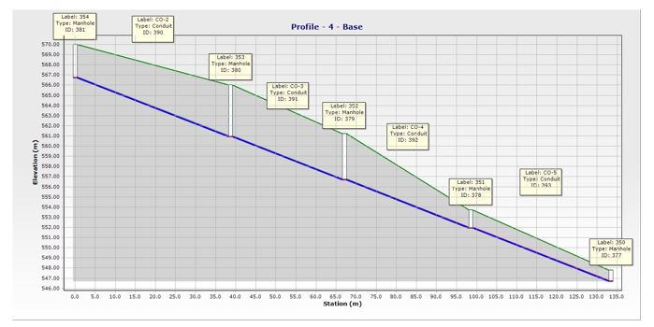
Results Profile:

Slide 53
Conclusion and Recommendations
Water distribution network
After evaluating the status of the current water distribution network at Burqa and finding out that the percent of losses is about 30% of the total supply and that it is unsuitable for future demand. There are other problems, so it is recommended that the new design which is represented in this project should be conducted.
Wastewater collection network
We conclude from our project:
The design is applicable for the selected design period that is 15 years.
All values of velocities, slopes and cover is verify the criteria which were mentioned.

Slide 54
Thank YOu

