Slide 1
Green Building and Sustainable Architecture
A Responsible Approach to Environmental and Human Health
Civil Engineering and Architecture
© 2010 Project Lead The Way, Inc.

Slide 2
Green Building and Sustainable Architecture
What Is Sustainability?
Green Building
Sustainable Design
Sustainable Building Design
Preservation of Natural Conditions
Human Comforts
Sustainable Building Life Cycle
Pre-Building Phase
Building Phase
Post-Building Phase
Sustainable Remodeling

Slide 3
What Is Sustainability?
The Royal Academy of Engineering
Philosophy
Meeting the needs of the present without compromising the ability of future generations to meet their own needs. World Commission on Environment and Development
Principle of intergenerational equity: “We don’t own the earth; we hold it in trust for our children.”
Implementation
Preserve and enhance the five capitals
Human
Environmental
Social
Financial
Manufactured
Notes:
Before we talk specifically about LEED, let’s talk about the more general topic of sustainability.
Before showing the contents of this slide ask students to define the word “sustainability.”

Slide 4
Green Building
U.S. Green Building Council
Planning, design, construction, operations, and end-of-life recycling of structures
Solutions that represent a healthy and dynamic balance between environmental, social, and economic benefits
Triple Bottom Line—a long term view for assessing potential effects and best practices for:
People
Planet
Profit
Notes:
Sustainable and green are often used interchangeably.
The U.S Green Building Council advocates for a sustainable built environment through community and consensus building, education and the LEED Green Building Program.

Slide 5
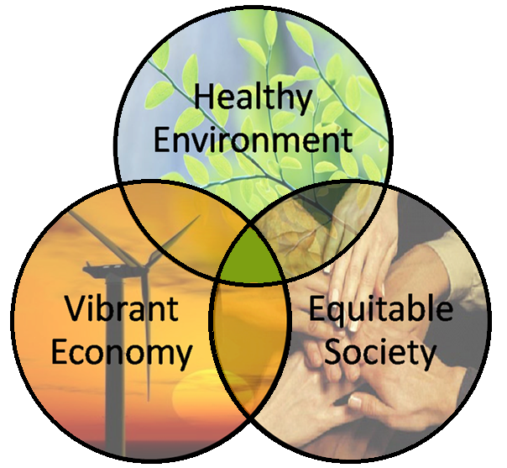
Sustainable Design
SUSTAINABILE
DESIGN
Notes:
The goal when designing a sustainable building is to design and create a structure that considers natural resources and ecological capacity, the human experience and social expectations, as well as economic and technical concerns.

Slide 6
Sustainable Building Design According to the Whole Building Design Guide
Optimize Site Potential
Optimize Energy Use
Protect and Conserve Water
Optimize Building Space and Materials
Enhance Indoor Environmental Quality
Optimize Operational and Maintenance Practices
National Institute of Building Sciences
Whole Building Design Guide
http://www.wbdg.org/design/sustainable.php
Notes:
The National Institute of Building Sciences (NIBS) advocates “whole building design.” The NIBS has published a Whole Building Design Guide which presents eight design objectives that describe a successful building design as cost effective, accessible, sustainable, functional, secure, and productive. Note that these characteristics address the triple bottom line and include the more expansive definition of sustainable design already discussed..
However, the Whole Building Design Guide defines sustainable design in terms of only environmental performance. These are the six fundamental principles related to sustainable design listed in the Whole Building Design Guide.
Ask students to share their thoughts on each principle as you present them.
Optimize Site Potential – includes proper site selection, security planning, building orientation, landscape design, storm water management, and preservation of local ecosystems
Optimize Energy Use – reduce energy load, increase efficiency, and maximize the use of renewable and inexhaustible energy sources.
Protect and Conserve Water – use water efficiently, and reuse or recycle water for on-site use, when feasible.
Use Greener Materials – material choices that prevent upstream pollution, maximizes value, and conserves resources and have a reduced effect on human health and the environment. Building is designed and operated to use and reuse materials in a sustainable way throughout its life cycle.
Enhance Indoor Environmental Quality – maximize daylighting, provide appropriate ventilation and moisture control, optimize acoustic performance and avoid high VOC emissions. Provide occupant control over internal systems such as lighting and HVAC.
Optimize Operational and Maintenance Practices – design building to reduce maintenance requirements, require less water, energy and toxic chemicals to maintain, reduce life-cycle costs. Include meters to track sustainability initiatives including reduction in water use, energy use and waste generation.

Slide 7
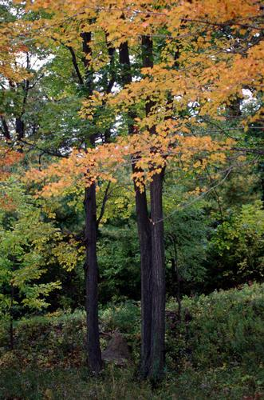
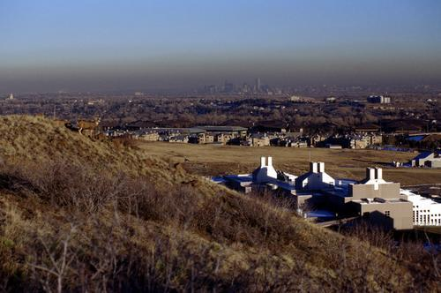
Preservation of Natural Conditions
An architect should minimize the impact of a building on its local ecosystem (e.g., existing topography, plants, and wildlife).
Notes:
Architects and engineers now consider wildlife and the destruction of waterways and food chains for the proposed building site in all phases of the structure’s life.

Slide 8
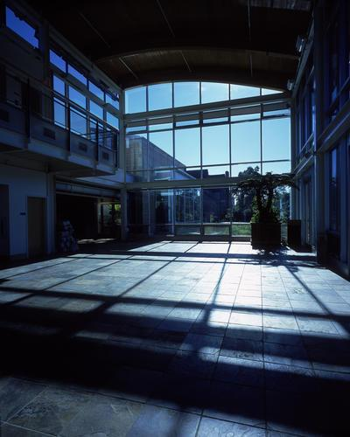
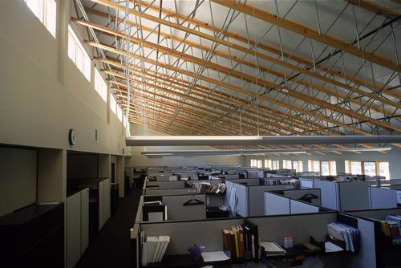
Human Comforts
A building’s design should enhance the work and home environments. This can improve productivity, reduce stress, and positively affect health and well being.
Notes:
Occupants who are comfortable in there surroundings are more productive.

Slide 9
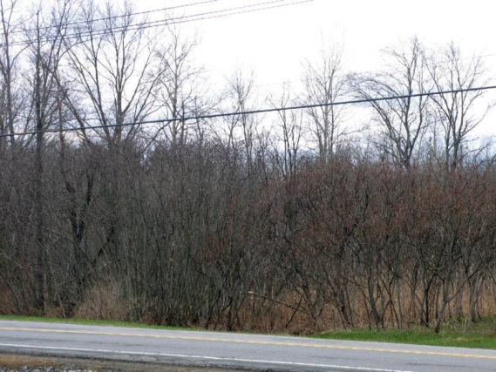
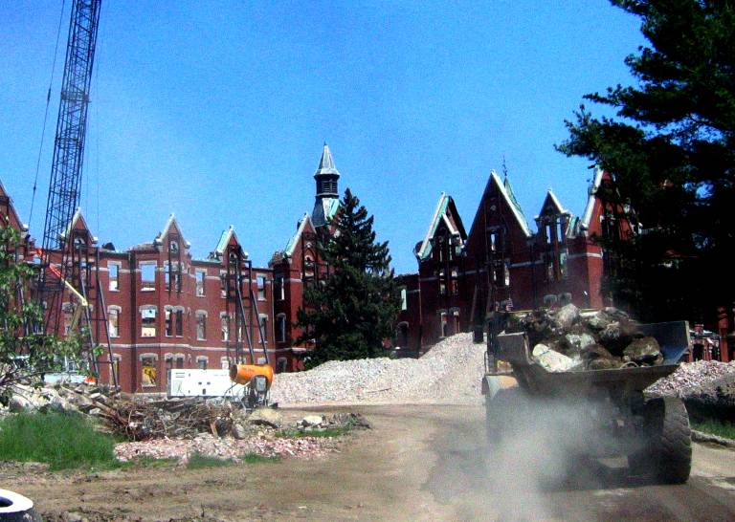
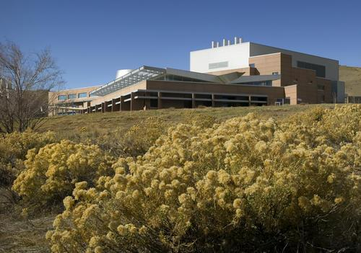
Sustainable Building Life Cycle
Pre-Building
Building
Post-Building
Notes:
Pre-Building Phase
How building materials impact the environment: harvesting trees could result in deforestation; mining mineral resources (iron for steel; bauxite for aluminum; sand, gravel, and limestone for concrete) disturbs the natural environment; even the transport of these materials can be a highly polluting activity, depending on their weight and distance from the site. The manufacturing of building products also requires energy and creates environmental pollution: for example, a high level of energy is required to manufacture steel or aluminum products.
Building Phase
The operation of the building life cycle considers natural resources, its carbon footprint, human comfort, and operating costs.
Post-Building Phase
Old materials become resources for other building or waste to be returned to nature. The sustainable-design strategy focuses on reducing construction waste (which currently comprises 60% of the solid waste in landfills) by recycling and reusing buildings and building materials.

Slide 10
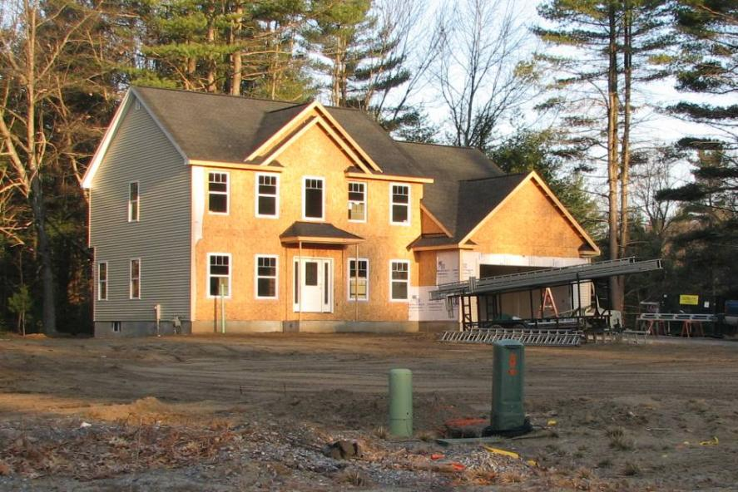
Pre-Building Phase
Site selection, building design, and building material processes, up to but not including installation.
Examine the environmental consequences of the structure’s design, orientation, impact on the landscape, and materials used.
Notes:
Neighborhood and cities can benefit by proper planning. Architects and planners should take into consideration of water demands and building material during the planning phase. Creative architects and planners can use the natural resources provided by the building site.

Slide 11
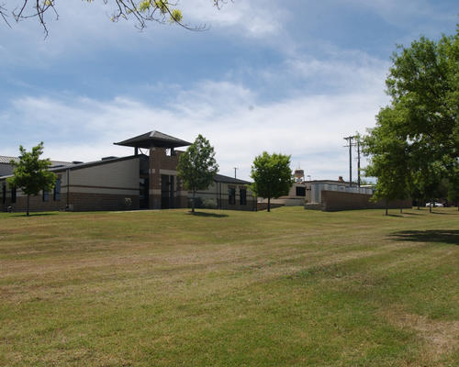
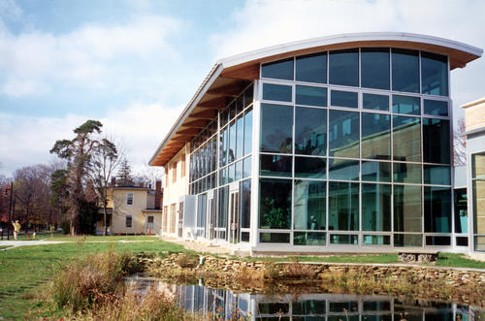
Building Phase
Construction and operation processes can reduce the environmental impact of resource consumption
Long-term health effects of the building environment on its occupants are considered
Notes:
Reduced energy consumption and the comfort of building occupants are two criteria that architects consider most during the life of the structure.

Slide 12
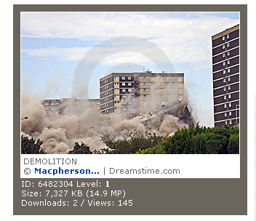
Post-Building Phase
Old materials become resources for other buildings or waste to be returned to nature. The sustainable design strategy focuses on reducing construction waste by recycling and reusing packaging and excess material.
Notes:
The sustainable design strategy focuses on reducing construction waste (which currently comprises 60% of the solid waste in landfills) by recycling and reusing buildings and building materials.

Slide 13
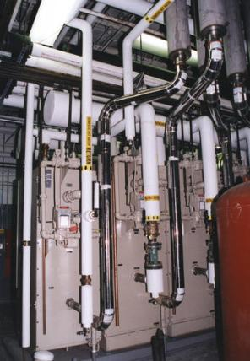
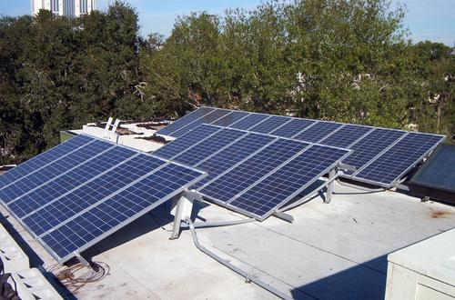
Sustainable Remodeling
Existing buildings can be remodeled, improved mechanical components can be installed, and building operating systems can be updated to make a building greener.
Notes:
Programs like (LEED) Leadership in Energy and Environmental Design and ENERGY STAR are helpful tools for improving an existing structure.

Slide 14
Green Building and Sustainable Architecture
What Is Sustainability?
Green Building
Sustainable Design
Sustainable Building Design
Preservation of Natural Conditions
Human Comforts
Sustainable Building Life Cycle
Pre-Building Phase
Building Phase
Post-Building Phase
Sustainable Remodeling

Slide 15
References
National Institute of Building Sciences (2014). Whole building design guide. Washington, DC. Retrieved from http://www.wbdg.org/design/index.php
U.S. Green Building Council, An introduction to LEED and green building. www.usgbc.org

Slide 16
Image Resources
Microsoft, Inc. (2009). Clip art. Retrieved April 7, 2009, from http://office.microsoft.com/en-us/clipart/default.aspx

