Slide 1
PROTECTING GROUNDWATER
IN MINING AREAS
MME Workshop
Duluth 2015
Bruce Olsen

Slide 2
WHY PROTECT GROUNDWATER?
Principal Source of Drinking Water in MN
Recharges Many Lakes and Streams
Extensively Used to Irrigate Crops
Supports Habitat for Many Plants and Animals
Heavily Used for Industry in Some Places
More Dependable Water Supply Than Surface Water

Slide 3
WHAT ARE THE PROBLEMS?
Over Use – Pumping More Than is Replaced
Misuse (Wasting) – Pumping for a Less Important Need
Contamination – Introducing a Substance that Makes Groundwater Unusable for Others
Knowledge Gap – Detailed Information About the Resource is Lacking in Many Areas
User Awareness – Limited Understanding of Cause and Effect

Slide 4
DEFINITION OF “MINING”
MN Statutes 6130.0100
“….the process of removing, stockpiling, processing, storing, transporting (excluding use of common carriers and public transportation systems), and reclaiming any material in connection with the commercial production of metallic minerals. This includes exploration activities such as the taking of large bulk samples.

Slide 5
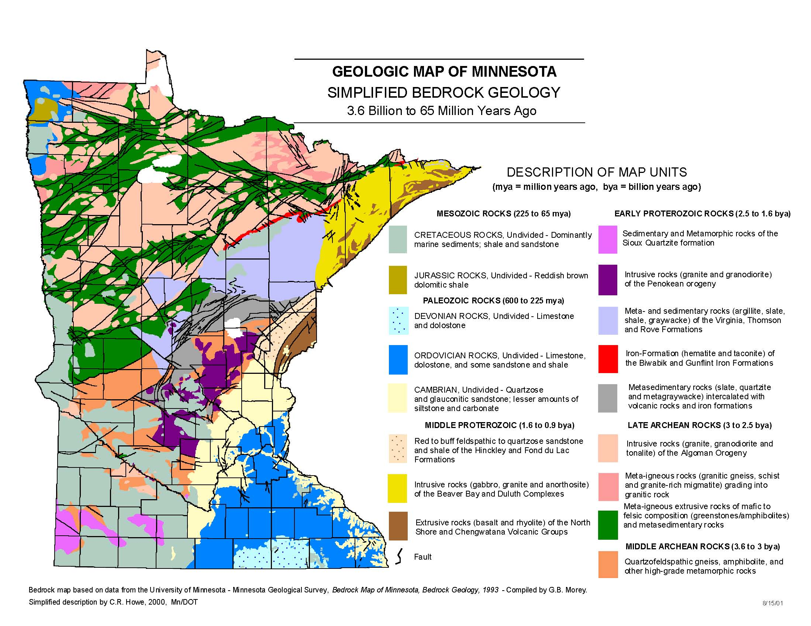

Slide 6
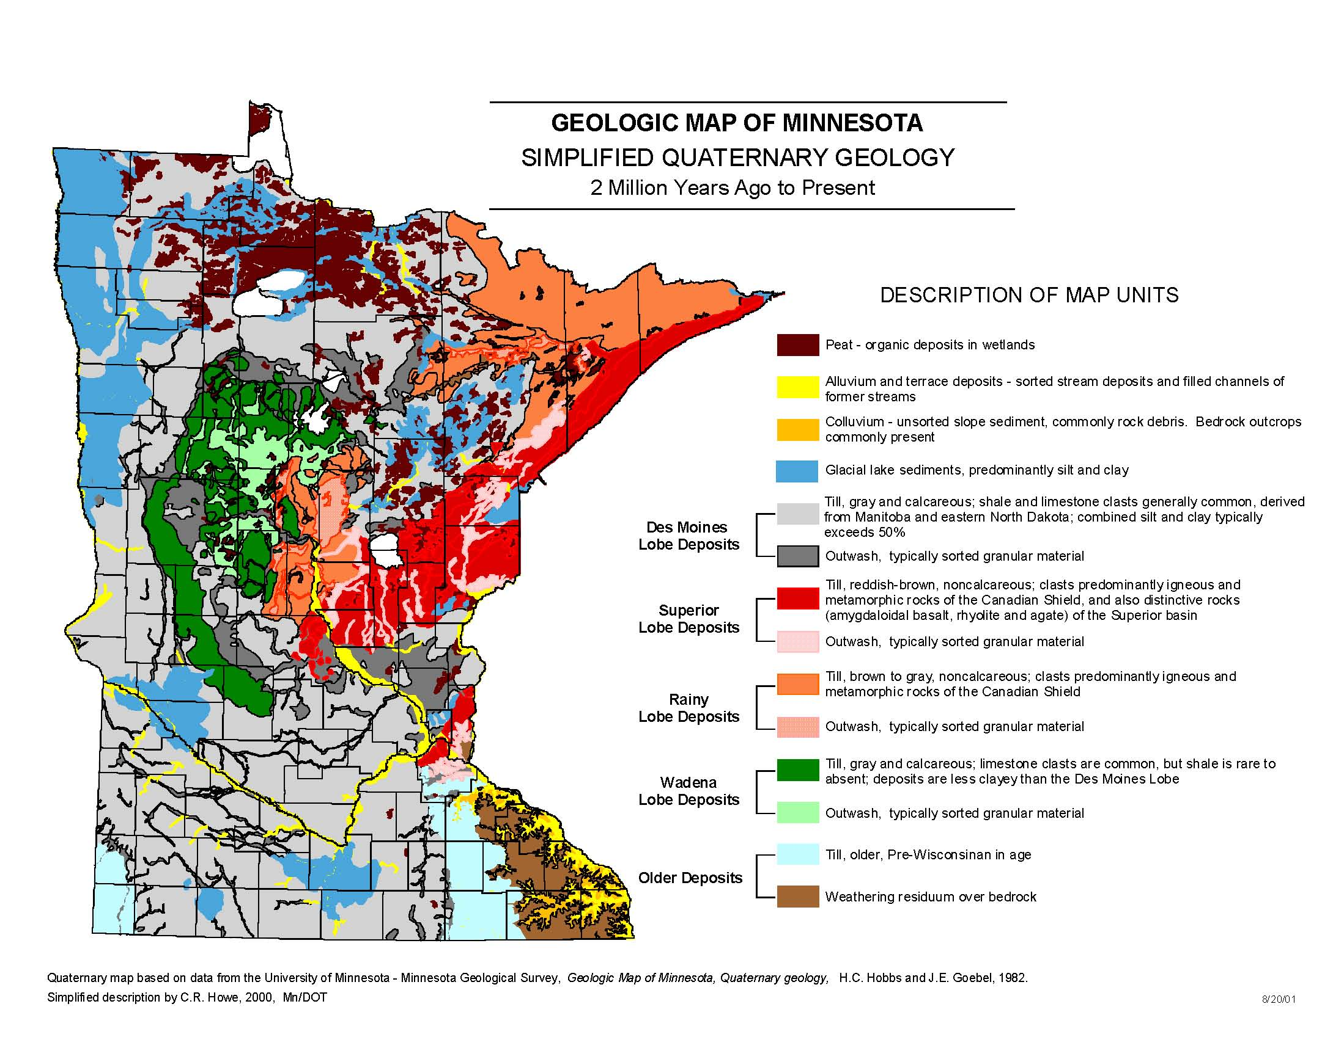

Slide 7
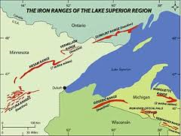

Slide 8
MINING FROM A
REGULATORY PERSPECTIVE
Ferrous Minerals (Iron Ores)
Non-ferrous Metallic (E.g.., Copper, Nickel, Platinum, Titanium, Gold, and Diamonds)
Industrial Minerals (Silica Sand, Sand &Gravel, Crushed Rock, Dimension Stone, Kaolin, and Peat}

Slide 9
WHO REGULATES MINING?
Ferrous and Non-ferrous Mineral Mining and Exploration are Regulated by MDNR
Industrial Minerals if on –
  State Land is MDNR
  County or Private Lands is Local Government

Slide 10
GROUNDWATER AND MINING
Geologic Materials Containing Mineral Resources Are Often Aquifers
Pumping is Often Used to Enable Mining Below the Natural Water Table
A High Degree of Interconnection Between Groundwater and Surface Water Often Exists Where Mining Occurs
Mining May Alter Groundwater Chemistry

Slide 11
GROUNDWATER “MINING”
Pumping Exceeds Annual Recharge
Decrease in Hydraulic Head Over Time
MNDNR Limits Pumping When -
  Hydraulic Head is ½ of the Original
  Potential Impacts to Surface Water/Eco Systems
MNDNR Stops Pumping When –
  Hydraulic Head is ¼ of the Original
  Negative Impacts to Surface Water/Eco Systems

Slide 12
PUMPING PROBLEMS
Impacts on Surface Water – White Bear Lake (city pumping), Straight River (irrigation), Savage Fen (city pumping)
Impacts on Groundwater – Granite Falls (ethanol plant), Brooten-Belgrade Area (irrigation), Downtown MPLS-STP (air conditioning)

Slide 13
CONTROLLING PUMPING
DNR Regulates Wells that Pump 10,000 gallons/day or 1,000,000 gallons/year
11,742 Active Appropriations Permits
Pumping Categories for 2011
  Public Water Supply 199 billion gal/year
  Industrial Processing 103
  Irrigation 73
  Other 72
                447 billion gal/year

Slide 14
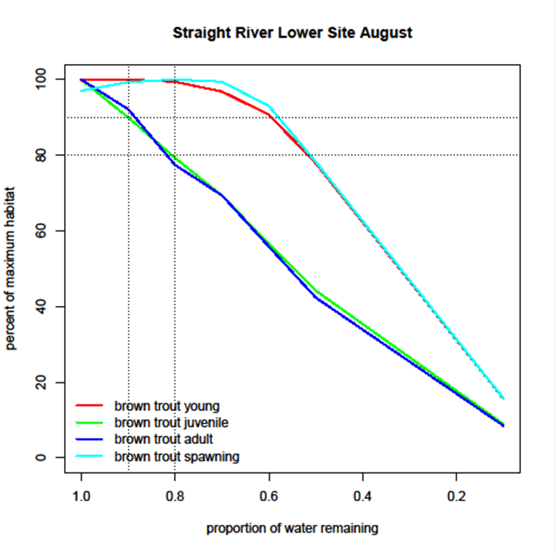
Stream flow affects habitat
Habitat decreases with decreasing flow;
Habitat availability affects species richness and abundance.
Notes:
Species richness and abundance is related, among other things, to availability of habitat. As flows are reduced, habitat is reduced for most riverine species.

Slide 15
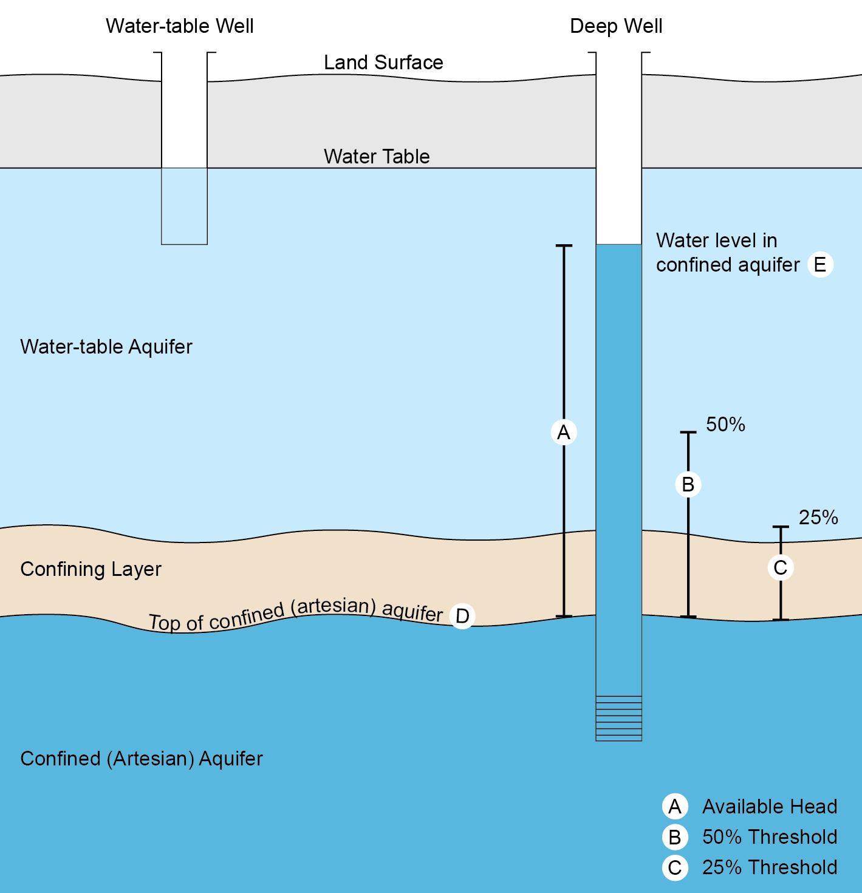
Safe Yield for Confined Aquifers
Notes:
This cartoon shows a two-aquifer system with a water-table and a confined aquifer. The N&E Metro has a more complex, multi-aquifer system, but the diagram is good for review the basics.
Refresher definitions: Water table – an actual surface below which rock or soil pores are completely filled with water. Water-table aquifers behave differently than confined or artesian aquifers, which I’ll get to in a moment.
Safe yield for water table aquifers is defined as a total withdrawal from the aquifer that does not exceed the average recharge to the aquifer. The idea is to keep the water-table aquifer from being completely drained. Water quality impacts, such as pulling in contaminated surface water, also have to be considered. In practical terms, other limits such as limits to surface-water impacts will almost always kick in at a lower use-rate than the water-table safe yield.
Confined (artesian) – groundwater is under pressure that causes water level in a well to rise above the top of the aquifer. This is shown by A in the diagram. Safe yield for confined aquifers is defined as a withdrawal rate that does not cause the pressure in the aquifer to progressively drop to the point that the water level in a well would drop below the top of the aquifer, which would create a water table within the formerly confined aquifer.
DNR has traditionally set a minimum threshold of 25% of the original water height remaining (C on the figure) as a buffer against completely drawing down to the top of the aquifer. A 50% threshold may also be set as a warning. The key aspect of these thresholds is that the limiting factor is where the water level regime in the observation finally ends up after pumping at a given rate for a long period of time.
Next, we’ll look at how this relates to observation-well levels measured over time, and then look at safe yield in the N&E Metro.

Slide 16
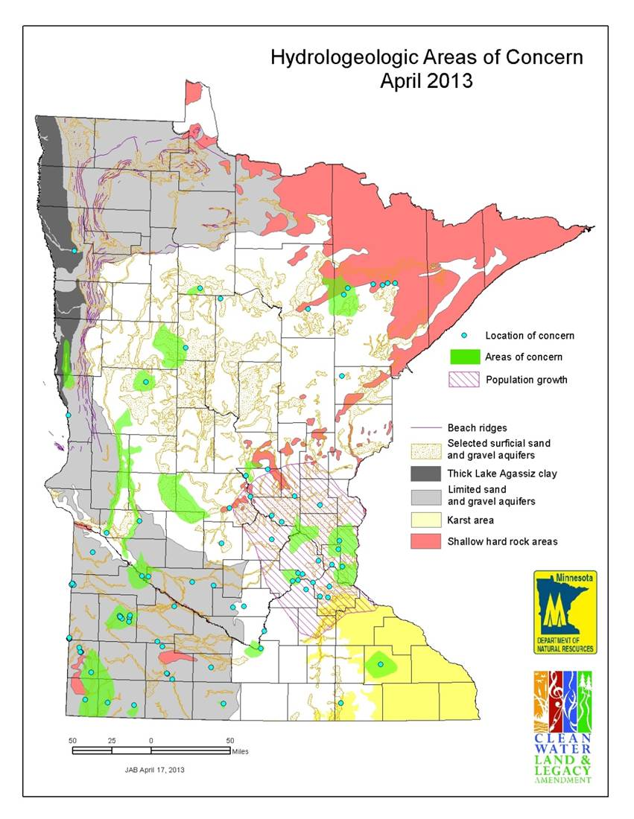

Slide 17
PUMPING AFFECTS GROUNDWATER FLOW DIRECTIONS
Seasonal Pumping May Change Local Flow Direction For Months.
Continuous Pumping May Impact Flow Directions for Decades or Longer
When Pumping Stops, the Flow Direction Is Likely to Reflect Natural Influences (e.g., Rivers, Streams, Topography)

Slide 18
DETERMINING GROUNDWATER
FLOW IN MINING AREAS IS COMPLICATED
Surface Water = Groundwater
Complex Geologic Conditions = Complicated Pathways for Flow
Groundwater Flow is Often Via Fractures Which are Difficult to Model
Pumping Alters Local Flow Directions = Changing Recharge Areas

Slide 19
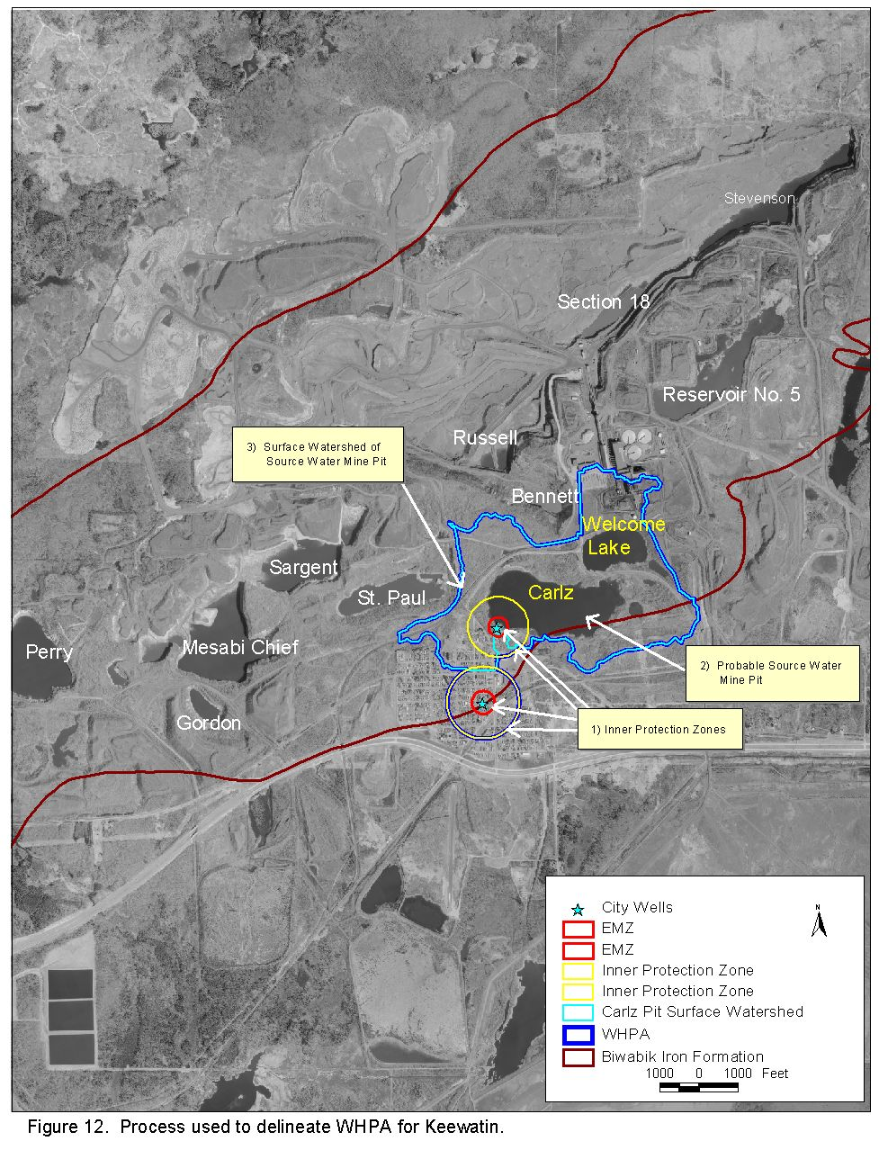
KEEWATIN WHPA
WHEN THE MESABI CHIEF PIT IS PUMPED
THE CARLZ PIT IS THE LOCAL
POTENTIOMETRIC HIGH

Slide 20
KEEWATIN WHPA
IF PUMPING STOPS
IN THE MESABI
CHIEF PIT
MESABI CHIEF PIT AREA
BECOMES THE LOCAL
POTENTIONMETRIC HIGH

Slide 21
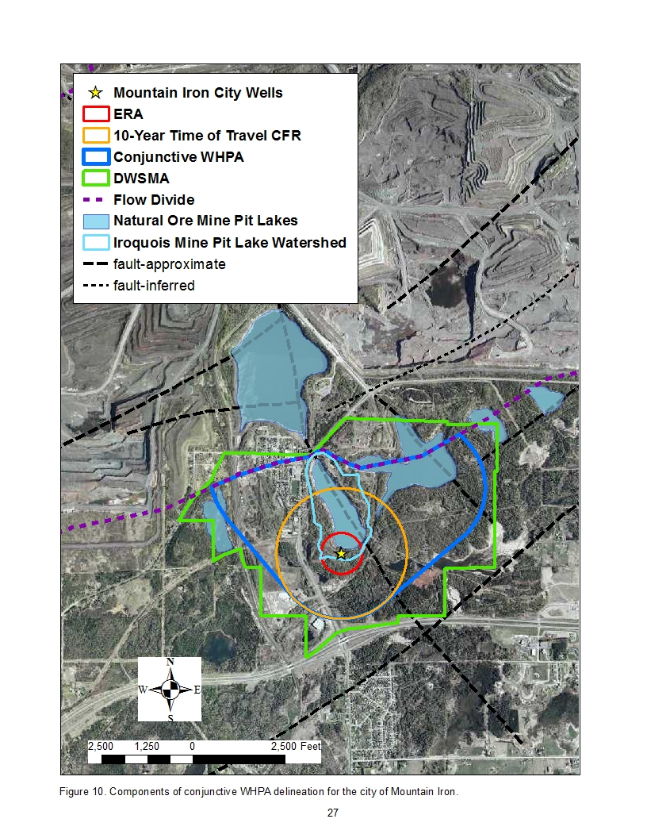
Mt. Iron WHPA
Future Changes to Pit
Pumping Will Change
Groundwater Flow Direction
And the WHPA Boundaries

Slide 22
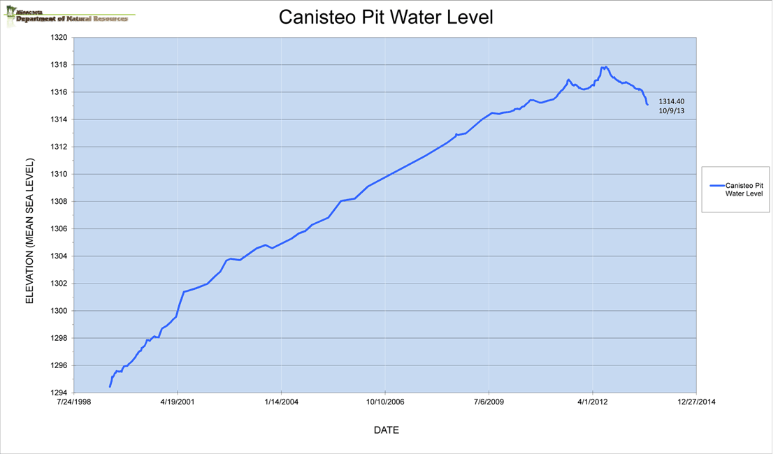
RISE IN SULFATE LEVEL VERSUS
NEARBY MINING PIT WATER LEVEL
250 mgl Secondary Drinking Water Standard

Slide 23
WELLHEAD PROTECTION ISSUES ON THE MESABI IRON RANGE
Storm Water Runoff
  Retention and Infiltration Ponds
  Mine Pits that Supply City Wells
Abandoned Underground Mine Workings
  Shafts
  Drifts
Potential Leaching from Waste Rock Piles

Slide 24
WELLHEAD PROTECTION ISSUES ON THE MESABI IRON RANGE
High Capacity Pumping from Mining
Unsealed Wells and Exploration Borings
Solid Waste Disposal
Leaking Sanitary Sewer Lines
Road Salt Management

Slide 25
POTENTIAL MINING IMPACTS
IN NORTHEASTERN MINNESOTA
Discharge of Process Water Containing Elevated Sulfate Levels
Acid Mine Drainage Resulting from Mining Sulfate Minerals
Introducing Oxygenated Water to Reduced Groundwater May Release Arsenic

Slide 26
WHAT IS THE MOST COMMON TYPE OF MINING IN MINNESOTA?
Aggregate (Sand, Gravel, Crushed Rock) Mining
Located on Public and Private Property
Often Associated With Shallow Depths to the Water Table (less than 50 feet)
Often Excavated Into Local Aquifers
Often Viewed as Harmless to Groundwater

Slide 27
POTENTIAL CONTAMINATION SOURCES IN AGGREGATE MINES
Fuel Storage
Equipment Storage and Maintenance
Bituminous Batch Plants
Runoff From Surrounding Lands Flows Into the Pit
Abandoned Pits Become Dumping Grounds

Slide 28
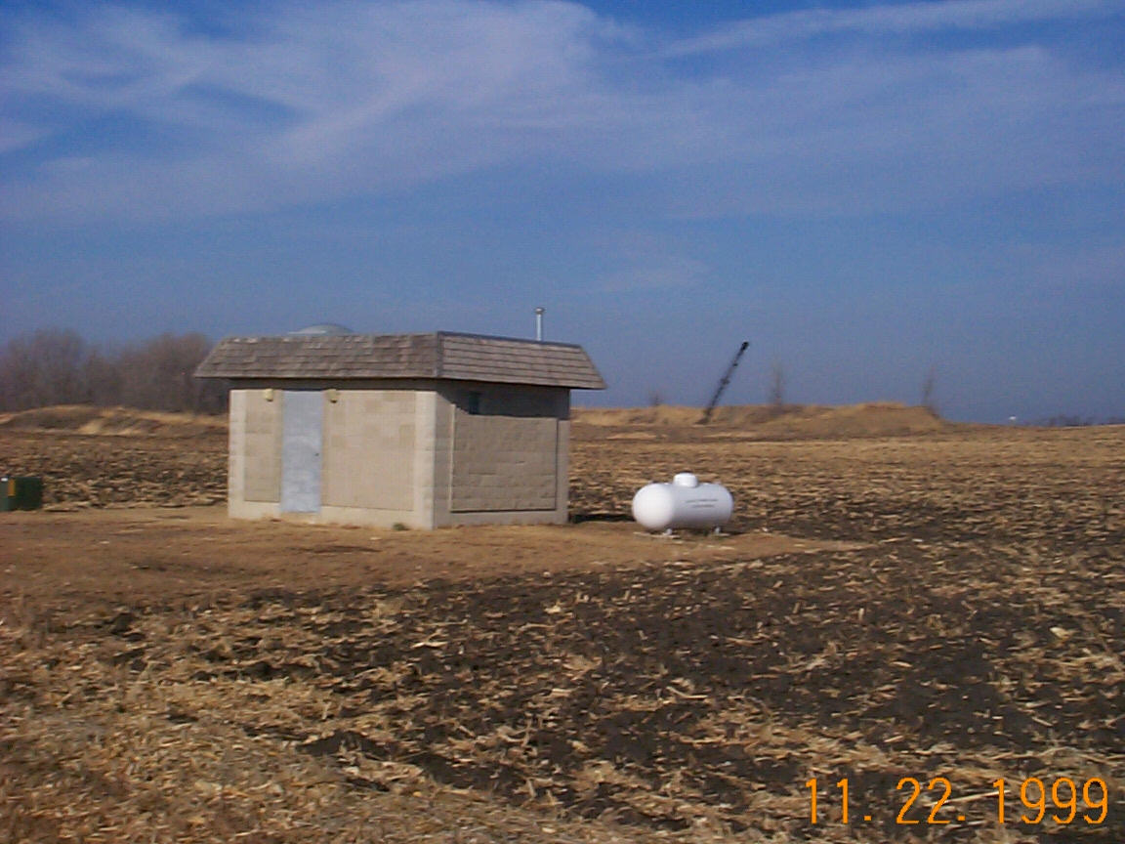
POTENTIAL WATER QUALITY ISSUES
GRAVEL PIT
CITY WELL

Slide 29
MINELAND RECLAIMATION
Mineland Reclamation Act 1969 and MDNR Rules in 1981 (ferrous), 1983 (peat), and 1993 (non-ferrous metallic).
Covers Lands that Are Disturbed by Mining Which Includes –
  Open Pits
  Waste Rock and Material Stock Piles
  Tailings Basins
  Buildings and Equipment
  Abandoned Infrastructure

Slide 30
GRAVEL PIT IN A PAIL
Learn about Groundwater Protection Issues in Mining Areas
Uses Inexpensive Materials for Classroom Activities
Two Lessons
Discussion Items for Teachers

Slide 31
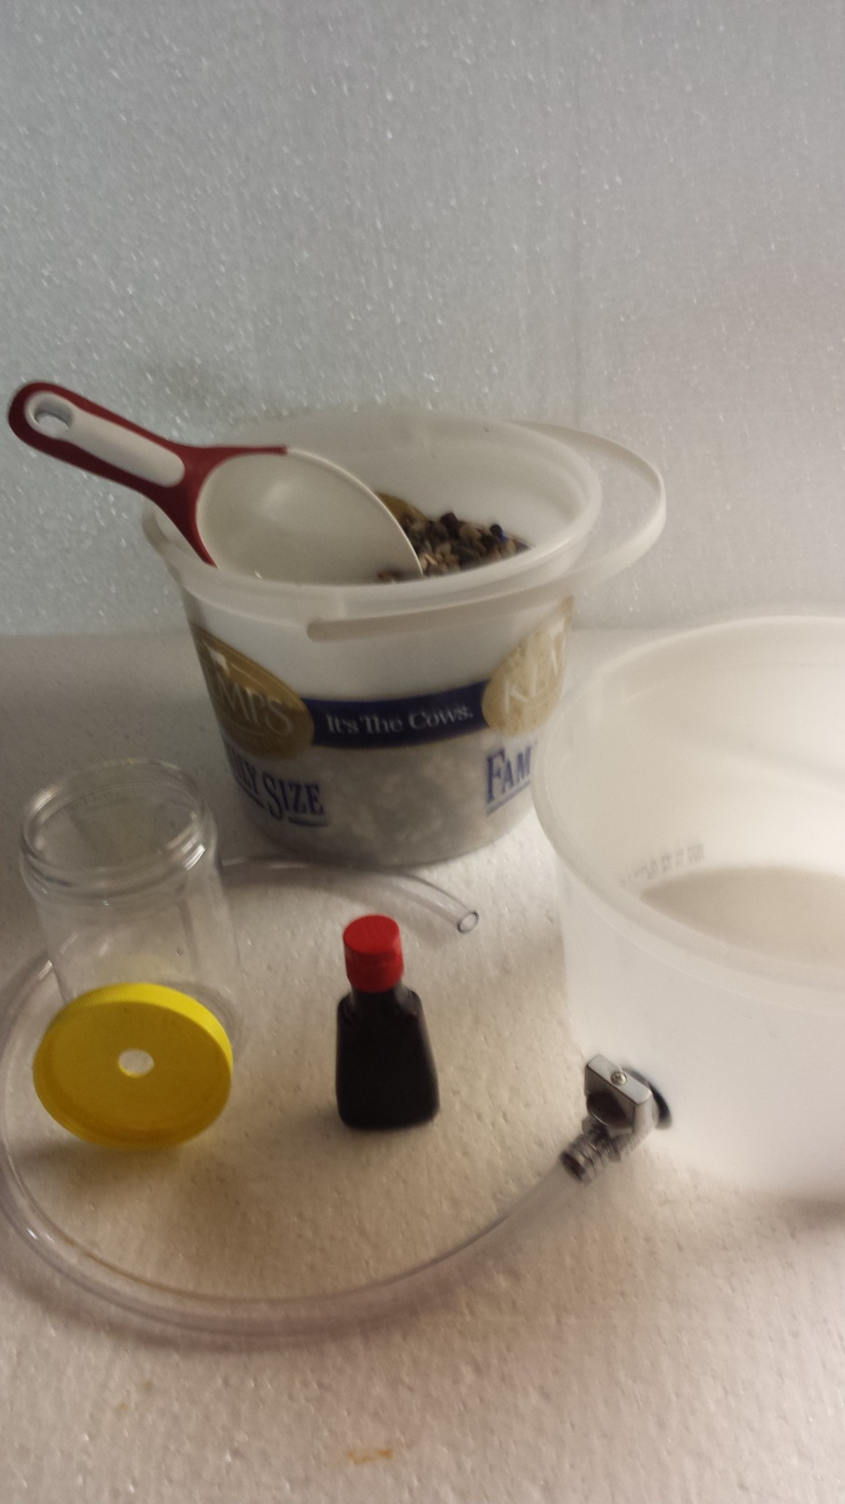
2 – Ice Cream Pails
Pea Gravel
Peanut Butter
Jar
½ X 3/8 inch Valve
Food Coloring
3/8 inch Vinyl Tubing

Slide 32
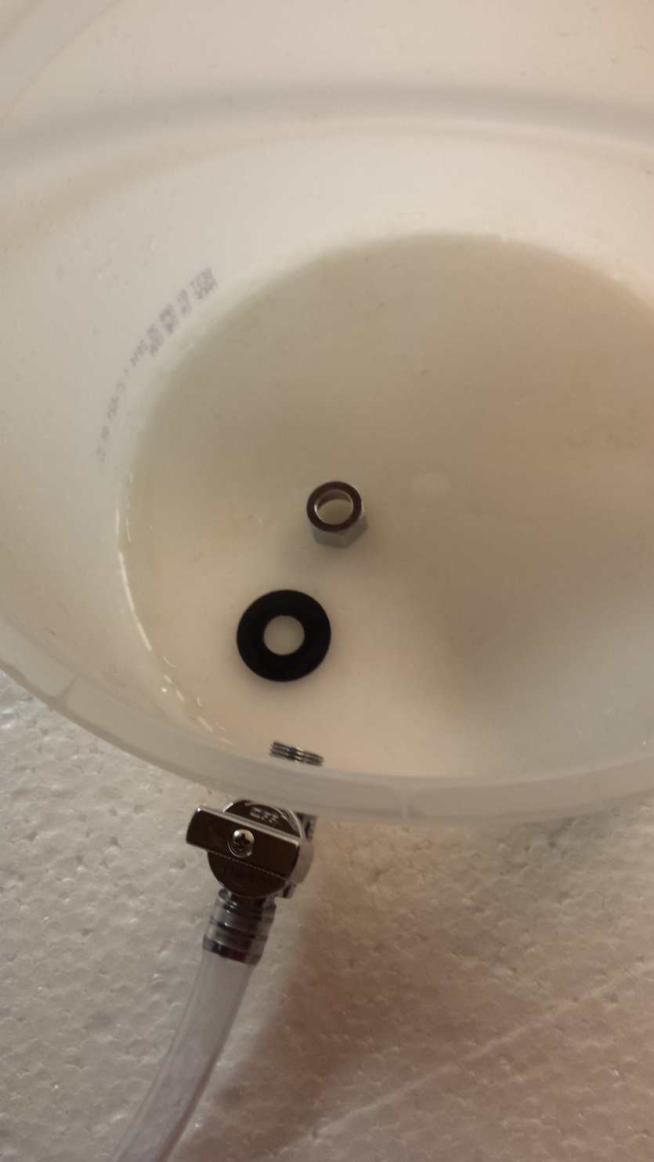
Valve Assembly Details
Hex Nut From Valve
5/16 inch ID Rubber Washer
½ inch PEX X 3/8 inch tubing
Straight Valve
½ inch OD X 3/8 inch ID Vinyl Tubing

Slide 33
LESSON 1
Learn about –
  How Groundwater May be Stored in a Gravel Deposit
  Relationship Between Mining and Groundwater Management

Slide 34
LESSON 2
Learn about –
  How Contaminated Recharge Can Contaminate Surface Water and Groundwater
  Ways to Prevent Water Contamination In Mine Pits
  Differences in the Time Required to Clean Up Surface Water Versus Groundwater

Slide 35
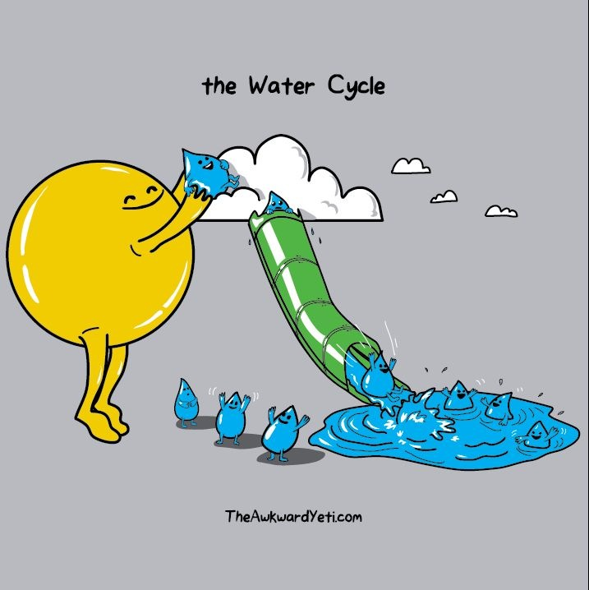
QUESTIONS

