Slide 1
Insecticide power
By, Jeffrey Luong, David Ramondo,
Kaylee Stone-Huygens, Mike Li

Slide 2
What is insecticide powder?
By, Mike Li

Slide 3
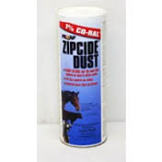
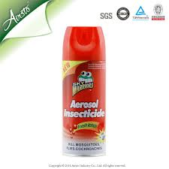
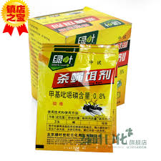
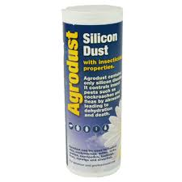
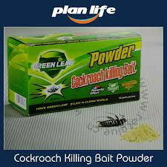
What is insecticide powders?
Use for killing pests (insects) as in ants, termites, etc.
Using toxins that kills the nervous system of the targeted insect.
Can be found in different kinds of powder form.
Can be found in many household stores.
You can even get Asian insecticide powder.

Slide 4
Why do we use insecticide powder?
By, David Ramondo

Slide 5
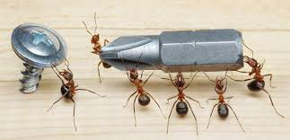
We use insecticide powder because…..
To help control pest infestations from pests like…
You can use the dusts/powders anywhere in your household where the pests are getting in

Slide 6
What does insecticide have to do with static electricity?
By, Jeffrey Luong

Slide 7
What is static electricity?
Static electricity is electrical charge that stay in a place of object in a period of time.
Static charges does not move.
Anything that moves through air have an electrical charge.
For example, airplanes/ jets/ aircraft have static charge.

Slide 8
Insecticide powder and static electricity?
Every chemically powder substances, goes through a machine that gives the substance a negative charge.
Air that we breathe have a neutral charge.
Negatives are attracted to neutrally charge substance.
This effects causes the insecticide powder to spread everywhere. Killing the insect.

Slide 9
How does insecticide kill an insect?
By, Kaylee Stone-Huygens

Slide 10
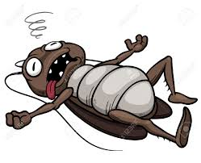
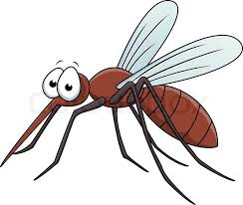
Toxic in insecticides?
Insecticide powder are toxic.
Insecticide powder are made with pyrethrum.
The powder cuts through the cuticles.
Reaches to the nervous system killing the nerve cells. Shutting down the nervous system.
Most commonly know insect exposure to pyrethrum

