Slide 1
Organic compound of
plant origin
or Botanical insecticide

Slide 2
Toxicants derived from plants are used as arrow-tip poisons and fish poisons.
Insecticides belonging to this group are used against pests having piercing and sucking type of mouth parts and at the same time they are beyond control by stomach poisons, which only kill when eaten by insects.
Plants products are used in many ways in insect control and among these nicotine , pyrethrum , retenone , neem are well known.

Slide 3
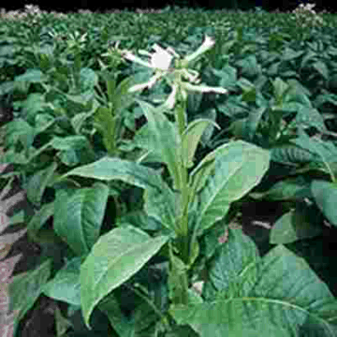
NICOTINE ( c₁₀h₁₄n₂ )
An alkaloid insecticide derived from tobacco plant
Nectiana tobacum and Nectiana rustica .
It is sold in form of nicotine sulphate containing 40% nicotine.
It is applied either in liquid or dust or as a fumigant.
Alkaloid nicotine is colourless, odourless liquid with boiling point 247ºC and specific gravity 1.009 at 20ºC.
It darken in light and air and become more viscous and develops disagreeable odour due to oxidation.
Tobacco plant

Slide 4
Preparation :
The extraction of this alkaloid is done by passing steam under pressure through tobacco stems and the stems thus obtained are condensed and the condensate is utilized for insecticidal use either as volatile nicotine sulphate.
It is prepared by soaking tobacco in warm lime water.
The nicotine content of the tobacco is highest in leaves and lowest in stalks.
Effectiveness is increased by use of appropriate wetting agents.

Slide 5
"Nicotine Sulphate 40%
Nicotine Sulphate 40% acts upon the central nervous system of the insect. It has both contact as well as fumigation action. It is very effective against a wide range of insect pests affecting fruits, flowers, vegetables, field crops as well as on Ectoparasites affecting livestock. Nicotine Sulphate 40% is used to kill Aphids, thrips, Bugs, Worms, Leaf-hoppers and similar sucking insects. It is also effective against lice, mite and ticks which are a menace to livestock.

Slide 6
Tobacco Dust :
The fine powder of dry roots , stems and waste from tobacco factories containing nicotine is called ‘tobacco dust’.
It is used against soil infesting insects.
Nicotine is incompatible with calcium dust, cryolite and barium fluosilicate.
Advantage of nicotine lies in its great margin of safety in plants.
Disadvantage its relative high cost and it is disagreeable to use.
0.05 % nicotine sulphate containing 40% nicotine is effective in controlling aphids.

Slide 7
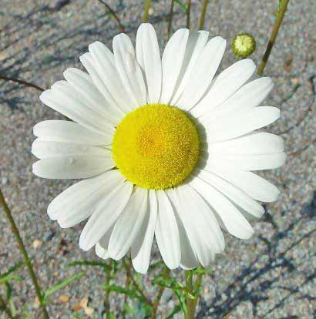
Pyrethrum :
It is Natural insecticide made from the dried flowers of Chrysanthemum coccineum C.roseum & C.carneum.
Active ingredients are pyrethrins and
cinerins.
Flowers are grinded and soaked in the
solvent ,ethylene dichloride.
The distilled off product is called oleoresins.
Oleoresins is further extracted with
kerosine or alcohal.
When exposed to sun light, UV rays heat &
air its loses toxic properties.
Storage in cold place from 0⁰ C to 60⁰C
inhibits decomposition.
Chrysanthemum flower

Slide 8
This is applied as a suspension in water or oil, or as a powder or as spray.
Its content ranges from 0.05 to 0.1% in preparation.
Spray contains 2% of pyrethrins.
Dust contains 0.1% to 0.2% pyrethrins.
Pyrethrins attack the nervous systems of all insects, and inhibit female mosquitoes from biting.
When present in amounts less than those fatal to insects, they still appear to have an insect repellent effect.
They are harmful to fish, but are far less toxic to mammals and birds.
It is mixed with synergist like sulfoxide or piperonyl butaoxide to increase toxicity.
Sesame oil is synergist and petroleum is effective solvent.

Slide 9
Pyrethrum mixed with stored grains protection against
stored grain pests.
It is formulated as dust, emulsion, solution and aerosols.
Powdered flowers and extracts are widely used against
flies, bed bugs and silver fish.
Dust or sprays are used against insects damaging
vegetables, ornamentals and fruit.
It is also used in livestock or cattle spray.
It is also used for protection of valuable turf.
Pyrethrum extracts are incompatable with calcium
arsenate, lime sulphur, paris green and hydrated lime.
It is compatable with dinitrophenols and
tetraethypyrophosphate.

Slide 10
Companion planting
Because of the natural insecticidal properties of the pyrethrums, they are used as companion plants, to repel pest insects from nearby crops and ornamental plants. They are thought to repel aphids, bed bugs , leafhoppers, spider mites, harlequin bugs, ticks, pickleworms and imported cabbage worms, among others that are in gardens and farms. For example, they are planted among broccoli plants for protection from several common insect pests.

Slide 11
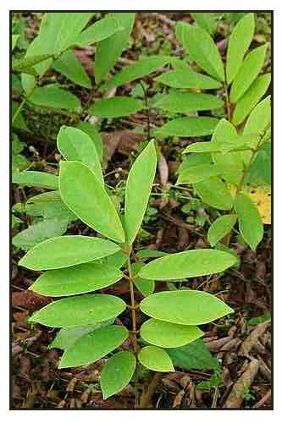
Rotenone (C₂₃H₂₂O₆ )
It is an odorless chemical that is used as a broad-spectrum insecticide, piscicide,& pesticide.
It occurs naturally in the roots and stems of several plants such as the Derris elliptica and D. malaccensis plant.
Natural occurring retenone are elliptone, sumatrol, malacol, toxicarol, degulin, tephrosin etc.
The roots are dried & powdered and mixed with 3.7 parts of diluent such as talc, clay & gypsum.
It is used in making sprays or impregnated dust.
Derris elliptica

Slide 12
It act as contact poison & attack on nervous system caused paralysis.
It is mildly toxic to humans and other mammals, but
extremely toxic to insects and aquatic life (fishs).
This higher toxicity in fish and insects is due to the fact that the lipophilic rotenone is easily taken up through the gills or trachea, but not as easily through the skin or through the gastrointestinal tract.
Melting point is 163⁰C .
It is soluble in chloroform, dichloroethane and
benzene.

Slide 13
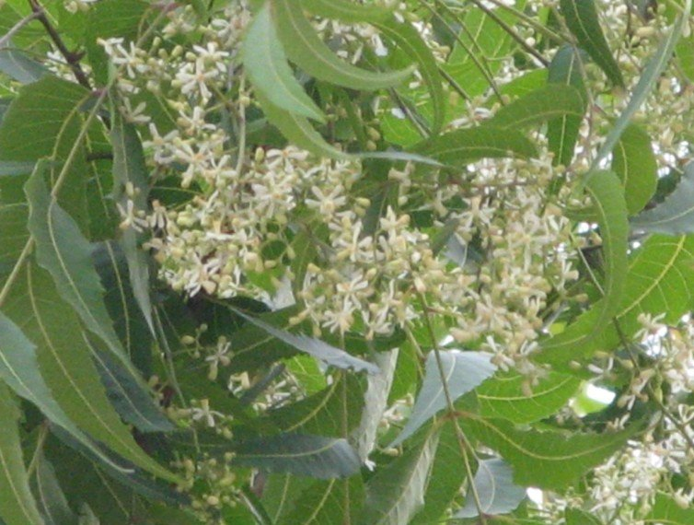
Azadirachta indica (Neem)
It is deciduous tree.
Commonly known as neem.
It possess repellent & insecticidal properties.
Neem seed powder suspension at 0.1% prepared by adding 9 gm. Of powder to 9 L of water.
Powdered neem seed when mixed with wheat seed at 1-2 parts/ 100 parts of seed affords protection against Sitophilous oryzae, Rhizopertha dominica & Trogoderma granarium.
Neem oil soap emulsion is useful for application for garden plants.
Neem

Slide 14
Neem is a key ingredient in non-pesticidal management (NPM), providing a natural alternative to synthetic pesticides.
Neem seeds are ground into a powder that is soaked overnight in water and sprayed onto the crop. To be effective, it is necessary to apply repeatedly, at least every ten days.
Neem does not directly kill insects on the crop. It acts as an anti-feedant, repellent, and egg-laying deterrent, protecting the crop from damage. The insects starve and die within a few days.
Neem also suppresses the hatching of pest insects from their eggs.
Neem cake is often sold as a fertilizer.

Slide 15
Neem cake
Neem Cake has an adequate quantity of NPK in organic form for plant growth. Being a totally botanical product it contains 100% natural NPK content and other essential micro nutrients as N(Nitrogen 2.0% to 5.0%), P(Phosphorus 0.5% to 1.0%), K(Potassium 1.0% to 2.0%), Ca(Calcium 0.5% to 3.0%), Mg(Magnesium 0.3% to 1.0%), S(Sulphur 0.2% to 3.0%), Zn(Zinc 15 ppm to 60 ppm), Cu(Copper 4 ppm to 20 ppm), Fe (Iron 500 ppm to 1200 ppm), Mn (Manganese 20 ppm to 60 ppm). It is rich in both sulphur compounds and bitter limonoids.

