Slide 1
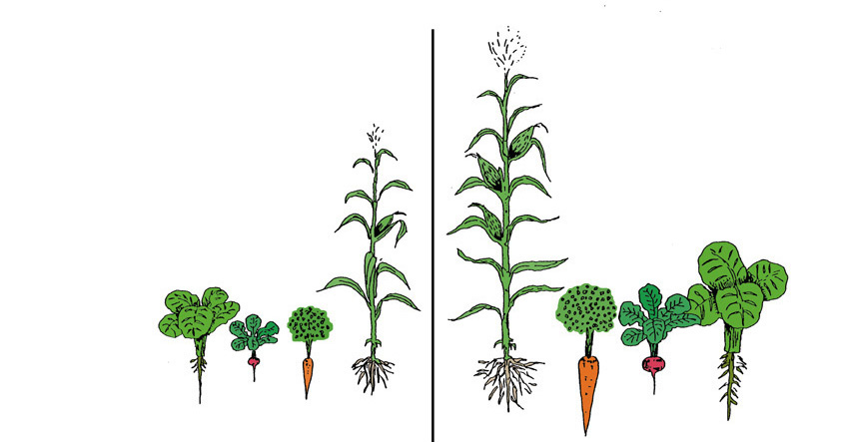
Environmental Requirements for Good Plant Growth

Slide 2
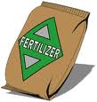
Environment:
Water
Nutrition
Temperature (High and Low)
Light and Day Length

Slide 3
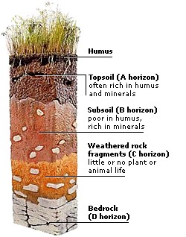
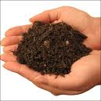
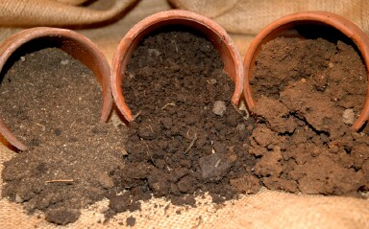
Underground Environment:
Soil – weathered rock
Three types of soil (sand/silt/clay)
Three layers (top/sub/bedrock)
Types of water in the soil
Gravitational water
Free moving capillary water – flood stage
Available capillary water or field capacity
Unavailable capillary water

Slide 4
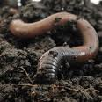
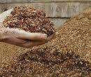
Soil improvements:
Drainage – add sand
Aeration – Earth worms, loam soil
Moisture retention – add organic matter

Slide 5
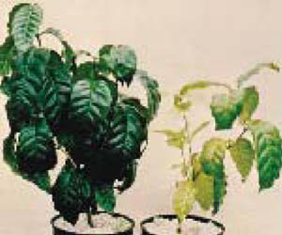
Nutritional Deficiencies:
Plants lacking NPK

Slide 6
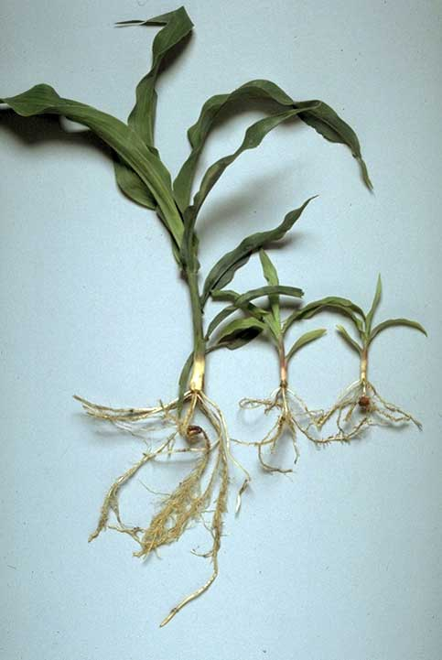
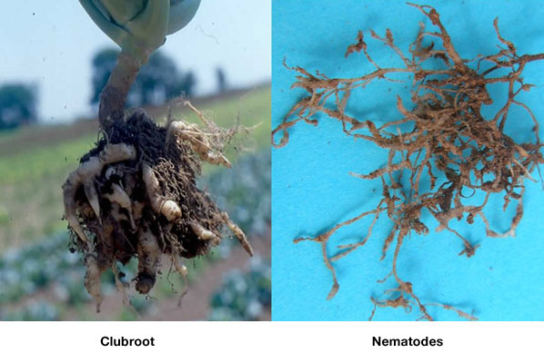
Soil Pests:
Nematodes

Slide 7
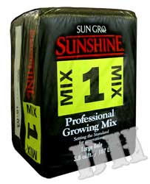
Planting Media Mixes
Advantages:
Mix is uniformed
Sterile no diseases
Lighter in weight, handles easier
Good moisture retention and drainage

Slide 8
Planting Media Mixes
Disadvantages:
Because of the light weight container blow over easily
Missing minor minerals in soil
Plants in mixes hesitate to extend roots into different growing mediums.

Slide 9
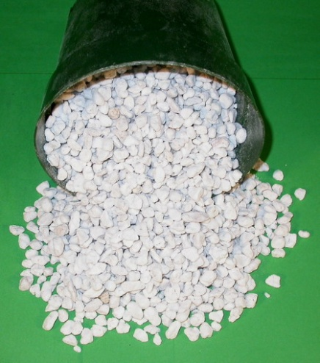
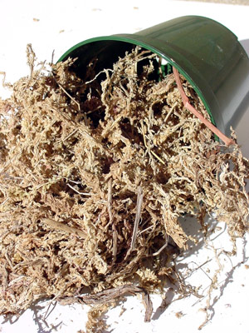
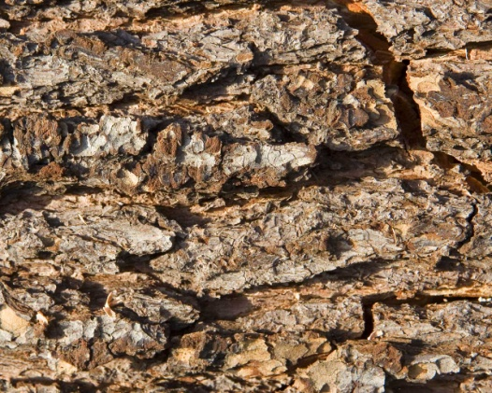
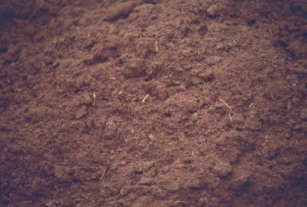
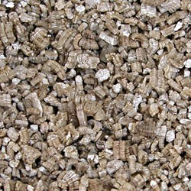
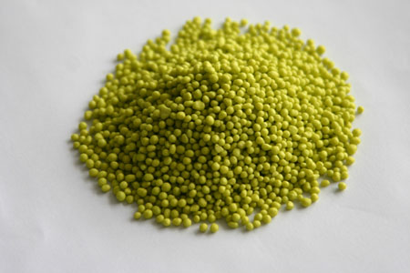
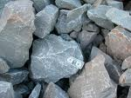
Content of Mixes:
Perlite
Sphagnum Moss
Peat Moss
Vermiculite
Limestone
Tree Bark
Slow Release Fertilizer

Slide 10
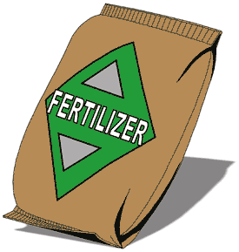
Plant Food and Fertilizers:
Water – 90% of plants weight
Plant Food – Fertilizer
Major – NPK (Nitrogen, Phosphorus and Potassium)
Secondary Nutrients (Calcium, Magnesium, and Sulfur)
Minor Elements: (Boron, copper, chlorine, iron, manganese, molybdenum, zinc, nickel)

Slide 11
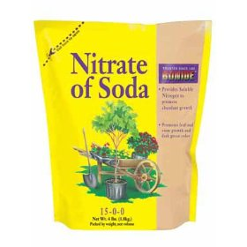
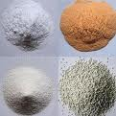
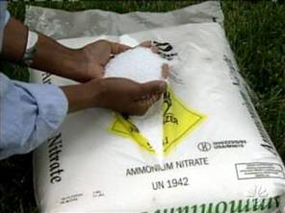
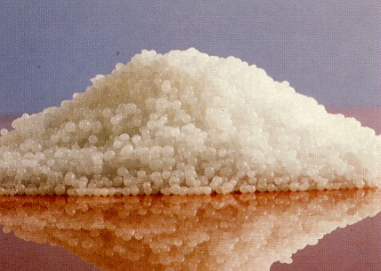
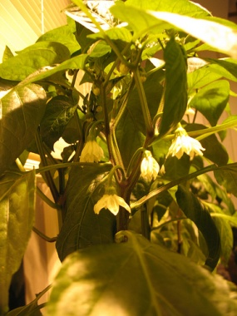
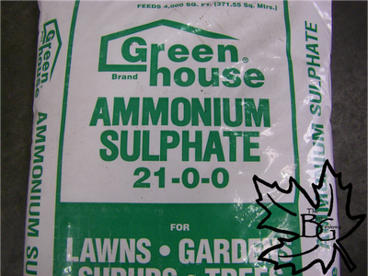
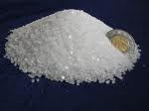
Nitrogen purchased in four forms:
Nitrate of soda
Ammonium nitrate
Ammonium sulfate
Urea formaldehyde
Nitrogen is the most noticeable effect on the plant.
Too much nitrogen:
lowers resistance to diseases
weakens stem
lowers fruit quality
delays maturity
Not enough nitrogen:
Plant turns yellow
Stunted roots and top growth

Slide 12
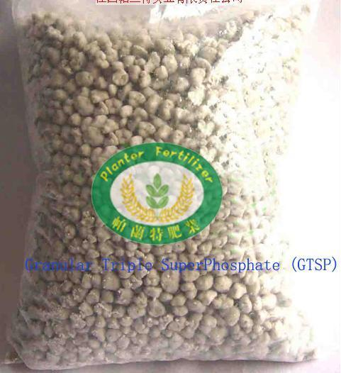
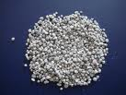
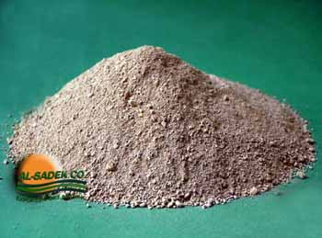
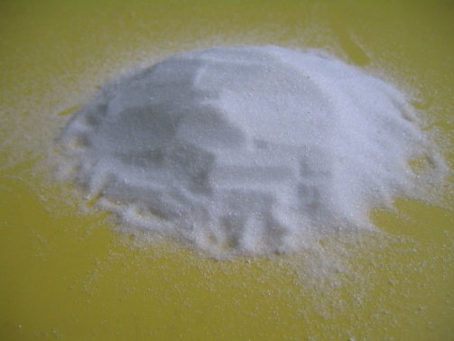
Phosphorous purchased in the following forms:
Superphosphate
Treble superphosphate
Rock Phosphate
Ammonium phosphate

Slide 13
Phosphorous affects plants in several ways:
Encourages cell division
Flowers and seeds don’t form without it
Hastens maturity
Encourages root growth
Makes potash available
Increases plants resistance to diseases
Improves quality of grain, root, and fruit crops

Slide 14
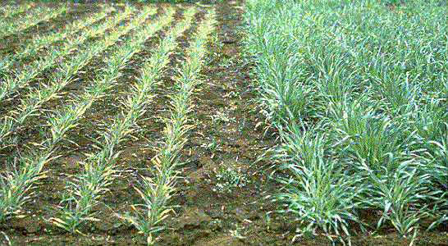
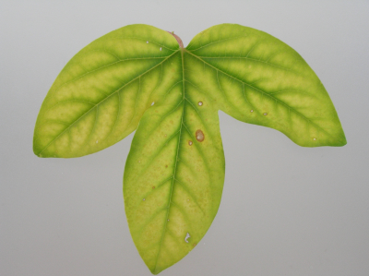
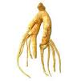
Too much phosphorus:
Plant roots dry out

Slide 15
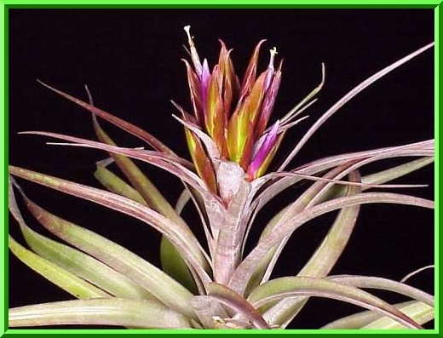
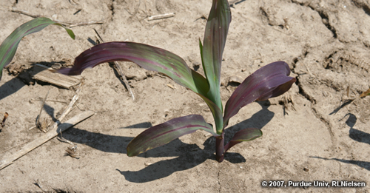
Not enough phosphorus:
Leaves turn purple
Reduced fruit, flower and/or seed production
Plant diseases
Poor quality fruits and seeds.

Slide 16
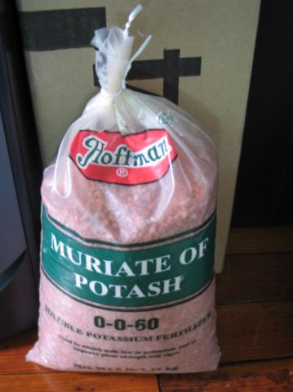
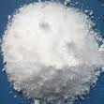
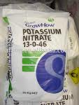
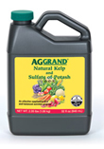
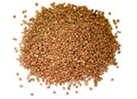
Potassium – the most common sources are:
Muriate of potash
Sulfate of potash
Nitrate of potash

Slide 17
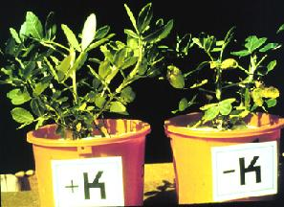
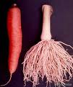
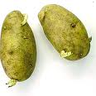
Potassium is essential because:
Increases plant resistance to diseases
Encourages strong root system
Essential to starch formation
Needed for the development of chlorophyll
Essential for tuber development
Encourages the use of C02 (carbon dioxide)

Slide 18
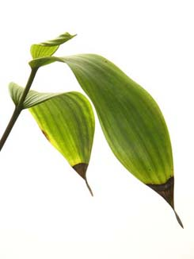
Too much:
Marginal yellowing or scorch on the edges of the leaves.

Slide 19
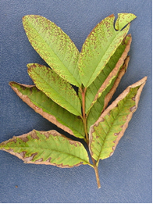
Too Little
Yellowing and curling of edges of lower (older) leaves
Sometimes leaves will turn purple
More likely to occur in times of drought stress
Leaf edges looked burned

Slide 20
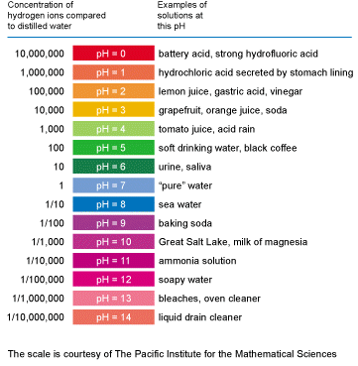
Soil pH
Acid – sour pH 0 -6.9 (to raise add limestone)
Alkaline – sweet 7.1 -14 ( to lower add sulfur)
Neutral – pH 7

Slide 21
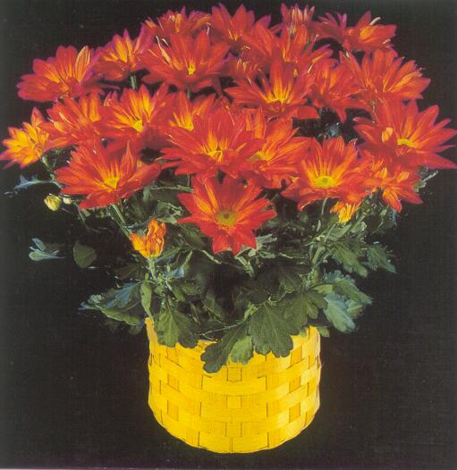
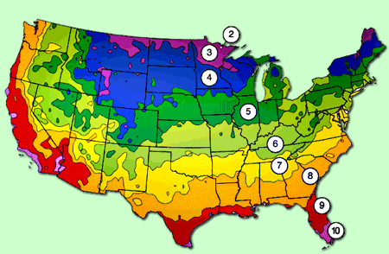
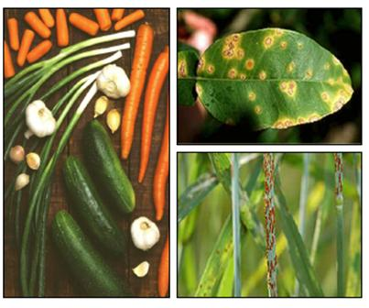
Above ground Environment:
Temperature – ideal 70 degrees Fahrenheit
Light - photoperiodism (Long or Short days)
Humidity 40 – 80% best
Adaptability of plants - grow in certain plant zones
Plant Diseases and Insects
Gases and Air Particles

Slide 22
The End

