Slide 1
VERMICOMPOSTING
Back to Basics
www.goodplanetsarehardtofind.org

Slide 2
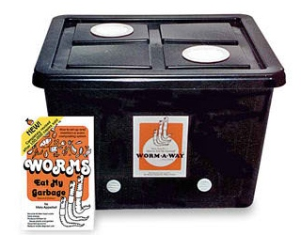
AKA: A Worm Bin

Slide 3
What is Vermicomposting?
The raising and production of earthworms and harvesting worm castings
Using worms to decompose organic food waste, turning the waste into a nutrient-rich material capable of supplying necessary nutrients to help sustain plant growth.
Vermicompost is similar to regular compost, except that worms take part in the composting process.

Slide 4
Why is Vermicompost Important?
Vermicompost or worm fertilizer is strictly organic. Vermicompost is used as an organic fertilizer in agricultural gardens. Vermicompost enriches the soil, creates an ecologically safe system of food production, and raises land productivity. By using vermicompost in gardens, harmful chemicals and pesticides are no longer needed in the cultivation of crops.

Slide 5
Worms: The most important organisms on Earth?
Cleopatra renamed the worm "a sacred creature", whose removal from Egypt was punishable by death. Nile Valley is said to be the most fertile tract of land on earth and it is literally one vast bed of earthworm soil.

Slide 6
Benefits of Vermicomposting

Slide 7
Benefits
Input Waste, Get Black Gold as an output!
Save Money by letting worms make compost for you free and fast!!
Be Eco-conscious/Green by diverting food waste from the landfills
Reverse the damage from years of bad soil management: Over fertilization, Chemicals, and over tilling.
Potential to make money

Slide 8
WASTE TO RESOURCES
INPUTS
Food Waste
Cardboard
Shredded Paper
OUTPUTS
Free “Black Gold” Compost
Free Fishing Bait
Compost Tea
Salable Red Worms
Salable Compost

Slide 9
SAVE MONEY
Worm Castings are EXPENSIVE!
Up to $8.00 per lb!
Let the Worms do all the work for you
Only have to purchase worms once
One wiggler can produce approximately 468 hatchlings per year.
Worm Castings better than Manure
They are the purest and most perfect form of plant food. In addition to containing unusually high populations of beneficial microorganisms crucial to healthy root systems, castings also naturally aerate the soil, retain high moisture levels, and release nutrients slowly over time to meet your plants needs. AND it’s Odorless!

Slide 10
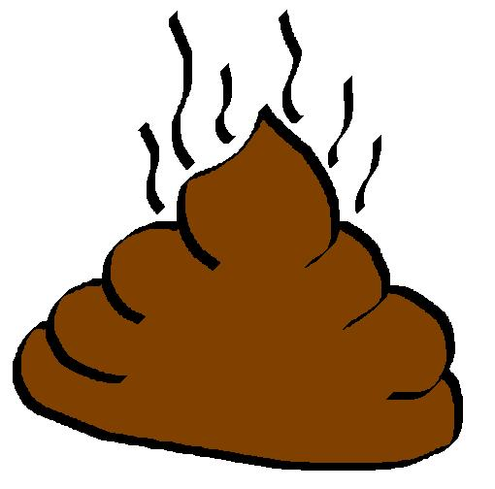
Why Manure is BAD
Horse Manure
Horses have incomplete digestive system
Weedy feed means weedy poop
Weed-free grains may contain herbicides
On-going use over the years creates toxic levels of magnesium
Cow Manure
This is a good all purpose manure.
It has a good balance of nutrients, but they are low in quantity.
Suitable for building poor soil, not so much growing plants

Slide 11
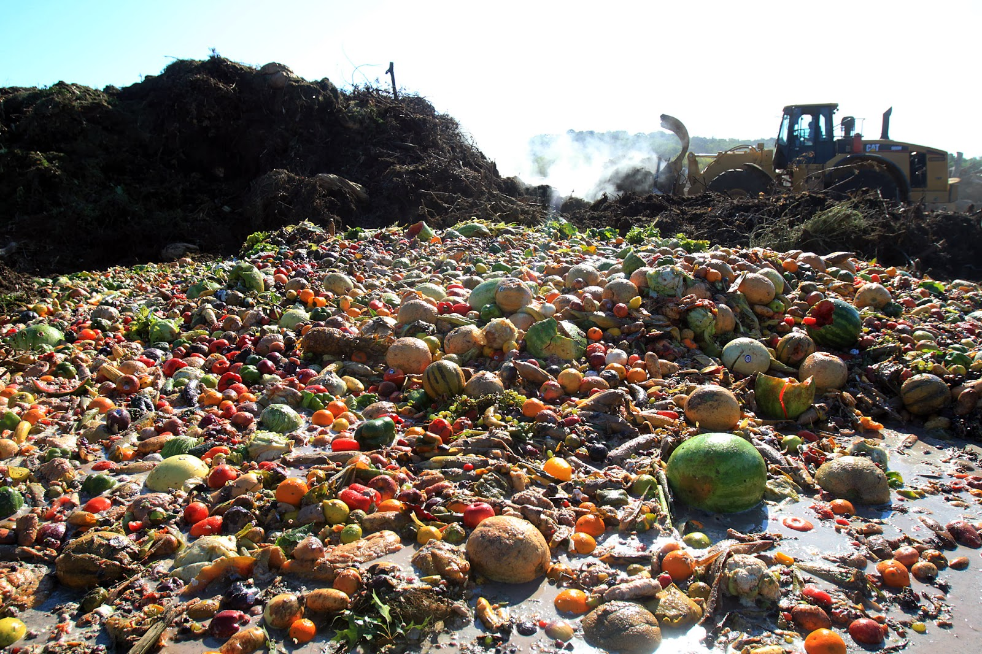
Convert food waste into fertilizer!
Saves food waste from entering our Landfills
Every year in America we throw away 96 billion pounds of food.
Our society wastes 1/2 of all food that it produces

Slide 12
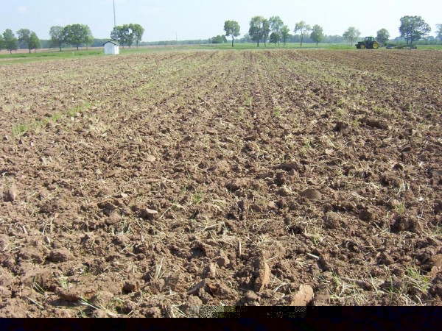
RESTORE SOIL FERTILITY!
SOIL IS MORE THAN DIRT!
It is teaming with micro-organisms!
TILLING IS HORRIBLE FOR SOIL HEALTH!!
Roto-tilling destroys the network of fungal hyphae that gives soil structure.
This includes the mychorrhizal network that is so important to plants.
Adding organic matter brings life to soils that have been damaged by years of over fertilization, and chemicals, and tilling.
"All plants--grass, trees, shrubs, agricultural crops--depend on the food web for their nutrition."----Soil and Water Conservation Society

Slide 13
What you need…
A suitable container (such as the Worm-a-Way Composting Bin). The container must provide air flow (to allow your wormies to breathe) and a dark environment (worms dislike light). You’ll also want a lid to preserve moisture. In one of her books (Worms Eat My Garbage) Mary suggests weighing your household food waste for one week and then providing one square foot of surface area per pound.

Slide 14
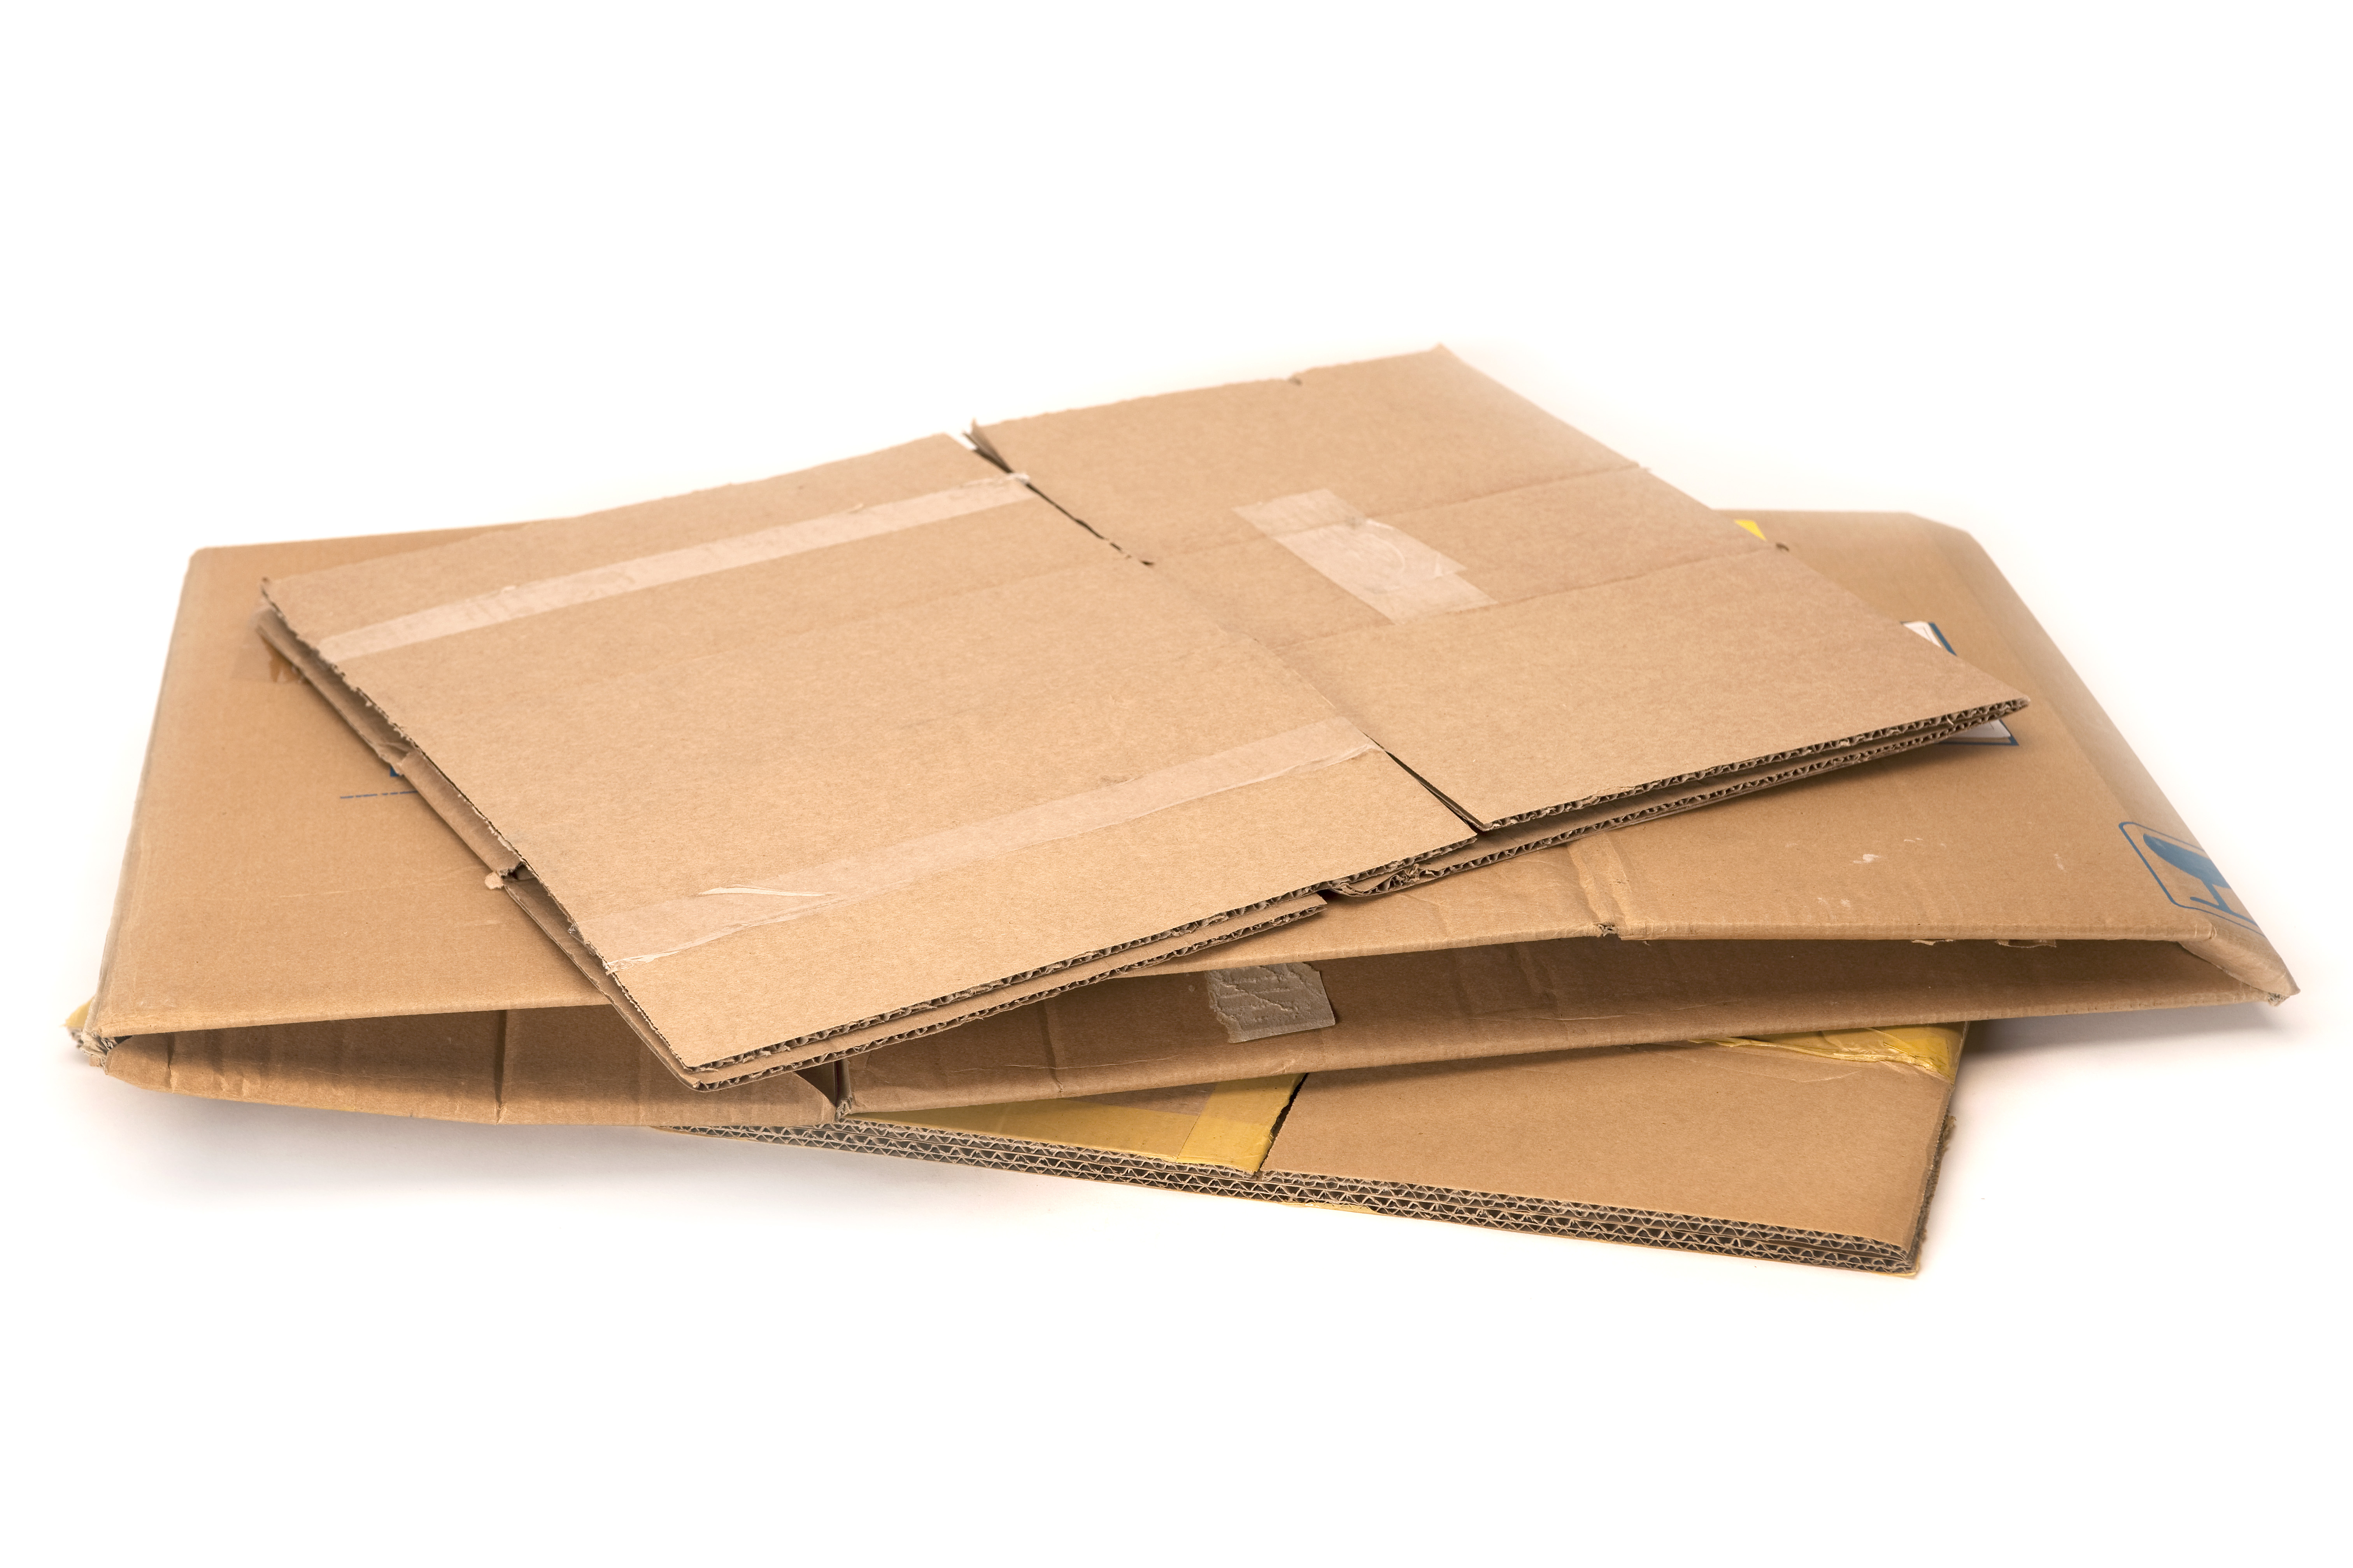
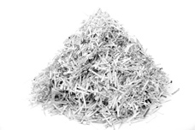
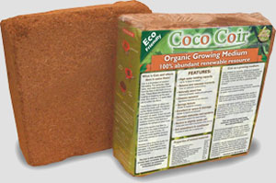
What you need… (continued)
Bedding to support the worms. This bedding will be both home and food to the worms. Bedding can be coir (coconut fiber bedding), shredded cardboard, newspaper or peat moss with each option having advantages and challenges. Whichever option you choose, the bedding should be damp but not soggy to provide an optimal environment for worms to turn your kitchen scraps into black gold.

Slide 15
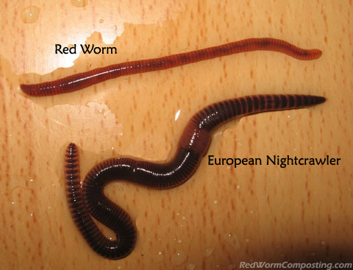
What you need… (continued)
Redworms (Red Wigglers) Not all worms are suited for life as worm-bin garbage recyclers. You’ll want Red Wigglers for this job

Slide 16
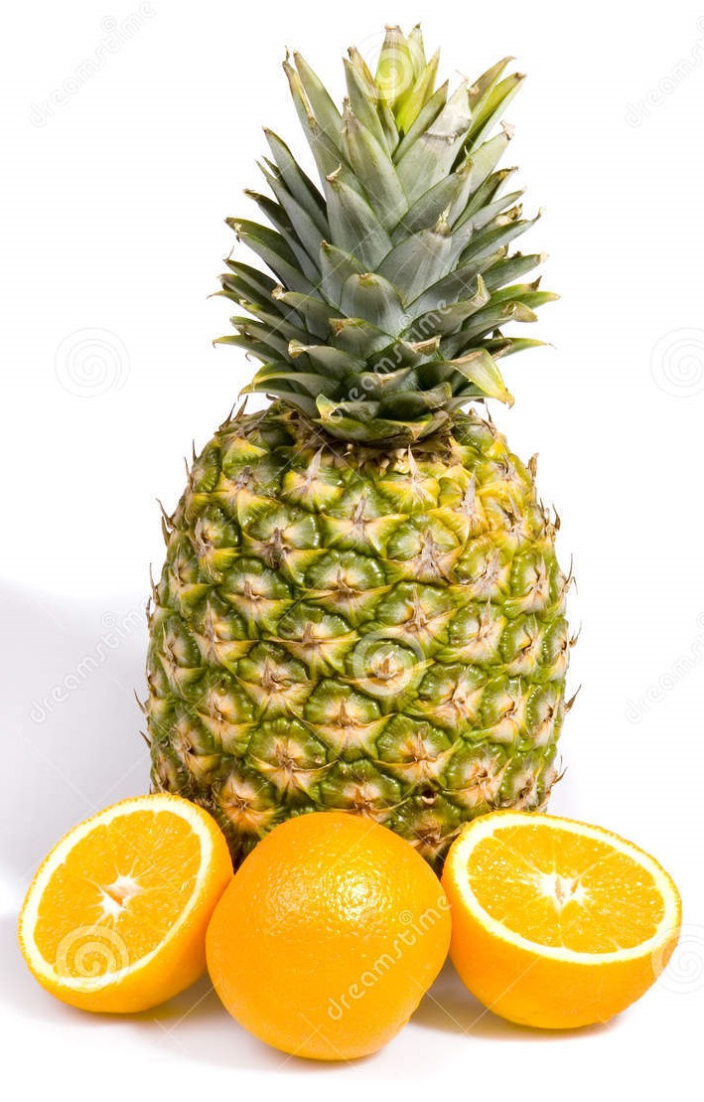
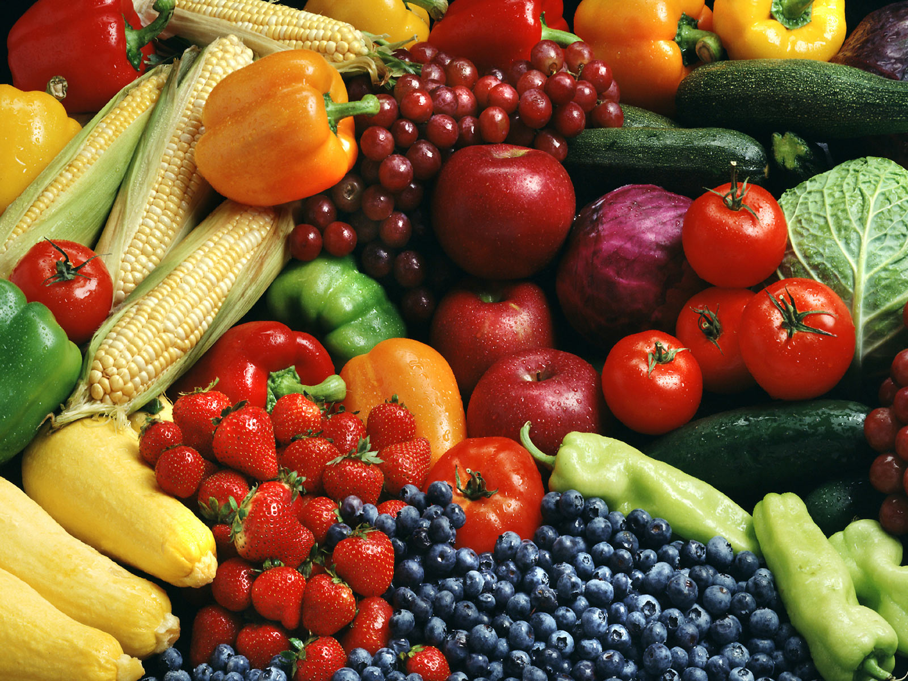
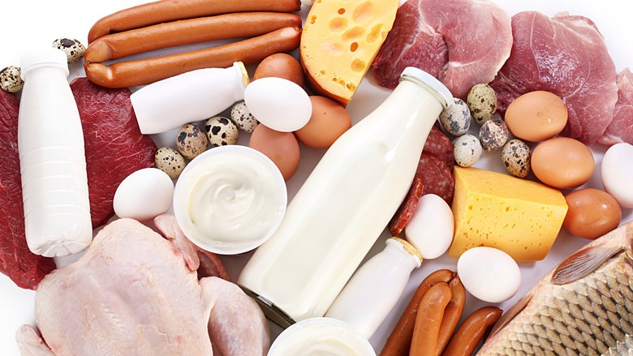
What you need… (continued)
Garbage (organic matter such as kitchen scraps) You can feed your worms almost anything, but here are some tips. Veggies and fruit work well, but avoid anything too acidic (think oranges). Worms may also have a hard time with onions and garlic. Your hardworking garbage worms also have a digestive system that will benefit from fine grit such as coffee grounds, cornmeal or crushed eggshells. Avoid lots of protein and fat materials as these can cause the bin (which is otherwise virtually odorless) to stink. And remember to begin sloooowly. If you give your worms a giant feast on day one and then keep adding, your food will start to rot before they have a chance to address it. (In other words, it will start to smell because they can’t eat it as fast as you provide it.

Slide 17
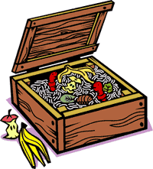
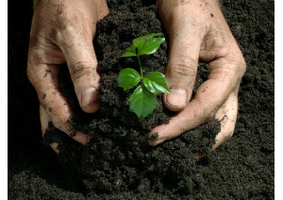
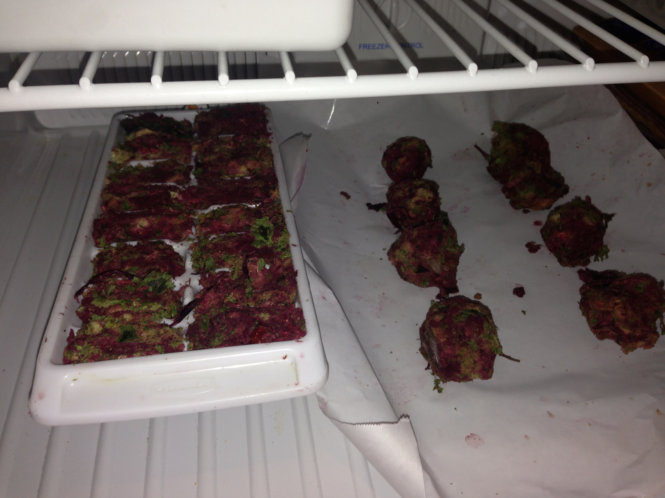
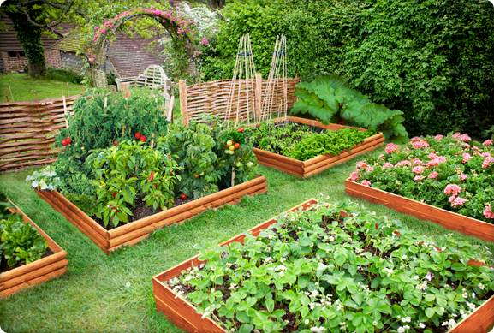
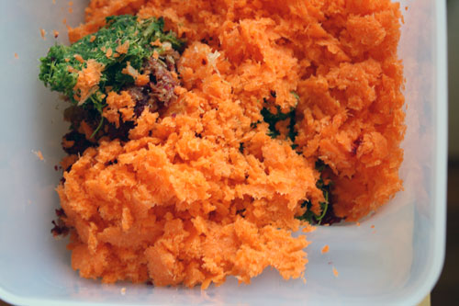
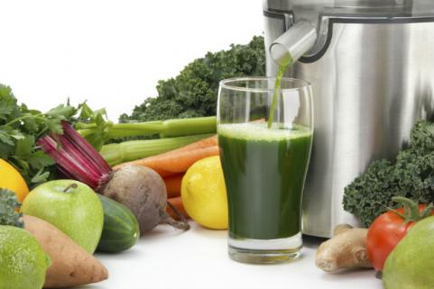
Vermicompost
Frozen Pulp Balls
Waste to Resources
Fast Growing Veggies
Pulp from Juicer

Slide 18
VERMICOMPOST APPLICATIONS
Worm Castings
Compost Tea

Slide 19
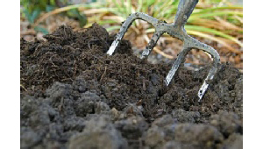
Worm Casting Applications
Potting soil amendment - 1:10 ratio vermicompost to soil.
Garden soil amendment - 1:10 ratio vermicompost to soil.
Side dressing plants and seedlings for slow release fertilizer.
Topical broadcast on lawn and garden areas for slow release fertilizer.
Compost Tea starter.

Slide 20
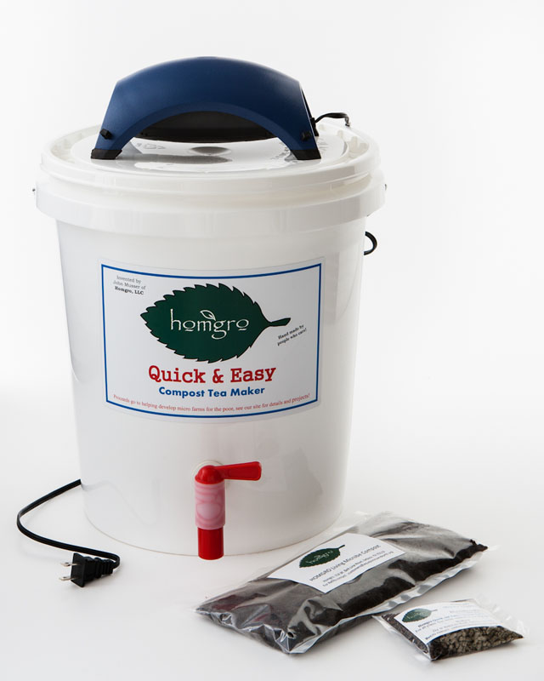
Compost Tea
Compost Tea is a highly concentrated microbial solution produced by extracting beneficial microbes from Vermicompost and or compost.
FOUR ESSENTIALS for happy microbes
Water, Air, Food, Comfort

Slide 21
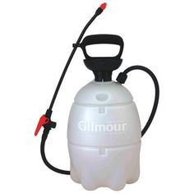
Compost Tea Application
Soil Application
8 to 20 gallons per acre
Foliar Spray
5 gallons per 5 feet of foliage
Beneficial microbes out compete pest and/or diseases
www.goodplanetsarehardtofind.org

