Slide 1
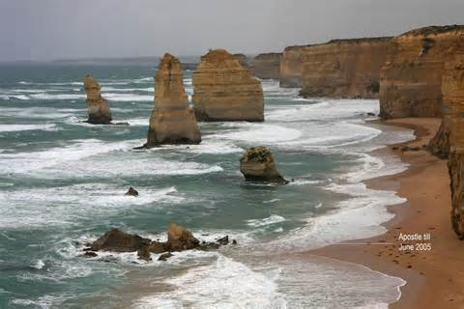
Water Erosion
Notes:
Picture is of an eroded beach line. Erosion was by waves.

Slide 2
Key Vocabulary
Runoff meander Rill oxbow lake turbulence
Gully alluvial fan ice age
Stream delta River
groundwater Tributary sand dune
Drainage basin Divide abrasion Flood plain beach
deflation

Slide 3
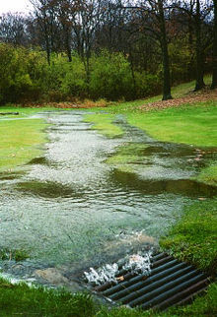
Runoff and Erosion
Running water creates many landforms.
Moving water is the major agent of the erosion that shaped Earth’s land surface.
Erosion by water begins with the splash of rain. Some rainfall sinks into the ground. Some evaporates or is taken up by plants. The force of a falling raindrop can loosen and pick up soil particles. As water moves over the land it carries these particles with it. This moving water is called runoff.
Runoff is all the remaining water that moves over the Earth’s surface.
When runoff flows in a thin layer over the land, it may cause a type of erosion called sheet erosion.

Slide 4
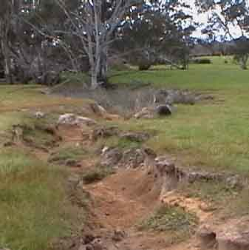
Rills and Gullies
Because of gravity, runoff and the material it contains move downhill.
As runoff travels, it forms tiny grooves in the soil called rills.
As the rills flow into one another, they grow larger, forming gullies.
A gully is a large groove, or channel, in the soil that carries runoff after a rainstorm.
As water flows through gullies, it moves soil and rocks with it, thus enlarging the gullies through erosion. Gullies flow only after it rains.

Slide 5
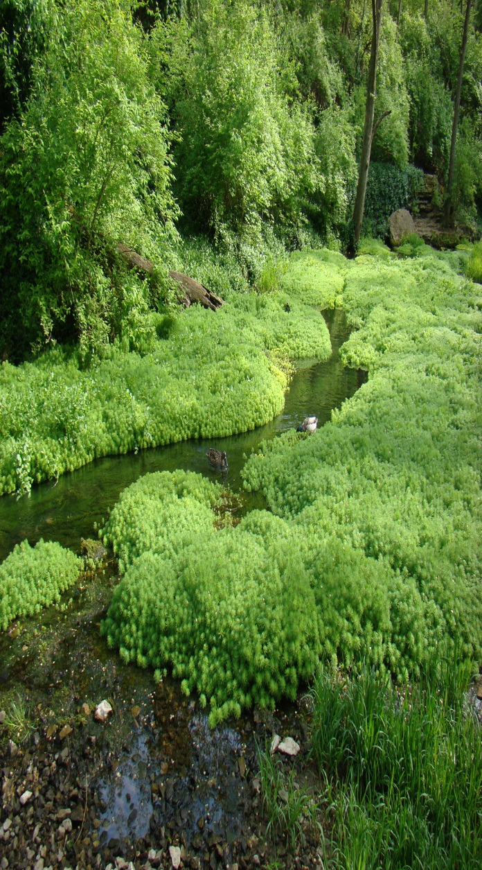
Streams and Rivers
Gullies join together to form a larger channel called a stream.
A stream is a channel along which water is continually flowing down a slope.
Unlike gullies, streams rarely dry up. Small streams are also called creeks or brooks. As streams flow together, they form larger and larger bodies of flowing water.
A Large stream is often called a river.

Slide 6
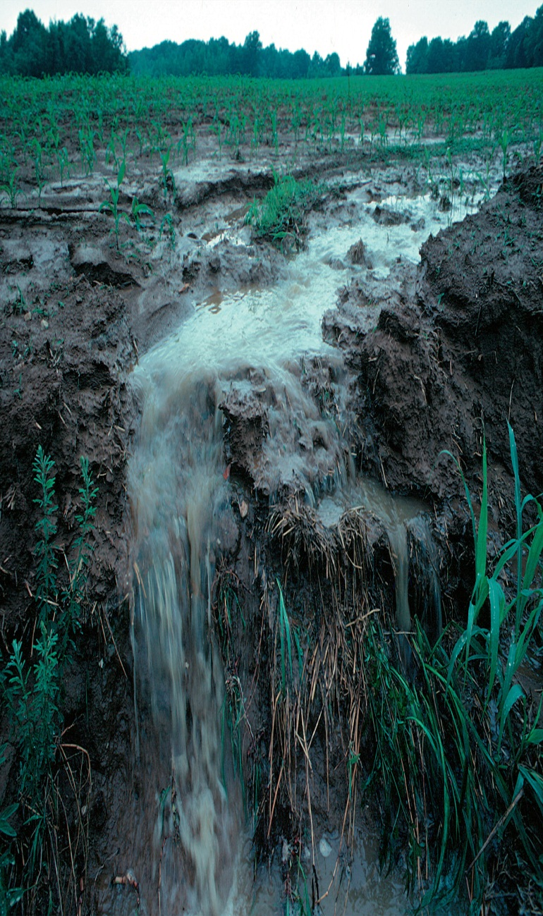
Amount of Runoff
The amount of runoff in an area depends on five main factors. The first factor is the amount of rain an area receives. A second factor is vegetation. Grasses, shrubs, and trees reduce runoff by absorbing water and holding soil in place. A third factor is the type of soil. Some types of soil absorb more water than others. A fourth factor is the shape of the land. Land that is steeply sloped has more runoff than flatter land. Finally, a fifth factor is how people use the land. For instance, a paved parking lot absorbs no water, so all the rain that falls on it becomes runoff. Runoff also increases when a farmer cuts down crops, since this removes vegetation from the land.
Generally, more runoff, such as plant leaves and roots, will reduce erosion. Even through deserts have little rainfall, they often have high runoff and erosion. This is because deserts usually have few plants. In wet areas, runoff and erosion may be low because there are more plants to protect the soil.

Slide 7
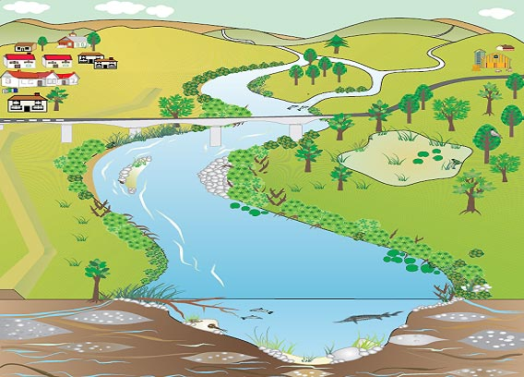
River Systems
A stream grows into a larger stream or river by receiving water from tributaries.
A tributary is a stream that flows into a larger stream.
A small creek that flows into a larger river is a tributary to that river. So too is a larger river that adds its water to another large river. For instance, the Missouri River becomes a tributary of the Mississippi River near the city of St. Louis, even though both rivers are about the same size there.

Slide 8
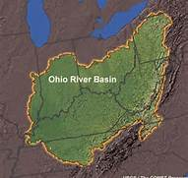
The tributaries to the Ohio River form a river system. All the streams – from tiny rills to great rivers – form the Ohio River system that drains a large part of eastern North America.
A drainage basin is the land are from which a river and its tributaries collect their water.
If you were to follow a river upstream all the way to its source, you would finally reach a divide.
A divide is the high ground between two drainage basins.
The most famous divide within the United States is the Continental Divide, which follows the high ground of the Rocky Mountains. The Continental Divide separates streams that flow into the Gulf of Mexico from streams that flow into the Great Basin or the Pacific Ocean.

Slide 9
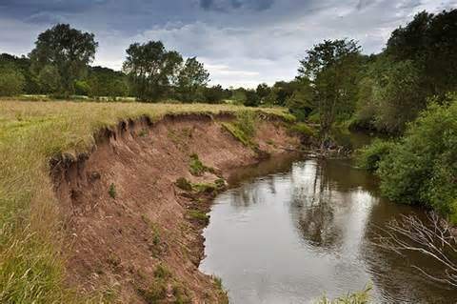
Erosion by Rivers
Scientists classify rivers by identifying certain features that form as a result of erosion.
Through erosion, a river creates valleys, waterfalls, flood plains, meanders, and oxbow lakes.
Rivers often form on steep mountain slopes. Near its source, a river is often fast-flowing and generally follows a straight, narrow course. The steep slopes along the river erode rapidly. The result is a deep, V-shaped valley.

Slide 10
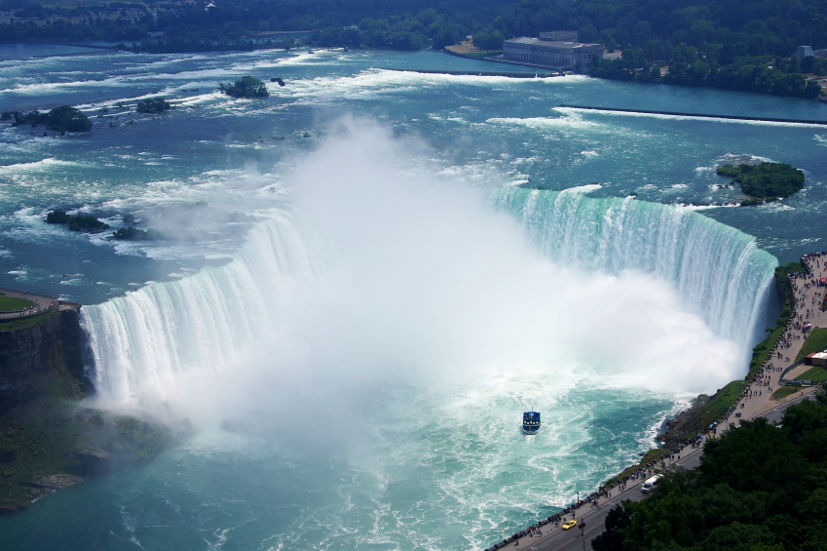
Waterfalls may occur where a river meets an area of rock that is very hard and erodes slowly. The river flows over this rock and then flows over softer rock downstream. The softer rock wears away faster than the harder rock. Eventually a waterfall develops where the softer rock was removed. This process formed Niagara Falls. Areas of rough water called rapids also occur where a river tumbles over hard rock.

Slide 11
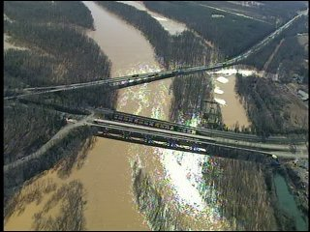
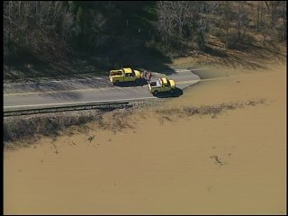
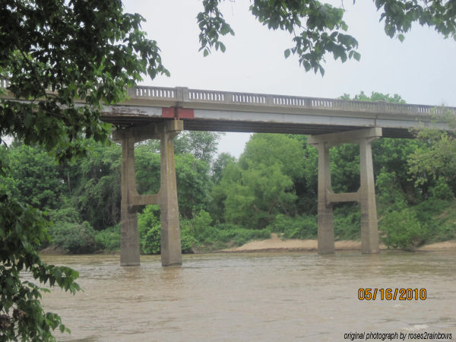
Lower down on its course, a river usually flows over more gently sloping land. The river spreads out and erodes the land forming a wider river valley.
The flat, wide area of land along a river is a flood plain.
a river often covers it flood plain when it overflows it banks during floods. On a wide flood plain, the valley walls may be kilometers way from the river itself.
A river often develops meanders where it flows through easily eroded rock or sediment.
A meander is a loop like bend in the course of a river. As the river widens from side to side, it tends to erode the outer bank and deposit sediment on the inner bank of a bend. Over time, the bend – or meander – becomes more and more curved.

Slide 12
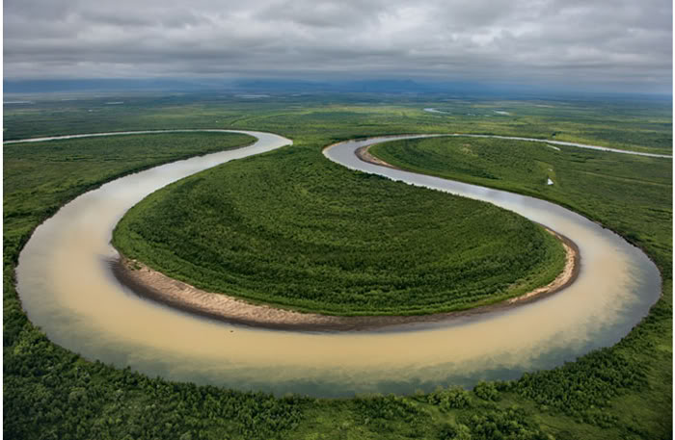
When the gently sloping part of a river flows through an area of sediment or soft rock it can erode a very wide flood plain. Along this part of a river’s course, its channel is deep and wide. Meanders are common along this part of a river. The southern stretch of the Mississippi River is one example of a river that meanders on a wide gently sloping flood plain.
Sometimes a meandering river forms a feature called an oxbow lake. An oxbow lake is a meander that had been cut off from the river.
An oxbow lake may foam when a river floods. During the flood, high water finds a straighter route downstream. As the flood water fall, sediments damp the ends of a meander. The meander has become an oxbow lake.

Slide 13
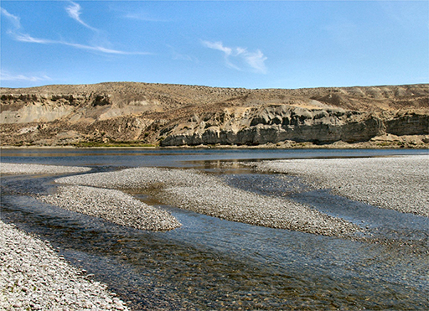
Deposits by Rivers
As water moves, it carries sediments with it. Any time moving water slows down, it drops, or deposits, some of the sediment. As the water slows down, fine particles fall to the river’s bed. Larger stones quit rolling and sliding.
Deposition creates landforms such as alluvial fans and deltas. It can also add soil to a river’s flood plain.

Slide 14
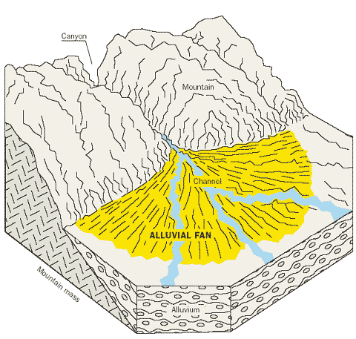
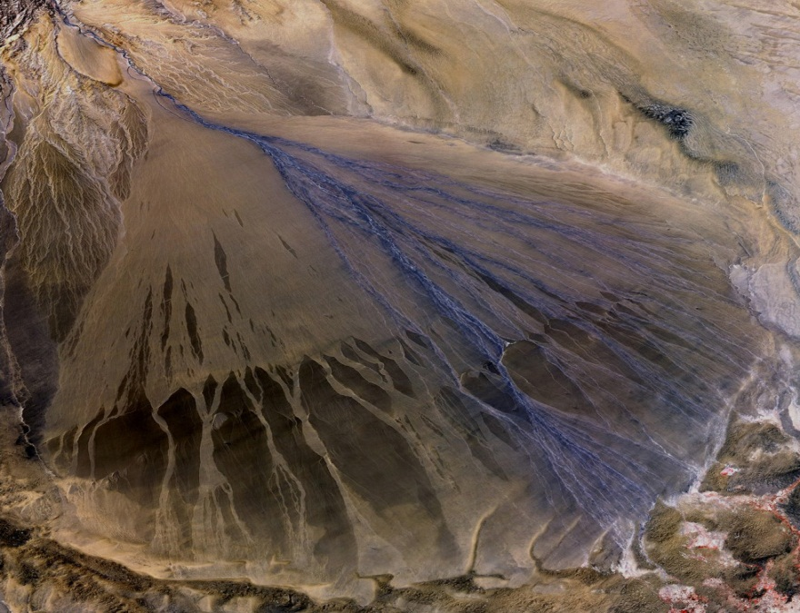
Alluvial Fans
Where a stream flows out of a steep, narrow mountain valley, the stream suddenly become wider and shallower. The water slows down. Here sediments are deposited in an alluvial fan.
An alluvial fan is a wide, sloping deposit of sediment formed where a stream leaves a mountain range. As its name suggests, this deposit is shaped like a fan.

Slide 15
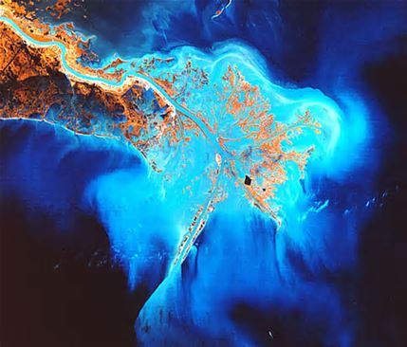
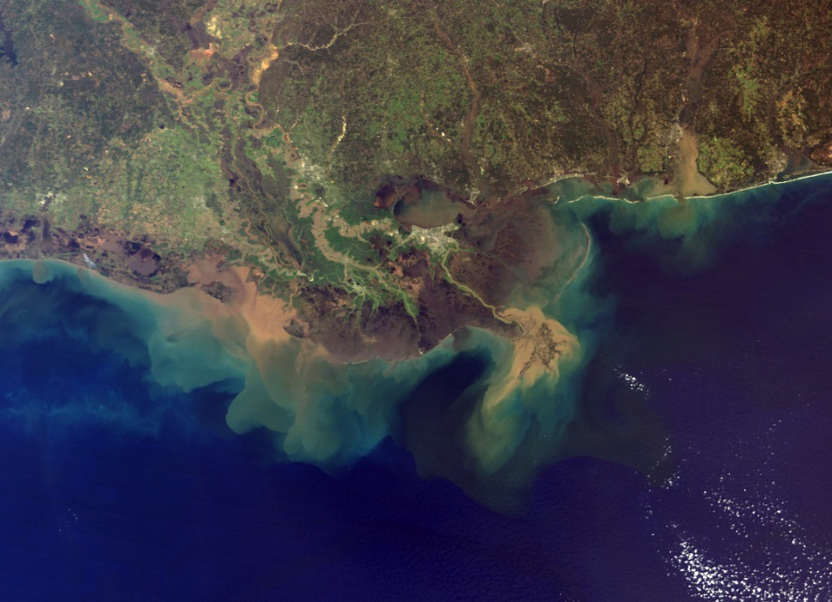
Deltas
A river ends its journey when it flows into a still body of water, such as an ocean or a lake. Because the river water is no longer flowing downhill, the water slows down. At this point, the sediment in the water drops to the bottom. Sediment deposited where a river flows into an ocean or lake builds up a landform called a delta.
Deltas can be a variety of shapes: some are arc shaped, other are triangle-shaped. The delta of the Mississippi River is an example of a type of delta called a “bird’s foot” delta.

Slide 16
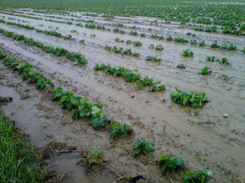
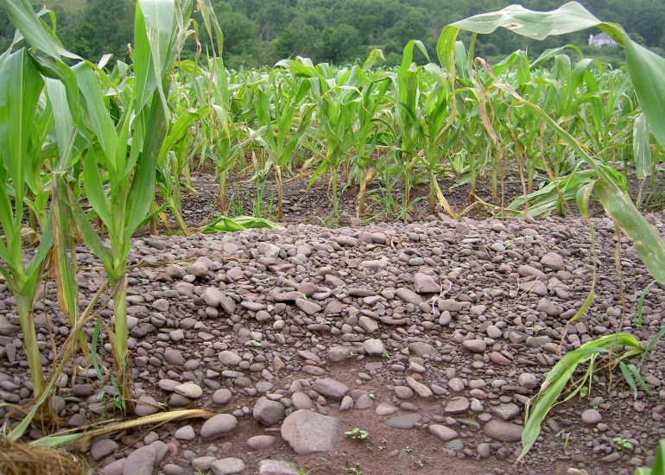
Soil on Flood Plains
Deposition also occurs during floods. Then heavy rains or melting snow cause a river to rise above its banks and spread out over its flood plain. When the flood water finally retreats, it deposits sediments as new soil. Deposition of new soil over a flood plain is what makes a river valley fertile. Dense forests can grown in the rich soil of a flood plain. The soil is also perfect for growing crops.

Slide 17
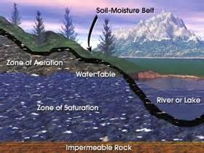
Ground Water Erosion and Deposition
When rain falls and snow melts, not all of the water evaporates or becomes runoff. Some water soaks into the ground. There it fills the openings in the soil and tricklets into cracks and spaces in layers of rock.
Groundwater is the term geologists use for the underground water. Like running water on the surface, groundwater affects the shape of the land.

Slide 18
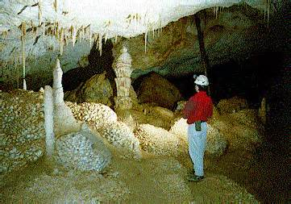
Groundwater can cause erosion through a process of chemical weathering. When water sinks into the ground, it combines with carbon dioxide to form a weak acid, called carbonic acid. Carbonic acid can break down limestone. Groundwater containing carbonic acid flows into cracks in the limestone. Then some of the limestone changes chemically and is carried away in a solution of water. This gradually hollows out pockets in the rock. Over time, these pockets develop into large holes underground, called caves or caverns.
The action of carbonic acid on limestone can also result in deposition. Inside limestone caves, deposits called stalactites and stalagmites often form. Water containing carbonic acid and calcium from limestone drips from a caves roof. As the water evaporates, a deposit of calcite forms. A deposit that hangs like an icicle from the roof of a cave is called a stalactite. Slow dripping builds up on a cone-shaped stalagmite from the cave floor.

Slide 19
Review Questions
What is the major cause of erosion on Earth’s surface?
Briefly describe five features formed by rivers and streams as they erode the land.
What are the results of deposition along the course of a stream or river?
How can groundwater contribute to erosion?
Comparing and Contrasting: how is an alluvial fan similar to a delta? How is it different?

