Slide 1
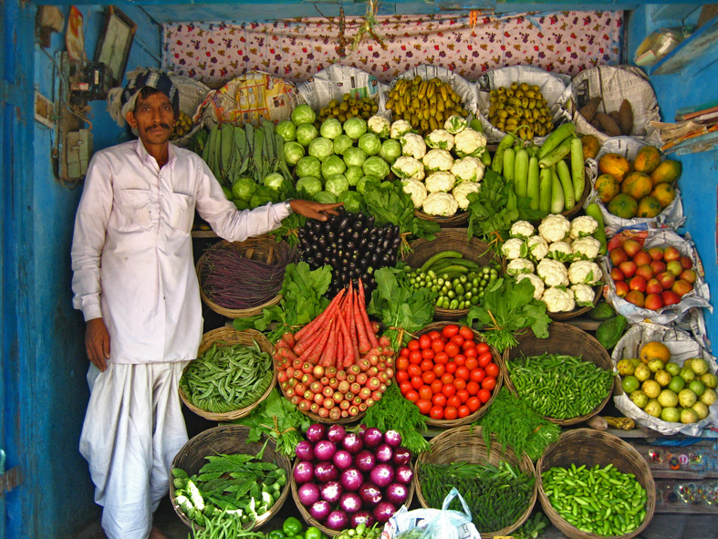
Photo credit: United Nations
Sanitation for Food Security
19 November 2013

Slide 2
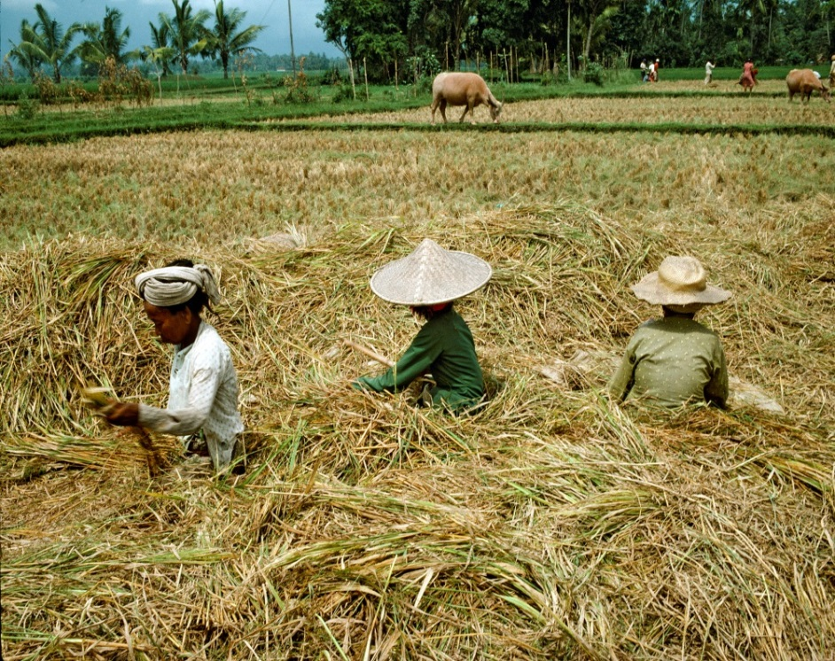
Sanitation for food security
sanitation and food security facts
World Health Summit defines Food Security as “when all people at all times have access to sufficient, safe, nutritious food to maintain a healthy and active life”
Photo credit: United Nations

Slide 3
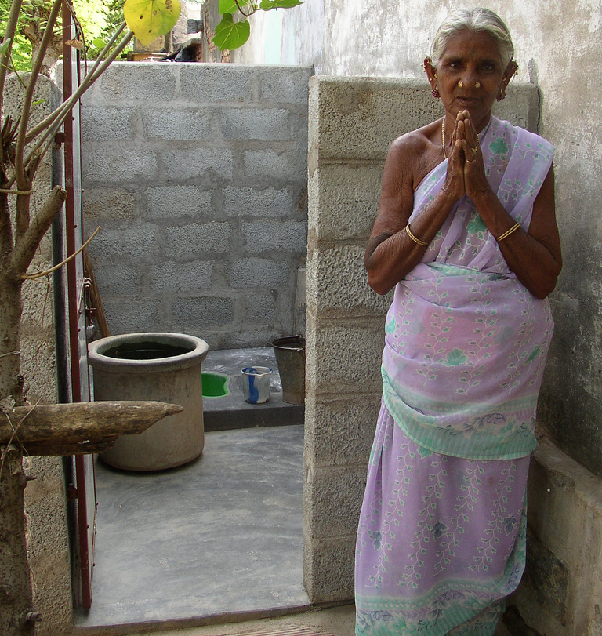
Sanitation for food security
sanitation and food security facts
40% of people in the world still do not have a toilet
925 million are malnourished world wide
Photo credit: Water.org

Slide 4
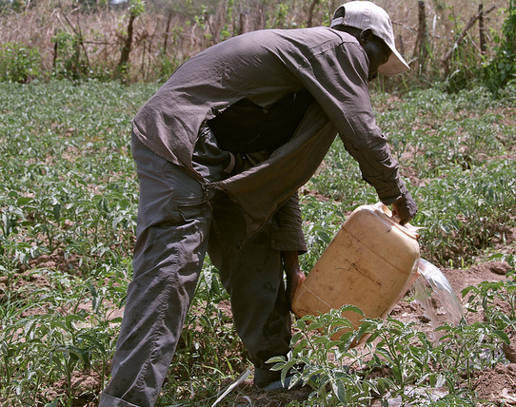
Sanitation for food security
sanitation contributes to food security
If faeces are collected in sanitary facilities, they can be used as a valuable resource in agriculture
Productive sanitation means making use of human excreta for nutrients, organic matter, water and energy
Photo credit: IARC

Slide 5
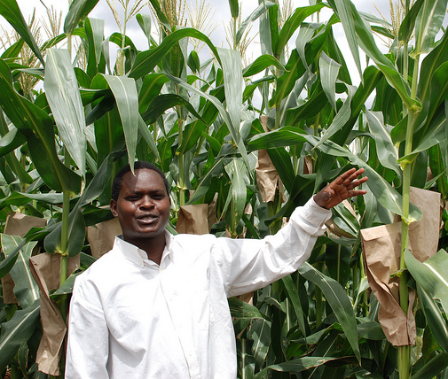
Sanitation for food security
Why sanitation leads to food security
Productive systems result in:
Recovery of nutrients and energy in household wastewater, minimizing consumption and pollution of water resources
Improved soil fertility
Nutrients and soil fertility increase agricultural productivity and therefore food security
Photo credit: Anne Wangalachi_CIMMYT3

Slide 6
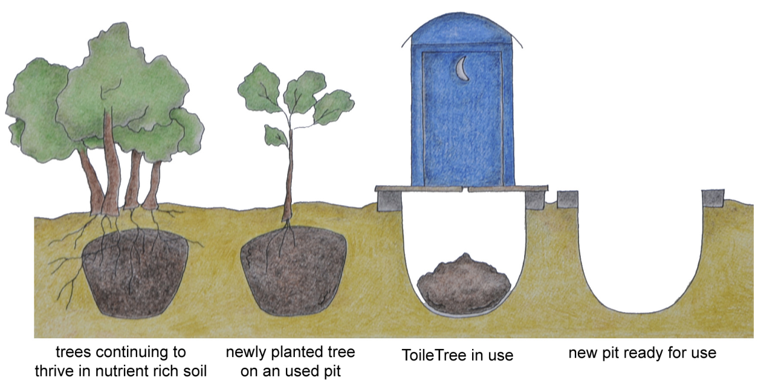
Sanitation for food security
Technologies for productive sanitation
Source-separated urine: produces a fertilizer rich in nitrogen
Struvite production: produces a mineral powder with high fertilizer value from urine
Arborloo: resultant nutrient rich substrate left by a pit latrine is used to grow a tree
Dry Urine Diverting Toilet: produces urine fertiliser and manure
Wastewater recycling: raw or partially treated wastewater spread on fields or used in irrigation
Photo credit: WeSustainLife.org
Photo credit: WeSustainLife.org

Slide 7
Sanitation for food security
Improve your family’s lives – Stand up for your right to a toilet!
www.sanitationdrive2015.org
Leanne Burney, UN Secretary-General's Advisory Board on Water and Sanitation Email: burneyl@un.org Therese Dooley, UNICEF Email: tdooley@unicef.org Amanda Marlin, Water Supply and Sanitation Collaborative Council Email: amanda.marlin@wsscc.org
Corinne Schuster-Wallace, United Nations University Institute for Water, Environment and Health
Email: corinne.schusterwallace@unu.edu

