Slide 1
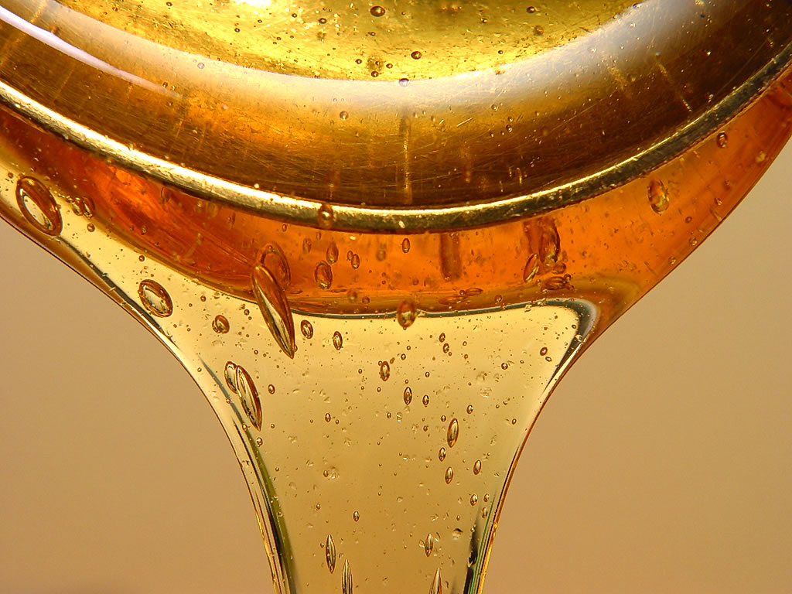
Temperature vs. Viscosity Lab
How does heating affect viscosity
How does viscosity affect flow rate

Slide 2
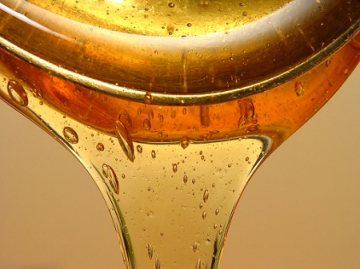
Formal Lab Report Reminder
The lab report must have a title (1 mark)
The lab report must be in order (1 mark)
You must have each heading on the left hand side of the page with all of the information for that heading, written in the line starting below that heading (1 mark)
Follow the handout you have on formal lab reports
Be as detailed as possible when writing your conclusion, it is worth the most marks

Slide 3
Problem & Hypothesis
Problem
How does heating up different liquids affect the viscosity and flow rate of that liquid? (1 mark)
Hypothesis
You must come up with a prediction as to how the viscosity will be affected by temperature (1 mark)
Write your hypothesis down using “if/than” statements (1 mark)
Your hypothesis must test what the problem is asking (1 mark)

Slide 4
Procedure
You will receive ½ mark for each point of the procedure you include in your lab report… total of 6.5 marks for the procedure
Take a 50 cm x 50 cm flat oven liner and measure a distance of 35 cm from the end when the tray is turned length wise
Draw a line from side to side using a sharpie pen at that mark

Slide 5
Procedure
Measure another 35 cm down from the first line and draw a line from side to side (35 cm gap will be our measuring distance for flow)
Set out 2 beakers (per liquid being tested) and fill each with approximately 300 ml of fluid
Allow one beaker to sit at room temperature while using a hot plate to heat the second beaker to between 80 & 90 °C
Using a measuring spoon, scoop up one table spoon of room temperature fluid

Slide 6
Procedure
Prop up the oven liner so that it sits with the 35 cm gap facing downward at an angle of 45° in the sink at the lab bench
Carefully pour (quickly and evenly) the liquid onto the tray just above the 35 cm start line and just left of center
As the fluid begins to run down hill and touch the start line, use the stop watch to start timing
Continue to time the fluid movement until it touches the finish line at the end of the 35 cm gap

Slide 7
Procedure
Repeat this process with the hot fluid but this time pour it just right of center (make sure you are pouring liquid and not a bunch of bubbles and froth)
Once the observations have been made and the data has been recorded, wash and dry the tray clean and repeat these step with the next liquid on the list
Investigate 5 liquids all together including:
Rogers syrup Canola oil
10w -30 motor oil Molasses
Liquid Hand Soap

Slide 8
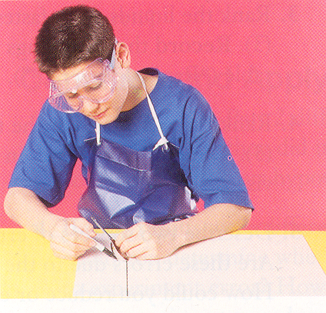
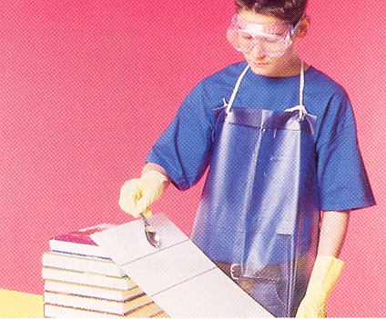
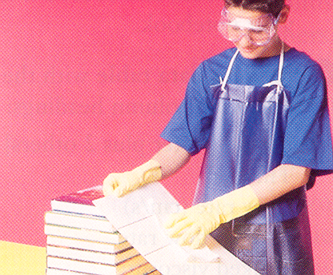
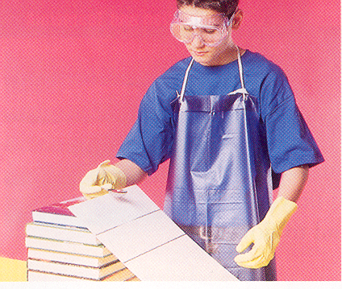
Diagram Total of 5 marks
You will be responsible for diagramming the steps in the lab. Your diagram must be labeled with all amounts, angles, distances… ect. (you will also get marks for your diagram being large enough & clear enough)

Slide 9
Materials
Please list all of the materials… 3 marks will be awarded for this section
Hot Plate 2. Thermometer
Beakers 4. Stop Watch
Tin Tray 6. Ruler
Sink 8. Sharpie pen
Spoon 10. Hand soap
Motor Oil 12. Rodgers Syrup
13. Canola Oil 14. Molasses

Slide 10
Variables Manipulated & Responding
You will need to list the Manipulated and the Responding variables in full
Answer these in full sentences please!!!
Each variable listed will be worth 2 marks for a total of 4 marks
Do not worry about stating that using different fluids is a manipulated variable… Forget that little fun fact

Slide 11
Control Factors
You will also need to come up with your own list of control factors for this experiment
The control factors you list must potentially affect the outcome of the experiment… “same hot plate” or “same beaker” will NOT get you marks!!!
List the factors clearly and in sentences if need be
You should easily be able to come up with 4 different control factors for this experiment
Each control factor you list will be worth 2 marks for a total of 8 marks

Slide 12
Observations
You need to set up your own table to record your observations
You already know the different materials that we will be testing and that will need to be put down in a column… however, the manipulate variable is still the temperature of each fluid
Make sure that responding and manipulated variables are in the correct columns on the table
Make sure that the titles for each column are very descriptive and that they have the proper units
The observations table will be worth 8 marks

Slide 13
Analysis
You need to provide a graph that displays all of the observations that were seen during the experiment
The graph needs to follow the proper format
The title must start with “The effect that… has on…” (3 marks for the title)
You will need to provide some type of legend that differentiates between the room temp trials and the heated trials
This will be a stacked bar graph like on the next slide
The graph will be worth 10 marks

Slide 14
Graph Format Example

Slide 15
Analysis Paragraph
Under the analysis heading after the graph, please answer each of these questions listed on the next slide You may answer each question in point form but it must be in complete sentences and you must include the question in your answer.
Total of 12 marks for the Analysis

Slide 16
Analysis Paragraph
Which fluid had the highest viscosity at room temp (1 mark)
Which fluid took the longest to cover 35cm at room temp (1 mark)
Which fluid had the highest viscosity at 90 ⁰C (1 mark)
Which fluid took the longest to cover 35 cm at 90 ⁰C (1 mark)
Which 2 liquids showed the largest change in flow rate as we heated them up… by how much for each (4 mark)
Which 2 liquids showed the smallest change in flow rate as we heated them up… by how much for each (4 mark)
Total for the analysis is 12

Slide 17
Conclusion
Under the conclusion section heading, please make sure you write out in full detail your original hypothesis, whether you were correct or not, and what you learned.
1. Restate your hypothesis (1 mark)
2. State whether your hypothesis was correct or not… if not, explain why (1 mark)
Explain, What did you learn? (3 marks)
Total of 5 marks for the conclusion

Slide 18
Extension Questions
After the conclusion heading, you must answer a set of extension questions that are designed to check your deeper understanding. The marks for these questions will be weighted double.
Total of 12 marks for the questions x 2 = 24
Rank the five fluids in order from the least viscous to the most viscous when they were at room temp. (1 mark)

Slide 19
Extension Questions con’t
Rank the five fluids in order from the least viscous to the most viscous when they were at 80 °C (1 mark)
Explain what two things happened to the particles in each liquid as they were heated in terms of how they were moving and the spaces between them. (2 marks)
In one simple sentence… how did this affect the viscosity of the liquids? (1 mark)

Slide 20
Extension Questions con’t
If the particles in the liquid began moving faster and spreading further apart as we heated them up…
What happened to the friction between the particles? (1 mark)
What happened to the attractive forces between the particles? (1 mark)
Would we have seen the same change in the viscosity of gasses if we were to have heated them up as well (1 mark)

Slide 21
Extension Questions con’t
If we were to heat up a gas…
a) What would happen to the speed of the particles in the gas? (1 mark)
b) What would heating up the gas do to the number of collisions the particles would encounter? (1 mark)
c) How would the changing number of collisions the gas particles underwent affect the friction between the particles (1 mark)
d) What would that do to the over all viscosity of the gas? (1 mark)

Slide 22
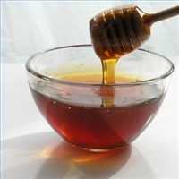
What’s Next
We will begin this lab in the next class!!
Be sure to get your good copy started tonight so that you will have less homework latter on
The whole lab is out of /92.5

