Slide 1
Heat Exchanger Theory and Design
Group 5
Maha El-Deeb
Khashayar Moez
William Read
Michael Teklu

Slide 2
Typical uses for heat exchangers
Heat a fluid before a process unit such as a reactor or a distillation column
Remove heat from a process to keep the temperature at a desirable level

Slide 3
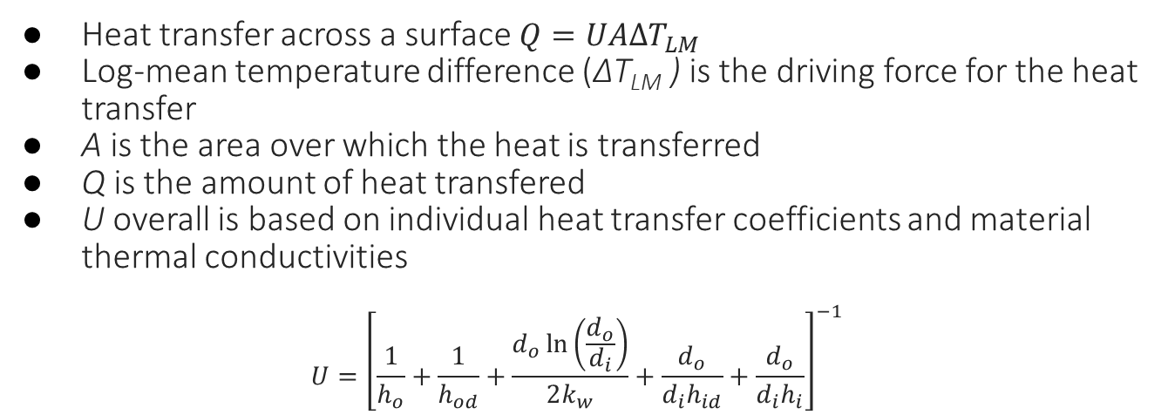
Heat Transfer Theory
Heat transfer across a surface $Q=UAΔT_{LM}$
Log-mean temperature difference (ΔT_{LM} ) is the driving force for the heat transfer
A is the area over which the heat is transferred
Q is the amount of heat transfered
U overall is based on individual heat transfer coefficients and material thermal conductivities
$$U={\left[\frac{1}{h_{o}}+\frac{1}{h_{od}}+\frac{d_{o}\ln\left(\frac{d_{o}}{d_{i}}\right)}{2k_{w}}+\frac{d_{o}}{d_{i}h_{id}}+\frac{d_{o}}{d_{i}h_{i}}\right]}^{−1}$$

Slide 4
Overall Heat Transfer Coefficient
Dependent on type of heat exchanger
Varies with types of fluids used
Hot Fluid | Cold Fluid | U (W/m²C)
Water | Water | 800-1500
Steam | Light Oils | 300-900
Heavy Oils | Water | 60-300

Slide 5
Fouling Factors
Most working fluids will foul exchanger surface
Results in lower thermal conductivity and heat overall transfer coeffiecient
Exchangers need to be oversized to compensate for proformace reduction
Fluid | Coefficient (W/m²C)
Light hydrocarbons | 5000
Steam | 4000-10,000
Notes:
They are usually quoted as heat transfer resistance rather than coefficients.
They should not be mistaken for safety factor ( common design mistake).
Must consider operation time between cleaning, and the size of the heat exchanger when deciding on a heat exchanger.
If exchangers are operating in series, then schedule it so that one is online while the other is undergoing cleaning.

Slide 6
Types of Heat Exchangers
Shell and Tube
Jacketed vessel
Double Pipe
Finned Tubes
Gasketed Plate
Notes:
Shell and tube: Used in high pressure applications and temps ( 30 bar and 250C and up)
Jacketed vessel: uniform heat distribution and high heat transfer efficiency.
Double pipe: highest overall heat transfer coefficient and the ability to achieve true counter flow.
Finned tubes are used when the heat transfer coefficient on the outside of the tubes is appreciably lower than that on the inside ( gas to liquid )
Casketed Plate: Large surface area. Easy to dissemble and clean, Compact design, cannot withstand high temp or pressure.

Slide 7
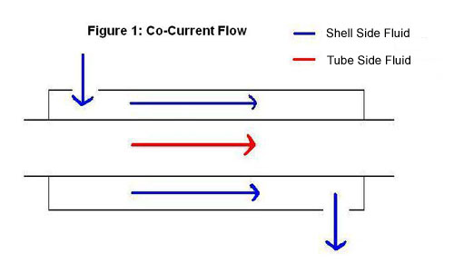
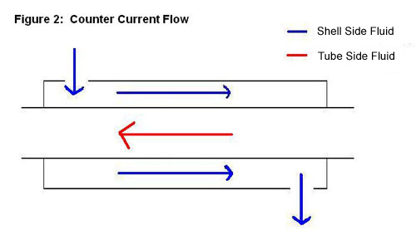
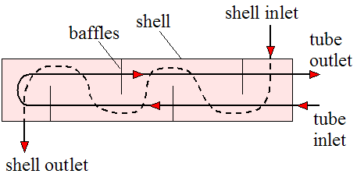
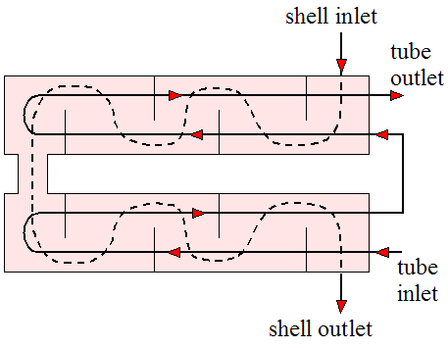
Flow Configuration
Notes:
Most shell-and-tube heat exchangers are either 1, 2, or 4 pass designs on the tube side. This refers to the number of times the fluid in the tubes passes through the fluid in the shell. In a single pass heat exchanger, the fluid goes in one end of each tube and out the other

Slide 8
Fluid Allocation
A good guideline to fluid allocation for no phase change
 | Shell | Tube
Corrosion |  | x
Fouling |  | x
Hot Fluid |  | x
Viscosity | x
Notes:
Corrosion and fouling for cleaning purposes / hot temp in tube to reduce shell temperature / viscosity for turbulent flow … if you cannot acchieve turb flow place in tube to predict individual coef easier/ flow ra

Slide 9
Heat Exchanger Sizing
Define the duty: heat transfer rates, temperature, and fluid flow rates
Determine fluid physical property data: viscosity, density, heat capacity
pick type of exchanger
Guess an initial value for the overall heat transfer coefficient U
Calculate log-mean temperature difference
Calculate the required area

Slide 10
Heat exchanger sizing (Cont’d)
Calculate individual coefficients (depends on type of heat exchanger)
Compare overall heat transfer coefficient to initial guess
Reiterate above steps to optimize heat exchanger i.e. lowest area

Slide 11
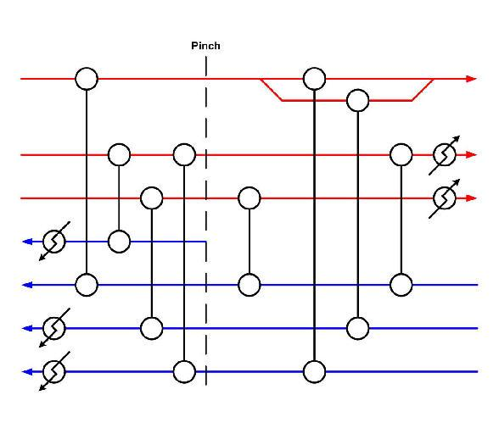
Pinch Analysis and HEN
Optimization of a heat
transfer system
Helps bridge the gap
between capital cost and
utilities cost
Very helpful in estimating
optimal HX requirements
and obtain an overall view
of the entire utility system
http://0.static.wix.com/media/3a5bb2e38090db68bfb7134fc250f425.wix_mp_512

Slide 12
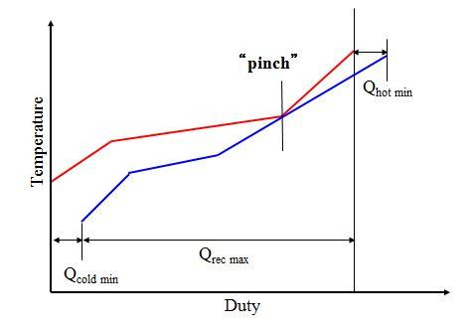
Pinch Analysis (continued…)
The pinch is determined from the composite curves of the process data
From the composite curves, the losest point of approach of the two curves is the pinch point
This point is where the process is most constrained, and can thus be treated as two separate problems
2012, G.P. Towler / UOP. Chemical Engineering Design, Principle, Practice, and Economics.

Slide 13
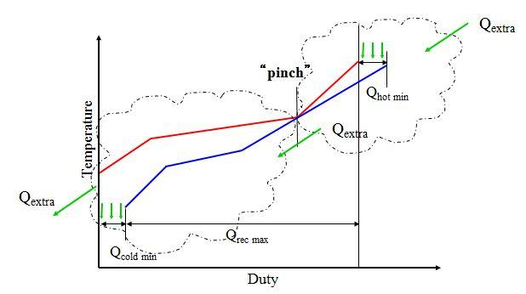
Pinch Analysis (continued...)
The area above the pinch can be considered a heat sink with heat flowing in from hot utility but no heat leaving out
In the area below the pinch, heat flows out of the region to the cold utility
When heat is transferred across the pinch, it leads to both hot and cold utilities that is greater than the minimum values
2012, G.P. Towler / UOP. Chemical Engineering Design, Principle, Practice, and Economics.

Slide 14
Maximize the heat recovery
Divide the problem at the pinch and design away from it
Above pinch match streams adjacent to the pinch that meet the restriction CPh ≤ CPc
Below pinch match streams adjacent to the pinch that meet the restriction CPh ≥ CPc
If matched streams do not meet restriction, split streams
Maximize heat exchanger loads
Supply external heating only above and cooling only below

