Slide 1
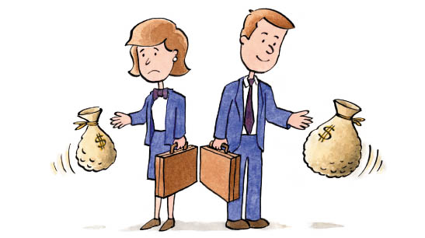
Gender inequality
Is the progress to gender equality stalled? If so, why?

Slide 2
INTRODUCTION
Gender stratification refers to the ranking of the sexes in such a way that women are unequal in power, resources, prestige, or presumed worth.
What Causes Gender Inequality?
The most compelling explanations of gender inequality are materialist theories. They explain gender inequality as an outcome of how women and men are tied to the economic structure of society. They point out that women's roles of mother and wife, although vital to the well-being of society, are devalued and also deny women access to highly valued public resources.

Slide 3
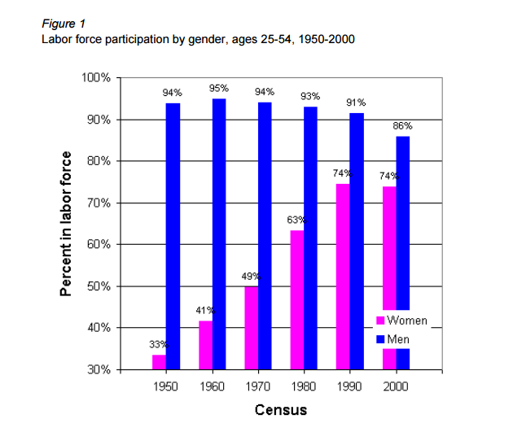
I) Women have come a long way
1) LFPR By Gender

Slide 4
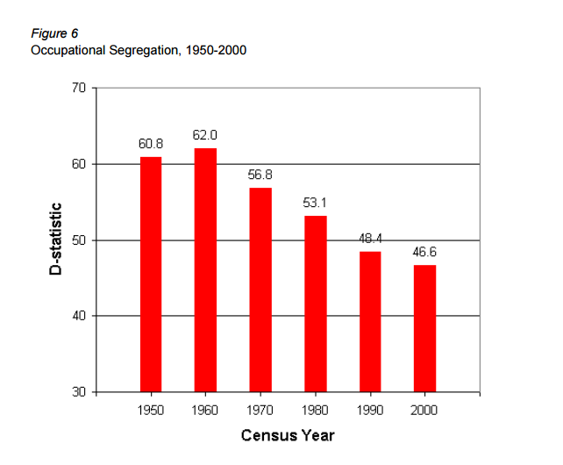
I) Women have come a long way
2) Occupational Segregation

Slide 5
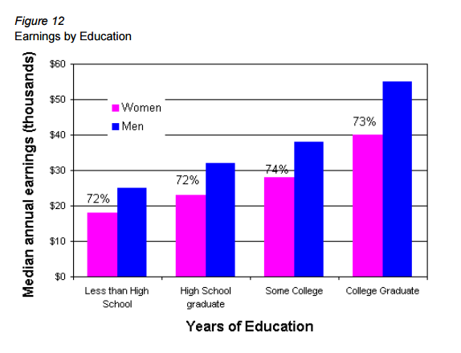
I) Women have come a long way
3) Gender differences by earnings in education

Slide 6
II) … but they still have far to go
Yes, the progress to gender equality is stalled!
At every educational level, women still earn (AROUND 15%) less than men with comparable credentials, even when they work the same number of hours a week in the same kind of job.
Some women, having broken into exclusive careers, are still trying to crack the glass ceiling. Many more women are still stuck in the basement, looking for an up escalator. Women constitute 62 percent of all minimum-wage workers, and working-class jobs are as sex-segregated today as they were in 1964. In all racial groups and at every age, women are more likely to live in poverty than men, although minority women are especially disadvantaged. African-American women earn just 64 cents, and Hispanic women just 55 cents, for every dollar earned by white, non-Hispanic men.
Gender desegregation of college majors and occupations slowed.
Women's labor-force participation in the United States also leveled off in the second half of the 1990s, in contrast to its continued increase in most other countries.

Slide 7
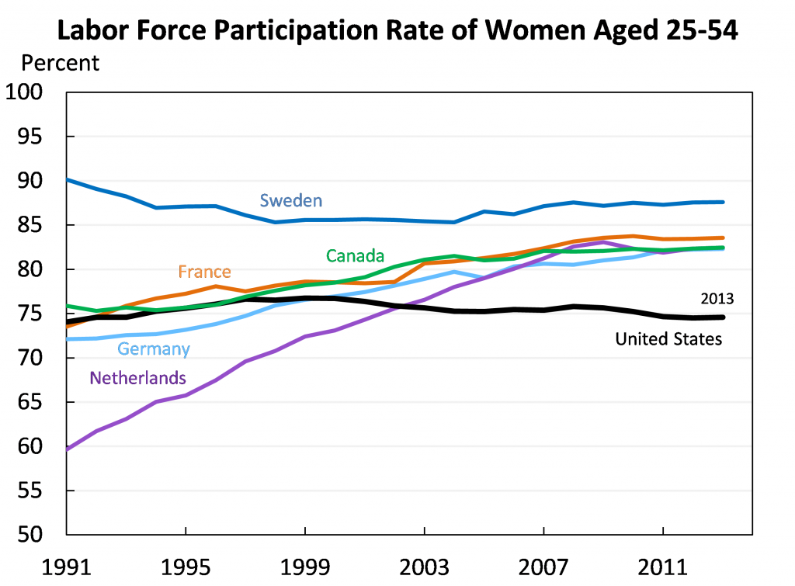
II) … but they still have far to go

Slide 8
Iii) Why ?
Many of these inequalities still result from discrimination. While few Americans would now openly claim that women are less capable than men, implicit bias tests consistently reveal that women are perceived as less competent, decisive or assertive than men.
Additionally, wage rates reflect the historical legacy of gender segregation. Occupations traditionally associated with women pay less than men’s jobs even when they require the same or greater levels of skill and stamina.
Out of nearly 200 countries, 180 now offer guaranteed paid leave to new mothers, and 81 offer paid leave to fathers. The United States offers none of these protections.
When couples have children, women fall even further behind, because policymakers have not caught up with new family realities. Dual-earner families are now the norm, but work policies are still designed for a labor force composed of full-time male workers with wives at home to take care of family obligations. The lack of family-friendly work policies and affordable quality child care, combined with men’s higher wages, encourages many women to cut back when work conflicts with family obligations. And this reinforces gender inequality over the long run.

Slide 9
Sources
http://www.courier-journal.com/story/opinion/contributors/2014/03/16/stephanie-coontz-women-have-come-a-long-way-but-still-have-far-to-go/6425971/
http://www.vanneman.umd.edu/papers/Cotter_etal.pdf
http://www.nature.com/scitable/forums/women-in-science/nyt-on-why-gender-equity-stalled-100843927
http://www.stephaniecoontz.com/articles/article86.htm

