Slide 1
Inequality, Gender and Development
Professor Diane Elson
University of Essex UK
Presentation to Advanced Graduate Workshop
Initiative for Policy Dialogue
Bangalore January 2015

Slide 2
Inequality of what?
Preference satisfaction?
Problem of adaptive preferences
Capabilities?
Equality of resources does not ensure equality of capabilities
But no capabilities without resources
Resources
Public services and infrastructure
Income ( expenditure often used as proxy)
Wealth
Inequality of income/expenditure and wealth now at forefront of research and policy agendas

Slide 3
Recent studies of inequality in income/expenditure and wealth
Inequality Matters: Report of the World Social Situation 2013, Department of Economic and Social Affairs, United Nations, 2013
http://www.un.org/desa/socdev/documents/reports/InequalityMatters.pdf
Humanity Divided: Confronting Inequality in Developing Countries ,United Nations Development Programme Bureau for Development Policy, New York, 2013 http://www.undp.org/content/dam/undp/library/Poverty%20Reduction/Inclusive%20development/Humanity%20Divided/HumanityDivided_Full-Report.pdf
Inequality in Asia and the Pacific, Asian Development Bank, 2014
http://www.adb.org/publications/inequality-asia-and-pacific

Slide 4
Recent studies of inequality in income/expenditure and wealth
Even it Up. Time to End Extreme Inequality , Oxfam , 2014 http://www.oxfam.org/sites/www.oxfam.org/files/file_attachments/cr-even-it-up-extreme-inequality-291014 en.pdf
Global Labour Report , 2014/15. Wages and income inequality, ILO ,2014
http://www.ilo.org/global/research/global- reports/global-wage-report/2014/lang-- en/index.htm
Piketty, Thomas. Capitalism in the Twenty First Century. Harvard University Press, 2014

Slide 5
Why does economic inequality matter?
Intrinsic reasons
Principles of dignity, respect and non-discrimination that are embodied in the human rights system
Instrumental reasons
Adverse economic, social and political consequences of high or rising inequality
High or rising levels of income inequality can harm the rate of growth and the duration of growth spells by reducing the propensity to invest
Extent of poverty reduction associated with a given level of growth significantly depends on income inequality levels and trends
Persistent inequality between different segments of a population can entrench the discriminatory practices and cultural biases that fuel social exclusion
High levels of inequality can distort political decision-making by undermining broad-based democratic participation

Slide 6
Measuring inequality in income/ expenditure and wealth
Measures of inter-household inequality
e.g. Gini coefficient, share of top 1 %, ratio of share of bottom 10% to top 10%
NB income-based inequality measures (used in OECD and Latin American countries) tend to run higher than expenditure-based ones (used in most developing Asian countries (as well as sub-Saharan Africa).
Measures of inequality between factors of production
e.g. share of labour income in GDP, share of capital income in GDP
NB high prevalence of self-employment and small businesses complicates attribution of income to factors of production
Measures of inter-individual inequality
e.g. wage gaps, differential rates of unemployment, employment , precarious work, asset ownership, hours of unpaid care-related work

Slide 7
Intersecting inequalities
Inequality in income/expenditure, wealth and employment intersects with other types of inequality such as race/ethnicity/ indigeneity, disability, and gender
Important to examine these intersections because some measures to reduce inter-household inequality may not be so effective in reducing other kinds of inequality, e.g. targeting income transfers to head of household
Necessary to examine individual level measures as well as household level measures: inequality experienced differently by different household members- intra-household inequality

Slide 8
Race/ethnicity/indigeneity and gender in recent inequality reports
DESA 2014 report includes disability and indigeneity but not gender
UNDP 2013 report includes gender inequality in labour market ( in separate chapter)
Oxfam 2013 includes gender inequality in employment, wealth and unpaid care –related work
ADB 2013 includes gender inequality in labour market ( in separate chapter)
ILO 2014 includes gender wage gaps and motherhood wage penalty ( in separate chapter)
Piketty does not include race/ethnicity/indigeneity or gender

Slide 9
Disability and economic inequality: DESA 2013 report
‘Data from 59 countries surveyed in the WHO World Health Survey (2002-2004), showed that, in lower-income countries, 22.4 per cent of all persons with disabilities were in the poorest wealth quintile compared to 13.3 per cent in the richest quintile.’
‘Persons with disabilities also tend to have lower employment rates than persons without disabilities. The World Report on Disability 2011 found that, among 51 countries, women with disabilities were 10.3 per cent less likely than women without disabilities to be employed, and that men with disabilities were 12.1 per cent less likely than men without disabilities to be employed.
‘In developing countries, disability gaps in employment rates were largest in the countries of sub-Saharan Africa, smallest in the countries of Latin America, and ranged in between in the countries of Asia.’
‘When persons with disabilities are employed, they are more likely to be
underemployed, receive lower earnings and experience higher job insecurity, even in high-income countries’.’

Slide 10
Indigeneity and economic inequality : DESA 2013 report
‘In countries and regions (Latin America, Northern America and Oceania) where data disaggregated by indigenous status exist, it is well documented that indigenous peoples face many socioeconomic disadvantages relative to non-indigenous peoples.’
‘..half of the gap in earnings between indigenous and non-indigenous groups is due to human capital deficits. ….The other half of the gap is due to unknown factors, which may represent the impact of discrimination and other social forces, in the labour market.’
‘In countries of sub-Saharan Africa, Asia and Latin America, poverty rates were between 1.5 and 5.1 times higher among indigenous peoples than in the rest of the population in the mid-2000s.’
‘Dispossession of indigenous people’s traditional lands and territories– which are often sources of valuable natural resources, such as oil and minerals–by both public and private entities has generated tensions over land tenure and access to productive land in many countries, adversely affecting the economic and socio-cultural stability of indigenous peoples’.

Slide 11
Gender and economic inequality: UNDP 2013 report Chp 5
‘Women’s lower incomes and more limited access to other resources required to secure a livelihood such as land, credit and assets reduce bargaining power within households. As such, women experience restricted ability to exercise their preferences in the gender division of unpaid/paid labour, the allocation of household income and their ability to exit harmful relationships.’
Many data problems : ‘Therefore, the bulk of the analysis is confined to an examination of gender differences in four variables:
1) employment-to-population ratios, 15 and older;
2) unemployment rates;
3) wages;
4) shares of females and males employed in the industrial sector to capture gender job segregation in the productive sector of the economy.’

Slide 12
Gender differences in employment-to-population ratios, 15 and older: UNDP 2013 report
Data available for 177 countries
The mean global ratio of F/M employment rates rose from 0.62 in 1990 to 0.70 in 2010. Reduction in gender gap
But only 4 countries ( all in SSA) reached parity
Most gains in countries that started off with low ratios
But : In 70% of 140 countries in which F/M ratios have risen, male employment rates have fallen. Levelling down ?
My comment: may be partly due to increasing male enrolment in tertiary education , or earlier male retirement. Unlikely to be women displacing men because of labour market segmentation
No positive correlation between change in F/M ratio in secondary school enrolment and the change in F/M ratio in employment- instead a weak negative relationship

Slide 13
Gender differences in unemployment rates: UNDP 2013 report
Measured as the M/F ratio of unemployment rates:
Higher ratio implies greater gender equality (in favour of women)
Data available for 67 countries
Mean M/F ratio fell from 0.861 in 1990 to 0.808 in 2007
Majority of countries have ratio less than 1-persistent gender inequality in access to work
Asia was only region that reduced gender gap in unemployment rates
NB well known problems with meaning of this rate in absence of well developed social security system

Slide 14
Gender wage differentials: UNDP 2013 report
Severe lack of comparable cross country data
Hourly or monthly earnings? Only full-time, or part-time too? Hourly earnings for part-time workers much lower than for full time workers
Much employment excluded: often only covers formal sector wages, and always excludes self employed earners
Raw differentials ( which pick up pre-market discrimination as well as in-market discrimination) or differentials adjusted for factors like education and job tenure ( which pick up only in-market discrimination) ? Raw gap in most recent year for 54 countries for which data available show lowest gap at 2.9 % ( Slovenia) and widest 45.6% ( Zambia)
Very slow progress in reducing gender wage gap in OECD countries and fast growing Asian economies – S Korea gap is 38.9 % despite highly educated female population
See also ILO 2014 for analysis of how far gender wage gaps can be ‘explained’ by factors such as education differentials

Slide 15
Motherhood wage penalty: ILO Report 2014
‘The motherhood wage gap measures the wage gap between mothers and non-mothers, the latter being defined in most econometric studies as women without dependent children. From the available research, it appears that the unadjusted motherhood gap tends to be larger in developing countries than in developed countries.’
The main reasons advanced for the motherhood wage gap include:
reduced “human capital”, or knowledge, arising from employment interruptions or reductions in working time;
employment in family-friendly jobs, such as some part-time positions, which are typically not as well paid;
employers making hiring and promotion decisions based on stereotypical expectations of the burdens imposed by families on mothers’ time and energy;
the undersupply or affordability of childcare and other work–family accommodations;
female-dominated occupations and workplaces tending to be less rewarded than male-dominated occupations due to undervaluation of women’s work.

Slide 16
Gender job segregation: UNDP 2013 report
Ratio of F/M shares in industrial sector employment
Data for 62 countries
Mean ratio fell from 0.62 in 1990 to 0.42 in 2010
Adverse change for women in so far as more ‘better jobs’ available in this sector than in services and agriculture
NB some service sector jobs (e.g. IT, finance, better than industrial jobs- so need to refine this measure)
Defeminization of industrial sector in many middle income countries, holds in all regions except Africa
Possible causes: technological changes, requiring more technically qualified labour force, combined with ‘family responsibility discrimination’, meaning employers less willing to invest in upskilling women

Slide 17
Key conclusions from UNDP 2013 report
Reduction of gender gaps in education not matched by reduction in gender gaps in labour market
Only labour market indicator that shows a narrowing of global mean gender gap is employment to population ratio, and this may be result of ‘levelling down ‘
Globally, more women are employed but they are arriving in the labour market in a period in which labour income share of GDP is falling in many countries
The report notes that
“ the simple average of labour shares in 16 developed countries for which data are available from 1970 to 2010 declined from about 75 percent of national income in the mid-1970s to about 65 percent in the years just before the global economic and financial crisis.
The average of labour shares in a group of 16 developing and emerging economies also declined from around 62 percent of GDP in the early 1990s to 58 percent just before the crisis . Even in China, a country where wages roughly tripled over the last decade, GDP increased at a faster rate than the total wage bill—and hence the labour income share went down’.

Slide 18
Concentration of women in ‘vulnerable’ employment: ADB 2014 report
In most Asian countries women have proportionately more jobs as own-account workers and contributing family workers compared with men
Because own-account workers and contributing family workers are mostly engaged in informal jobs without access to social protection, they are considered more vulnerable to poverty and hardship relative to wage and salaried workers
[NB contributing family workers typically do not get paid a wage of their own]
The overrepresentation of women in these vulnerable types of jobs is especially pronounced in Bhutan, Cambodia, Nepal, and Pakistan

Slide 19
Differences in women’s employment rates by class and country: ADB 2014 report
‘In Bangladesh, India, Indonesia, Nepal, Pakistan, and Timor-Leste, women from wealthier households are substantially less likely to be employed as compared with those from the lowest wealth households.’
‘women from wealthier households are more likely to be employed as compared with women from the poorest households in Cambodia, the Maldives, and the Philippines.’
‘ women with at least a secondary school education are substantially less likely to be employed when compared with women with no schooling in Bangladesh, Cambodia, India, Indonesia, Nepal, and Timor- Leste.’
‘ women in the Maldives and Pakistan who have secondary schooling or beyond are more likely to be employed’

Slide 20
Policy recommendations: ADB 2013 report
Boost the remunerative value and security of women’s jobs
Enforce antidiscrimination measures
[NB no mention of minimum wage legislation]
Improve the compatibility of women’s market work with childcare
Provide publically funded maternity leave and child care
Promote enabling policies for women in the informal sector
Provide women with greater access to credit,
Strengthen women’s property rights,
Promote skills development for women beyond gender stereotypes,
Improve the productivity of women farmers
Implement gender-responsive social protection measures

Slide 21
Gender and extreme inequality: Oxfam report 2014
Oxfam report highlights the wealth and political power of the top 10 % and 1 %
‘Men are overwhelmingly represented at the top of the income ladder, and women are overwhelmingly represented at the bottom.
Of the 2,500 people that attended the World Economic Forum in 2014, just 15 percent were women.
Only 23 chief executives of Fortune 500 companies are women.
Of the top 30 richest people in the world, only three are women.
The richest in society are very often disproportionately represented in other positions of power; be they presidents, members of parliament, judges or senior civil servants. Women are largely absent from these corridors of power.’

Slide 22
Tax rich men to fund public services for poor women: Oxfam Report 2014
Oxfam report does not call for more women to be admitted to the ranks of the very rich and powerful
But for policies that include more effective taxation of the rich to fund public services for poor women
Highlights inequality in the unpaid work of caring for family and community:
‘the majority of unpaid care work is also shouldered by women and is one of the main contributors to women’s concentration in low-paid, precarious and unprotected employment. In many countries, women effectively subsidize the economy with an average of 2–5 hours more unpaid work than men per day’.

Slide 23
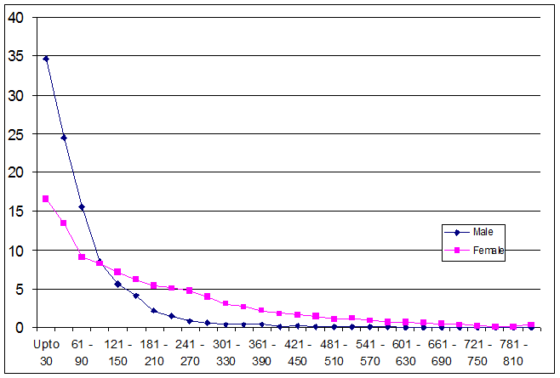
Unequal distribution of unpaid work: India, minutes per day, % pop aged 15-64 Source : Budlender 2008
Notes:
In India, around 35 per cent of males, and a little over 15 per cent of females, do virtually no unpaid care work. But many women do more than 8 hours (480 minutes) of unpaid care a day.

Slide 24
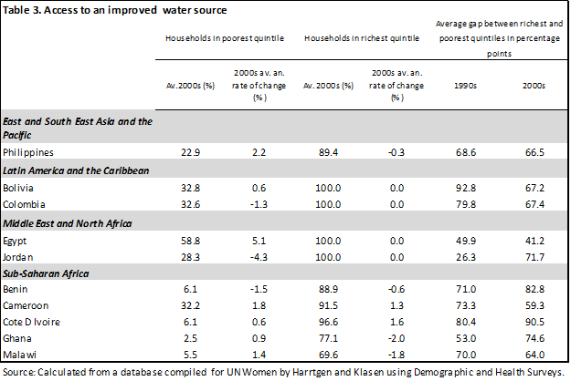
Wealth inequality and water

Slide 25
Economic inequality between women
None of the reports explicitly consider this
Previous two slides point to inequality between women with respect to unpaid care-related work
Women in higher income households have better access to the infrastructure that reduces unpaid care-related work- water, sanitation and energy
Women in higher income households can hire paid domestic workers
In some countries many women in higher income households are not employed and have no income of their own: lack of financial autonomy often leads to lack of bargaining power, dignity, rights. Can draw on husband’s income to buy consumer goods and care-related services for household. Can be problem of too much ‘leisure’.
In many countries, low income women work long hours for low pay, and also have long hours of care-related work. Problem of over-work

Slide 26
Can policy successfully address women’s economic inequality without increasing inter-household economic inequality?
Focusing only on increasing the employment rates and earnings of women who have completed secondary and tertiary educationi s likely to increase inter- household inequality
This is particularly likely if accompanied by the privatization and marketisation of provision of infrastructure and care services that reduce unpaid work
To avoid this, policy must also improve the earnings and conditions of work of low income women who are already employed ( including through policies to raise the ‘floor’ through minimum wages and employment guarantees)
And ensure low income women have access to affordable, publically provided infrastructure and care services

Slide 27
Policies to support equality for all
1. Reforms in economic reasoning
2. Growth that “bubbles up” rather than “trickles down”
3. Socially useful banking and finance, at macro as well as micro levels
4. Just and democratic public finance
5. Socially responsible markets and fair trade
6. Support for equitable property rights
7. Economic and social rights as an objective of economic policy
See Jain and Elson (Eds) 2011, Introduction

Slide 28
Additional references
Budlender, Debbie (2008) The Statistical Evidence on Care and Non-Care Work across Six Countries. Programme on Gender and Development, Paper No. 4 (Geneva: UNRISD).
Jain, Devaki and Elson, Diane (eds) Harvesting Feminist Knowledge for Public Policy, Sage/ IDRC , New Delhi, 2011.

