Slide 1
What is Poverty?
MATT Fawkes

Slide 2
Definition
United Nations Official Definition
“Fundamentally, poverty is a denial of choices and opportunities, a violation of human dignity. It means lack of basic capacity to participate effectively in society. It means not having enough to feed and cloth a family, not having a school or clinic to go to, not having the land on which to grow one’s food or a job to earn one’s living, not having access to credit. It means insecurity, powerlessness and exclusion of individuals, households and communities. It means susceptibility to violence, and it often implies living on marginal or fragile environments, without access to clean water or sanitation”

Slide 3
Definition
United Nations
Absolute Poverty vs Overall Poverty
Absolute: "a condition characterized by severe deprivation of basic human needs, including food, safe drinking water, sanitation facilities, health, shelter, education and information. It depends not only on income but also on access to services.“
Overall: takes various forms, including "lack of income and productive resources to ensure sustainable livelihoods; hunger and malnutrition; ill health; limited or lack of access to education and other basic services; increased morbidity and mortality from illness; homelessness and inadequate housing; unsafe environments and social discrimination and exclusion. It is also characterized by lack of participation in decision making and in civil, social and cultural life. It occurs in all countries: as mass poverty in many developing countries, pockets of poverty amid wealth in developed countries, loss of livelihoods as a result of economic recession, sudden poverty as a result of disaster or conflict, the poverty of low-wage workers, and the utter destitution of people who fall outside family support systems, social institutions and safety nets

Slide 4
Definition
World Bank Organization Description
“Poverty is hunger. Poverty is lack of shelter. Poverty is being sick and not being able to see a doctor. Poverty is not having access to school and not knowing how to read. Poverty is not having a job, is fear for the future, living one day at a time.
Poverty has many faces, changing from place to place and across time, and has been described in many ways. Most often, poverty is a situation people want to escape. So poverty is a call to action -- for the poor and the wealthy alike -- a call to change the world so that many more may have enough to eat, adequate shelter, access to education and health, protection from violence, and a voice in what happens in their communities.”

Slide 5
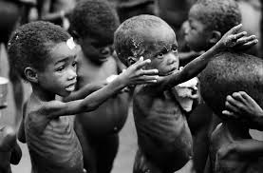
What Causes Poverty to Occur?
Lack of access to:
Information
Education
Healthcare
Overpopulation
Healthy Living conditions
Food and Water
Political Corruption
Dictators

Slide 6
Poverty Rate by Race

Slide 7
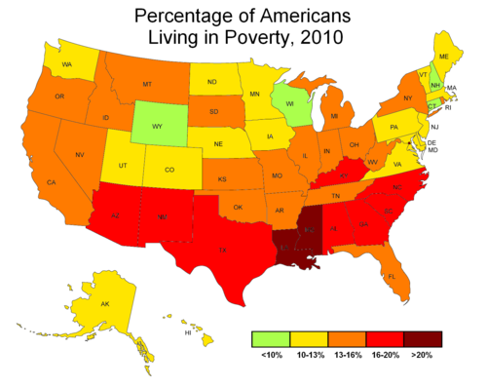
Poverty Rates by State

Slide 8
Poverty Rates World Wide

Slide 9
Measurements of Poverty
The U.S. Census Bureau determines poverty status by comparing pre-tax cash income against a threshold that is set at three times the cost of a minimum food diet in 1963, updated annually for inflation using the Consumer Price Index, and adjusted for family size, composition, and age of householder.
“Family" is defined as persons living together who are related either by blood or marriage. Thresholds do not vary geographically.
The Official Poverty Threshold for a family of four in 2012 was $23,492

Slide 10
Problems with this measurement
Formula for US calculation can be viewed as dated.
Does not take into account certain sources of income for example food stamps
Does not take into account many common expenses of today such as child care
Measures families as a single unit, meaning it does take into account interfamily inequality.

Slide 11
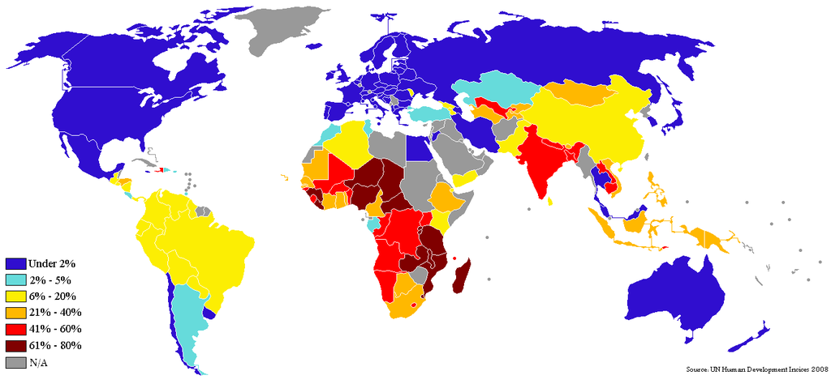
World Wide Poverty Measurement
The World Bank has defined the international poverty line as the percent of a country’s population that lives on less than $1.25 a day
Originally the poverty line was set at $1.00

Slide 12
Potential Solutions and Conclusion
Combat the issue of “Brain-Drain”
Greater humanitarian aid
Implementation and development of new technologies
Increase the quality and availability of education
Increase wages of lower income employees

Slide 13
Questions
Should combating global poverty or poverty in our country be a higher priority for the United States?
Can we ever completely eradicate poverty, or will some element of it always exist?

Slide 14
Sources
http://www.census.gov/hhes/www/poverty/about/overview/measure.html
http://www.un.org/esa/socdev/unyin/documents/ydiDavidGordon_poverty.pdf
http://www.colorado.edu/philosophy/heathwood/pdf/worldbank.pdf
http://www.brookings.edu/research/testimony/2012/06/05-poverty-families-haskins

