Slide 1
Free time activities
Maskalan O.A.

Slide 2
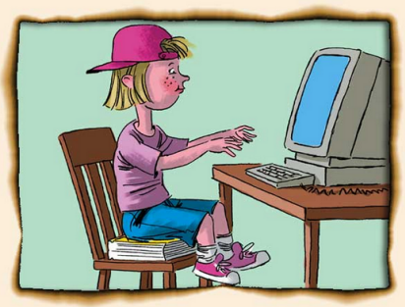
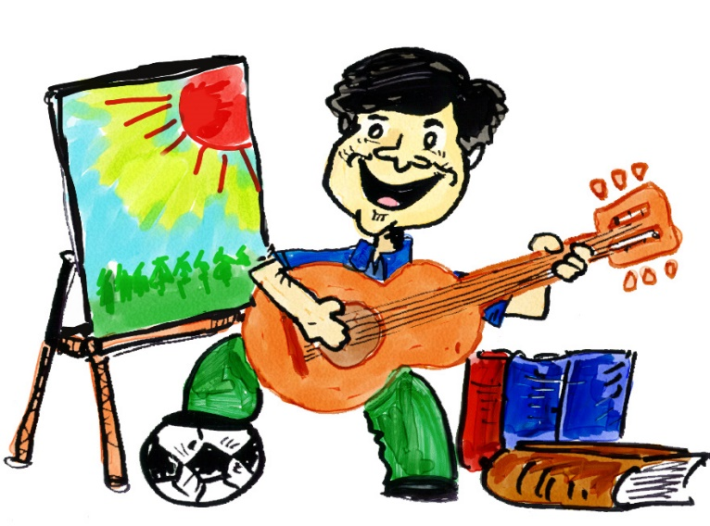
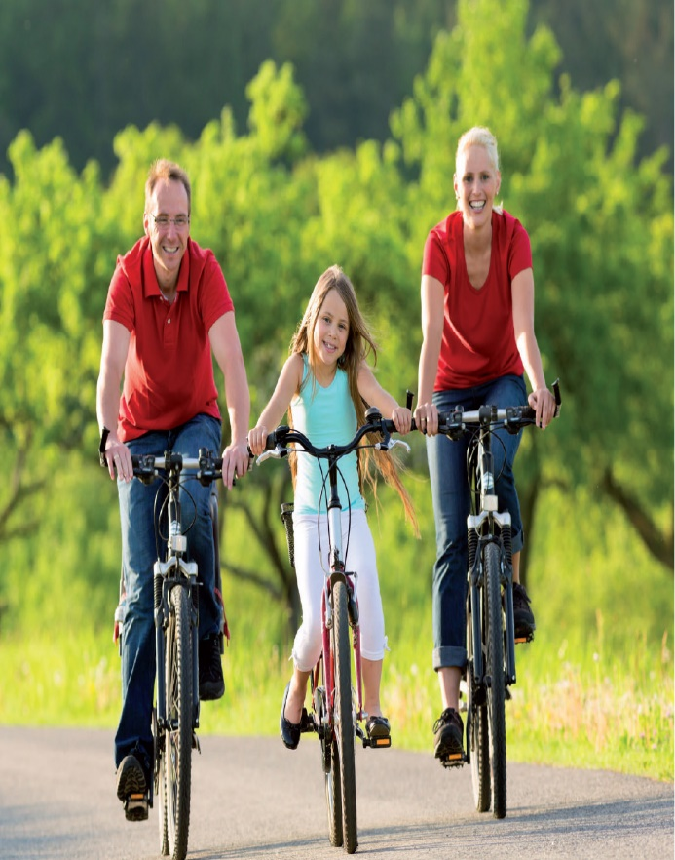
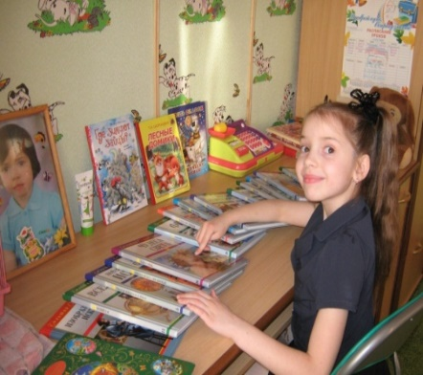
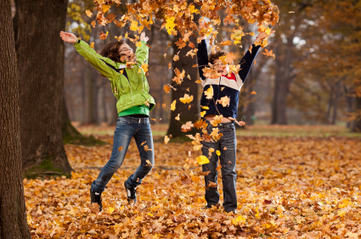
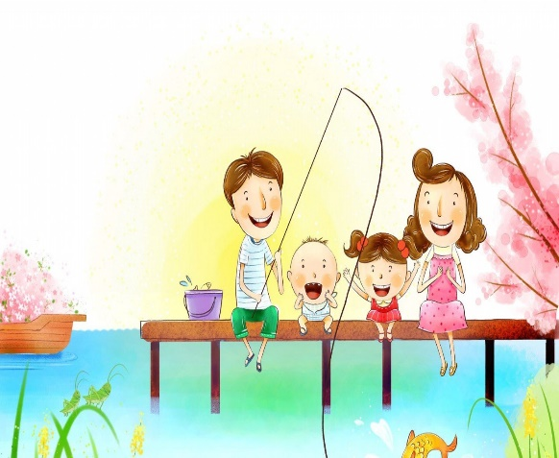
What is the theme of our lesson?

Slide 3
What do you usually do in your free time?
I enjoy V ing
I prefer V ing
I like V ing

Slide 4
What is the best way to spend free time? The best way to spend free time is to…. We usually ….. My friends and I …. Next weekend I am going to ….. Sometimes my family …..

Slide 5
Do you like the lesson? What was the most interesting task? Choose the mark for this lesson. I was the best. 5 I had some mistakes. 4 I could be better. 3 I had poor knowledge.2 H/w ex.17 p. 121

