Slide 1
Attention-Deficit/Hyperactivity Disorder
Continuity Clinic
2011

Slide 2
ADHD: What is it?
Mental Health Disorder
DSM IV: ADHD is a “persistent pattern of inattention and/or hyperactivity-impulsivity that is more frequent and severe than is typically observed in individuals of comparable levels of development.”

Slide 3
ADHD: Prevalence
At least 3% of US children are affected (usual quoted rates 5-8%)
9.2% of males and 2.9% of females have behaviors consistent with ADHD
Lifelong issue
60-80% of children diagnosed continue to have some symptoms into teen and adult years
Factors that increase risk: low birth weight, prematurity, IUGR; lead exposure, prenatal exposure to cigarettes and alcohol; genetic syndromes

Slide 4
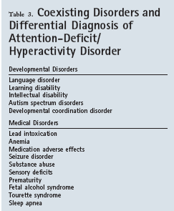
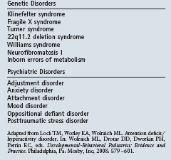

Slide 5
ADHD: Types
Predominately inattentive
Predominately hyperactivity/impulsivity
Combined type

Slide 6
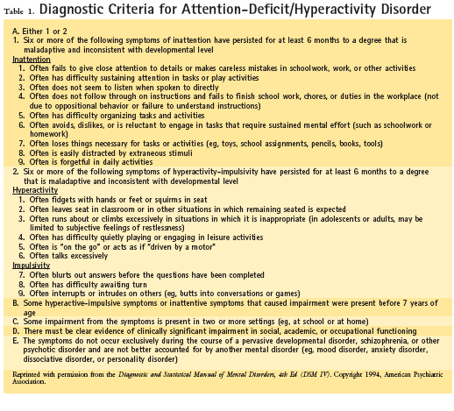

Slide 7
Inattention (Attention-Deficit)

Slide 8
Hyperactivity or Impulsivity

Slide 9
Further Diagnostic Criteria

Slide 10
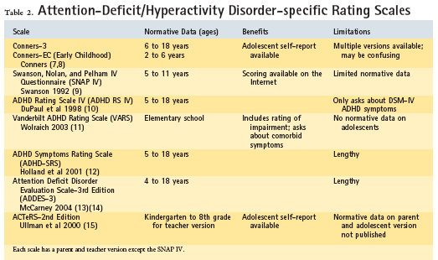

Slide 11
ADHD: Treatment Options

Slide 12
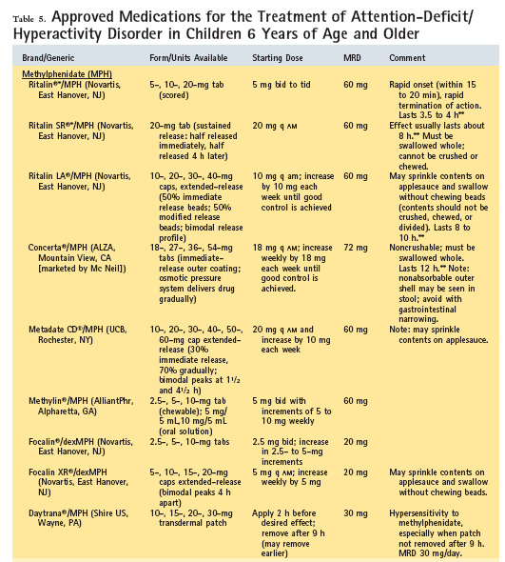

Slide 13
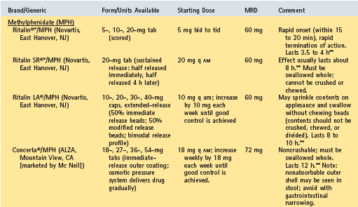

Slide 14
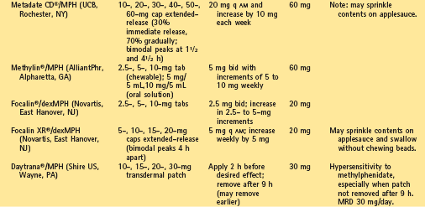

Slide 15
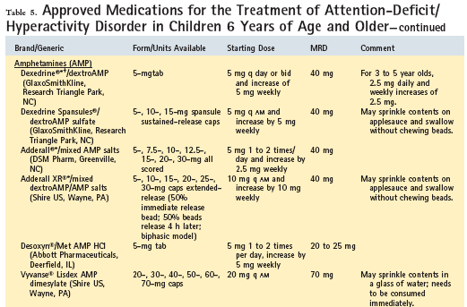

Slide 16
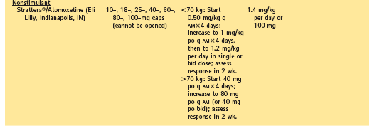

Slide 17
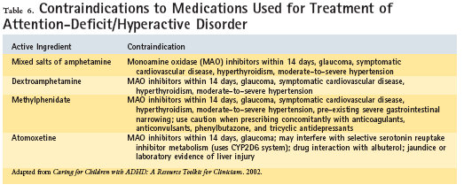

Slide 18
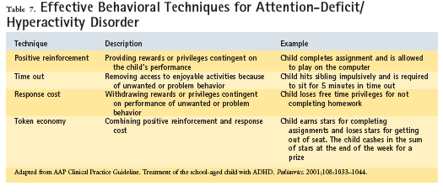

Slide 19
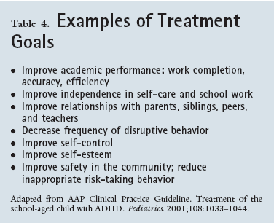

Slide 20
Reference
Anna Maria Wilms Floet, Cathy Scheiner, and Linda Grossman. Attention-Deficit/Hyperactivity Disorder. Pediatrics in Review, Feb 2010; 31: 56-69

