Slide 1
Life satisfaction in elderly women
Vibeke Horstmann, fil lic

Slide 2
Health and economy are related to life satisfaction
Are health and economy equally important in
groups that are living under different life conditions?
Is the way of handling problems in life important for life satisfaction?
Are the relations to life satisfaction stable
over time?

Slide 3
Elderly single living women
Latvia: 260 women
Sweden: 288 women
The women are participating in the ENABLE-AGE Survey Study starting 2002

Slide 4
Life satisfaction
All in all – how satisfied are you with your life?
Very unsatisfied Very satisfied
0 | 1 | 2 | 3 | 4 | 5 | 6 | 7 | 8 | 9 | 10

Slide 5
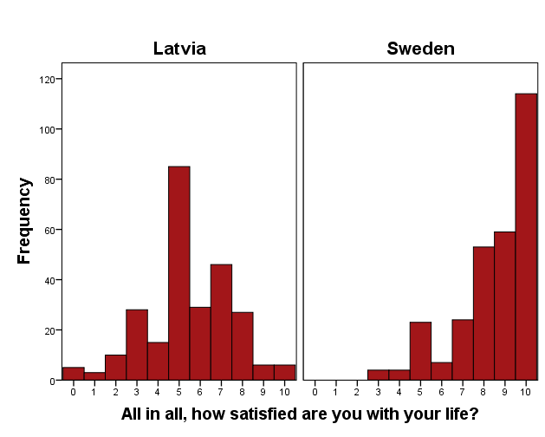
Life satisfaction

Slide 6
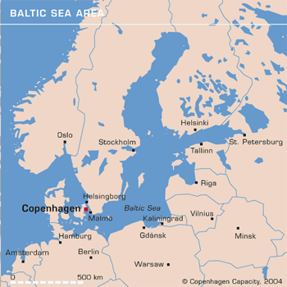
Morten Almkvist
Sweden
Latvia
Morten Almkvist
Barrybar
http://www.flickr.com/photos/barrybar/2482410
Historical differences:
Turbulence in Latvia - Political stability in Sweden
21 May 2013 Home and Health Workshop / Vibeke Horstmann

Slide 7
Differences between the countries:
Infant mortality
Latvia : 9 per 1000 new-borns
Sweden : 3 per 1000 new-borns
Life expectancy at birth
Latvia : 72 years
Sweden : 81 years
GDP
Latvia : GDP per capita: 4,000 US dollar
Sweden : GDP per capita: 27,000 US dollar

Slide 8
Differences between the groups of women:
Age
Latvia: 75-84 years
Sweden: 80-89 years
University education
Latvia : 26 %
Sweden : 6 %
Standard of living
Latvia : 20 % do not have bath and toilet within the dwelling
Sweden : Income per month 8 times higher

Slide 9
Significant differences:
Health | Latvia | Sweden
Number of diseases | 8 | 5
Number of symptoms | 14 | 7
Perceived health | 4 | 3
Functional independence | 8 | 9
Dependence in ADL | 31% | 56%
Economical standard | Latvia | Sweden
Income per month (euro) | 100 | 850
Income satisfaction | 2 | 8

Slide 10
Health and economy are not equally important:
Health
6 %
Latvia
Life satisfaction
Economical standard
18 %
Health
15 %
Sweden
Life satisfaction
Economical standard
2 %

Slide 11
Coping attitudes:
Endurance: ”I never give up”
Same in the Latvian and Swedish samples
Helplessness: ”I ask others for help”
Much stronger in Latvian than Swedish sample
Distraction: ”I try to think of something else”
Much stronger in Latvian than Swedish sample

Slide 12
Ways to achieve higher life satisfaction:
Coping attitudes are important for life satisfaction:
Latvia : 29 %
Sweden : 15 %
Problems with health:
Latvia: the woman manages to distract herself
Sweden: the woman has high endurance
Problems with economy:
Not related to the way the woman deals with the problems, neither in Latvia nor Sweden

Slide 13
If one only is healthy … ?
Low standard of living and
politically unstable conditions
seems to be a more serious obstacle than poor health for achieving life satisfaction
Co-authors: Signe Tomsone, Maria Haak, Susanne Iwarsson, Anne Gräsbeck.
Life Satisfaction in Older Women in Latvia and Sweden – Relations to Standard of Living, Aspects of Health and Coping Behaviour
Journal of Cross Cultural Gerontology

Slide 14
Nine years later…
Remaining for studying life satisfaction:
Latvia: 49 women
Sweden: 51 Women

Slide 15
Are changes in health and economy related to change in life satisfaction?
Is there a change in life satisfaction?
Are there changes in health and economy?
Conclusions

Slide 16
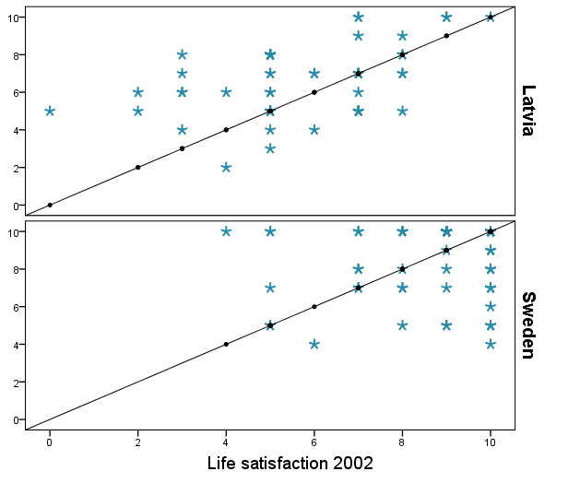
Change in life satisfaction?
Increased
Decreased
Life satisfaction 2011

Slide 17
Changes in factors related to life satisfaction
 | Latvia | Sweden
Number of symptoms | 50 % had more symptoms | 60 % had more symptoms
Perceived health | 8 % perceived worse health | 43 % perceived worse health
Functional independence | 59 % decreased independence | 56 % decreased independence
Depression | 50 % were more depressive | 80 % were more depressive
Income satisfaction | 97 % were more satisfied | _______

Slide 18
Changes in factors related to life satisfaction
changes in
 | Latvia | Sweden
Number of symptoms |  | 60 % had more symptoms
Perceived health
Functional independence | 59 % decreased independence
Depression | 50 % were more depressive | 80 % were more depressive
Income satisfaction | 97 % were more satisfied | _______
50 % had more symptoms
8 % perceived worse health
43 % perceived worse health
56 % decreased independence

Slide 19
Conclusions
Despite the decrease in functional independence life satisfaction increased in the Latvian sample thanks to the increase in satisfaction with the income
As there was an increase in especially number of symptoms there was a decrease in life satisfaction in the Swedish sample

Slide 20
Thank you for your attention!

