Slide 1
Theory of Mind
Presenter: Mai Hinton
Mentors: Lindsey Powell & Kate Hobbs
February 2011

Slide 2
Today’s Presentation
What is theory of mind?
Theory of mind studies with preschool-age children
False Belief Task
Theory of mind studies with younger children
Looking Time
Helping
Discussion

Slide 3
What is theory of mind?
Understanding others’ mental states, such as thoughts, feelings and beliefs, and using them to predict and explain their behavior

Slide 4
Do children possess a ToM?
Preschool studies (3- and 4-year-olds)
Elicited response
False Belief Task (Wimmer & Perner, 1983)

Slide 5
Sally-Anne Task
Sally plays with her dollie and then places her into the crib, under the covers.
Sally then leaves the room.
While Sally is gone, naughty Anne hides the dollie in the toy box.
Sally returns.
“Where will she look for her dollie?”

Slide 6
Discussion of Sally-Anne Task
Consistent and significant results over many studies
4-year-olds answer correctly; 3-year-olds do not
Do you think this is good evidence of ToM?
Why do 3-year-olds fail this task?
Are 3-year-olds capable of a ToM?
What could be done differently?

Slide 7
Spontaneous-response tasks
Violation of Expectations
Measure looking time
Onishi & Baillargeon, 2005

Slide 8
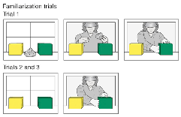
Understanding False Beliefs
Familiarization trials
Trial 1: Agent plays with toy, hides it in the green box and then leaves hand in green box for several seconds and curtain drops
Trial 2 & 3: Curtain opens, agent reaches hand into green box (where the toy is) and stays there until curtain drops
(Onishi & Baillargeon, 2005)

Slide 9
True Belief
Expected ⬆
Agent watches while the toy moves from the green to yellow box
TB-yellow

Slide 10
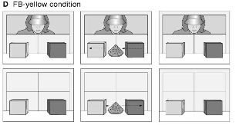
False Belief
Same as TB-yellow but then toy shifts to the green box when the agent is not watching
FB-yellow
⬅ Unexpected

Slide 11
ToM in 18-month-olds?
Current Research
Baillargeon reading
In This Lab
Helping Task
Looking Time Task

Slide 12
Helping Task
(Buttelmann, 2009)
Active behavioral measure

Slide 13
Looking Time Task in Our Lab
Onishi & Baillargeon design

Slide 14
Looking Time Results
☐ Yellow Box
Green Box
Our Data
Onishi & Baillargeon, 2005

Slide 15
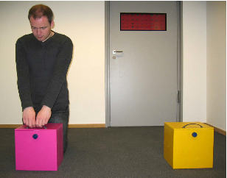
Helping Task Results
Note: There were also 9 children who did not help.

Slide 16
Looking at Both Looking Time and Helping Tasks

Slide 17
Discussion
Recap
Theory of mind
Studies
Thoughts?

