Slide 1
The Relationship Between Theory of Mind and Language
A COMPARISON STUDY BETWEEN DEAF AND HEARING INFANTS
WEST RESENDES ’12
3.3.2011
SUPERVISED BY
DR. SUSAN CAREY,
KATE HOBBS, & DR. JENNIE PYERS

Slide 2
Overview of Hour
Review from Last Week: Overview of ToM
ToM in Deaf Children
Relationship between Language and ToM
Tasks for Proposed/Future Studies
Anticipated Results
Implications
Questions

Slide 3
Theory of Mind
ToM = the ability to understand others’ mental states – including their beliefs, goals, and desires - to predict and explain people’s actions (Premack & Woodruff, 1978)
Different components in ToM
False-Belief
Gaze Following
Goal Understanding
Joint Attention
Notes:
Oftentimes, when people talk about ToM, they are actually talking about false-belief.
That’s understandable because most of the popular literature on ToM focuses on false-belief.
However, I want to tell you that ToM is much broader than that,
as it incorporates all of the elements of social understanding.
As you can see here, false-belief is just one component –
we also have gaze-following, goal understanding, and joint attention.
Premack, D. G. & Woodruff, G. (1978). Does the chimpanzee have a theory of mind? Behavioral and Brain Sciences, 1, 515-526

Slide 4
Theory of Mind Timeline
Notes:
You can see here a timeline of critical milestones in ToM development,
ranging from when they first pay attention to outlines of faces at 1 month old to passing the classical false-belief tasks,
such as the Sally Anne task you learned about last week, at age 4 or 48 months on the timeline.
The early stages serve as precursors to social cognition, SLIDE

Slide 5
Theory of Mind Timeline
Understand goal-directed action: surprised when E reaches for object different than previously reached
Notes:
…as you can see at 6 months, a normally-progressing child will understand goal direction in the respect that
the child will be surprised when the experimenter reaches for objects different than previously reached.
That’s just incredible, because at 6 months, infants are already showing social intention-understanding. SLIDE
NOTE: (If anyone asks)
Experiment = Woodward 1998

Slide 6
Theory of Mind Timeline
Notes:
Then at 9 months, infants are able to follow the direction of another’s finger to look at a target.
This understanding of pointing will enable them to be able to express themselves
in the most basic manner possible without language a few months later.
Keep this in mind: we will use pointing as one of our tasks for the study. SLIDE

Slide 7
Emerging Research in Early ToM
Researchers are rapidly moving to fill in the developmental gap between ages 1-3
Seminal paper: Onishi & Baillargeon, 2005
2 main tracks of research now
Notes:
Now, does everyone feel they have a good understanding of the different stages of ToM and when they emerge?
Ok, developmental psychology is as old as William James, and Theory of Mind research started just over 30 years ago.
In the last 15 years, there has been an explosion of research focusing on that gap between 1 and 3 to explain the big question of why 3-year-olds fail false-belief while 4-year-olds pass it.
What is required for ToM? Does it really just appear at age 4, out of the blue?
How do you explain that magical appearance?
Well, as you learned last week, Onishi and Baillargeon discovered that – actually, does anyone remember what they discovered last week? SLIDE

Slide 8
Theory of Mind Timeline
Notes:
Correct, their discovery is right there on the timeline –
they found that 15-month-old infants possess a form of false belief understanding
as they expect others to reach for an object in the same place they put it in,
even if their belief is false after the object magically moves to another place.
This was a very important finding that has motivated further research in this topic. SLIDE

Slide 9
Links between Early ToM and Toddler ToM
Wellman & Brandone (2009): Early ToM predicts Later ToM – longitudinal study w/controls
But the debate still continues today
Why would infants pass false-belief at 15 months, but not at 3 years?
Answer: Implicit v. Explicit False-Belief
Implicit
FB
OR
Explicit
FB
Notes:
So, you may be wondering – is early ToM really related to later ToM? Wellman and Brandone support that conclusion with a longitudinal study they did which showed that early ToM did predict later ToM, even when controlling for IQ, language competence, and executive functioning. But the debate still continues today.
Now, you might be wondering, why would infants pass false-belief at 15 months, but not at 3 years? I should explain that the false belief that we’ve found at 15 months is implicit, and the false belief at age 4 is explicit. As you may remember from last week, Implicit FB means that the child cannot articulate his FB yet. We find this though looking-time tasks. Then, explicit FB means that the child can articulate his FB.
So, we have two possibilities with the developmental timeline of FB. We either have 1 full timeline, in which implicit FB becomes explicit FB, or 2 parallel timelines that develop separately from each other. These theories are still emerging, and they are still very debatable.

Slide 10
Emerging Research in Early ToM
Researchers are rapidly moving to fill in the developmental gap between ages 1-3
Seminal paper: Onishi & Baillargeon, 2005
2 main tracks of research now
Notes:
So, with this explosion of research, two tracks emerged – two main factors that might be driving ToM development - EF and language.
We’ll focus on the language track today. SLIDE
NOTE: Don’t go into EF in depth.

Slide 11
Discussion Question!
Based on the reading, and your general knowledge in psychology, what do you think is the relationship between language and ToM?
Notes:
But first, a discussion question! READ Take a minute to think about it, and I’d be happy to hear your thoughts now. DISCUSS.

Slide 12
Discussion Question
Based on the reading, and your general knowledge in psychology, what do you think is the relationship between language and early ToM (before age 2)?
Early ToM affects language acquisition
Language acquisition affects early ToM
They are two separate processes
Notes:
Now, I’ll narrow the question for you, and I’ll also give you some options for answers. READ. By a vote of hands, A… B… C…

Slide 13
Convince-Your-Neighbor
Based on the reading, and your general knowledge in psychology, what do you think is the relationship between language and early ToM?
Early ToM affects language acquisition
Language acquisition affects early ToM
They are two separate processes
Notes:
It seems that not everyone agrees about this question, so let’s take a couple of minutes to talk, in groups of two, to the person sitting next to you about why you think your answer is correct and see if you can reach a consensus.
DISCUSS
Ok, the final answer is that we don’t know yet, but we hope that our study will help answer this question. SLIDE

Slide 14
ToM & Language
Different theories about the relationship between ToM and language
Researchers have suggested linguistic competency and language fluency to be essential to ToM development (Hresko, Reid, & Hammill, 1981; Schick, de Villiers, de Villiers, & Hoffmeister, 2007)
But we don’t know about Early ToM yet! That’s what we will find out with our study.
To empirically look at relationship between these two concepts, we need a way to manipulate language ability
Notes:
That was a great discussion about the relationship between language and ToM.
Now, I’ll add what I think about it. As you saw from the paper you read, there are quite a few different theories about the relationship between ToM and language.
Some theories book EF or working memory as the mediator of ToM, while others say that it’s language that controls ToM.
It has been relatively well-established in the literature that linguistic competency and language fluency is essential to toddler ToM development, as you should have seen from the intro of the paper.

Slide 15
Deaf Children
Most feasible way to control for language
We don’t want to force children into isolation, as that breaks research ethics.
9/10 of deaf children born to hearing parents
Hearing parents likely will not be fluent signers
90% of deaf children are at risk of language delay if the parents do not rapidly acquire sign language and appropriately expose them to it
When we refer to deaf children in this presentation: we specifically mean deaf children of hearing parents (DoH) who will be language-delayed

Slide 16
False-Belief in Deaf and Hearing Children at Age 4
Hearing Kids usually pass False-Belief
Deaf Kids: generally delayed, but literature is mixed as to the severity of the delay
Peterson et al. (2005): “1/3 of late-signing deaf children aged 5.5-13.2 years could pass a false belief task”
Confound: Sally-Anne task & others= high-verbal tasks
Only tests child’s ability to verbally express understanding of ToM (Chandler, Fritz, & Hala, 1989)
High-verbal means that they will struggle due to their language delay
But – deaf kids fail low-verbal ToM tasks too
Seems to indicate that the language demands of the task aren’t impeding deaf kids
Notes:
Mention that deaf kids have different language experiences - which leads to different degrees of language delays - which also leads to corresponding delays in toddler ToM.

Slide 17
Deaf Children & Low-Verbal Tasks
Failing Low-Verbal Tasks does NOT indicate that language doesn’t have an impact on ToM
We argue that children may still need language in low-verbal tasks to reason about the task
Chomsky: Internal (I)-Language
When we refer to language, we don’t just mean articulated words

Slide 18
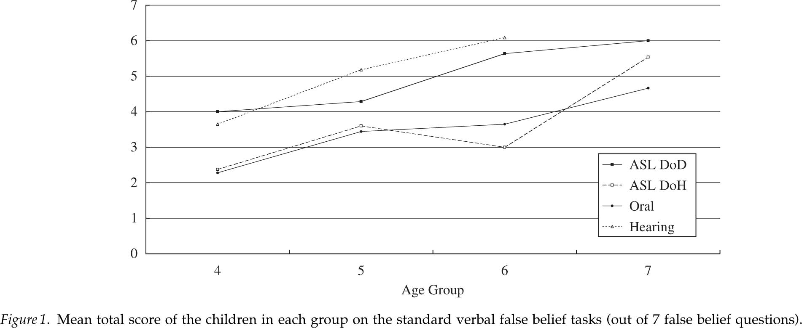
Schick, de Villiers, de Villiers, & Hoffmeister (2007)
Why do Deaf signing kids = Hearing kids on ToM?
Notes:
I’m going to quickly go over some of the results from the paper you read – which was a study on Deaf children about ToM and language.
These are results from the Toddler ToM tasks, and you can see here – the hearing kids are doing the best. They pass at a very good rate when they’re 5 and 6 years old.
Now, the line directly below them, are the signing deaf children who were born to deaf parents. The results of the hearing and the native signing deaf kids are very similar, and that’s not surprising.
Can someone explain why? ANSWER.
Then you can see on the bottom of the chart, the Oral and signing deaf children of hearing parents are much more delayed on ToM, which is to be expected.

Slide 19
Deaf Kids and Other ToM Tasks
Precursors to ToM
Mixed Results in research
Not delayed: Deception (Gale, de Villiers, Pyers, Schick, & Hoffmeister, 2009)
Delayed: Their understanding of the senses of seeing and hearing (Schmidt, 2011)
Delayed: Joint Attention (Gale & Schick, 2009)
Notes:
I also want to mention briefly here how Deaf kids do on some other ToM tasks.
There have been mixed results in the research, and also, not very much literature that actually compares deaf to hearing kids.
They are not delayed in Deception, which depends on some understanding of false-beliefs. But, really related to ToM.
However, they are delayed in their understanding of the senses of seeing and hearing.
What that means is that they were delayed in understanding that knowledge can be obtained through seeing and hearing. They are also delayed in JA.
Gale E. & Schick, B. (2009). Symbol-Infused Joint Attention and Language Use in Mothers With Deaf and Hearing Toddlers. American Annals of the Deaf, 153, 484-503.
Gale, E., de Villiers, P., Pyers, J., Schick, B. & Hoffmeister, R. (2009). Deception in Oral and Signing Children: Not Delayed nor Dependent on Complex Language. SRCD Convention, Denver, CO.
Schmidt, E. (2011). “Children’s Understanding of the Knowledge Gained Through Seeing and Through Hearing” Unpublished thesis, Wellesley College.

Slide 20
Why does language have an impact on false belief?
A few theories out there… (See the paper you read)
Jill de Villiers’ syntactic theory (2002):
~ The child must master “full syntax of mental verbs … to represent in his own mind the belief states of other people.”
~ Sentence Complements -> Explicit False-belief
It was in the cabinet. (S:T/F) [complement]
She thought [it was in the cabinet.] (C:F -> S:T!)
Notes:
There are certainly quite a few theories out there, and we’ll focus on one today – Jill de Villiers’ syntactic theory. To put it in a simple way – the child must master full syntax of mental verbs to represent in his own mind the belief states of other people. Jill looks at sentence complements in specific, and argues that understanding of those comes before false-belief understanding. one has to understand complements before understanding false-belief. So, I have two sample sentences. The first one is a simple sentence –it was in the cabinet. It can either be true or false. READ second one. The complement is “it was in the cabinet” for the second one – it is a phrase that depends on the main verb of “she thought.” The second sentence is more complex, as the complement can either be T/F, but the whole sentence will still be true. This syntactic structure is the best or only way we talk about FBs, and might be also how we represent FBs in the language of thought - or Chomsky’s I-Language as I mentioned before. We argue that understanding the second type of sentence is required for understanding explicit FBs. The way we talk about false-belief reflects how we think about it. If we don’t understand complements, then we can’t think about them.
This is a pretty radical theory - basically, if we don’t have certain components of language, we can’t think about things. What are your thoughts on that?
De Villiers, J. & Pyers, J. (2002) Complements to cognition: a longitudinal study of the relationship between complex syntax and false-belief-understanding. Cognitive Development 17, 1037-1060.

Slide 21
How language might play a role in early ToM
With this theory of language’s role in toddler ToM, we need to go back in time – see if language is related to early ToM (under age 2) as well
2 possible hypotheses that our study will test for:
1. Language is separate from early ToM
2. Language is linked to early ToM

Slide 22
1. Language is separate from early ToM
Deaf = Hearing Kids in ToM at 18 months
Notes:
It’s possible that language and young ToM are two entirely separate processes that do not directly influence each other.
If so, then we should find that deaf and hearing kids perform equally well on ToM tasks when they’re infants.
Then, later down the road, the deaf kids become delayed in toddler ToM, especially in classical false-belief.
If our results support this timeline, then it would strongly suggest that the relationship between language and ToM isn’t as strong as we thought before.

Slide 23
2. Language is linked to early ToM
Deaf ≠ Hearing in ToM at 18 months
Notes:
Our second hypothesis is that language plays a role in early ToM, but we can’t define that exact role.
Our results would support this hypothesis if the deaf kids do worse than the hearing kids at the early ToM tasks we run them on.
Language may affect early ToM, which in turn, affects toddler ToM – but this relationship may be mediated by joint attention. And we’re not sure about the directionality of the relationship.
This model is one that we’d like to avoid, if possible, since it presents more questions than answers!

Slide 24
Participants
Age Range: 18-22 months old
Hearing Children
Laboratory for Developmental Studies (here!)
Deaf Children
Boston Children’s Hospital
Clarke Schools for Hearing and Speech – Canton & Northampton, MA
Soundbridge Schools, Connecticut
Summit Speech School, New Jersey

Slide 25
In Detail: Our Targeted Deaf Children
Our subjects: language-delayed deaf children
How does this happen?
They are either trained by their parents to speak, not sign, or they were born into non- signing families.
Thus, they may be delayed in toddler ToM in comparison to their hearing peers, but we predict that they might not be delayed in early ToM.

Slide 26
Tasks
3 Early ToM Tasks
Unsuccessful Imitation
Declarative Pointing Production
Helping
Successful Imitation
(Control if children fail the first task)

Slide 27
Unsuccessful Imitation
Meltzoff (1995)
Adult who tries, but fails to do something
Child has the opportunity to imitate the action
Will they understand the adult’s goal and complete the action?
Notes:
Goal understanding has been shown to be a precursor to ToM, as it requires social cognition.
So, we are testing that through a imitation task…. READ

Slide 28
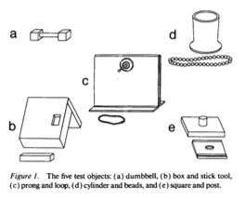
5 Test Objects for Unsuccessful Imitation Task

Slide 29
Pointing
Camaioni et al. (2004)
Declarative pointing linked to ToM
 | Comprehension Adult points | Production Child points
Imperative Need-based
Declarative To inform |  | ToM!
Notes:
Declarative linked to ToM in the respect that the child recognizes that others can pay attention to an object and share attention with someone else.
So, a child can see an object, think “Oh, it’s important.” then the child will want to share that object with another person.
So, I’ll go over the actual task: SLIDE

Slide 30
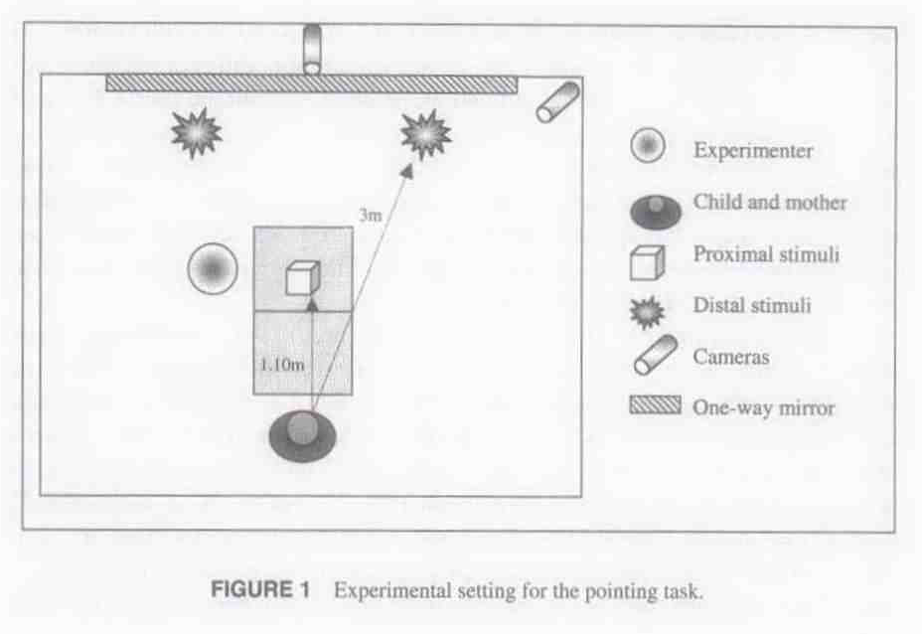
Notes:
As an example - declarative pointing production task…
“Experimenter… activated a mobile hanging from the ceiling in front of the child and behind herself and looked silently at the child for 15s.
The mobile moves for about 10s, then stops.
Experimenter then asks the child “What happened?””
The child now has the opportunity to point to the mobile behind the experimenter.

Slide 31
Helping
Buttelmann et al., 2009
Notes:
ASK THEM TO EXPLAIN IT

Slide 32
Anticipated Results
???
Notes:
Time for another discussion question!

Slide 33
Discussion Question!!
What do you think the anticipated results of this study will be?
If D = H, which hypothesis does that support?
If D ≠ H, which hypothesis does that support?
Language is separate from early ToM
Language is linked to early ToM
Notes:
The answer is – we don’t know. We’ll review the two possibilities we see happening..

Slide 34
1. Language is separate from early ToM
Deaf = Hearing Kids in ToM at 18 months
Notes:
If the deaf kids and the hearing kids perform the same on the three tasks we run them on,
that offers support to our first hypothesis that language is a separate process from early ToM.
We say this because the deaf kids are arguably language-delayed by virtue of their hearing status in an incompatible environment,
and if their early ToM is equal to their hearing peers, that indicates that their language delay doesn’t have an impact on early ToM.
That would indicate that the relationship between language and “toddler ToM” isn’t as strong as we thought before.

Slide 35
2. Language is linked to early ToM
Deaf ≠ Hearing in ToM at 18 months
Notes:
However, if the deaf kids perform worse than the hearing kids on the early ToM tasks,
then that offers support to our second hypothesis that language is indeed linked to early ToM.
However, it would create a difficult picture for us to figure out, as we would be unsure whether it is a deficit in language or JA that would cause the delay in early ToM.
We would not be sure if the relationship goes in the order of JA-Language-Early ToM-Age 4 ToM, or another combination thereof.

Slide 36
Implications, Real World Applications
The results of this study could offer an answer to the question about the role language plays in both toddler (age 4) and early ToM development.
Results could influence early intervention for deaf children, how hearing parents raise their deaf child, and how day cares will take care of deaf children – to prevent the delay in ToM and cognition from happening.
Any questions?

Slide 37
References
Buttelmann, D., Carpenter, M., & Tomasello, M. (2009). Eighteen-month-old infants show false belief understanding in an active helping paradigm. Cognition, 112(2), 337-342.
Camaioni, L., Perucchini, P., Bellagamba, F., & Colonnesi, C. (2004). The Role of Declarative Pointing in Developing a Theory of Mind. Infancy, 5(3), 291-308.
De Villiers, J. & Pyers, J. (2002) Complements to cognition: a longitudinal study of the relationship between complex syntax and false-belief-understanding. Cognitive Development 17, 1037-1060.
Gale E. & Schick, B. (2009). Symbol-Infused Joint Attention and Language Use in Mothers With Deaf and Hearing Toddlers. American Annals of the Deaf, 153, 484-503.
Gale, E., de Villiers, P., Pyers, J., Schick, B. & Hoffmeister, R. (2009). Deception in Oral and Signing Children: Not Delayed nor Dependent on Complex Language. SRCD Convention, Denver, CO.
Hresko, W.P., Reid, D.K., & Hammill, D.D. (1981). The Test of Early Language Development (TELD). Austin, TX: Pro-Ed.
Meltzoff, A. N. (1995). Understanding the intentions of others: Re-enactment of intended acts by 18-month-old children. Developmental Psychology, 31(5), 838-850.
Onishi, K. H., & Baillargeon, R. (2005). Do 15-Month-Old Infants Understand False Beliefs?. Science, 308(5719), 255-258.
Peterson, C. C., Wellman, H. M., & Liu, D. (2005). Steps in Theory-of-Mind Development for Children With Deafness or Autism. Child Development, 76(2), 502-517.
Premack, D. G. & Woodruff, G. (1978). Does the chimpanzee have a theory of mind? Behavioral and Brain Sciences, 1, 515-526
Schick, B., de Villiers, P., de Villiers, J., & Hoffmeister, R. (2007). Language and theory of mind: A study of deaf children. Child Development, 78(2), 376-396.
Schmidt, E. (2011). “Children’s Understanding of the Knowledge Gained Through Seeing and Through Hearing.” Unpublished thesis, Wellesley College.
Wellman, H. & Brandone, A. (2009). Early intention understandings that are common to primates edict children’s later theory of mind. Current Opinion in Neurobiology, 19, 57-62.

