Slide 1
Learning Styles or Multiple Intelligences or Best Practices for Paradigm-shifting Meta-cognition Instruction as it Applies to the Educational Environment Zeitgeist for the Modern Facilitator/Learner Accountability Relationship Ethos
Taught to you by: Isaac Robinson, with a little help from his friends

Slide 2
The current learning styles.
1. Visual/Spatial
2. Verbal/Linguistic
3. Kinesthetic/Body
4. Logical/Mathematical
5. Musical
6. Interpersonal
7. Intrapersonal
8. Existential/Spiritual
9. Naturalist

Slide 3
I’m going to blow your mind.
Watch this video.

Slide 4
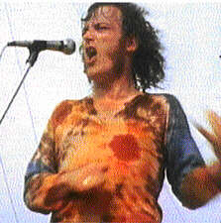
What did each learning style see?
1. Visual
2. Verbal
3. Kinesthetic
4. Logical
5. Musical
6. Interpersonal
7. Intrapersonal
8. Existential
9. Naturalist
He doesn’t know he’s not really playing a guitar.

Slide 5
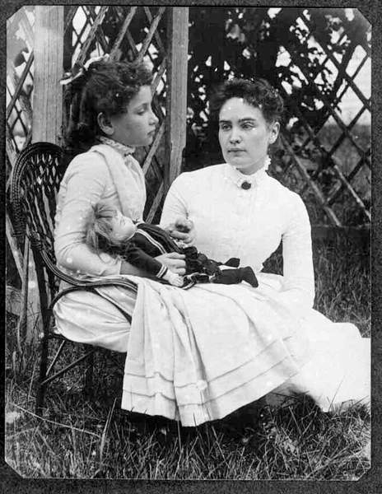
Meet the Visual/Spatial Style
Visual/Spatial – spatial reasoning, imagination, fine motor control, “see ideas”, seek visual stimulation, visual arts, like to change their physical environment, physically SEE the concept in action
Helen Keller was not a visual/spatial learner.

Slide 6
That’ll learn ‘em!
Let them move around (see other views)
Visually stimulating classroom (be careful!)
Brainstorming
Videos/computers/overhead projector
Projects that allow them to make visuals
Let them see the concept in action.
Sauron learned visually.

Slide 7
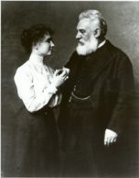
Meet the Verbal/Linguistic Style
Verbal/Linguistic – good spellers, like puns and word games, may develop own language, hear words when thinking, like lecture, discussion and essay, are good story-tellers, use descriptive language
Helen Keller was not a Verbal/Linguistic learner, either, Alexander.

Slide 8
That’ll learn ‘em!
Auditory learners learn by hearing things.
Vocabulary words
Journals and reflection using words
Speeches and acting
Let them talk and ask questions.
Let them answer them, too.
Don’t be deceived, some auditory learners will try to take over your class.

Slide 9
Meet the Kinesthetic Style
Bodily/Kinesthetic – body contact, physical movement, balance and poise, quick and intuitive response to physical stimulus, hands-on, large gestures, can do hands-on activities for extended periods of time
President Eisenhower finds out that Helen Keller was a kinesthetic learner.

Slide 10
That’ll learn ‘em!
Kinesthetic learners need to move. Sometimes.
Hands-on activities
Dancing and acting
Writing is movement!
Toe and finger taps can be done at your desk.
Math and language manipulatives
Computers can be interactive.
ADHD doesn’t always equal kinesthetic learner.
Play catch, origami, tie knots, doodle

Slide 11
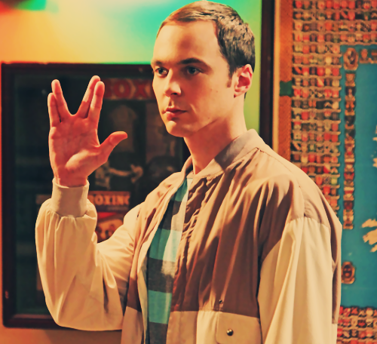
Meet the Logical Style
Logical/Mathematical – Seek order and consistency, good with cause and effect, break down patterns and problems into their constituent parts, good with puzzles and numbers, troubleshooters
Spock and Sheldon are both Logical learners

Slide 12
That’ll learn ‘em!
Be organized.
Allow them to test hypotheses and ask questions. They probably aren’t testing your authority.
Puzzles, charts, discussions and debates as projects.
Set clear and reachable goals in class. Allow student participation in goal-setting.
Let them know WHY you’re doing the assignment.
Give them grading rubrics ahead of time.

Slide 13
Meet the Musical Style
Musical style – rhythm and patterns, disinclined to express thoughts in words, music expresses emotions, excellent ability to listen, learn other languages
Disco Stu learns music from you!

Slide 14
That’ll learn ‘em!
Patterns, sounds and rhythm are great – if you can do it.
Encourage toe and finger tapping.
Projects can include music. History is musical.
Codes, number sequences, other languages
Encourage expression of feelings using descriptive words
Work at home with music.
Put things to music, but don’t shoe-horn it.
Do types of music matter?
Be careful about headphones in class!

Slide 15
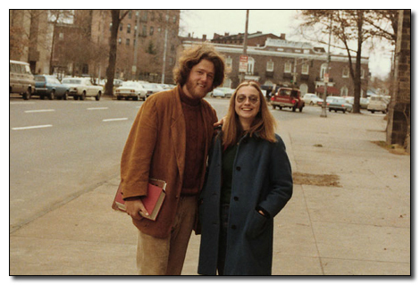
Meet the Interpersonal Style
Interpersonal Style – Group work, good leadership, social influence, concern for social impact, relationships, gregarious, well-liked
One of the people in this picture is known for strong interpersonal skills, and the other is not.

Slide 16
That’ll learn ‘em!
Group work, teams, interaction with you.
Drama, competitions, games
Greeting cards, gifts, anything to be given
Watch movies and analyze characters
Give them freedom, but don’t let them take over.
Strong interpersonal skills can save you from the Klingons, but they can also prevent work from getting done. Don’t let charisma distract you.

Slide 17
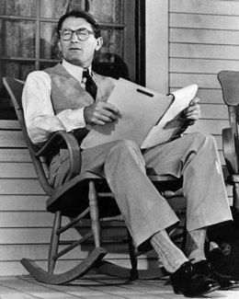
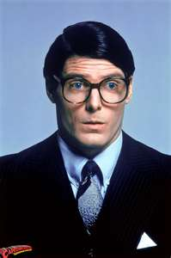
Meet the Intrapersonal Style
Intrapersonal style – awareness of their own thought patterns, ethical awareness, comfort with self, aware of actions, strong likes and dislikes, realistic goals, justice and fairness, instinctual
Clark Kent and Atticus Finch show strong Intrapersonal Characteristics.
Boo!
That really isn’t funny.

Slide 18
That’ll learn ‘em!
Journals, diaries, reflection of any kind
Class discussions require participation.
Shyness does not equal intrapersonal learner.
Relate it back to them.
Talk about values and reasons.
What would YOU do in that situation?
ASK WHY! – You should be doing this, anyway.
Keep your rules fair and just.

Slide 19
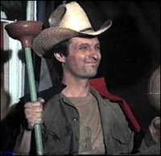
Meet the Existential Style
Spiritual/Existential – intangibles like recognizing and loving art, truth, beauty, etc.; deep meaning, cross-discipline learning, in-context, friends and family connection, philosophy/religion
This lesson could be taught entirely in the context of MASH. Hawkeye, here, is not merely the cowboy-plumber he appears. His thoughts are much deeper.

Slide 20
That’ll learn ‘em!
Overview, preview, reasons, wrap-up, reflection
Global views, multiple points of view
Cross-curricular lessons
Application of concepts
Review art (not just paintings)
Give your reasons, show connections
Existential learners will ask a lot of questions, and try to find deeper meaning everywhere they can. If this gets too tedious, give them Bob Dylan’s “Blonde on Blonde” record and tell them to figure that one out. You’ll get some quiet… at least for a while.

Slide 21
Meet the Naturalist Style
Naturalist – organized, structured, seek patterns, collections and categories, remember attributes, relate to living organisms and environments, impose their own sense of order and structure
Regardless of the politics imposed upon them, Bert and Ernie show naturalist tendencies and an inability to get along at times because their categorization can be incompatible.

Slide 22
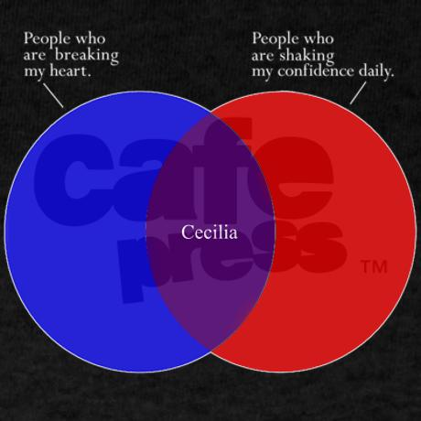
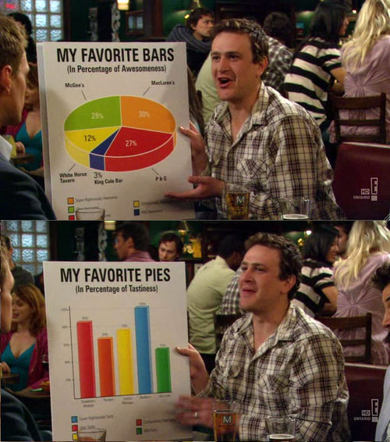
That’ll learn ‘em!
ORGANIZATION! You need it and they’ll love it.
Charts, graphs, maps, categorizing of any kind
Gathering, collecting, building, grouping
Nature activities
They may have trouble seeing other people’s patterns and organization patterns at first. Once they are trained to see other perspectives, and the order therein, they’ll feel better about the world and your classroom.
This is really hilarious if you’re a visual learner. Naturalist learners may get confused.

Slide 23
Tips
Don’t be disingenuous. If you can’t stand to sing, don’t.
You aren’t a rapper. Seriously, you aren’t.
Don’t over-do it. Elementary school décor isn’t cool.
Overlap when you can.
Try it one way and then explain it from a different learning style.
Don’t tell them what you’re doing. People act differently when they know what’s going on. Heisenberg said so.
The students we have are probably not simply visual or auditory learners. They’d have been more successful in a regular high school if they were.
Don’t get stuck teaching to your preferred learning style.
Don’t think that a person can only learn one way.
Smells matter! Good Smells make for better learning AND repeated smells help recall (smell it in class, at night and then during the test)

Slide 24
Hoggify a little health from your Fred
http://www.tecweb.org/styles/stylesframe.html
http://surfaquarium.com/MI/
http://www.ldrc.ca/projects/miinventory/miinventory.php
Howard Gardner
http://www.cracked.com/article_19391_6-ways-your-sense-smell-secretly-controlling-your-mind.html
Yoda said, “you must unlearn what you have learned.” Be creative and open your mind to learning styles other than your preferred style and you’ll be a more effective teacher. And also defeat the Empire.

Slide 25
Here’s where I got the pictures:
Helen Keller images rudely stolen from:
http://www.helenkellerbirthplace.org/helenkellerbio/helen_keller_birthplace2_bio.htm
http://www.barewalls.com/pv-394458_Dwight-D-Eisenhower-Helen-Keller-1953.html
Disco Stu: http://simpsonit.org/?sivu=hahmot/disco_stu
Spock: www.startrek.com
Atticus Finch: http://www.sodahead.com/fun/whos-your-favorite-to-kill-a-mockingbird-character/question-827395/
Clark Kent: www.therpf.com
The Clintons: www.butlersheetmetal.com
Hawkeye: http://www.proprofs.com/quiz-school/story.php?title=mash-4077-knowledge-test
Bert and Ernie: http://thewordwarrior.wordpress.com/2009/11/14/on-toleration-and-the-muppets/
Sauron: www.johnhowe.com
Captain Kirk: www.spacetimenews.com
Bob Dylan: www.amazon.com
Charts: www.cafepress.com and http://24.media.tumblr.com/tumblr_kps623PdwQ1qzohf4o1_500.jpg

Slide 26
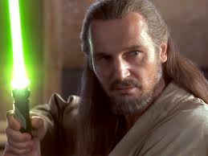
Here’s my contact information:
Isaac Robinson
irobinson@neosho.edu
620-431-2820-509
The pictures and funny captions are there to help you remember stuff. Nobody remembers Clip Art; good luck getting that big-glasses picture of Hilary Clinton out of your head.

