Slide 1
Fault and Fracture Distribution Within a Tight-Gas Sandstone
Ian McBride

Slide 2
Overview
Where we are
The geology of the area
Early exploration of area
Later exploration
Current situation
Conclusion

Slide 3
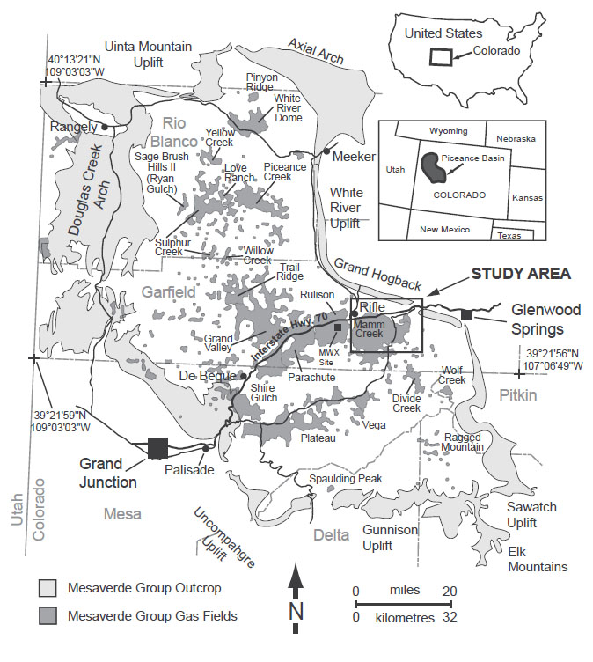
Piceance Basin, Colorado USA
NW Colorado
Huge Oil Shales
Fractured Sandstone
Coal

Slide 4
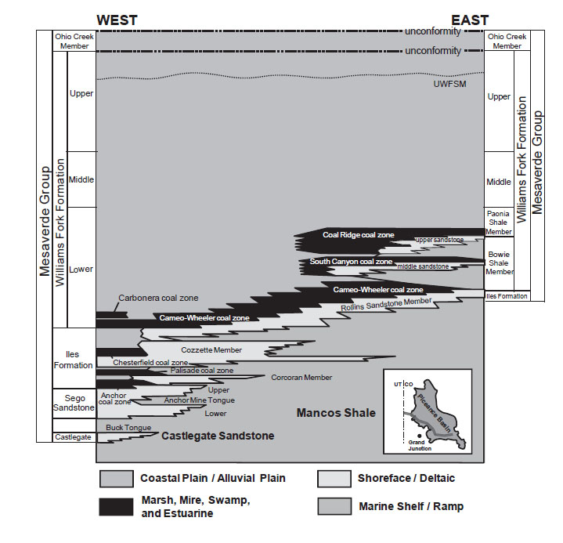
Geology
Coastal plains
Alluvial deposits
Deltaic deposits
Marsh/Swamp

Slide 5
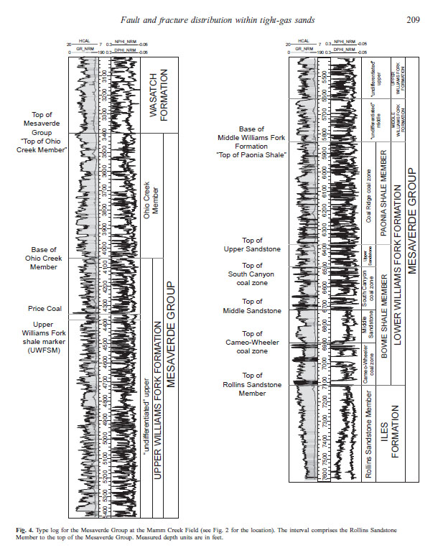
Early Exploration
Tight Sandstones appeared to have low permeability
Highly fractured but poor correlation to net payout
Not economically feasible
Nuked it in 1969!
6000+ ft.

Slide 6
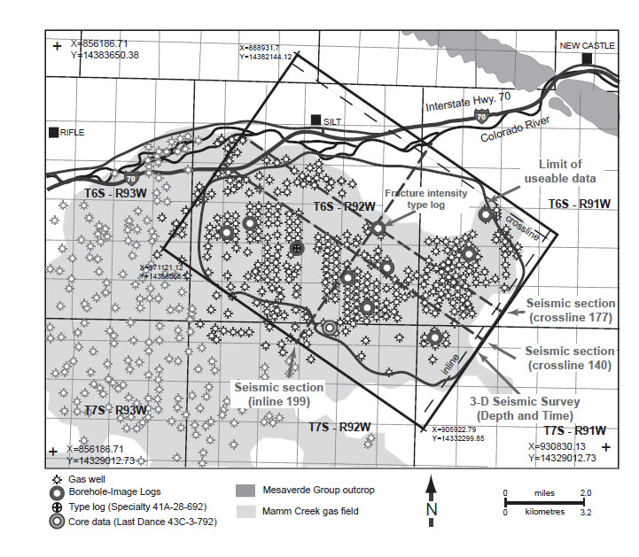
Later Exploration
Understanding the faults and fractures is the key to the petroleum
Better recovery methods + higher oil prices = economic feasibility
Many wells drilled
Area of further study

Slide 7
The Faults and Folds
Further study of Faults and folds helped focus petroleum exploration for higher net pay out.
New technologies were instrumental in further exploration

Slide 8
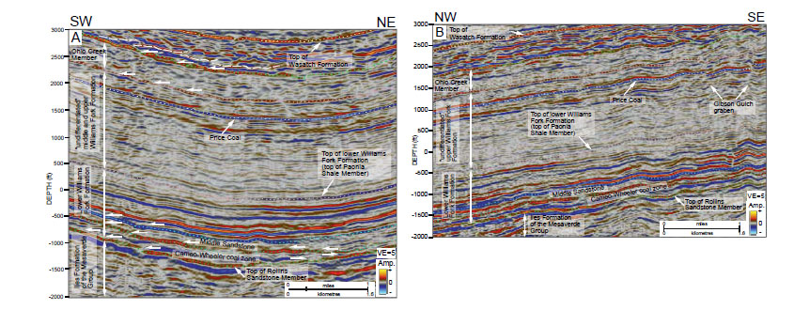
Seismic Imaging

Slide 9
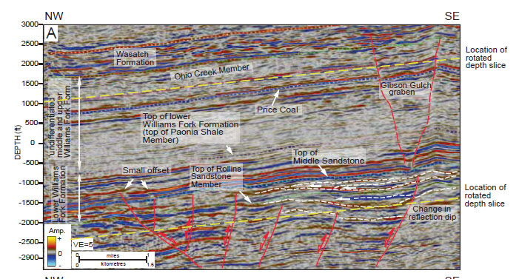
Able to accurately map faults and folds in 2D

Slide 10
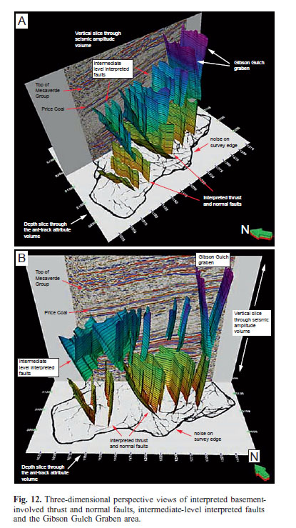
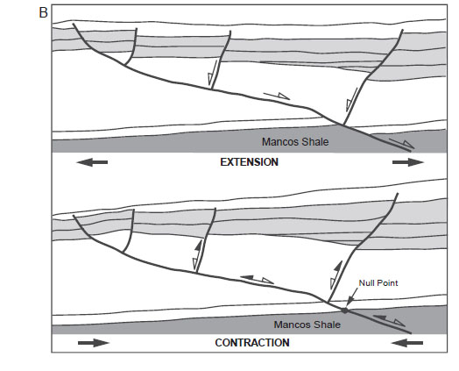
Next Level!

Slide 11
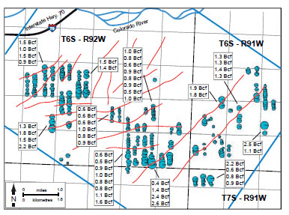
Today
Wells concentrated along fractures
Clear NE-SW trend
More efficient
More profitable

Slide 12
Conclusion
Known petroleum deposits
Early exploration was ineffective
New tech. brought better success
Now gas is extracted much more efficiently

Slide 13
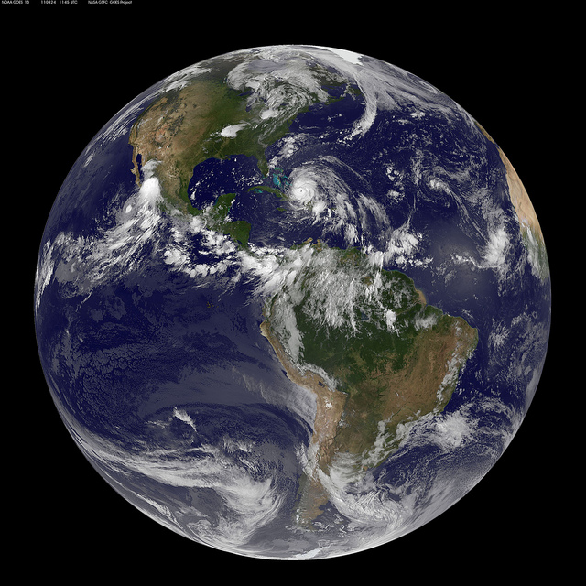
Thank You!

