Slide 1
Coal

Slide 2
What is coal?
Most abundant fossil fuel in the world
Enough coal reserves to last 200 years
Dark sedimentary or metamorphic combustible rock made from swamp plants that died millions of years ago and were transformed by intense heat and pressure

Slide 3
What is the coal used for?
heating
Burned to turn water into steam, which turns blades of a turbine to generate electricity
Steel production

Slide 4
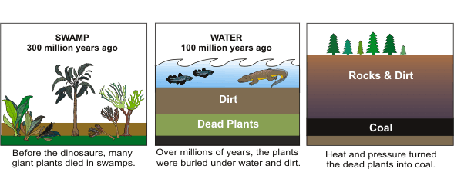
HOW IS COAL MADE ???

Slide 5
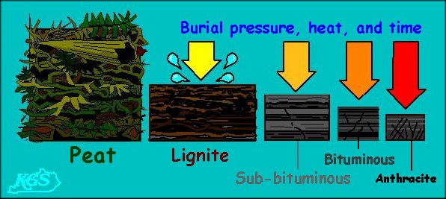
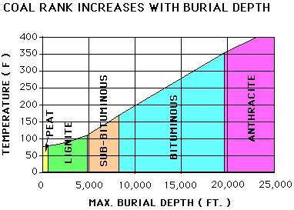
Types of Coal
Grades of Coal
Peat
Lignite
Sub‐bituminous
Bituminous
Anthracite

Slide 6
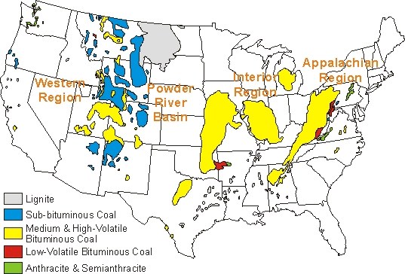
Where is coal?

Slide 7
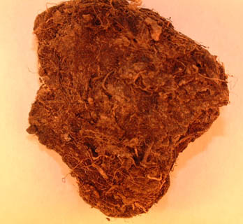
Peat
Lowest grade; newest deposit, not true coal
Found in wetlands
Least amount of heating value
Concern: destroying wetlands

Slide 8
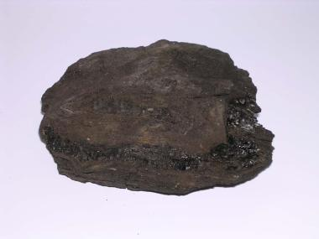
Lignite
Sedimentary rock
Brownish-black coal
High moisture content
“soft”
Used for generating electricity
Carbon content: 20-25%

Slide 9
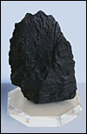
Sub-bituminous Coal
Sedimentary rock
Dull black
Harder than lignite, higher energy value
Used for electricity
Carbon content: 30-45%

Slide 10
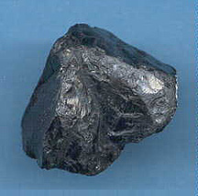
Bituminous Coal
Sedimentary rock
Most common type; 50% of US coal reserves
Harder than sub-bituminous coal, more energy
Used for heating and electricity
Carbon content: 45-80%

Slide 11
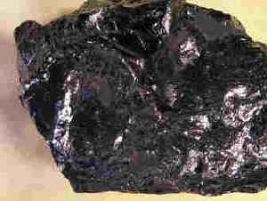
Anthracite
Metamorphic rock
“hard” coal, black and shiny
High
highest energy content
Only 1.5% of US coal reserve base (rare)
Carbon content: 80-96%

Slide 12
Coke
Almost pure carbon
Coal heated with out air to remove any water

Slide 13
Coal Key
Peat-Brown
Lignite-Yellow
Sub-bituminous-Red
Bituminous-Green
Anthracite-Blue
Coke

Slide 14
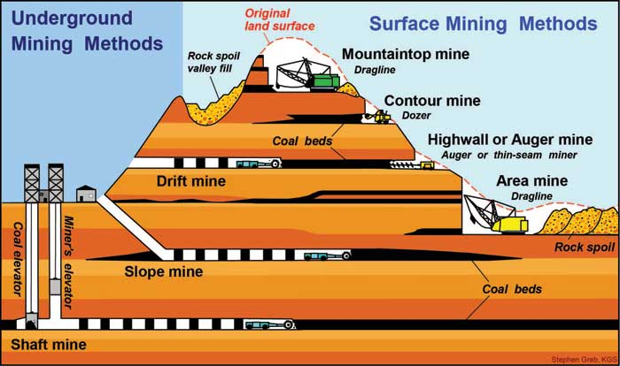
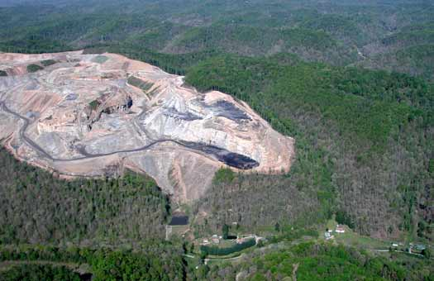
Coal Mining

Slide 15
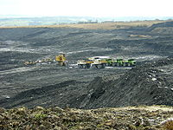
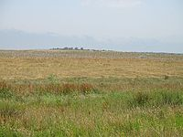
Mine Reclamation
Mine reclamation is the process of restoring land that has been mined to a natural or economically usable purpose

Slide 16
Surface Mining Control and Reclamation Act, 1977
Requires that coal-mining sites be restored to natural areas or productive land

Slide 17
Cookie Mining

