Slide 1
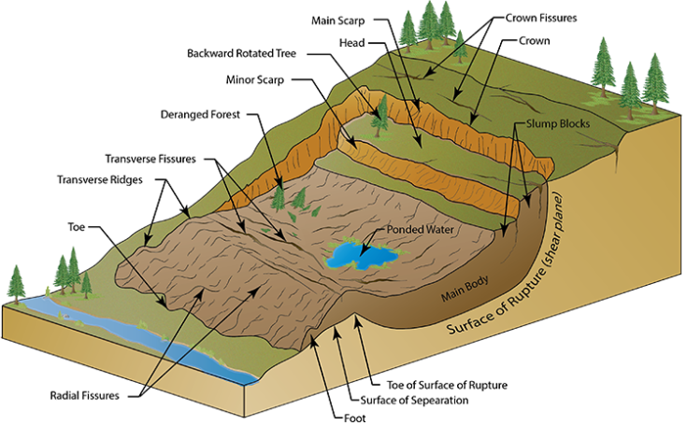
Landslides in the Bear Lodge Mountains
Karl M. Emanuel
North Zone Geologist
Black Hills National Forest

Slide 2
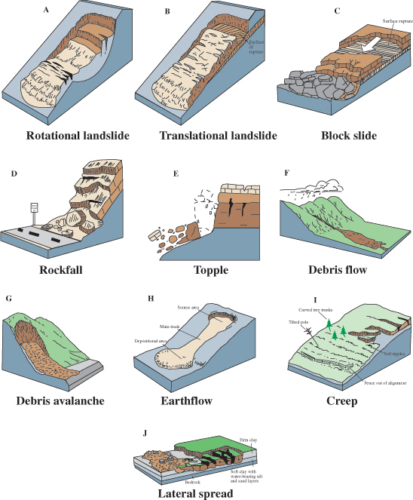
This slide shows generalized illustrations of most of the major landslide types.
All of the these slope failure styles are seen within the Black Hills, but most of the those observed in our area are of the following types.
Rotational
Topples
Debris Flows
Earthflows
The majority of landslides in our area are composite types, as well, with characteristics of more than one slide type.
Due to this composite nature, they are more unstable under wet and saturated conditions and can transition to highly dangerous debris flows.

Slide 3
This figure shows most of the common features of a rotational landslide, which is the dominant style of mass movement found in the Bear Lodge Mountains.

Slide 4
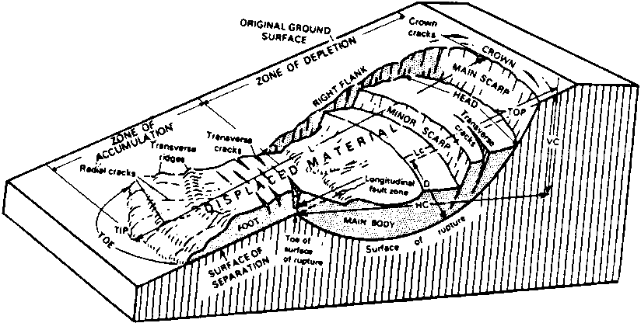
This figure also shows most of the common features of rotational landslides. It is a bit more detailed, however, and more of the typical features for this type of slide are labeled on this diagram.
Lc refers to the length along the surface from the head scarp to toe of the surface rupture.
Vc and Hc are the vertical and horizontal distances involved for a given slide’s profile.

Slide 5
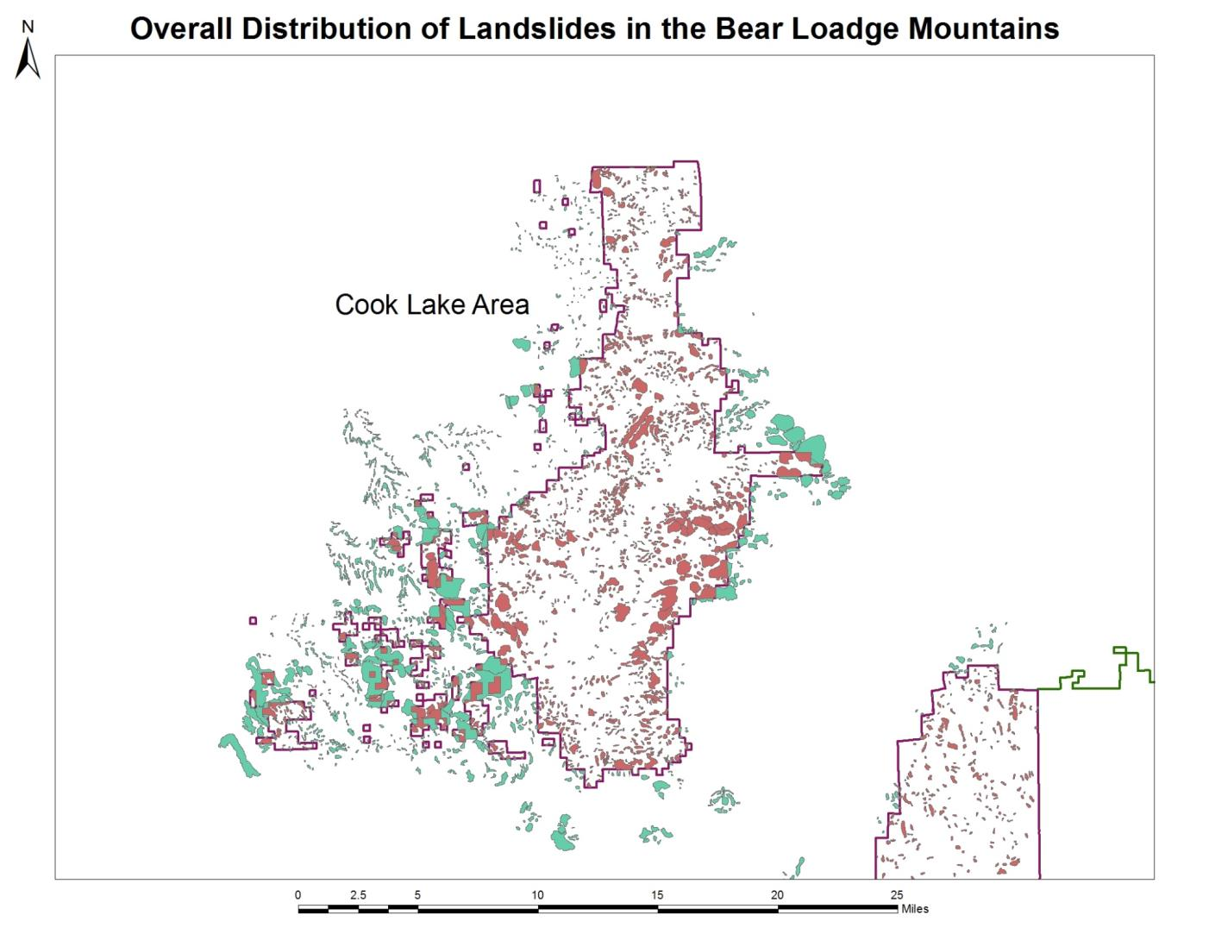
Overall Distribution of Landslides in the Bear Lodge Mountains
This slide shows all of the landslides, both active and dormant, that are suspected to occur in and adjacent to National Forest lands in the northern part of the district.
There are almost 3200 occurrences shown on this slide.
Pink indicates those occurrences interior to the forest.
Green indicates those nearby occurrences outside of the forest

Slide 6
Wyoming contains more identified landslides than any other state in the union. These feature, however, are not unusual and are an integral part of our normal landscape. They area as natural as any other part of our environment.
The Wyoming Geological Survey (WGS) identified roughly 1550 active landslides within Crook County in the early 1990’s , and these occurrences totaled over 38,000 acres in surface area.
Although only 247 (16%) of these active occurrences are found on the National Forest, they represent over 25% of the total area identified in the county, and many of these features are quite large (greater than a square mile in size).
The area surrounding Cook lake contains a minimum of 6 large slides that are considered active by the WGS.

Slide 7
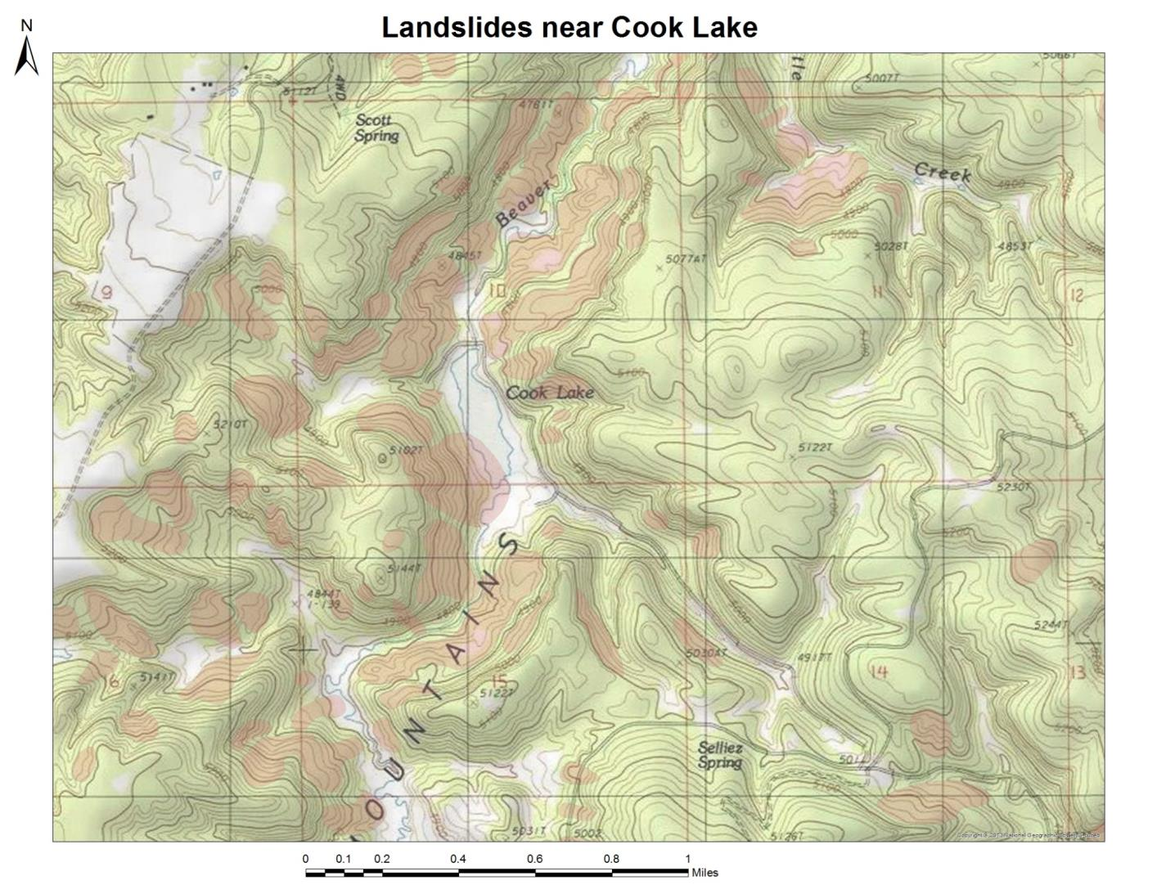
The Beaver Creek Drainage is lined by landslides along most of its length…these are indicated by red shading.
The Cook lake and dam are bordered by several of these large composite slides.
The Wyoming Geological Survey’s (WGS) hazards group has identified many of these as active…these more active zones are further indicated by dashed outlines.

Slide 8
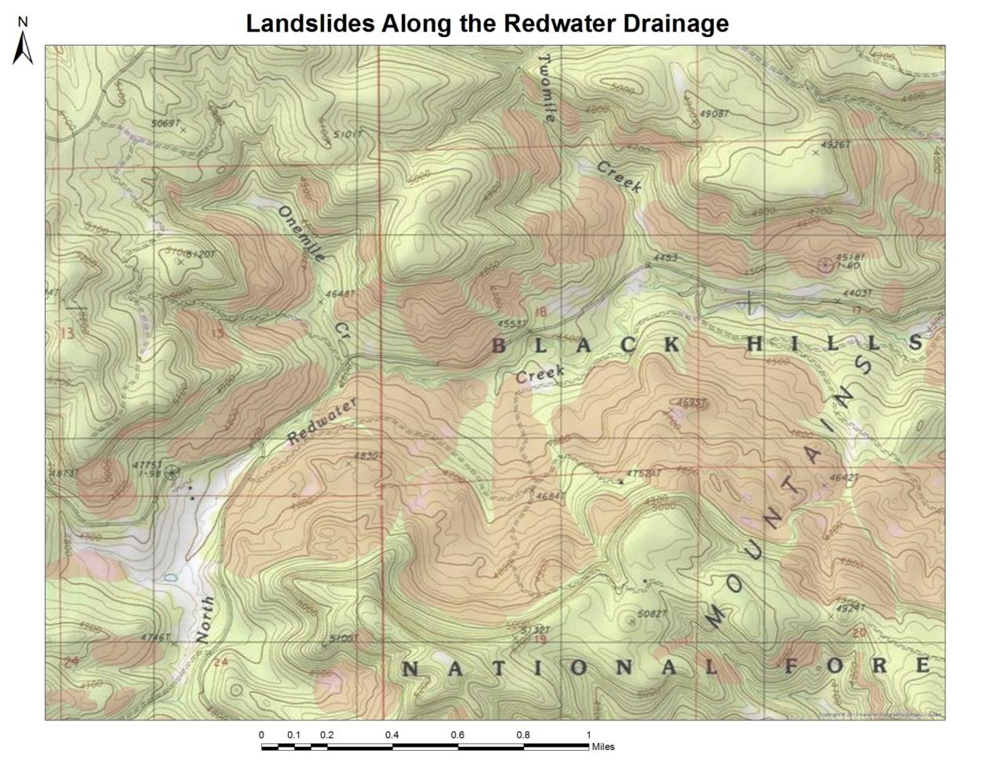
The Redwater drainage is similarly lined by numerous large landslides…shown shaded in red.
The WGS also regards these as active…as indicated by dashed outlines.

Slide 9
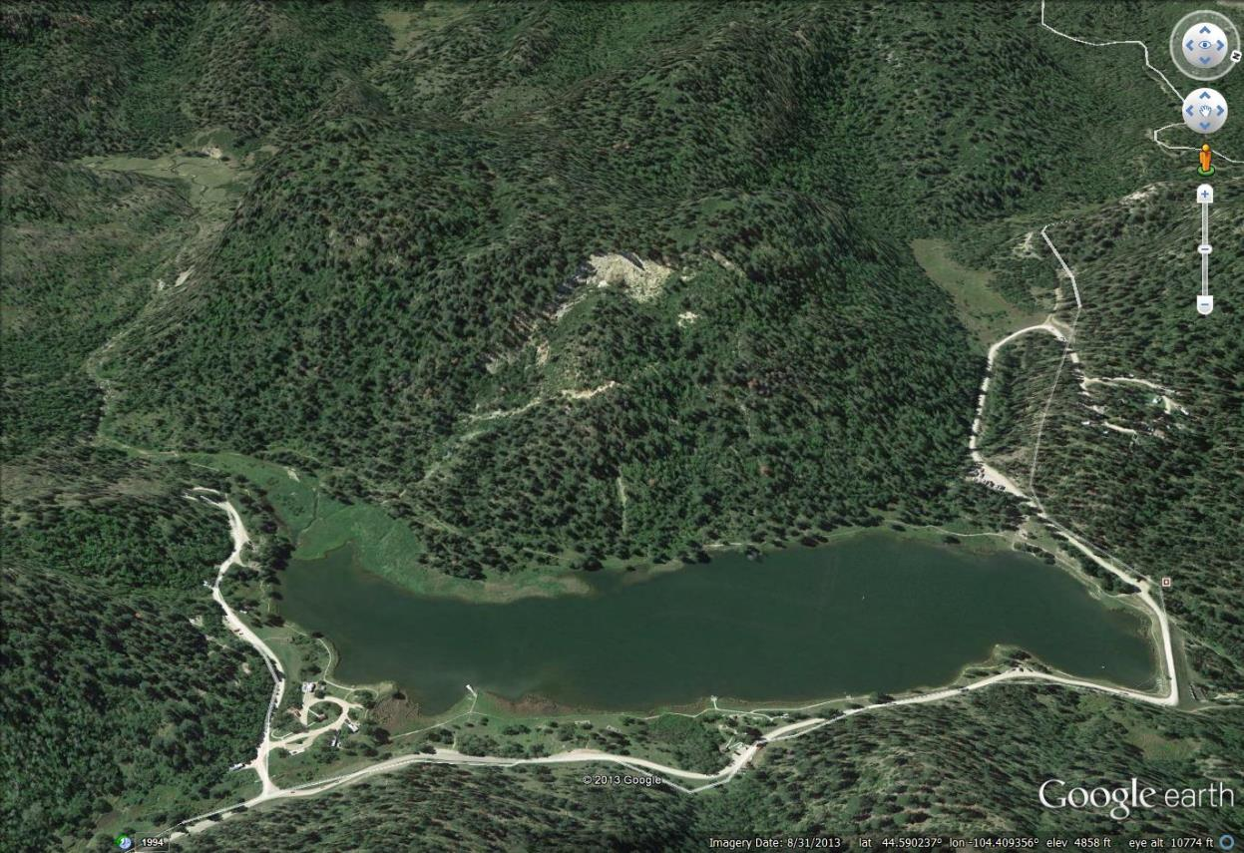
Cook lake view showing the camping loops.
Loop B
Loop A

Slide 11
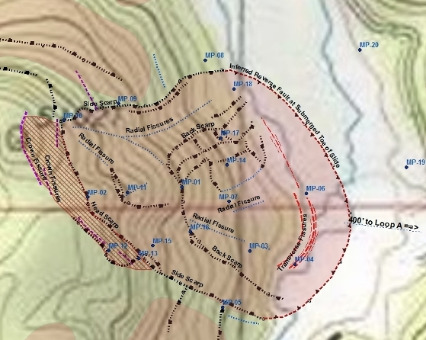
Cook Lake Landslide
Structures and Monitor Points
1800 ft. long by 1200 ft. wide w/ Vertical relief of 320-360 ft.

Slide 12
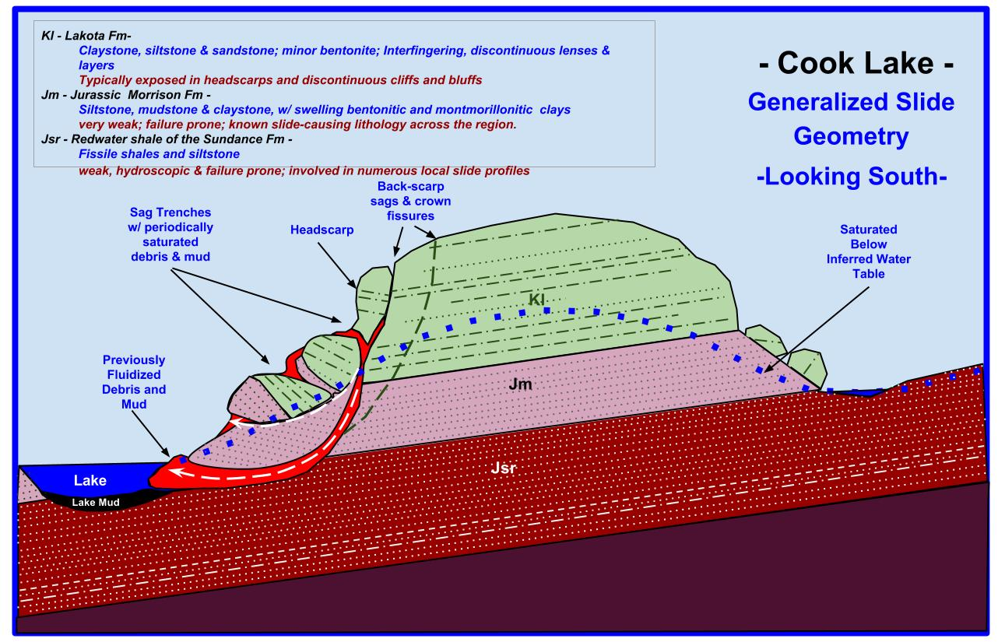

Slide 13
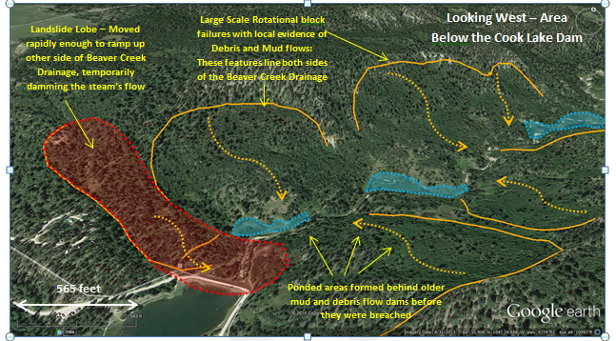
The dam is located on an active slide that probably blocked the flow of Beaver Creek at some point in the past.
The area just downstream shows evidence that numerous other debris and mudflows have occurred in the past which have similarly blocked the flow of Beaver Creek.

Slide 14
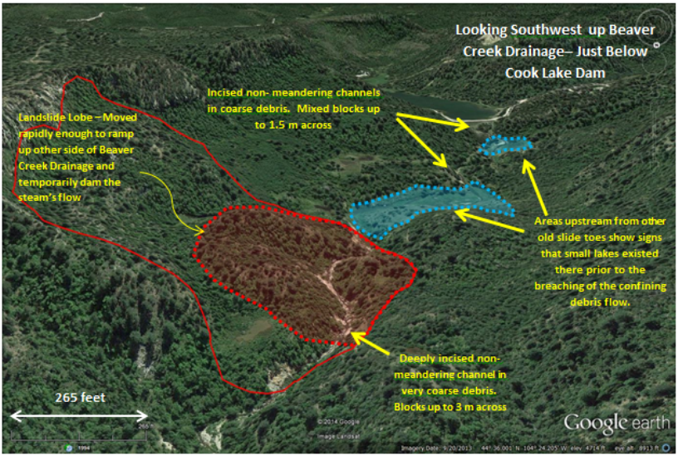
One lobe of a large landslide downstream from the dam, located within an active portion of a larger slide complex, flowed fast enough and far enough to push debris up the other side of the drainage. This slide buried the stream channel in 40-60 ft. of mud and coarse debris. This event was most likely a fast moving mud/debris flow.

Slide 15
Key Features of the Cook Lake Slide
Water and gravity are the key motivators. Most of the slopes in the area have 200 to 400 ft. of vertical development from adjacent valley floors. Many side slopes have perched water tables and contain ponds that keep the slopes moist through much of the year. The Cook Lake Slide system has almost 360 ft. of vertical relief.
The rocks beneath the landslide dip towards the lake at 5 to 5-10° . They are composed of slide prone Morrison Formation silts/shales and Redwater Shales, which are overlain by cliffs of Lakota Formation sandstones and siltstones.
The rock strength of the Morrison Formation is low enough that it often fails under its own weight when lying at a mere 5-7° slope. This suggests its angle of internal friction is very low. The dip of these units is already at a 5-7° angle, and they slope into the lake basin.
The lakeside slide covers an area of 30.45 acres, and is up to 320 ft. thick at the head scarp end.

Slide 16
Key Features of the Cook Lake Slide
(Continued)
The volume of material within the landslide body as currently outlined is 8.5 M cuyd. This corresponds to roughly 15-20 million tons of mud and debris.
There is an additional 2-3 Mt of loose rock perched in the fractured wall behind the head scarp of the slide.
A minimum run-out distance of 1500 ft. is likely if fluidization occurs. This is how far a landslide can be predicted to go if saturation and failure occurs (assuming a conservative angle of internal friction near 20°).
Last year was the record year for precipitation since records have been kept (the last 29 years).
last year had 200% of normal snowpack in the upper Bear Lodge and 28.7 inches of precipitation locally.
The average annual precipitation at the Bearlodge RAWS SNOTEL station is 18.5 inches.
Ten of the last 11 years have had above average precipitation.

Slide 17
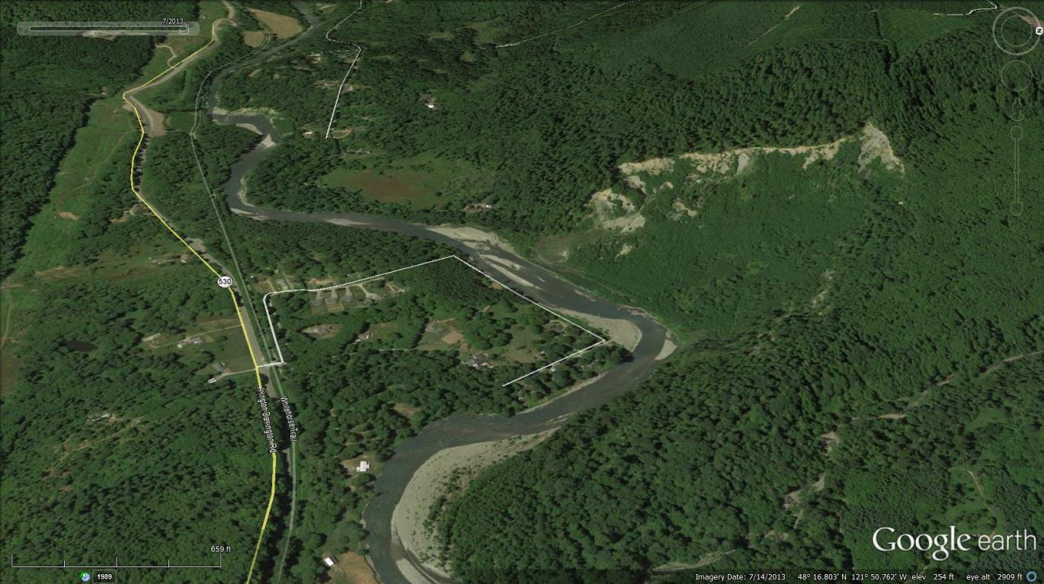
Oso, Washington
July 14, 2013
Eight months prior to the 2014 slide event

Slide 18
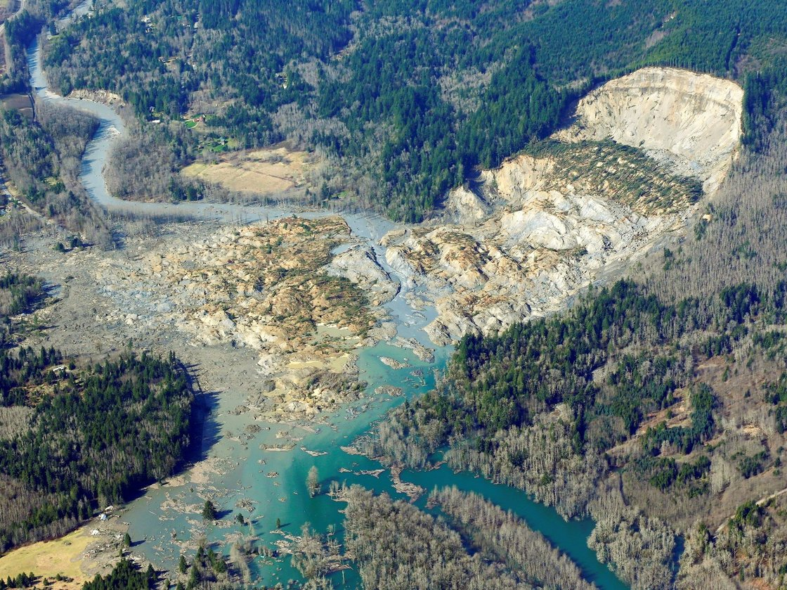
Oso, Washington, March 22nd ,2014
Rotational Block Failure/ Debris Flow
37 deaths - up to 25’ thick
Attained maximum speeds of 60 mph

Slide 19
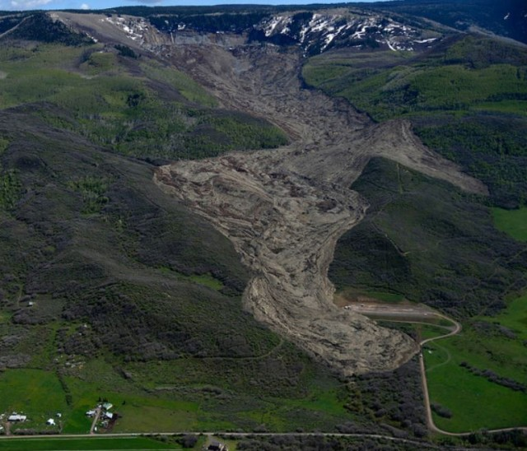
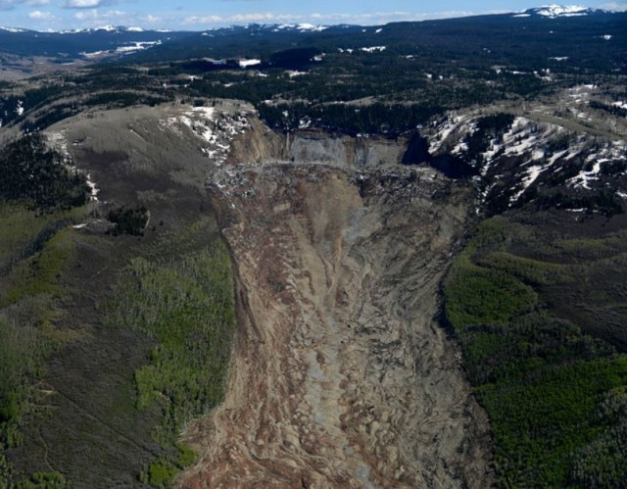
Grand Mesa, Colorado
Earthflow/Debris Flow
May 26th , 2014
3 deaths - up to 200’ thick
Over 3 miles long
Attained maximum speeds near 50 mph

Slide 20
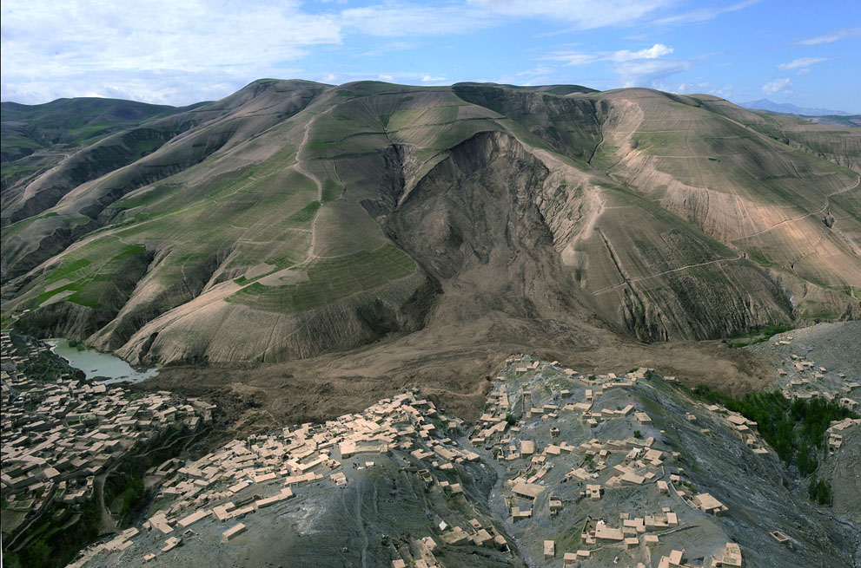
Abi Barik, Afghanistan
Earthflow/Debris Flow
– May 5th 2014 –
~ 2000 deaths - up to 200’ thick
Attained maximum speeds of over 80 mph

Slide 21
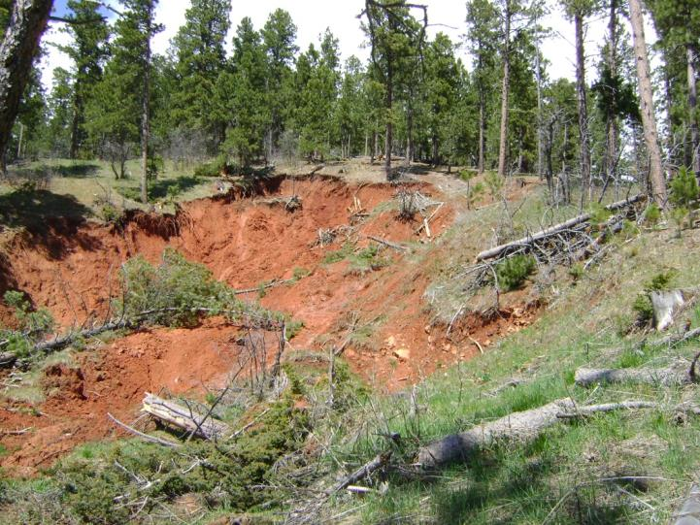
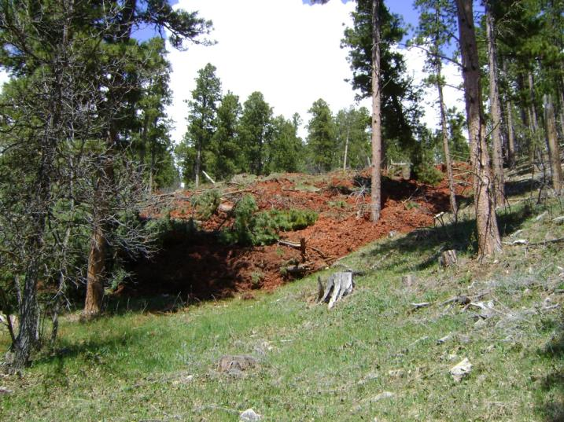
Houston Creek Area
South Western flank of the Bear Lodge
Spring, 2014
Earthflow on older Rotational Block Failure
Slide toe buried an approximately 1 acre area to a depth of 20 ft.

