Slide 1
Epigenetics
Originally defined as “ the branch of biology which studies the causal interactions between genes and their products, which brings the phenotype into being” Waddington, 1942
“The study of any potentially stable, and ideally, heritable change in gene expression or cellular phenotype that occurs without changes in Watson-Crick base-pairing of DNA” Goldberg , Allis and Bernstein. Cell, 2007.

Slide 2
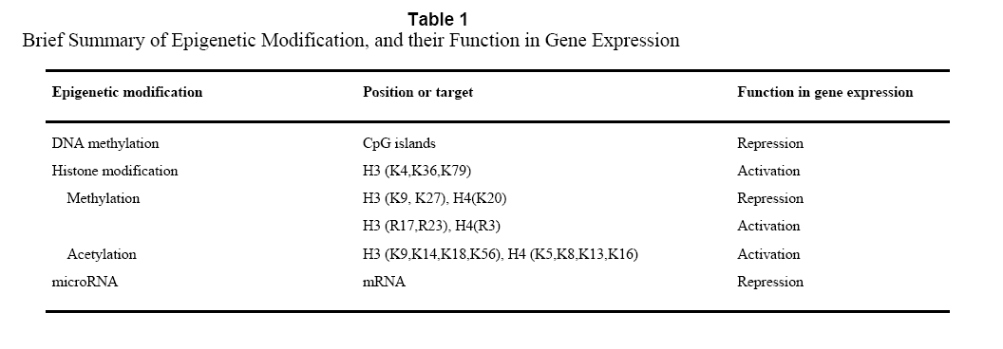
Three main players
Li and Zhao, Stem Cells Dev., 2008

Slide 3
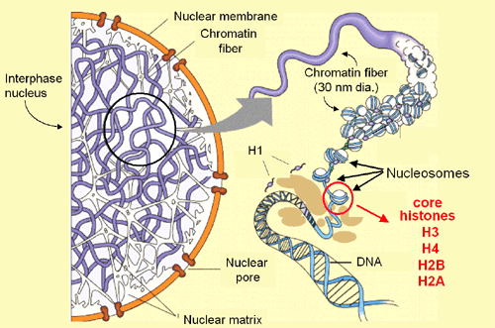
Chromatin

Slide 4
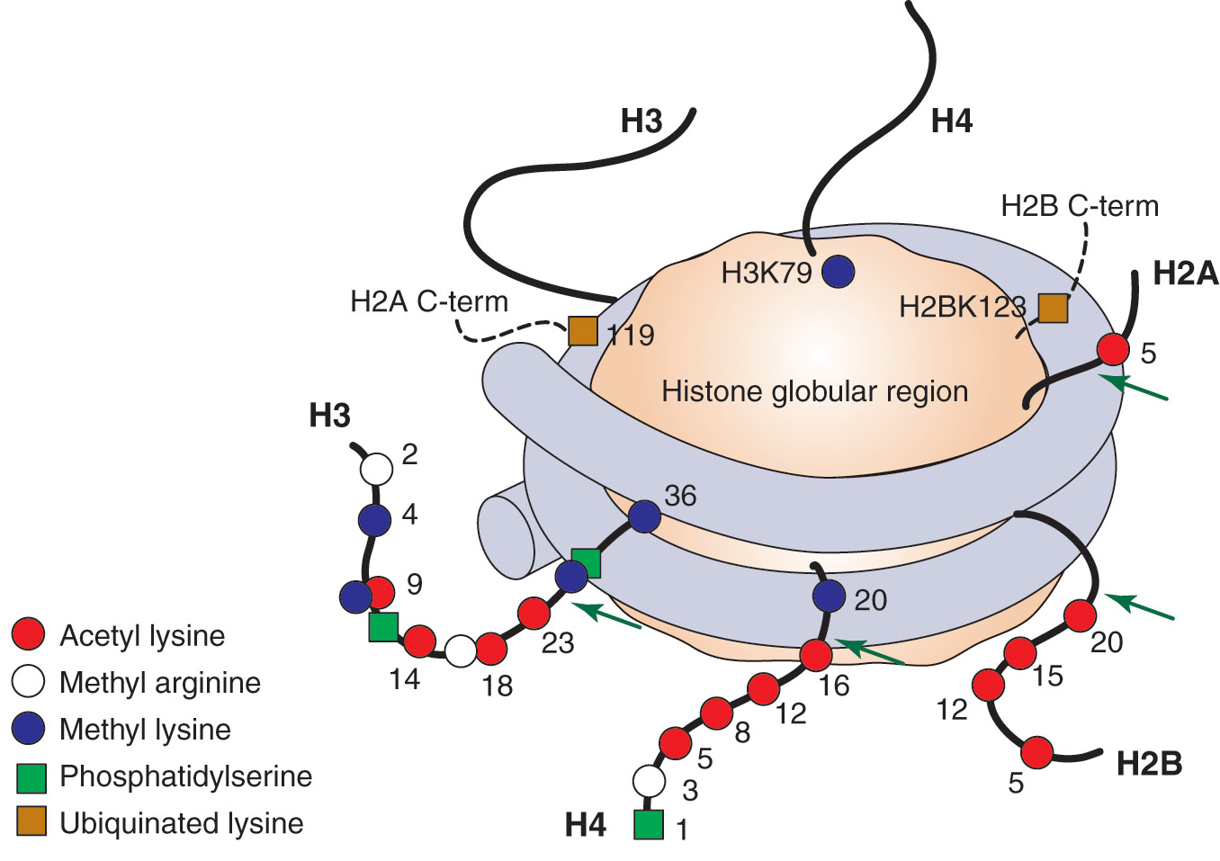
Histone modifications on the nucleosome core particle
Adapted from Turner, B. M., Cell 111 (2002): 285-291.

Slide 5
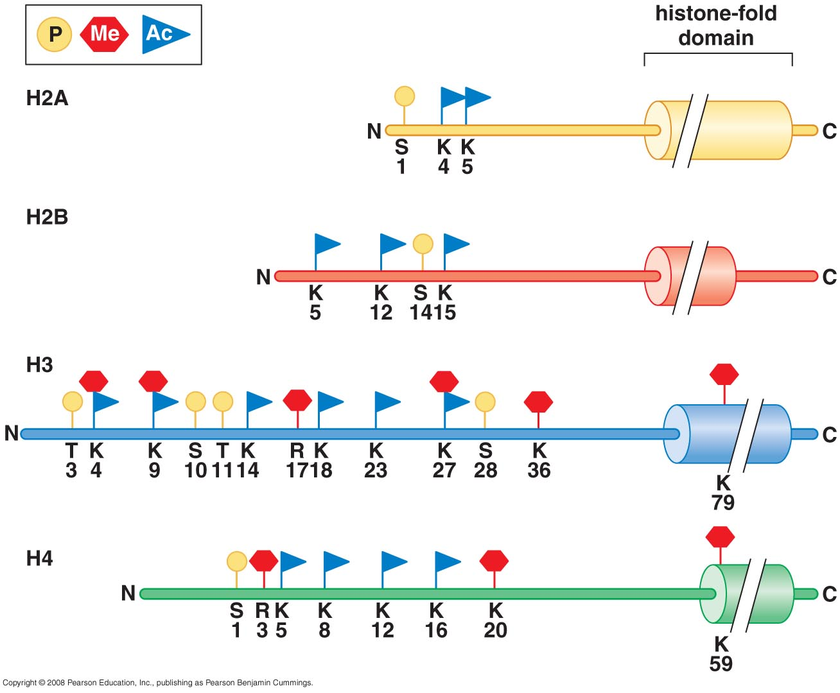
Histone modifications determine function

Slide 6
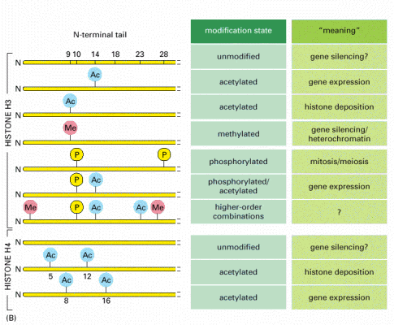
Examples of the “histone code” for H3/H4
See table 7-7
Modifications include acetylation, methylation, phosphorylation, and ubiquitylation. Modification patterns comprise the “histone code”.
Principle: “Epigenetic “ marks alter gene function
Ac = acetyl (lysine) Me = methyl (lysine), P = phosphoryl (Ser or Thr)

Slide 7
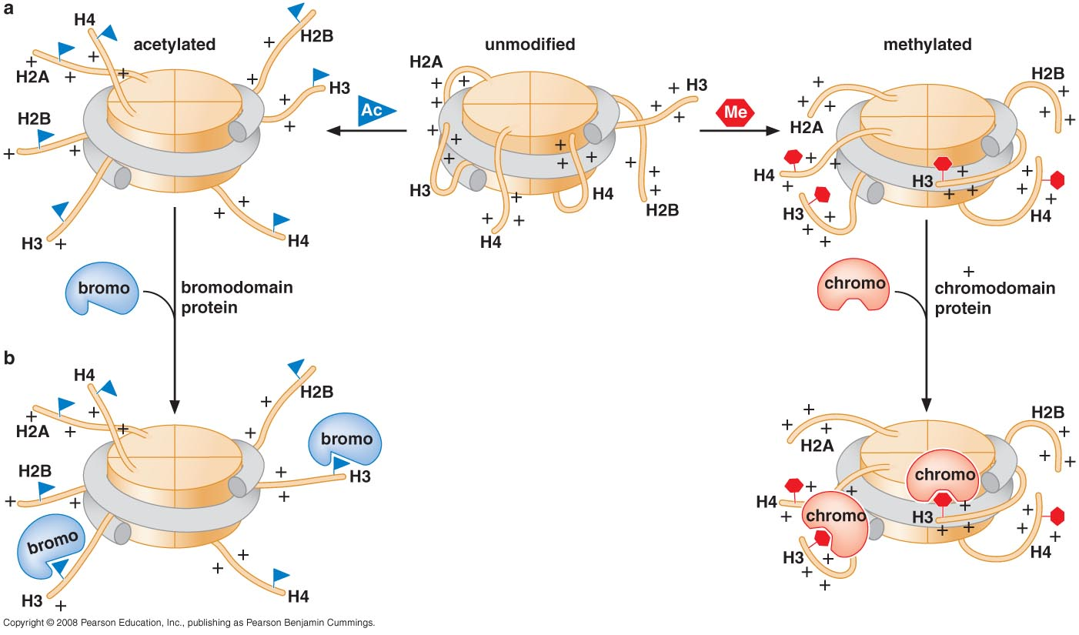
Histone tail modifications alter chromatin accessiblity

Slide 8
Histone modifying complexes and nucleosome remodeling complexes recognize the modified histones through specific domains
Kouzarides, Cell, 2007

Slide 9
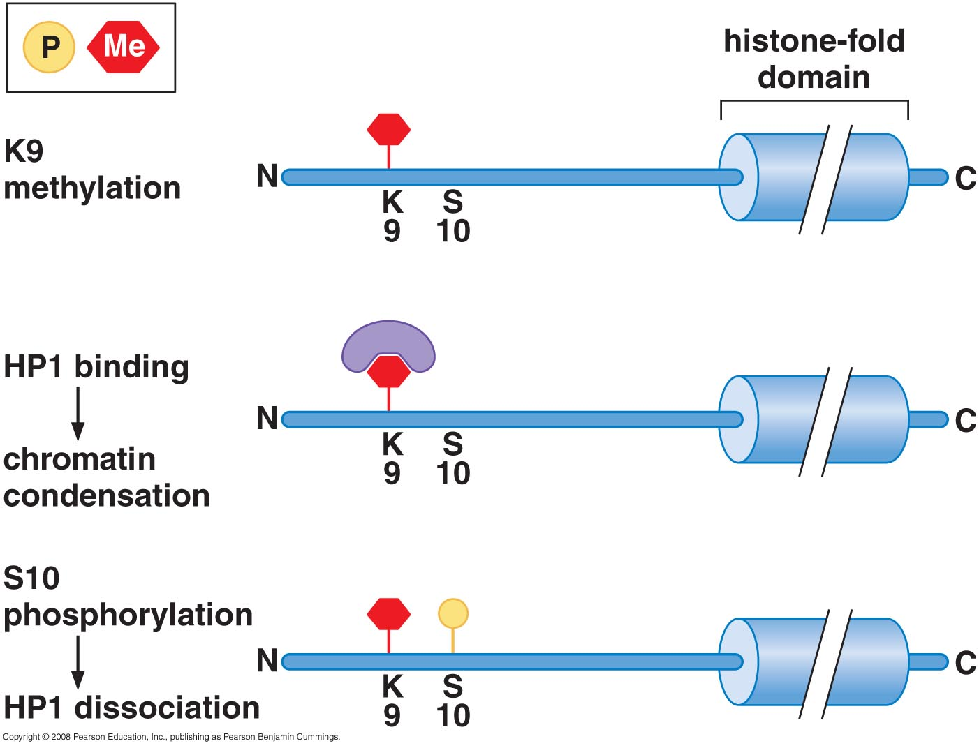
Is there a histone code?
In Drosophila:
During metaphase HP1 is temporarily lost from mitotic chromosomes
This is associated with phosphorylation of the neighboring serine residue, mediated by cell cycle kinase Aurora B

Slide 10
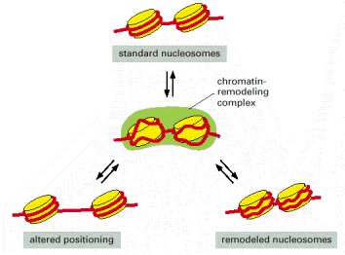
Chromatin-remodeling and histone-modifying complexes work together to alter chromatin structure

Slide 11
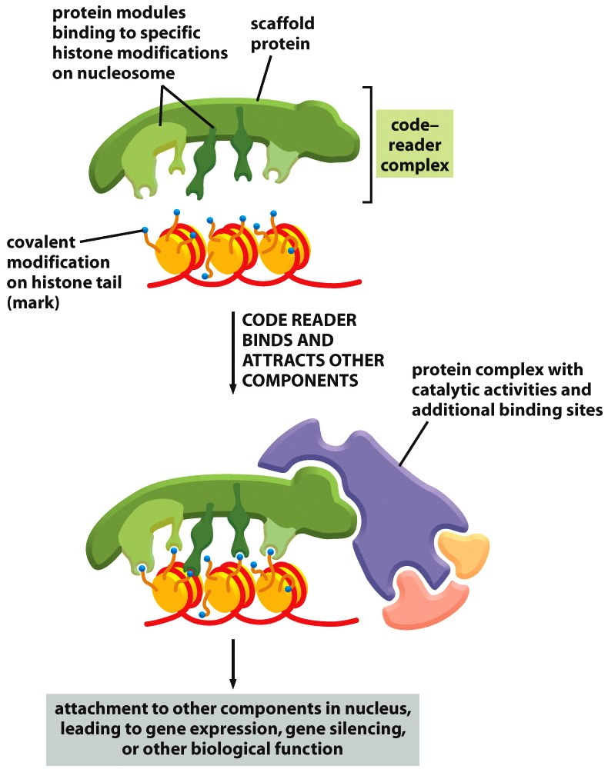
Figure 4-43 Molecular Biology of the Cell (© Garland Science 2008)

Slide 12
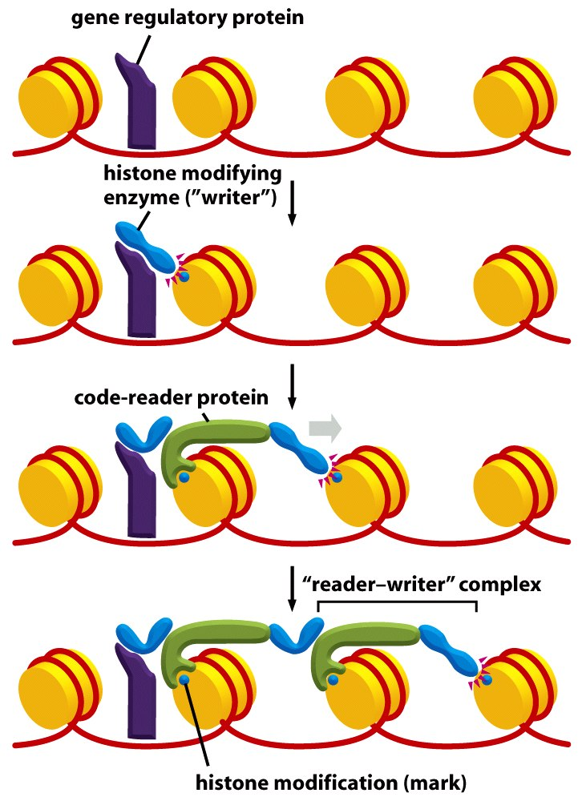
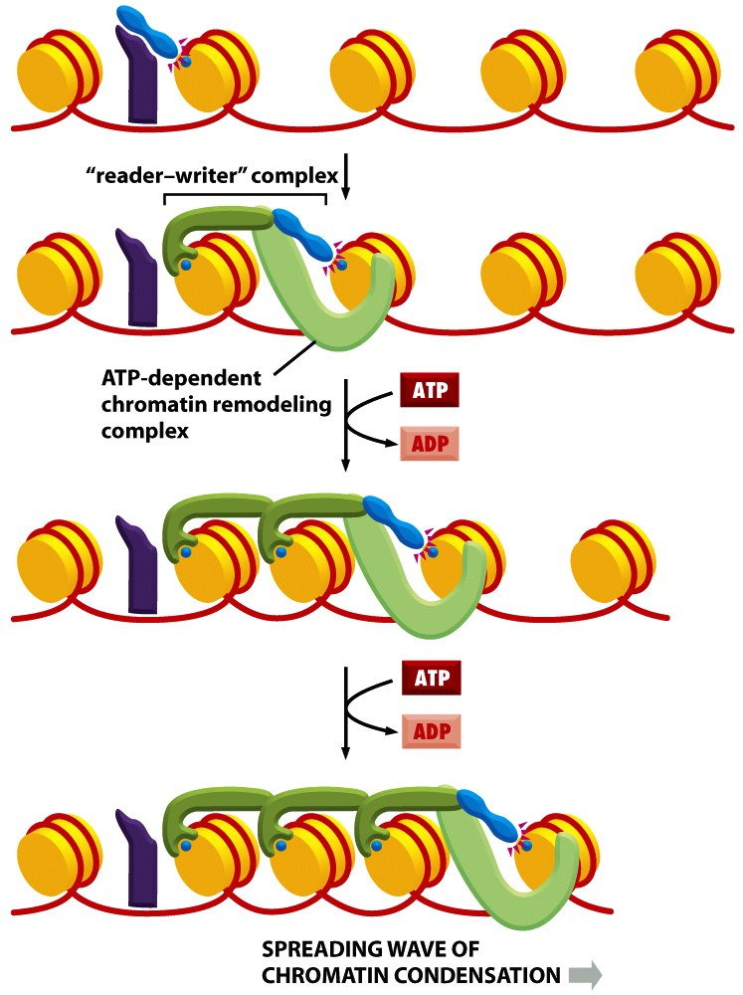
Spreading of an epigenetic mark and remodelling
Figure 4-46a Molecular Biology of the Cell (© Garland Science 2008)
Figure 4-45 Molecular Biology of the Cell (© Garland Science 2008)

Slide 13
Are the histone modifications really epigenetic and thus heritable?
Histone demethylases, deacetylases, dephosphorylases
Is DNA methylation or an RNA speices involved?
Can this mark be propagated during replication?

Slide 14
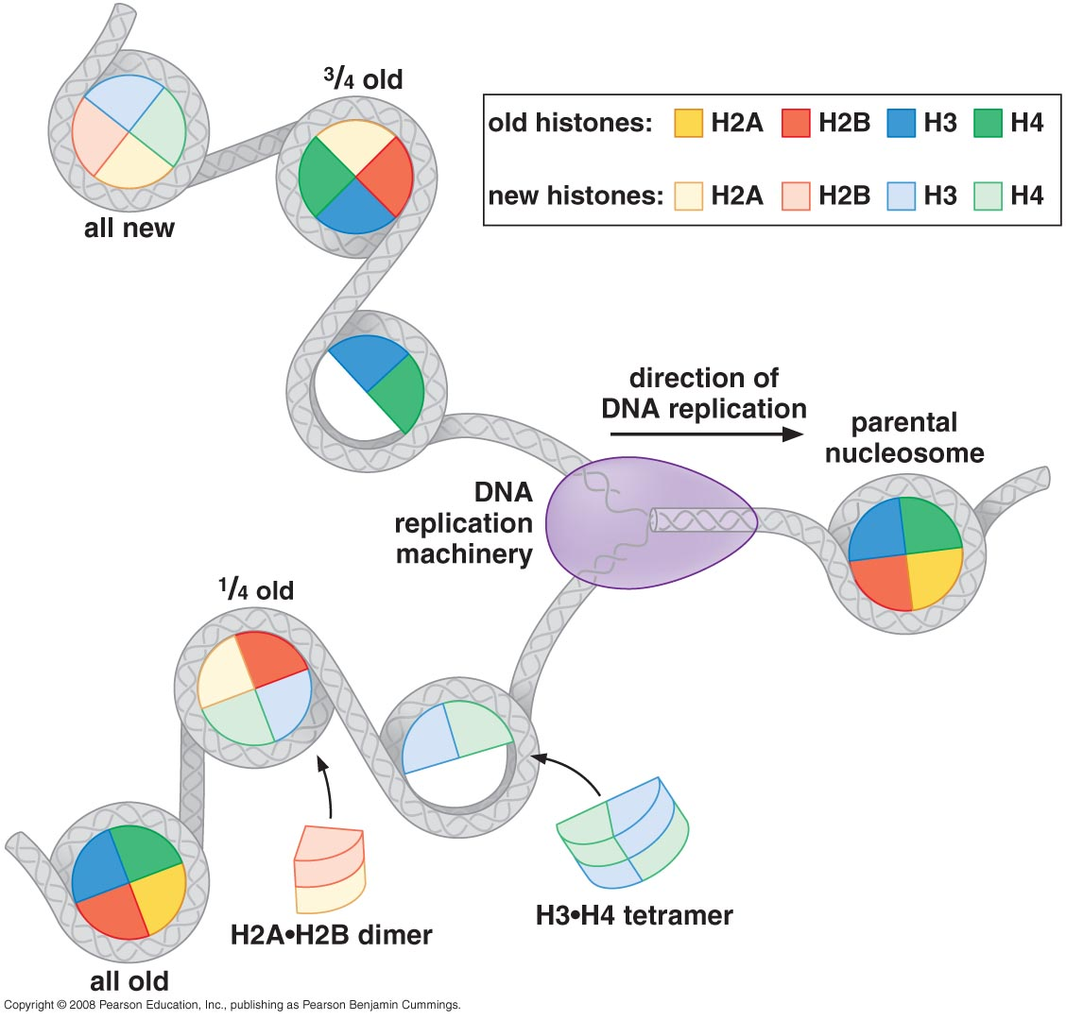
Inheritance of histones after DNA replication
Differential labeling of old and new histones
Results indicate:
Old histones are present on both of the daughter chromosomes
Mixing is not entirely random: H3.H4 tetramers and H2A.H2B dimers are composed of all new or all old histones
H3.H4 tetramers remain bound to the DNA
H2A.H2B dimers are released and enter the local pool available fir new nucleosome assembly

Slide 15
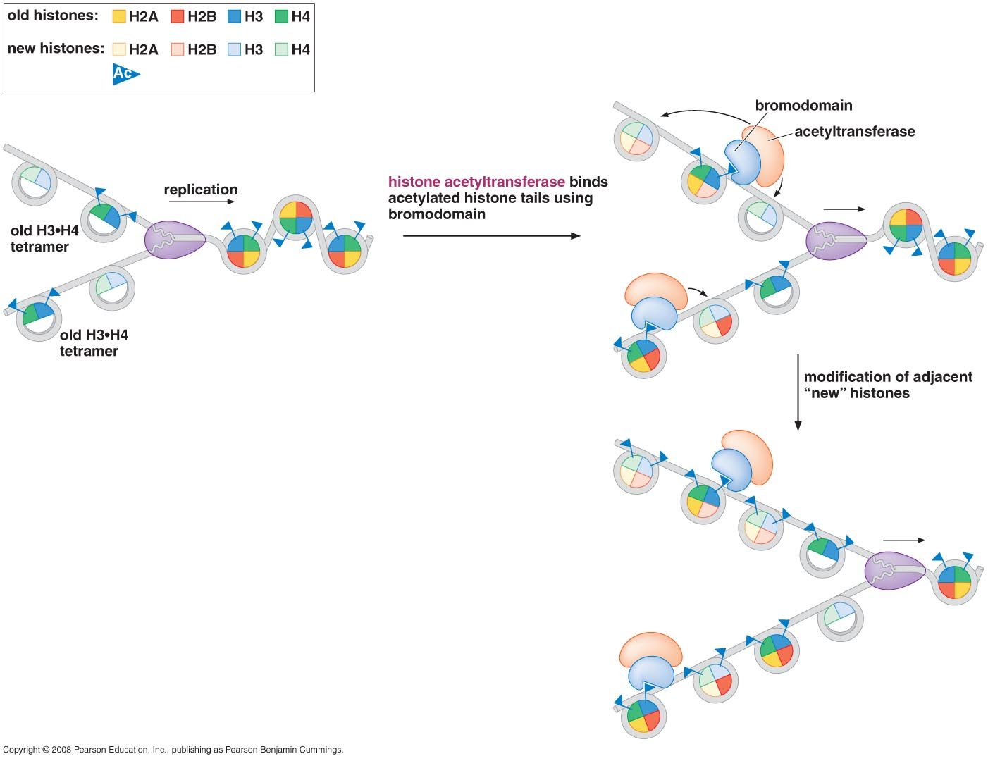
Inheritance of parental H3:H4 tetramers could potentially facilitate the inheritance of chromatin states

Slide 16
DNA Methylation
Methylation to the 5’ position of cytosines just before guanosines in CpG nucleotides
CpG nucleotides are uncommon in mammalian DNA (about 1%) and are present 10-20 times their average density in selected regions called CG islands (1000-2000 nucleotides long)

Slide 17
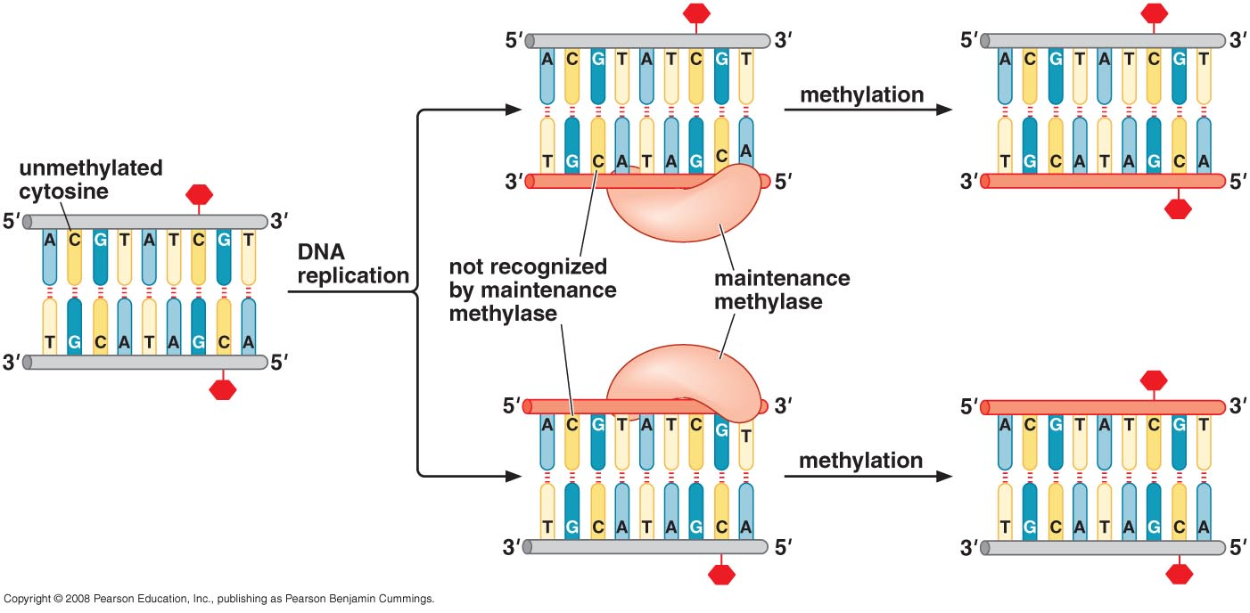
Epigenetic gene regulation: Patterns of DNA methylation can be maintained through cell division
Figure 17-28 Molecular Biology of the Gene

Slide 18
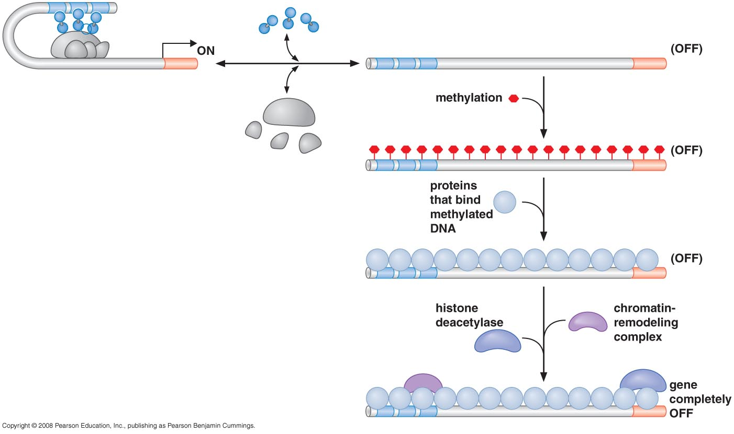
Role of methylation in silencing
Figure 17-25, Molecular Biology of the Gene

Slide 19
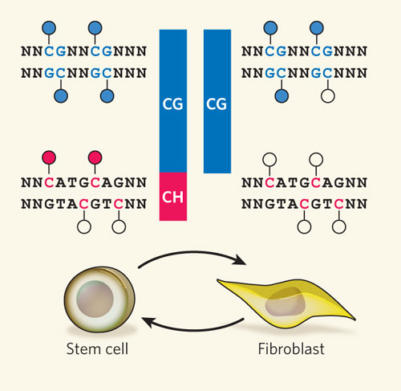
DNA methylation patterns differ between stem cells and differentiated cells
Filled circles: methylated cytosines; Unfilled circle: unmethylated cytosines.
H stands for A, C or T;
N stands for any nucleotide.
Dirk Schübeler, Nature. 2009. 462: 296-297.

Slide 20
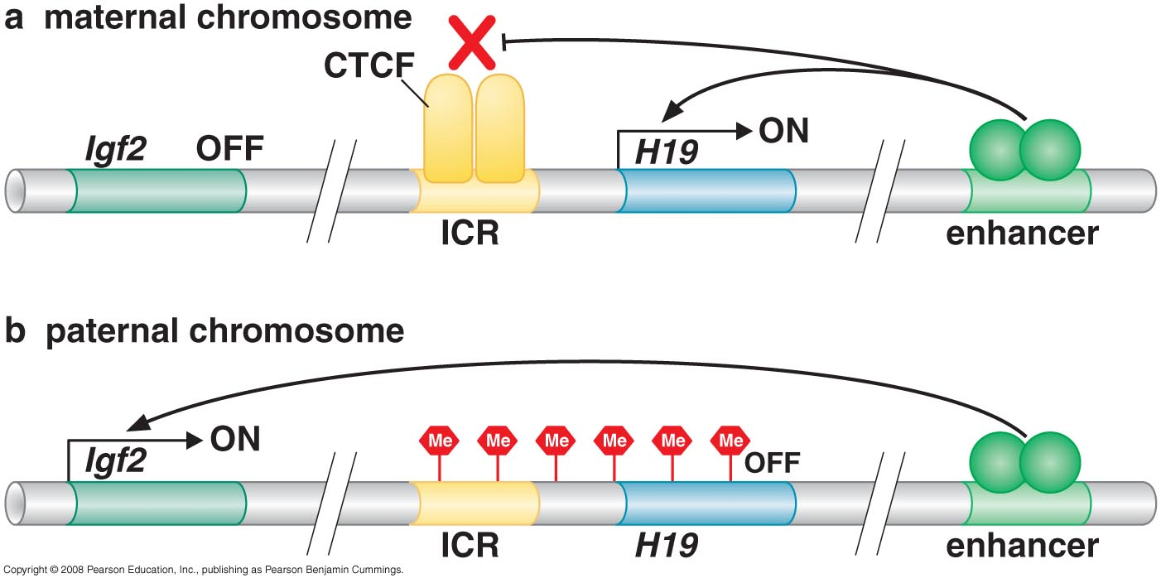
DNA methylation lies at the heart of Imprinting
Figure 17-26

Slide 21
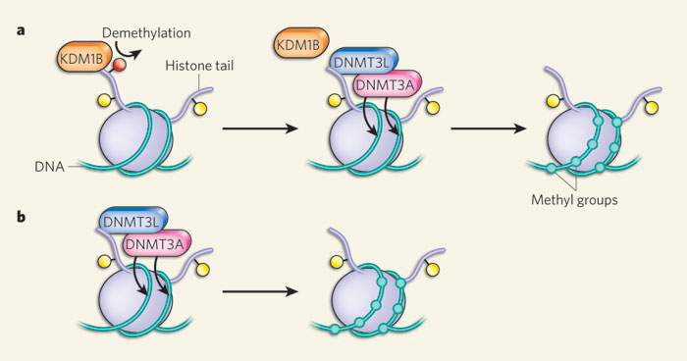
Recent study by Ciccone et al suggests that Imprinting involves histone demethylation and DNA methylation

Slide 22
RNA meets Chromatin
Dosage compensation: a strong link between RNA and chromatin
RNA interference can direct Heterochromatin Formation
si/miRNAs can also affect specific gene expression either post-transcriptionally or post-translationally

Slide 23
Short RNAs (21-23 nt) direct silencing of genes in three different ways
-RNA interference (RNAi): Several types of short RNAs repress, or silence expression of genes with homology to those short RNAs:
microRNAs (miRNAs) are derived from precursor RNAs encoded within genes
small interfering RNAs (siRNAs) are produced from dsRNAs
This can happen by two mechansims:
post-transcriptional gene silencing (PTGS) and transcriptional gene silencing (TGS).
PTGS can, in turn, be divided into two main mechanisms:
direct sequence-specific cleavage,
and translational repression and RNA degradation.
http://www.nature.com/focus/rnai/animations/animation/animation.htm

Slide 24
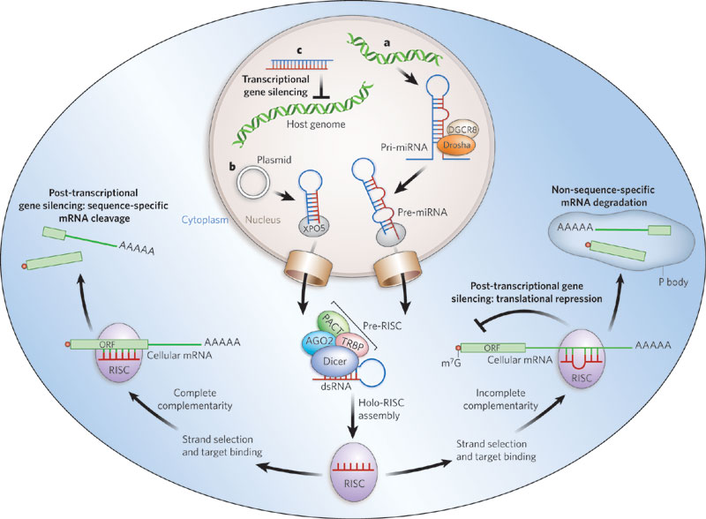
Overview
Incorporation of a guide strand RNA into RISC makes the mature complex that is ready to silence gene expression; RISC: RNA-induced silencing complex

Slide 25
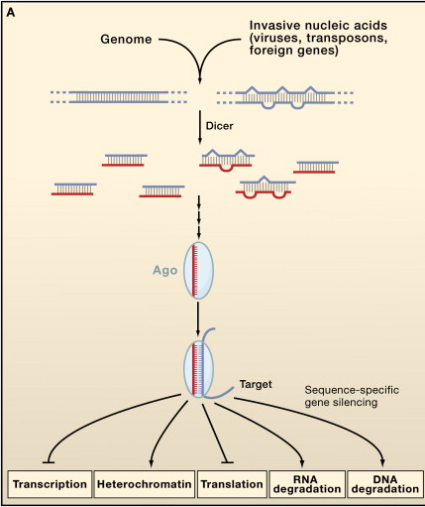
Core features of miRNA and siRNA silencing
In general:
- miRNAs- regulators of endogenous genes
- siRNAs- defenders of genome integrity in response to foreign or invasive nucleic acids such as viruses, transposons, and transgenes.
Single-stranded forms of both miRNAs and siRNAs are found to associate with effector assemblies known as RNA-induced silencing complexes (RISCs).
Carthew and Sontheimer. 2009 Cell 136, 642–655

Slide 26
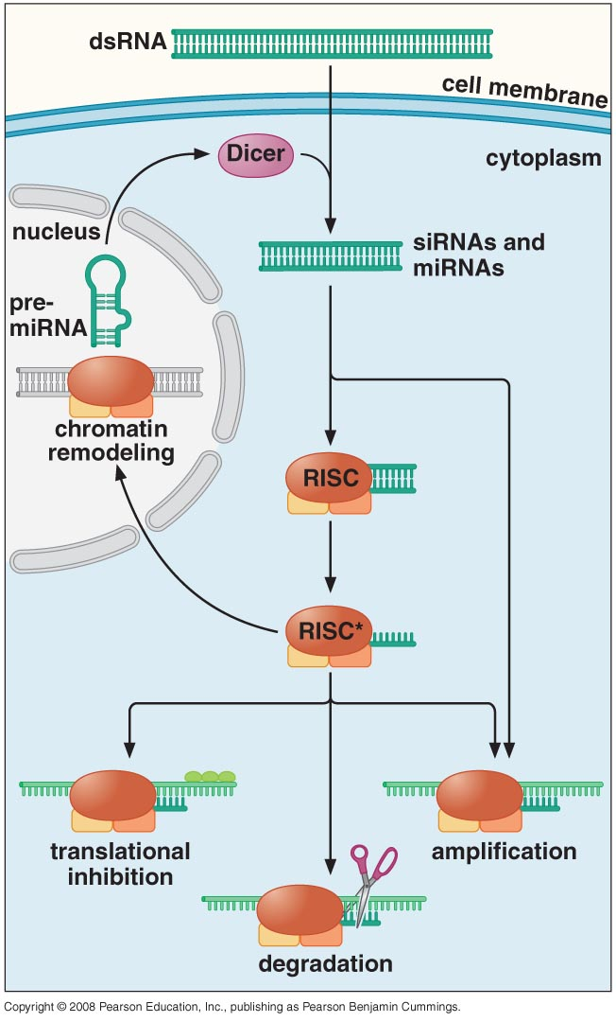
Machinery includes:
-Dicer (Rnase-III-like enzyme) that generates the siRNAs and miRNAs
-RNA-induced silencing complex (RISC): contains various proteins including a member of the Argonaute family (Slicer) and the siRNA/miRNA which is denatured to a guide RNA. Some RISC complexes can be directed to the nucleus to recruit chromatin modifying complexes….silencing of transcription
-RNA –dependent RNA polymerase (RdRP).

Slide 27
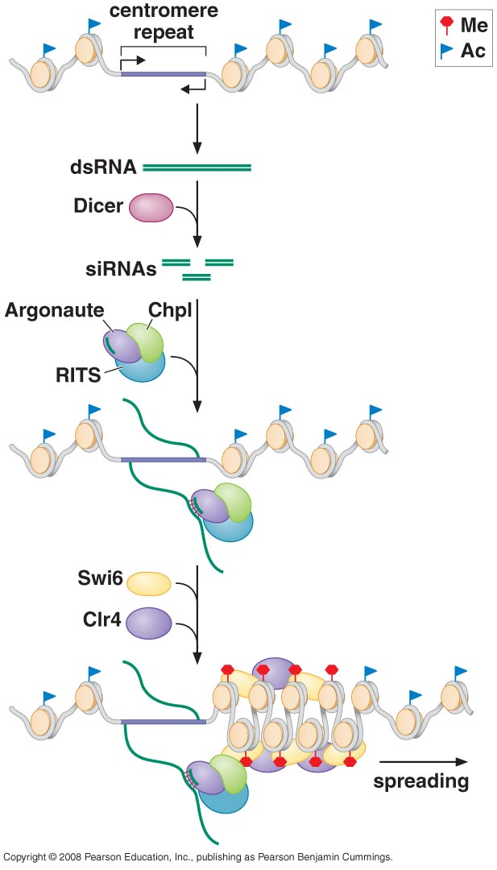
siRNAs can transcriptionally silence genes by directing chromatin modification ( in fission yeast)
Figure 18-13, Molecular Biology of the gene

Slide 28
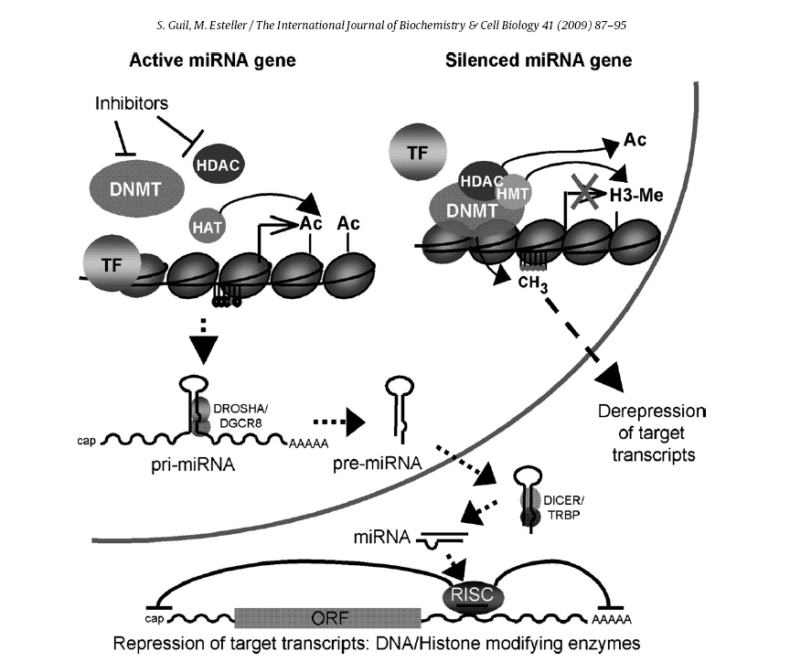
Epigenetic changes may affect miRNA expression and vice versa

Slide 29
Synopsis
Ultimately, expression of genes requires that RNA Pol and transcription factors have access to promoter and enhancer sequences to initiate transcription
Chromatin structure around genes is dictated by:
modifications to histones and the resulting interactions of histone modifiers and chromatin remodelers
DNA methylation, which can recruit histone modifiers/remodelers
siRNAs, again ultimately directing chromatin modification and remodeling
si/miRNAs can also affect specific gene expression either post-transcriptionally or post-translationally

