Slide 1
INFLUENCES OF ARSENIC ON FRESHWATER BIOFILMS, FISH AND THEIR NUTRIENT CYCLING INTERACTIONS
SFS 2016
Annual meeting
Baigal-Amar Tuulaikhuu, Anna M. Romaní
Berta Bonet, Laura Barral, Kit Magellan, Helena Guasch
Institute of Aquatic Ecology, Department of Environmental Sciences, University of Girona, Spain

Slide 2
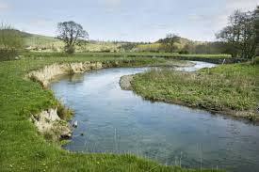
Background
Arsenic and other metal(loid)s are released from mining or industrial activities and enter to water and soil
As
Cu
As
As
As
As contained rocks
Zn
As
As
Fe
As
Mo

Slide 3
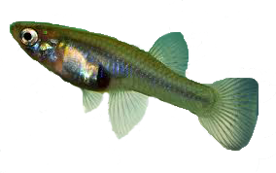
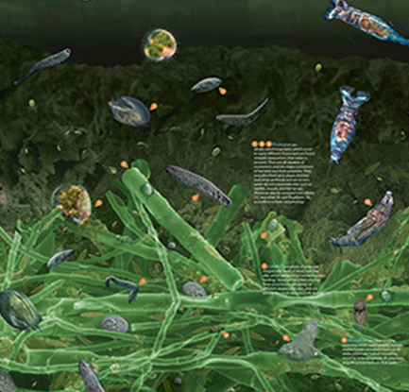
Background
Biofilm modulates As toxicity to fish
The most toxic to fish and other animals
iAs (V)
iAs (III)
MMA (V)
MMA (III)
DMA (V)
DMA (III)
Biofilms
Periphyton
TMAO (V)
TMA (III)
Epipsammon
(© Stream Biofilm Project,
The University of Auckland)
Biofilm converts arsenic species
Notes:
In aquatic ecosystem it mostly retains in sediment and biota in bottom area. In the bottom area there are microbial communities called biofilm and it is composed of diatoms, green algae, cyanobacteria, bacteria, protozoa, fungi, and other microscopic organisms, all embedded in an extracellular matrix (Sabater and Admiraal, 2005).

Slide 4
Objective
The purpose of this study was to evaluate if environmentally-realistic arsenic exposure causes toxicity to aquatic organisms.
We investigated:
The fate of arsenic
Effects on biofilms structure and function
Effects on fish growth and physiology
using a simplified fluvial system

Slide 5
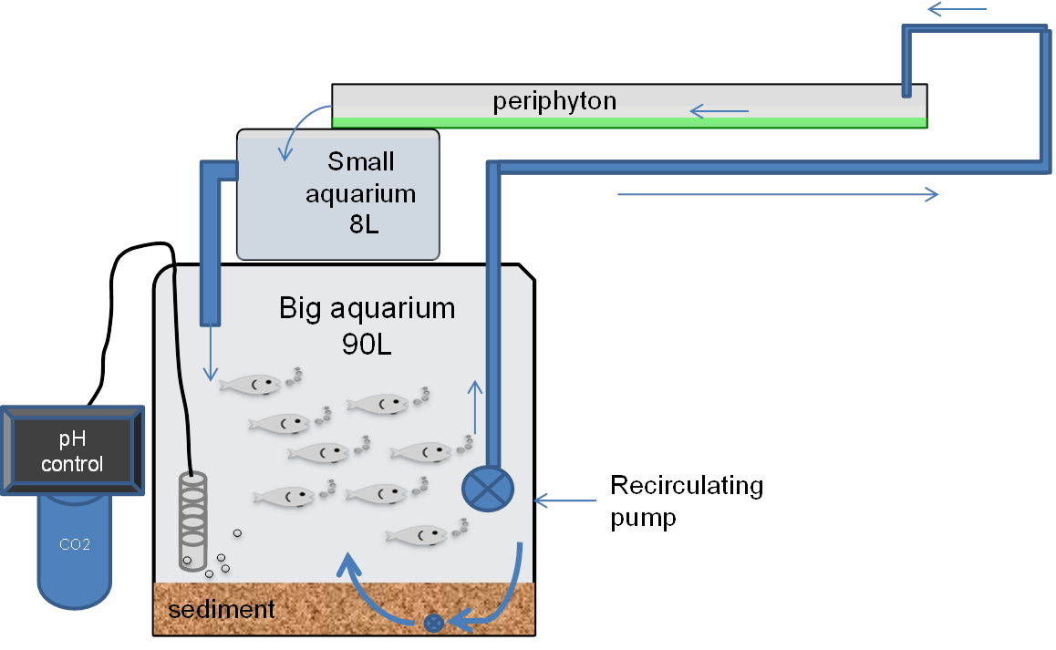
Experimental set up
Methods
epipsammon was developed on it
12
Notes:
The system has big aquarium for fish, small aquarium for water mixing and a channel for periphyton growth. Periphyton was grown for 3 weeks, and As added at day 22, after 3 days fish were added. The experiment has four different treatments: control (C), biofilm (B), arsenic (As) and biofilm with arsenic (B+As). Water circulates through the system, providing nutrient recycling interaction between fish and biofilms. All aquarium has sediment to enhance ecological realism and epipsammon was developed in it.

Slide 6
Arsenic fate
Results
120 µg/L
Fish
0.89
19.1 %
Water
60 days
28 µg/L
0.32 %
Periphyton
79.7 %
Sediment
Most Arsenic was retained to sediment
The contribution of biofilm to Arsenic retention was low
Accumulation in fish was very low
Notes:
We added 120 ug/L arsenic. After 60 days in water 19.1% left and Most Arsenic is retained to sediment.
The contribution of biofilm to Arsenic retention was low. The accumulation in fish was very low

Slide 7
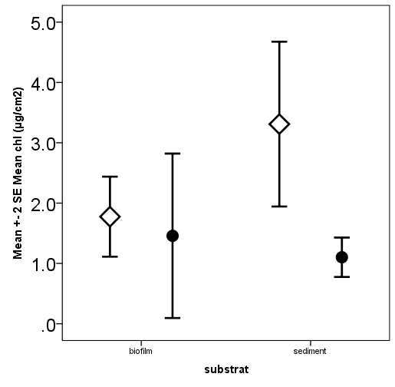
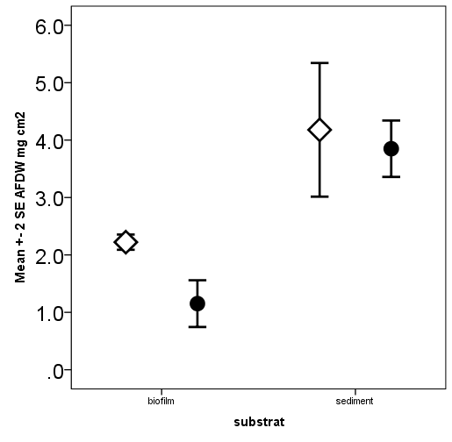
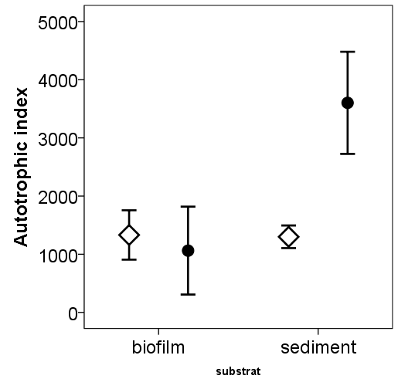
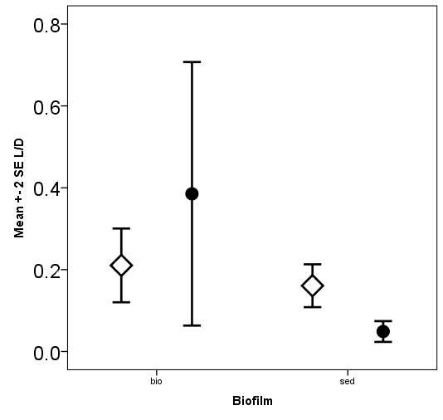
As effect on structural and functional attributes of biofilm
Results
B
Chl-a
B
AFDW
B+As
B+As
µg/cm²
µg/cm²
p=0.69
p=0.035
p=0.007
p=0.63
periphyton
epipsammon
periphyton
epipsammon
Autotrophic index
Live to dead bacteria ratio
p=0.568
p=0.007
p=0.35
p=0.018
periphyton
epipsammon
periphyton
epipsammon
Tuulaikhuu et al., 2015 Aquatic toxicology 166, 72-82

Slide 8
As effect on structural and functional attributes of biofilm
Results
Nutrient cycling and stoichiometry
Measured C,N, and P in the biofilm (%)
Periphyton
Epipsammon
Calculated total amount | B | B+As | p
Excreted +Egested P by fish (mg in 56 days per Eu) | 9.57±0.29 | 8.36±0.87 | 0.079
P in periphyton (mg) | 1.78±0.9 | 0. 61±0.19 | 0.092
P in epipsammon (mg) | 3.7±1.1 | 2.3±0.26 | 0.094
Total P in water (90L) | 0.23±0.05 | 0.23±0.05 | 1.000
Excreted +Egested N by fish (mg in 56 days per Eu) | 118.5±4.9 | 103.9±10.8 | 0.1
N in whole periphyton (mg) | 31.3±8.2 | 13.6±4.0 | 0.028
N in epipsammon (mg) | 50.9±24.6 | 31.0±9.3 | 0.262
Total N in water (90L) | 8.37±2.5 | 4.0±4.0 | 0.191
 | B mean±SD | B+As mean±SD | Change %
C (%) | 23.4±2.6 | 19.7±2.5 | -15.8
N (%) | 0.72±0.16 | 0.64±0.1 | - 11.1
P (%) | 0.04±0.02 | 0.028±0.01 | - 30.0
 | B mean±SD | B+As mean±SD | Change %
C (%) | 15.2±5.5 | 11.6±1.8 | - 23.7
N (%) | 0.99±0.35 | 0.68±0.17 | - 31.3
P (%) | 0.07±0.02 | 0.06±0.01 | - 14.3

Slide 9
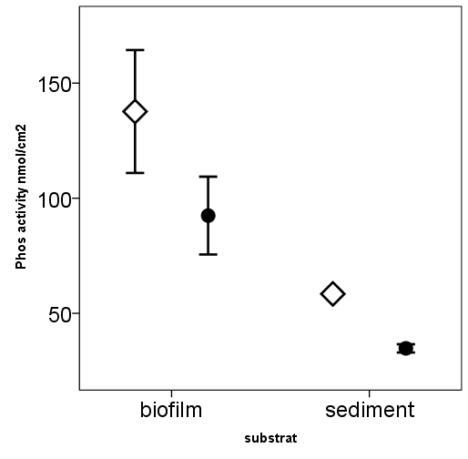
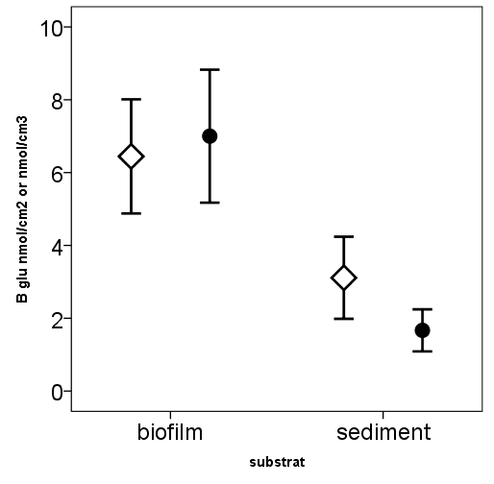
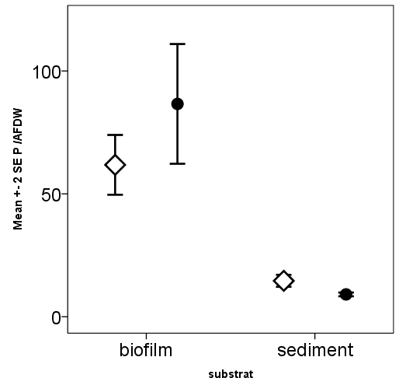
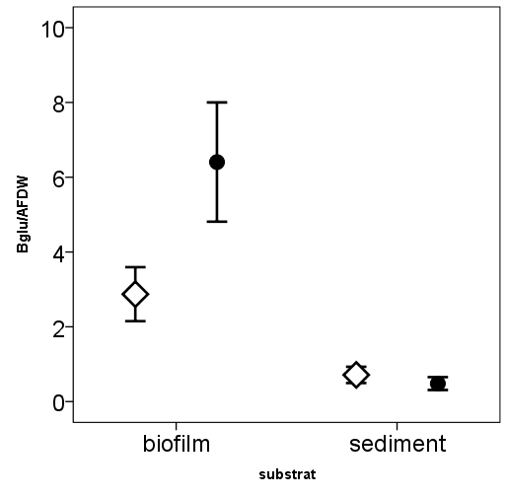
As effect on structural and functional attributes of biofilm
Results
Extracellular
enzyme
activities
Phosphatase
β-Glucosidase
B
B
B+As
B+As
(nmol MUF/cm². h)
(nmol MUF/cm². h)
p=0.04
p<0.001
p=0.67
p=0.32
periphyton
epipsammon
periphyton
epipsammon
(nmol MUF/g AFDW. h)
(nmol MUF/g AFDW. h)
p=0.31
p=0.092
p=0.04
p=0.36
Tuulaikhuu et al., 2015 Aquatic toxicology 166, 72-82
periphyton
epipsammon
periphyton
epipsammon

Slide 10
Arsenic effect on fish growth
Results
Arsenic did not influence fish growth rates overall; yet smaller fish gained less weight and larger fish gained more weight in +As treatment.
P=0.075 (Fish length×As in ANCOVA)
Gained weight of fish in the treatments per day linked to their body length. The lines show a linear regression of the gained weight and fish length.
Tuulaikhuu et al., 2016
Science of the Total Environment 544, 464-475

Slide 11
Arsenic effect on fish Antioxidant Enzyme activities
Results
Tuulaikhuu et al., 2016
Science of the Total Environment 544, 464-475

Slide 12
Summary
Concentration
CAT
biofilm
water
sediment
Conductivity
water
Time
NO₃
O₂
Periphyton
Lower biomass , lower nitrogen content and lower phosphatase activity
Epipsammon
Lower proportion of algae (more heterotrophic), lower phosphatase activity and a higher proportion of dead bacteria
Sediment
Fish
Higher catalase activity and changes in growth
Live bacteria
Phosphatase activity
Food consumption and excretion
Dead bacteria
Diatom
Catalase activity
CAT
Toxicant
Green algae

Slide 13
Concluding remarks
Our results highlight the interest and application of incorporating some of the complexity of natural systems in ecotoxicology
Support the use of criterion continuous concentration (CCC) for arsenic lower than 150 μg/L and closer to the water quality criteria to protect aquatic life recommended by the Canadian government (5 μg As/L).

Slide 14
Thank you for your attention
Acknowledgements
Financial support: Spanish Science and Education Ministry (Project CTM2009-14111-CO2-01) and the Spanish Economy and Competitiveness Ministry (Project CGL2013-43822-R).
Baigal-Amar Tuulaikhuu benefited from a doctoral fellowship from the Techno 2 Program of the European Union Erasmus Mundus partnership.
Thank you very much for your attention

