Slide 1
Agrobacterium Tumefaciens Mediated Gene Transfer

Slide 2
What is Biotechnology?
The term biotechnology includes the traditional biotechnological processes used for centuries in the manufacture of bread, alcohol, wine, beer, fermented milk products and some medicines, as well as modern biotechnology that involves amongst others, recombinant DNA technology, genomics, proteomics and bioinformatics.
NATIONAL BIOTECHNOLOGY POLICY 2009.

Slide 3
Agrobacterium Tumefaciens Mediated Gene Transfer
Agrobacterium tumefaciens, a soil bacterium known as‘nature’s own genetic engineer
It has the natural ability to genetically engineer plants.
It carries genetic information from bacteria to plant cell.
genetic transformation of plant cells with a piece of DNA is called T-DNA
It causes crown gall disease
It can be use as a vehicle to transfer genes in plants.

Slide 4
Example:- Observed in many varieties of wood plants – Grapes – Roses – Apples – Cherries – Pecans • Also infects herbaceous plants – Daisies – Asters – Beets – Turnips – Tomatoes – Sunflowers – And recently: monocots like grasses, corn and rice

Slide 5
Crown Gall
The disease gains its
name from the large tumor-like swellings (galls) that typically occur at the crown
of the plant, just above soil level.
Basically, the bacterium transfers part of its
DNA to the plant, and this DNA integrates into the plant’s genome, causing the production of tumors and associated changes in plant metabolism.

Slide 6
The normal T-DNA contains genes that encode plant growth hormones and cause the production of a plant tumor called a crown gall.

Slide 7
The T DNA containing plasmid is called (Tumor-inducing) Ti Plasmid.
Any DNA within the T-DNA will be transferred to the plant and integrated into the plant nuclear DNA.
Using recombinant DNA methods, the tumor causing genes were deleted from the T-DNA
The DNA of interest can be inserted by using binary vectors.

Slide 8
The plasmid that carries the artificial T-DNA is usually called a binary vector. Now, binary vectors are the most popular tools in the plant science community
A binary vector consists of T-DNA and the vector backbone. T-DNA is the segment delimited by the border sequences, the right border (RB) and the left border (LB), and may contain multiple cloning sites, a selectable marker gene for plants, a reporter gene, and other genes of interest. The vector backbone carries plasmid replication functions for E. coli and A. tumefaciens, selectable marker genes for the bacteria, optionally a function for plasmid mobilization between the bacteria and other accessory components.

Slide 9
DNA of interest can be inserted in the multiple cloning site of the binary vector

Slide 10
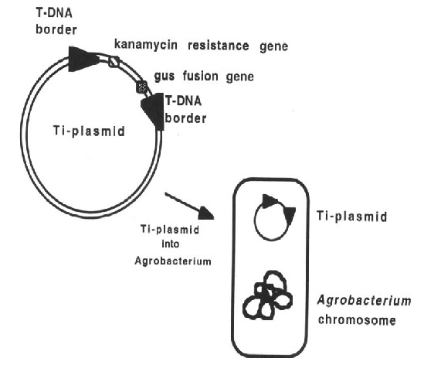
In addition to the gene of interest, there can be a selectable marker and reporter gene is present in between the T-DNA borders.
A reporter gene encodes an enzyme with an easily assayable activity that is used to report on the transcriptional activity of a gene of interest.
Selectable markers used include antibiotic resistance genes and herbicide resistance genes.
the gene for a selectable marker is put between the T-DNA borders. This allows the selection of plant cells that have been genetically transformed.

Slide 11
The medium in this petri dish contains the antibiotic Kanamycin The bacteria on the right contain Kanamycin resistance, a plasmid that is resistant to Kanamycin, while the one on the left has no resistance

Slide 12
A widely used reporter gene in plants is the uidA, or gusA, gene that encodes the
enzyme β-glucuronidase (GUS).
This enzyme can cleave the chromogenic (colorgenerating) substrate X-gluc (5-bromo-4-chloro-3-indolyl β-D-glucuronic acid), resulting in the production of an insoluble blue color in those plant cells displaying GUS activity.
Plant cells themselves do not contain any GUS activity, so the production of a blue
color when stained with X-gluc in particular cells indicates the activity of the promoter that drives the transcription of the gusA-chimeric gene in that particular cell.
The GUS assay is easy to perform, sensitive, relatively inexpensive, highly reliable, safe, requires no specialized equipment, and is highly visual (Jefferson 1987; Jefferson et al. 1987; Jefferson and Wilson 1991).

Slide 13
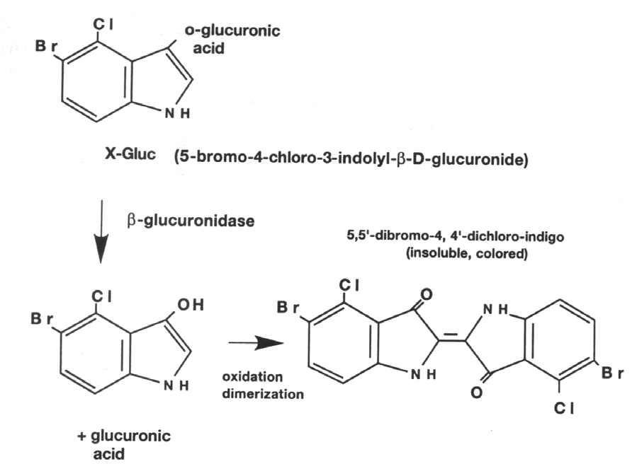
X-Gluc (5-bromo-4-chloro-3-indolyl-β-D-glucuronide), a substrate of β-
glucuronidase, is cleaved to produce glucuronic acid and chloro-bromoindigo.
When oxidized, chloro-bromoindigo dimerizes to produce the insoluble blue
precipitate dichloro-dibromoindigo.

Slide 14
*When Agrobacterium infects a host plant, a part of the Ti (tumor-inducing) plasmid of the bacterium is transferred from the bacterium to the plant. *The transferred T-DNA is integrated into the plant nuclear . *None of the T-DNA genes are necessary for T-DNA transfer from the bacterium to the plant cell. Other genes (the virulence, or vir genes) on the Ti-plasmid are necessary for transfer.
The modified T-DNA is put back into Agrobacterium and is transferred to the plant by the normal infection process.

Slide 15
The selection of plant cells that have been genetically transformed. (A) Untransformed callus (B) Transformed callus
production of an insoluble blue color in those plant cells displaying GUS activity.
Tropical Agricultural Research Vol. 22 (1): 45 - 53 (2010)

Slide 16
*The main goal in any transformation procedure is to introduce the gene of interest into the nucleus of the cell without affecting the cell’s ability to survive. *If the introduced gene is functional, and the gene product is synthesized, then the plant is said to be transformed. Once the inserted gene is stable, inherited and expressed in subsequent generations, then the plant is considered a transgenic.

Slide 17
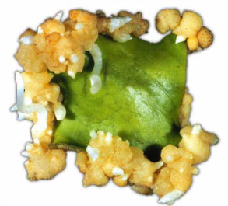
Regeneration of Transgenic plants from Transformed callus
Callus on selective CIM after two weeks
B. Shoot regeneration from leaf derived calli on selective shoot regeneration medium.
C. Rooted plantlet on selective rooting medium.
D. Hardened transgenic plants after six weeks.
www.pelagiaresearchlibrary.com

Slide 18
Detection of Inserted Genes
Polymerase chain reaction is a quick test to determine if the regenerated transgenic cells or plants contain the gene.
It uses a set of primers (DNA fragments) – forward and backward primers, whose nucleotide sequences are based on the sequence of the inserted gene.
The primers and single nucleotides are incubated with the single stranded genomic DNA and several cycles of DNA amplification is conducted in a PCR machine.
Analysis of the PCR products in agarose gel will show if the plants are really transformed when DNA fragments equivalent in size with the inserted gene is present and amplified.

Slide 19
PCR

Slide 20
Gel electrophoresis
Analyze and separate DNA (fragments, product of RE digests, etc.) by gel electrophoresis
Separation based on size.
– DNA is a poly anion
– In electric field, will migrate
based on size = # of bp.
– Gel matrix (agarose), polyacrylamide
(polymer network),
or capillary flow.

Slide 21
PCR analysis of genomic DNA isolated from leaves of non-transformed and transformed shoots.
Lane 1 = A 500 bp DNA ladder.
Lane 2 = Plasmid (positive control).
Lanes 3 and 4 = DNA samples from non-transformed controls.
Lanes 5-8 = DNA samples from callus-derived transformants (T1-T4)
Lanes 9-13 = DNA samples from direct shoot bud induction transformants (T5-T9).

Slide 22
Through micropropagation multiplied into several thousand plants in less than a year
Tip bud
Leaf
Tip bud
Leaf
Axillary bud
Internode
Root
Axillary bud
Internode
Root

Slide 23
Gene transferred plant
A single new Transgenic Plant can be multiplied into several thousand plants in less than a year

Slide 24
Reference:
Tropical Agricultural Research Vol. 22 (1): 45 - 53 (2010)
Development of an Efficient Agrobacterium Mediated Transformation Protocol for Sri Lankan Rice Variety - Bg 250
R.M.L.K. Ratnayake and G.H.C.M. Hettiarachchi1
Department of Chemistry, Faculty of Science, University of Colombo, Sri Lanka
Pelagia Research Library Advances in Applied Science Research, 2011, 2 (2): 357-366,
Recovery of Transgenic Plants by Agrobacterium-mediated Genetic Transformation in Dianthus caryophyllus L. (carnation) Jetinder Kumar Kanwar and Surinder Kumar*Department of Biotechnology, University of Horticulture and Forestry, Solan(H.P.), India Amir Khan et al, Available online at www.pelagiaresearchlibrary.com
ISAAA-Agricultural Biotechnology (A Lot More than Just GM Crops)
Chapter 3-Blue Plants: Transgenic Plants With The Gus Reporter Gene
Susan J. Karcher. Department of Biological Sciences, Purdue University, West Lafayette, IN 47907-1392
Komori et al, Current Status of Binary Vectors and Superbinary Vectors
Toshiyuki Komori*, Teruyuki Imayama, Norio Kato, Yuji Ishida, Jun Ueki, and Toshihiko Komari
Plant Innovation Center, Japan Tobacco Incorporated, Iwata, Shizuoka 438–0802, Japan www.plantphysiol.org/cgi/doi/10.1104/pp.107.105734

