Slide 1
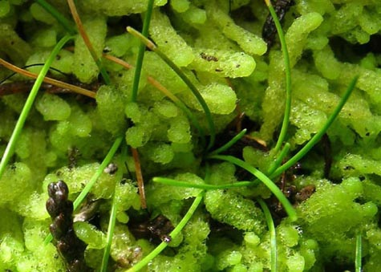
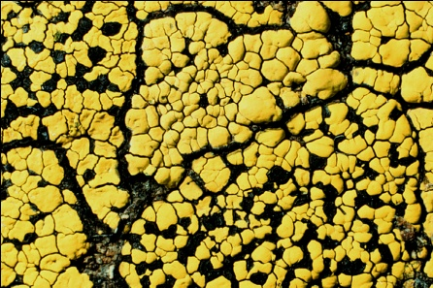
Lichens, Bryophytes and Climate Change

Slide 2
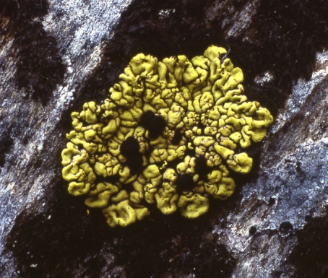
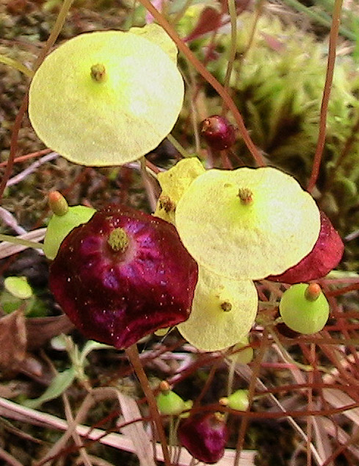
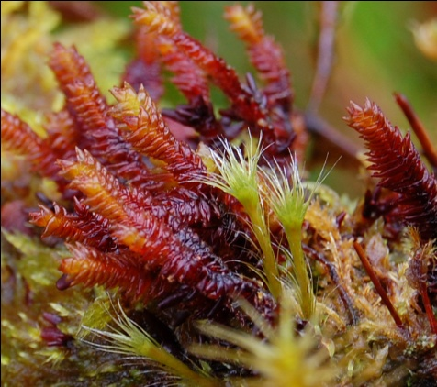
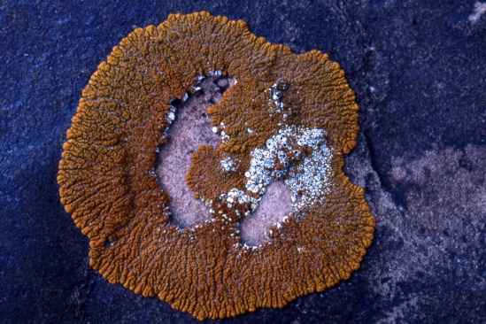
Outline
Goals and Scope
Research Question
Overall Workflow
Imaging Approach
OCR, NLP, Geo-referencing
Outreach and Crowd Sourcing

Slide 3
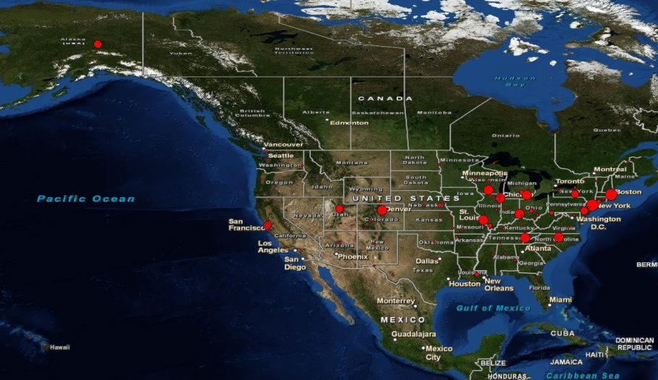
Goals and Scope
Collections
16 digitization centers (collaborators)
> 60 non-governmental US herbaria (95%)
~ 2.3 million specimen (90%)
900,000 lichens
1.4 million bryophytes
Mobilizing existing
digital records

Slide 4
Goals and Scope
Geographic Scope
Mexico
US
Canada

Slide 5
National Portals
National Portals
http://symbiota.org/nalichens/
http://symbiota.org/bryophytes/

Slide 6
National Portals
Lichen Consortium
Started in 2009
16 Collections
~ 600,000 Records
Bryophyte Consortium
Started in 2010
7 Collections
> 800,000 Records

Slide 7
National Portals
Virtual Flora
Dynamic Checklists
Published Checklists
Dynamic Keys
Taxonomic Information
Species Pages
Distribution Maps
Observations

Slide 8
Research Question
How are changes in distribution patterns of lichens and bryophytes over time correlated with man-made environmental changes?
How accurately can we predict where specific species can be found using existing herbarium data?

Slide 9
Bryophytes and Lichens
Different evolutionarily but similar in size and habitats occupied (epiphytes, soil mats, and rocks)
Both dominate much of the arctic and northern boreal regions (lichens in upland areas and bryophytes in wet habitats.
Both also occur commonly in many other ecosystems (deserts to tropics)
Bryophytes, particularly in peat bogs store a major part of the worlds organic carbon

Slide 10
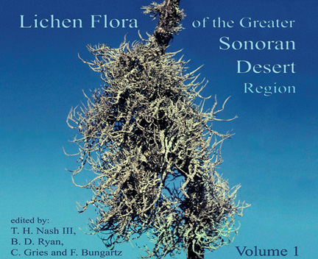
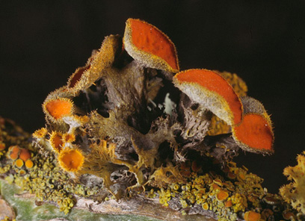
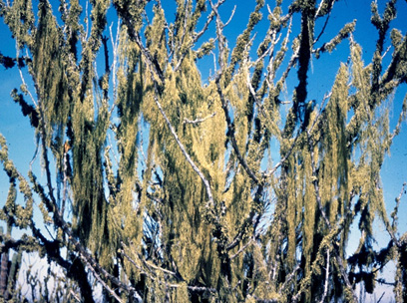
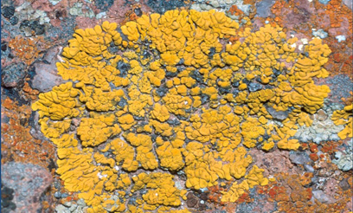

Slide 11
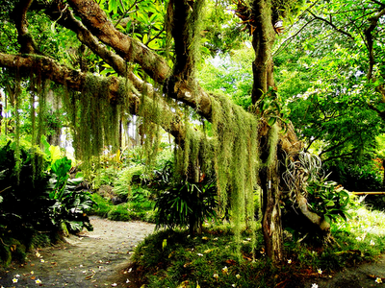
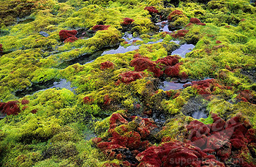
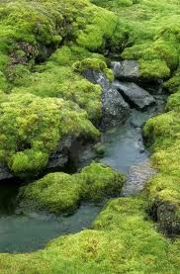
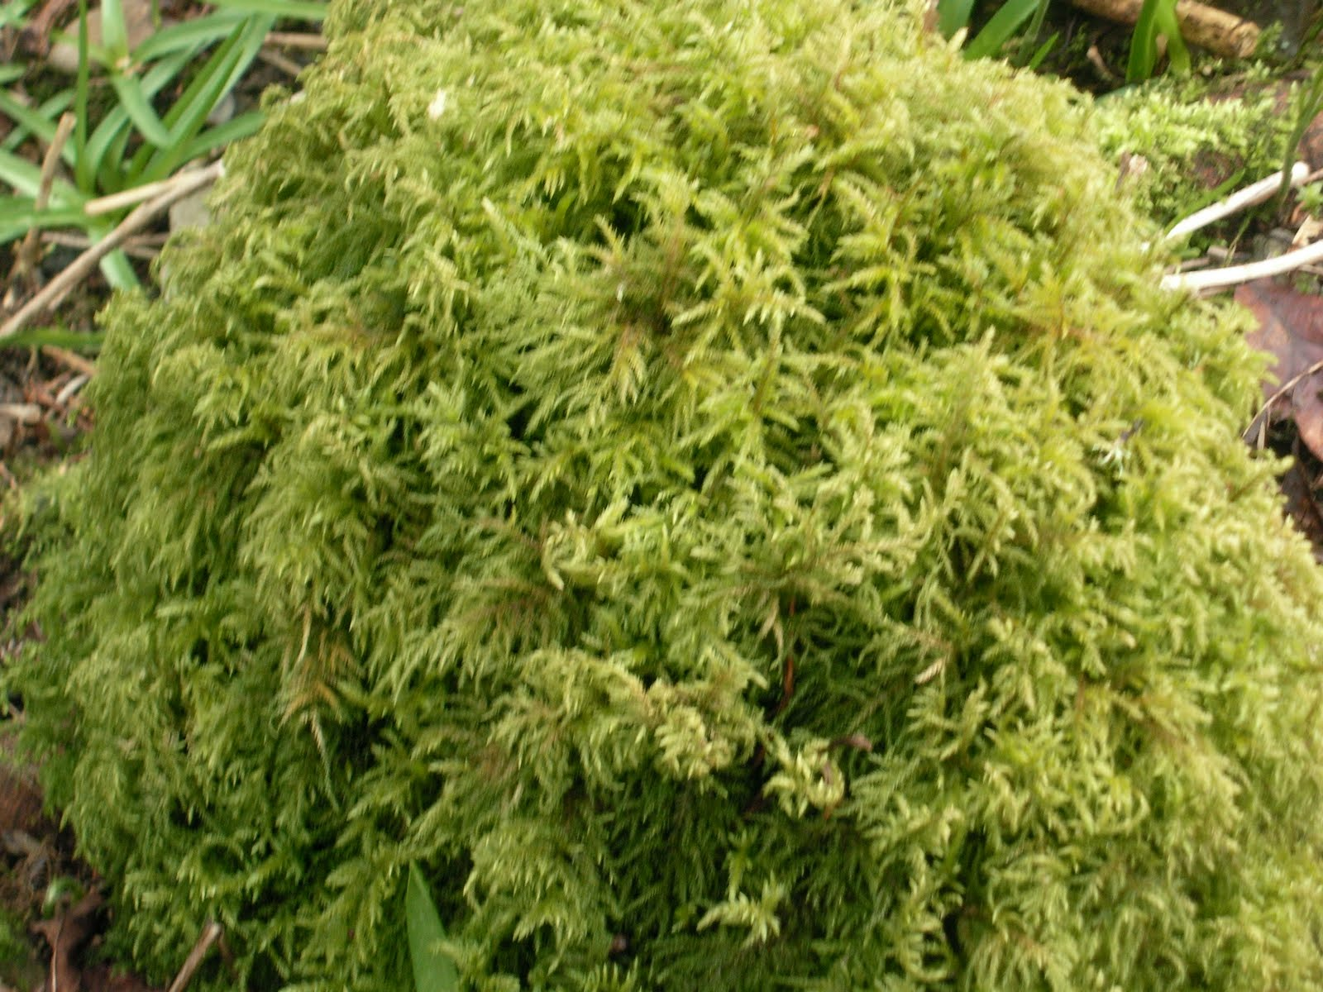

Slide 12
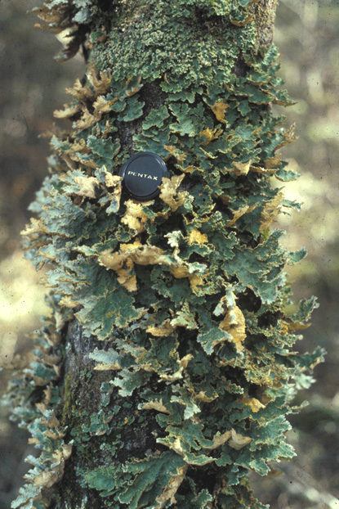
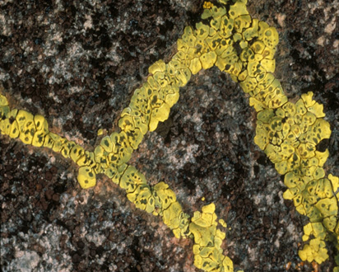
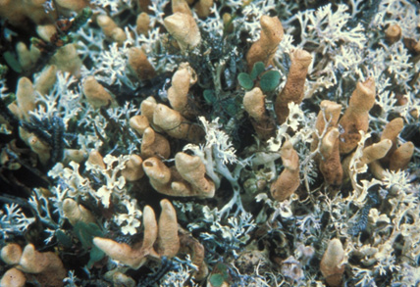

Slide 13
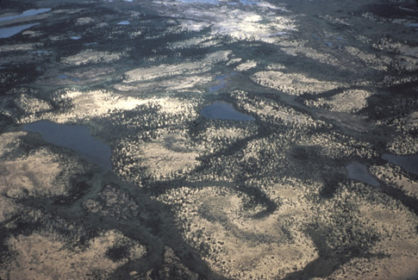
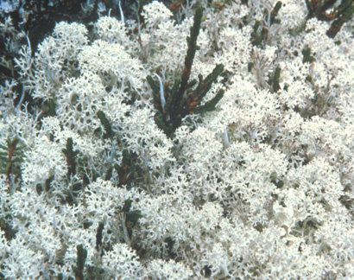
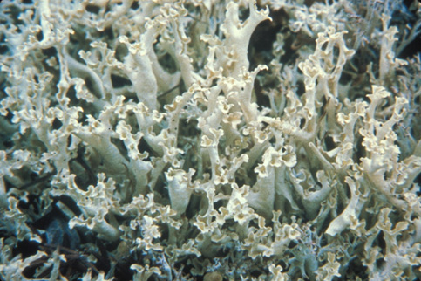
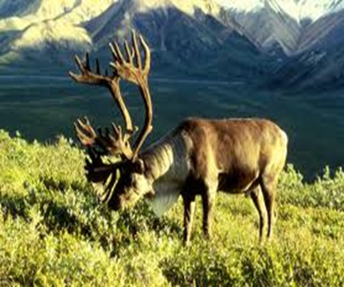

Slide 14
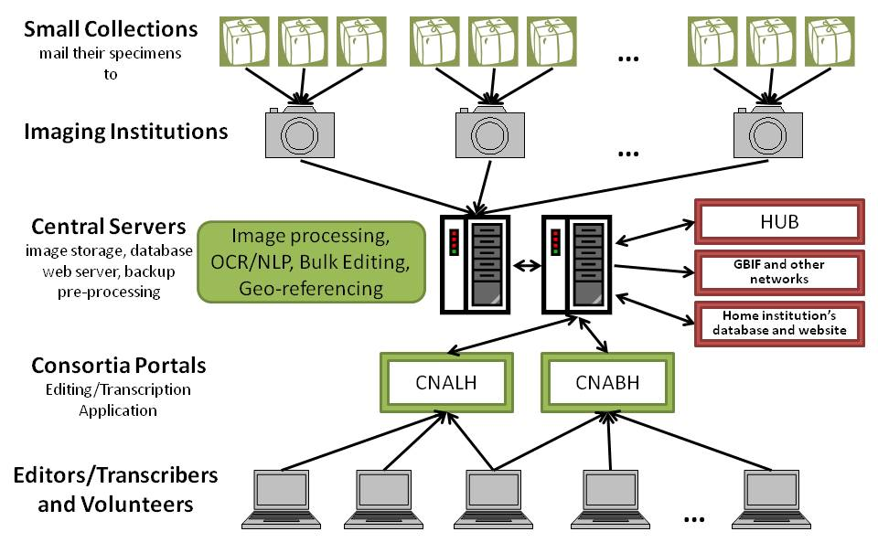
Digitization Workflow

Slide 15
Digitization Workflow
Central Processing
OCR
NLP
Bulk processing
Preliminary
geo-referencing
processed
Take Image
File name: barcode
Upload to folder on FTP server Florida
Image processing
+
Create/Merge Record in Portal
Link Image
unprocessed
Create Skeleton File
Darwin Core Fields: barcode, species name +
Upload to folder on FTP server Florida
Upload Record in Portal
Link Image
reviewed
Find Duplicates and Edit Record in Portal
Pending review
Existing Digitized Records
Darwin Core+
Manage Records in Portal
Approve Record in Portal
reviewed

Slide 16
LBCC: Workflow Overview
Image all specimen / specimen labels
Upload to portal
Record exists => link image to existing record
Record absent => create empty record
Automated OCR label
Block of raw text => database
Automated NLP (field parsing)
Review data
Keystroke full record
Collector name & number => look for dups
Reparse full record => learnable parsers

Slide 17
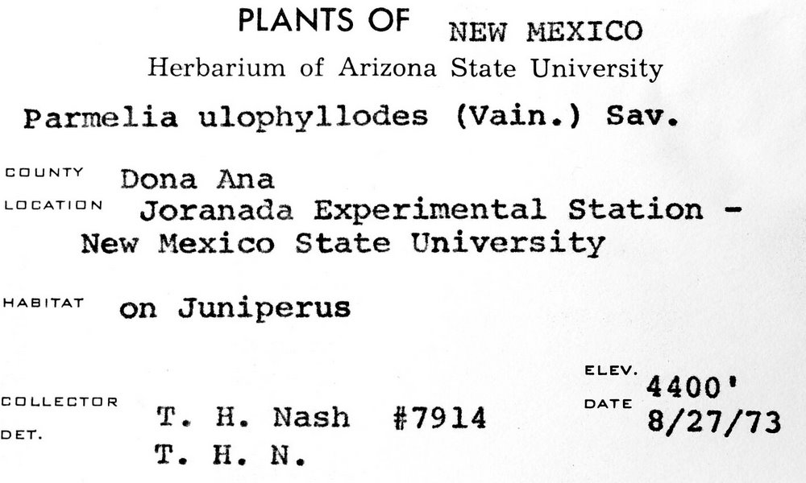
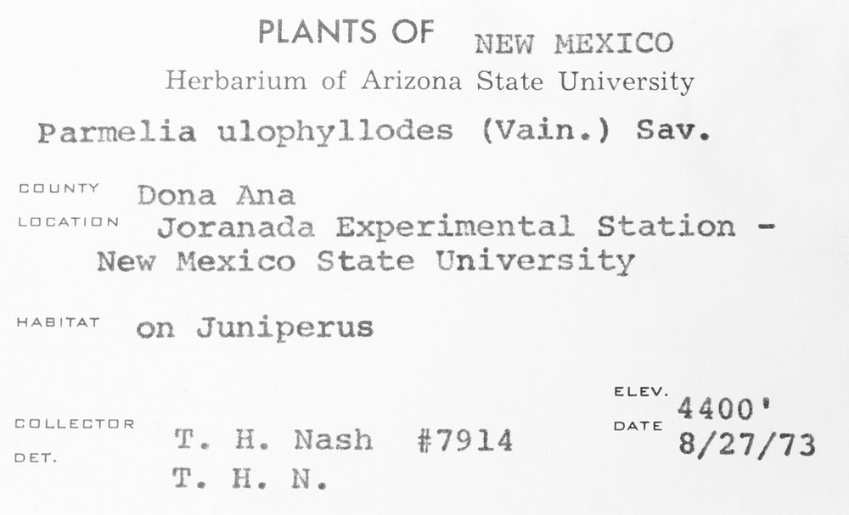
Optical Character Recognition
Tesseract V3
Dual cycle
Automatic
Manual review
Expected hurtles
Handwritten labels
Old fonts
Faded labels
Form labels
Adjustable image variables
Â¢_].L.|Â»â€˜Â¢ .'Â».f.'._..â€˜~,(.J
fin-xâ€˜*\'a:"511z:1 wf .~\:'i/.onli State University
P.â€™~.r"~2= ,_. gg J:.2 " J*J*" â€ (=:\â€˜-â€œax "Â»..'\-12
â€˜ â€œ "â€˜ ;T~;â€˜~7i?Â»-1_1_\f;>sf`;,' ESX
ZÂ»ie+â€˜-Â». â€œ~'.Â»te;~:i_.t<Â» ff`t;~f3":.f.â€œ
Â» Â»4 xx, ,
"""â€˜â€œâ€T"â€™ <1;-.rs f3'a,1.z>.t;;aÂ¢f~rus â€™
V4 J 'if . rÂ°'Â° M '1?nies ivain.) Sav.
neutal Station - " '1 ~Â»r';;4-\P ` 1.
T11 ./P.. ,J ..-.
ELEV. ' `.fJL_\ LATL Q _â€˜ 1 _ Yâ€™ DATE
_ ,. W5. (> f- , -:â€˜; i f>i_T ~~ . A 1:
Â». v\ .-v Â»~. 4. a xvala 8/27/73
PLANTS OF NEW r~1ExIco
Herbarium of Arizona State University
Parmelia ulophyllodes (Vain.) Sav.
COUNTY â€œÂ°â€â€œâ€œ
Joranada Experimental Station -
New Mexico State University
"â€œâ€œâ€œ' on Juniperus
ELEV. ‘ 4400
EEILLEETUR DATE
DU T. H. Nash #7914 8/27/73
T. H. N.

Slide 18
Natural Language Processing
Dual cycle
Automated after import
Manual review
Various algorithms
Salix, Herbis, Apiary, Symbiota
Symbiota: trainable parsing algorithm
Parsing profiles
Recognize content / format
Look-up tables

Slide 19
Making use of duplicates
Large number of duplicates
Matching collector, number, date
Matching collection event
Adjacent numbers
Matching collection date
Combined algorithms
Duplicate index
Exsiccati index

Slide 20
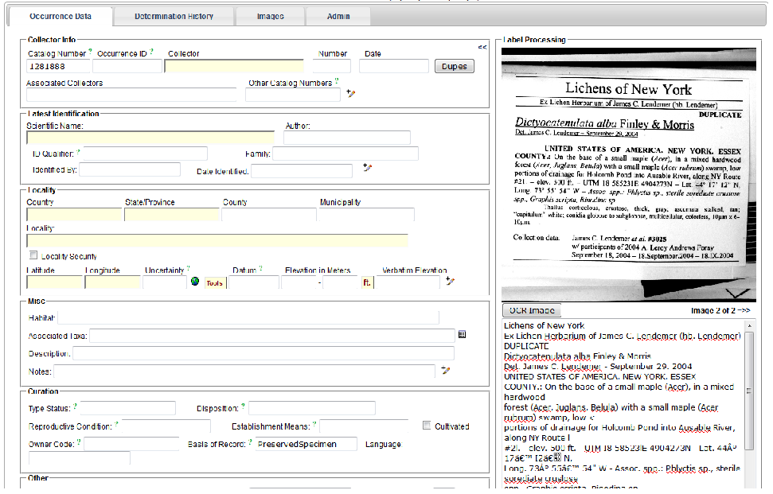
Label Review

Slide 21
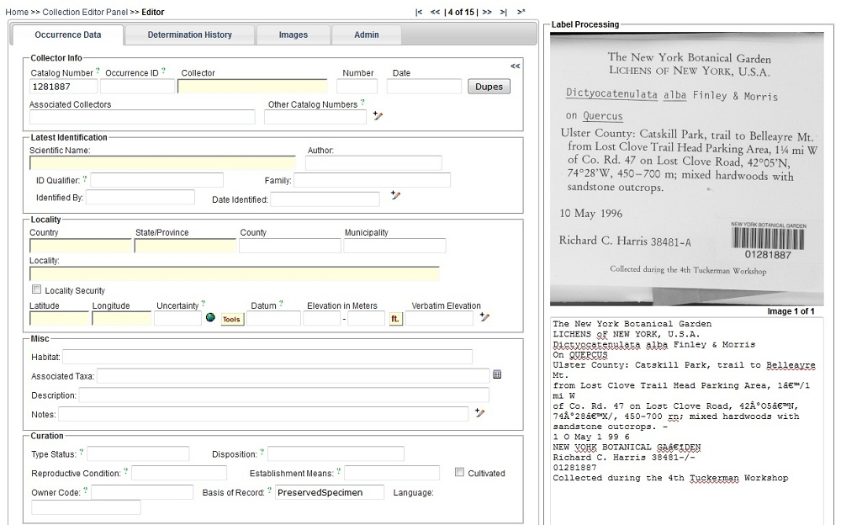

Slide 22
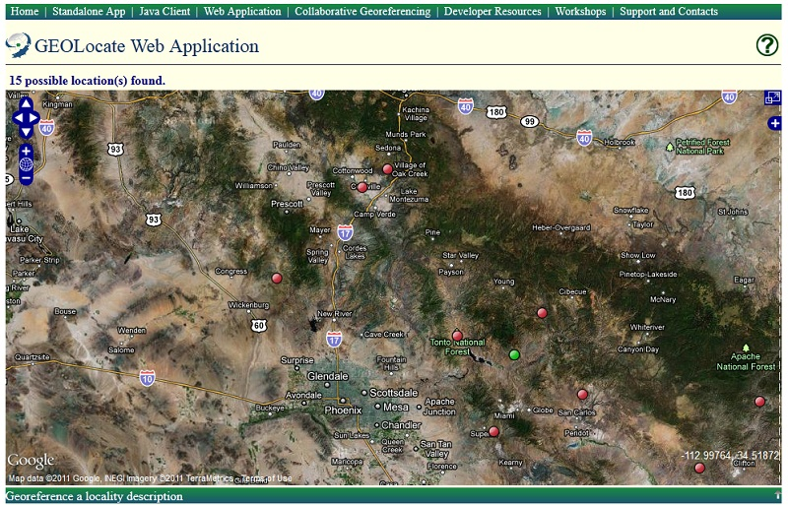
Geo-referencing
Supervised batch processing
GeoLocate web app using HTML5
Crowdsourcing
Make it fun!

Slide 23
Processed Records => Central DB
Weekly extracts of “Review-new”
Output as CSV and XML
Darwin Core
Extended formats
Import into central database main responsibility of collection
Specify import functions

Slide 24
Collaboration
National Portals are Biodiversity Content Management Systems
User Access Management
Record / Observation Data Entry/Editing
QC Messaging
Taxonomy Management
Species Description Entry/Editing
Image Upload
Character and Character State Entry/Editing

Slide 25
Project Information
http://lbcc.limnology.wisc.edu/

Slide 26
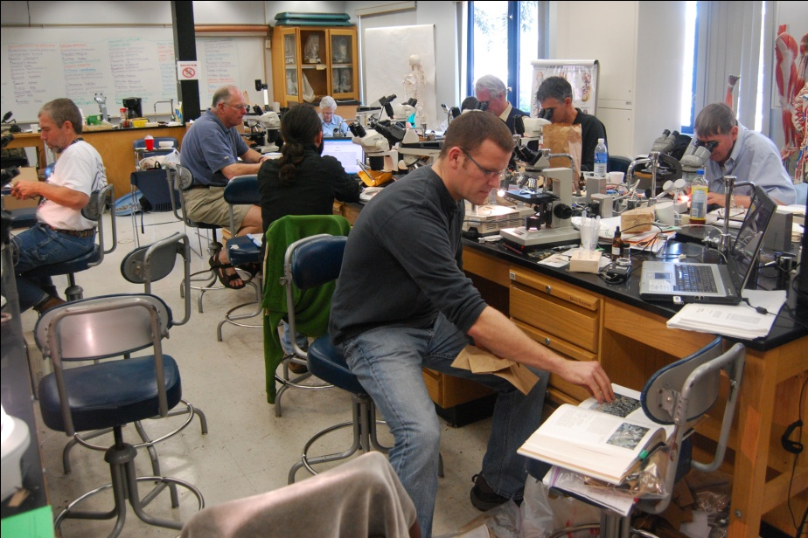
Outreach
Extensive Existing Outreach Programs
Volunteer Programs at CAS, F, FH, PH, UC, WTU
Local workshops
Field Courses (Forays, Bio-Blitz)
Training in Taxonomy, Collecting, Preserving
Seminars
Internships

Slide 27
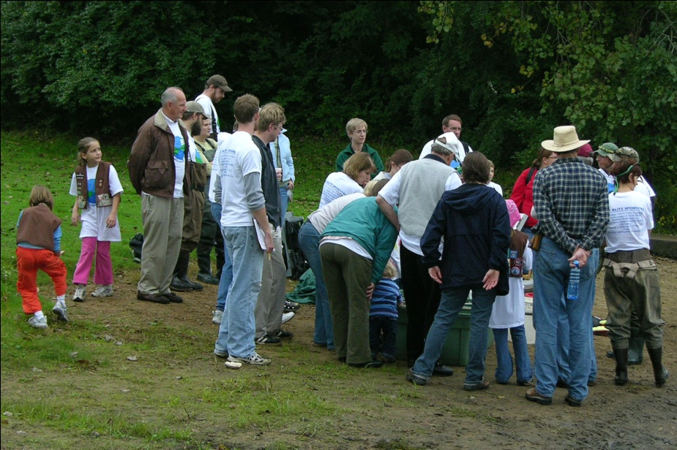
Outreach and Crowd Sourcing
Volunteer program within LBCC
Outreach at Local Amateur Meetings
Online Community Center
Establish Event Information Center
Online Training
Online Question and Answer Service
Online Seminars and Presentations
E-mail Newsletter

Slide 28
Outreach and Crowd Sourcing
Online Community Center (cont.)
Discussion/Exchange Forum
Number of Records Entered Accounting
Competitions
Data Entry (Monthly, Annual Champoins)
Photography
Fun Facts
The Most Obscure Label

Slide 29
Crowd Sourcing
Online Data Entry/Editing
Sophisticated User and Workflow Management System in SYMBIOTA
Volunteer data entry
Volunteer data editing
Professional quality control

Slide 30
Challenges
Automating OCR, NLP, Geo-referencing
Data Quality
Recruiting/maintaining volunteer community

Slide 31
Thank You
Thomas H. Nash and Edward Gilbert, Marilyn Larsen
Michael Adamo
Bruce Allen
Meredith Blackwell
Bill Buck
Alina Freire-Fierro
John Freudenstein
Alan Fryday
David Giblin
Karen Hughes
Steffi Ickert-Bond
Timothy James
Jennifer S. Kluse
Matt Von Konrat
Ben Legler
Tatyana Livshultz
Robert Lücking
Francois Lutzoni
Bob Magill
Andrew Miller
Brent Mishler
Donald Pfister
Richard Rabeler
Malcolm Sargent
Edward Schilling
Michaela Schmull
Blanka Shaw
Jon Shaw
Carol Shearer
Larry StClair
Barbara Thiers
Funded by the NSF ADBC program

