Slide 1
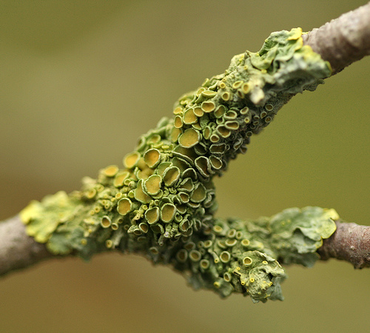
Lichens

Slide 2
Definition
Lichens- combination of a green algae (or cytobacterium) and a fungus
Exist in a mutualistic relationship- if separated, they cannot exist
Inhabit areas that neither fungi nor algae alone can exist, so they are first life forms to colonize newly exposed soil or rock

Slide 3
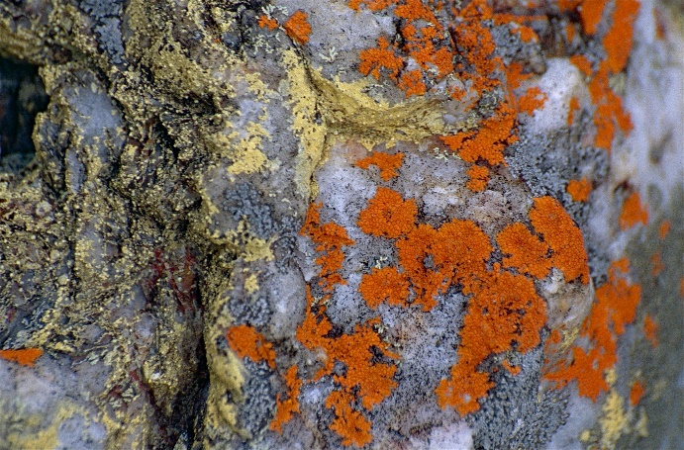
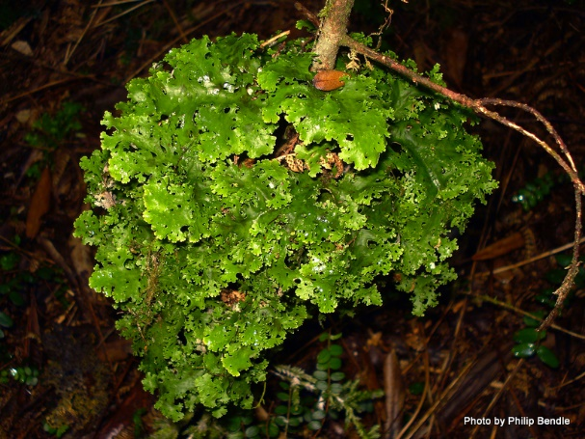
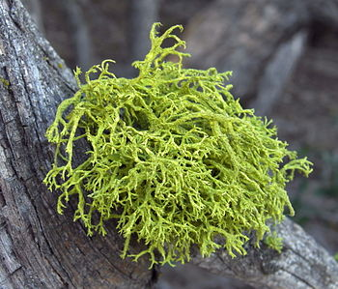
Categories
Crustose lichens- grow flush or encrusting
Foliose lichens- leaf like
Fruticose lichens- have fingerlike projections

Slide 4
Uses/ Economic Importance
Ancient Greece- used as dye
Usnic acid from Usnea used as an antimicrobial in China
Erythrolitimin, the dye in litmus paper to check pH comes from many different lichens
Food for tundra herbivores such as reindeer and caribou
Some lichens or their acids cause allergic contact dermatitis

Slide 5
Uses/ Economic Importance
Because they readily incorporate cations (positively charged ions) into their stuctures, lichens can be quite sensitive to pollutants in the air, so they can be used to determine level of air pollution
Example: In 1985, a study was done that revealed that 81% of the 172 lichen species that were present in Ohio Valley in 1917 were gone because of pollution, especially sulfur dioxide

Slide 6
Structure
The lichen’s thallus, or body, forms when fungal hyphae grow around algal cells to become the medulla
Fungal hyphae project below the lichen body to form rhizines, or holdfasts
Fungal hyphae also form a cortex, or protective covering, over the algal layer and sometimes under it as well

Slide 7
Structure

