Slide 1
Genome editing
Pete Jones

Slide 2
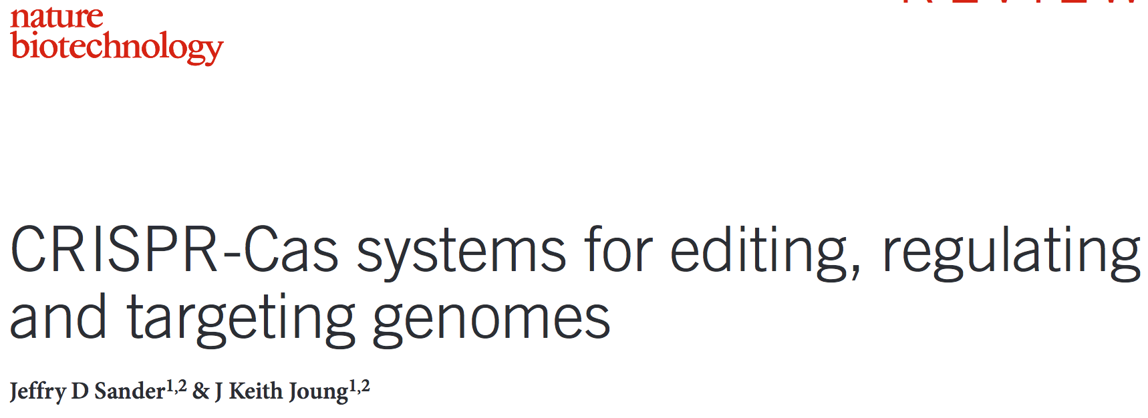
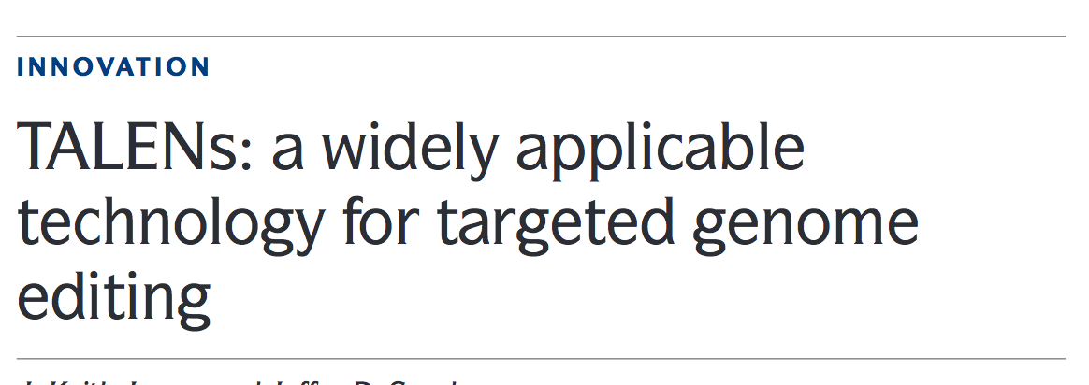
Genome editing
Growing interest in genome editing
Pubmed search “genome editing”
Pubmed search “CRISPR”

Slide 3
Outline
Approaches to understanding gene function.
Different approaches using genome editing to elucidate gene function.
What can we do with genome editing?
Specific examples from our research and others
Challenges and problems.
Future directions.

Slide 4
Genetic approaches
How do we identify a gene as being involved in a disease or process?
Forward genetics -> mutagenise a population of individuals or cells, screen for phenotype of interest.
Reverse genetics -> Gene identified as potentially involved in disease, process -> modify to analyse function.
GWAS studies -> Reverse genetics.

Slide 5
What does a gene do?
How do we find out what a gene does and how that relates to our disease/process of interest?
Functional Experiments -> localisation, interactors
Remove the gene function -> what happens without it?
DNA
RNA
Protein
Genetic engineering
siRNA
Small Molecule Inhibitors
Antibodies
Off-target effects
Incomplete knock-down
Residual effect of low expression
Length of effect
Protein Isoforms
Off-target effects
Effectiveness
Length of effect

Slide 6
Genetic engineering
Recombination approaches (mice, yeast).
Transposable elements (Drosophila), Bacterial insertion of DNA (Arabidopsis).
Transfection of gene constructs into cells (randomly integrated).
Until recently, not possible to make genetic changes in human cells -> genome editing.

Slide 7
What is genome editing?
A genetic engineering approach in which DNA is inserted, removed or replaced at a precise location within the genome.
Engineered nucleases.
Recombination-based approaches
Viral genome editing:
rAAV
Nuclease based genome editing:
Zinc-finger nucleases
Meganucleases
TALENs
CRISPRs
Creation of isogenic cell lines -> only differ by the change we’ve introduced.
Make (nearly) any modification we desire!

Slide 8
Genome editing
Precise alterations to the genome
Single base pair changes
Insertion
Knock-out
rAAV
CRISPR
TALENs
Notes:
Precise alterations to genome.
Can investigate functions of genes, regulatory elemets, or SNPs.
We can do this by generating knockouts, Knock-ins, or specific insertions.

Slide 9
Nuclease-based genome editing
Engineered nucleases which will cut at a desired position in the genome
TALENs - transcription activator-like effector nucleases
Xanthomonas bacteria express TAL arrays to bind and activate host promoters
TAL array is a series of DNA binding domains assembled to recognise a specific sequence
33-34 amino acid sequence – only 12th and 13th residue vary – and determine nucleotide binding.
We can construct these arrays, add a nuclease and use for genome editing
Fok1
TGAGGAGGCGGCAACGGCGGGCGCCGGGGCGGCGGGCCCCGGGGCGAGCA
ACTCCTCCGCCGTTGCCGCCCGCGGCCCCGCCGCCCGGGGCCCCGCTCGT
Fok1
Cleavage
Notes:
In the last coupe of years, there has been an explosion in the use of genome editing.
This has predominantly been using TALENs and CRISPRs
TALENs -> DNA binding domains, linked together
CRISPRs -> based on a system that bacteria use as immunity against viruses. Design a guide

Slide 10
Nuclease-based genome editing
CRISPRs
CRISPR-Cas system – an form of acquired immunity found in bacteria.
The guide RNA directs the Cas9 protein to a target site.
Creating a guide RNA is very simple.
Cleavage
Guide RNA
Cas9 Protein

Slide 11
Nuclease-based genome editing
TALENs and CRISPRS
Nuclease-induced DSB
NHEJ-mediated repair
HDR-mediated repair
Donor Template
Donor Template
Insertion or deletion mutations
Single nucleotide alterations
Precise sequence insertion
Notes:
TALENs and CRISPRs can be used to generate a variety of genetic alterations.

Slide 12
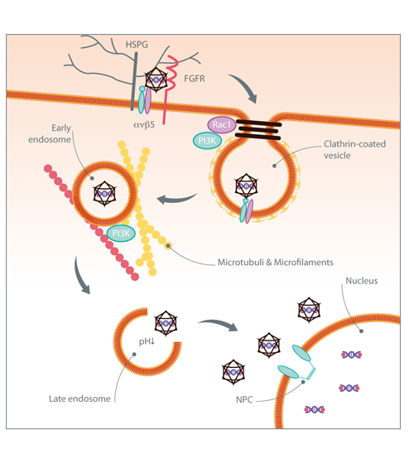
rAAV genome editing
Use a viral vector to carry DNA into cell
Homologous recombination allows incorporation of modified DNA into the genome.
Incorporation of an antibiotic resistance gene allows selection of successfully edited cells.

Slide 13
rAAV genome editing
Single nucleotide alteration
ITR
LoxP
G418 Resistance Gene
LoxP
Exon
ITR
Insertion into genome by homologous recombination
Single nucleotide alteration
LoxP
G418 Resistance Gene
LoxP
Exon
Removal of G418 resistance gene
Single nucleotide alteration
LoxP
Exon

Slide 14
Applications of genome editing
GWAS studies have identified >4000 SNP associations with ~200 diseases.
How do these SNPs contribute to disease?
Which genes are contributing to disease? How?
CAD -> 1000 SNPs -> ~50 loci.
Telomere-length associated genes.

Slide 15
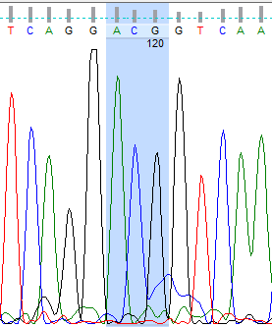
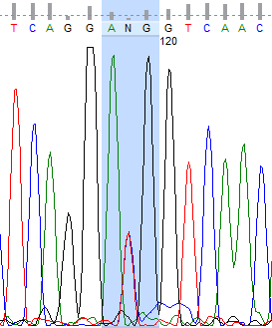
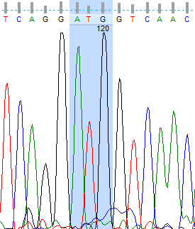
Applications of genome editing
CAD GWAS Hit -> 1 SNP within exon of ZC3HC1
rAAV mediated genome editing -> isogenic cell lines.
CC
CT
TT
Targeting each allele of rs11556924.
Have now generated genome edited cell lines of all 3 genotypes.
Investigating effect of rs11556924 on ZC3HC1 protein function and cellular phenotype.
Notes:
rAAV mediated genome editing to create isogenic lines to analyse the effect of the SNP.
DLD-1 colon carcinoma cell line, which is pseudodiploid.
Targeting from Het, both ways.
Most of this analysis, single homozygote, 2 hets. Now have 3 of each. Currently editing to obtain Homozygous risk.

Slide 16
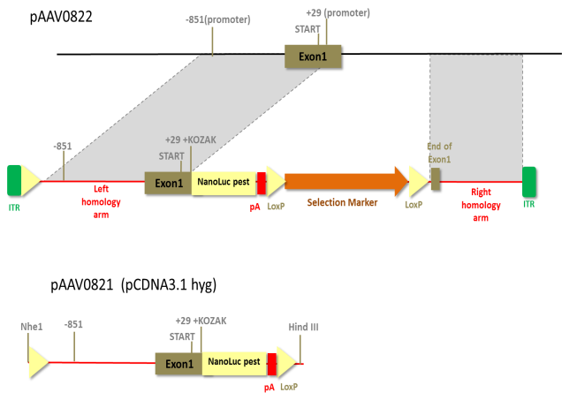
Applications of genome editing
ANRIL lncRNA in CAD 9p21 GWAS significant locus.
Insert luciferase reported attached to Exon 1 of ANRIL to visualise expression.
pAAV0866
ANRIL reporter
PGK Pro + Puro
1.2kb
LHA:1kb RHA: 1.2kb
Cre-expression plasmid
Insertion 672 bp in Exon 1 of ANRIL
=NanoLuc 638bp+LoxP 34 bp

Slide 17
Applications of genome editing
ANRIL lncRNA in CAD 9p21 GWAS significant locus.
Insert inducible promoter to allow us to control expression of ANRIL.
pAAV0823
PGK Pro + Puro
1.2kb
LHA:1kb RHA: 1kb
Cre-expression plasmid
Insertion 411bp up stream Exon 1 of ANRIL
(LoxP 34bp+TRE3G Promoter 377 bp)

Slide 18
Applications of genome editing
KIAA1462 CAD GWAS Significant Locus
9 significantly associated SNPs
Cell-cell junctional protein
How does this gene contribute to CAD?
Use CRISPRs at SNPs, with oligonucleotide donor for HDR
Also generate Knockout using CRISPR

Slide 19
Challenges and Future Directions
Challenges of using genome editing:
Off-target effects
Knock-outs -> Compensatory expression changes (redundancy)
Effects may be due to GxE interactions, may not be easily detectable.
Delivery into difficult to transfect cell types, whole organs, organisms.
Future Directions
Increased specificity
Gene therapy
GM crops/animals?
Other applications?

Slide 20
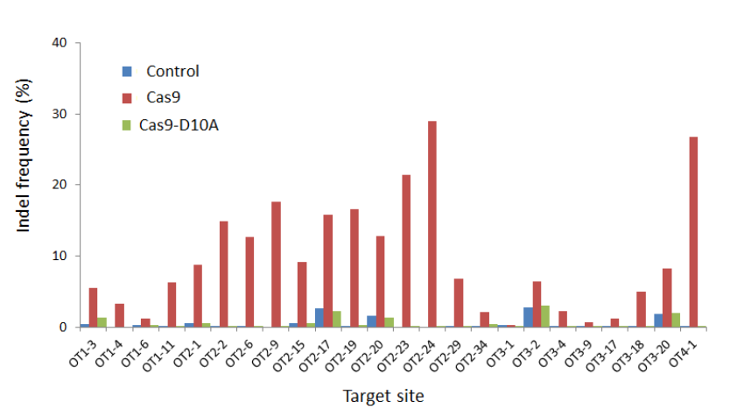
Future Directions
Use of CRISPR nickases
guide RNA
guide RNA
Nickase Cas9
NHEJ
Shen et al. 2014, Nat Meth., 11, 399–402

Slide 21
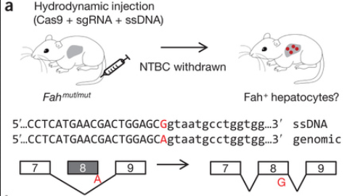
Future Directions
Gene Therapy
Genetic liver disease caused by SNP in Fah gene
Single SNP results in skipping of exon 8, unstable protein – loss of function
Adult mice -> injection of CRISPR.
1/250 hepatocytes modified by this approach -> selective pressure -> healthy mouse.
Genetic Disorders -> Correction of mutations
Other potential gene therapy -> HIV “receptor” CCR5 in T-Cells.
Notes:
NTBC is drug which allows mice to survive despite disease.
After CRISPR of SNP, NTBC withdrawl ->
Selective pressure of

Slide 22
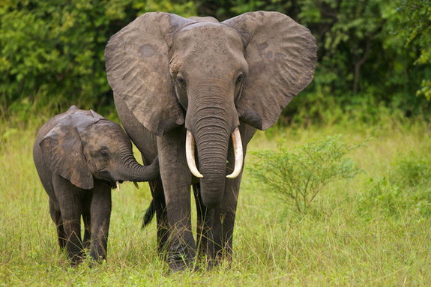
Future Directions
George Church, Harvard – inventor of CRISPR genome editing
Insulate permafrost, protecting trapped greenhouse gases
Graze arctic tundra
functioning grassland
CRISPRs
Mammoth genes into Asian elephant

Slide 23
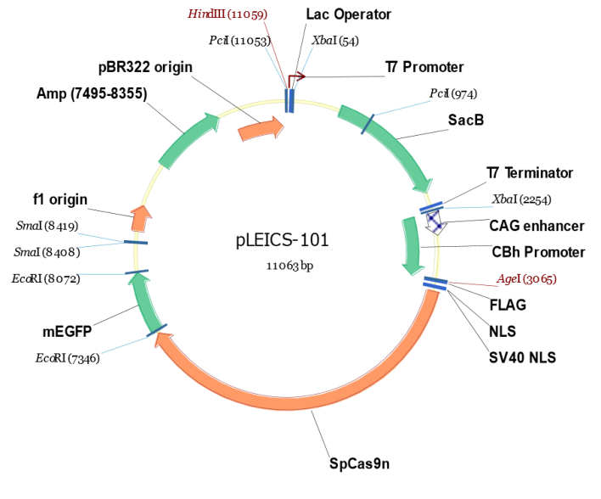
Further information
www.genome-engineering.org
www.horizondiscovery.com
UoL cloning service -> PROTEX

Slide 24
Acknowledgements
Peng Gong
Mike Kaiser
Rath Rajmohan
David McVey
Maryam Ghaderi Najafabadi
Sarah Andrews
Noor Shamki
Gavin Morris
Tom Webb
Nilesh Samani

