Slide 1
Amino Acid & Basic Classification
Ayesha Shaukat
M.Sc, M.Phil
Biochemistry

Slide 2
INTRODUCTION:
Amino acids are the building blocks of the proteins.
About 500 amino acids are known.
Proteins are linear polymers built of monomer units called amino acid.
Proteins are the most abundant macromolecules in human body.
The function of proteins is directly dependent on the three dimensional structure.
Proteins contain a wide range of functional groups includes, alcohols, thiols, thioethers, carboxylic acid and carboxamide, variety of other basic groups.

Slide 3
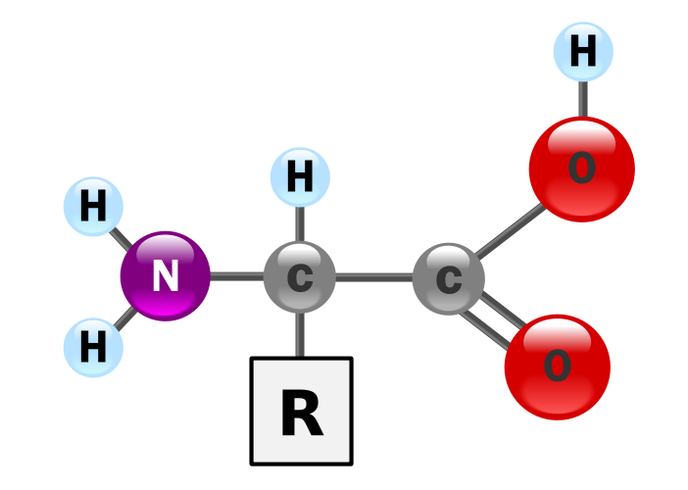
General structure

Slide 4
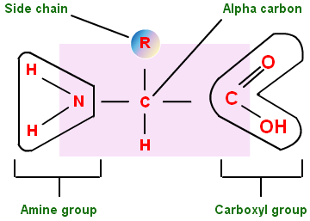
Simple description

Slide 5
Properties of Amino Acid:
With four different groups connected with tetrahedral a-carbon atom and a-amino acids are chiral.
20 L-a amino acid
Only L-a-Amino acids occur in proteins
D-amino acids is the feature of non-mammalian species.
Amino acids may have positive, negative or zero net charge
Strong acids/ weak acids
Zwitterion

Slide 6
Classification of amino acids:
Amino acid forms a larger component of body in the form of proteins.
Structurally amino acids can be classified on the basis of functional groups locations as, alpha, beta, gamma and delta amino acid
Other classification related to polarity:
Acidic, basic and neutral
Nutritional classification

Slide 7
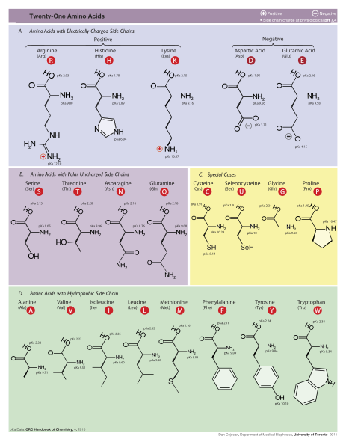

Slide 8
Classification of amino acid on the basis of R-group:
On the basis of polarity and their interaction with water at biological pH
Polarity of R-group varies from hydrophobic (non-polar) and hydrophilic (polar)
Non-polar, Aliphatic R groups
Aromatic R groups
Positively charged R groups
Negatively charged R groups

Slide 9
Amino acid classification due to R-group polarity
Amino acids with non-polar R group:
8 amino acids have non-polar, hydrophobic R-groups
Ala is the least hydrophobic because of its small methyl group.
Val, leu and ile have hydrophobic branched aliphatic R groups which cluster in water.
Proline and S containing side chains of met are also hydrophobic in nature.
Phen and trp are the most hydrophobic because of their phenyl and indole rings.

Slide 10
Amino acid with uncharged polar groups:
7 amino acids have polar R groups, which are uncharged at physiological pH .
These are the relatively hydrophobic.
Gly is the border line member of this group its smaller R-group has no influence on the polarity of a-NH2 and a-COOH groups.
The –OH group of the ser, thr and tyr makes them more polar R groups in this class.
Asn and gln are uncharged derivatives of aspartic and glutamic acids.

Slide 11
Amino acids with positively charged polar R groups:
Lys and arg are positively charged at neutral pH and are highly hydrophilic.
His may have positive charge or un-charged depending upon the pH of the media.
At pH 6 >50% of its R-group are protonated but at 7 pH, only 10% have positive charge . The property of his is to contribute to the buffer action of the proteins.

Slide 12
Amino acids with negatively charged acidic R groups
Asp and glu are present in this class
At 7 pH these amino acids are negatively charged
Includes Aspartate and glutamate

Slide 13
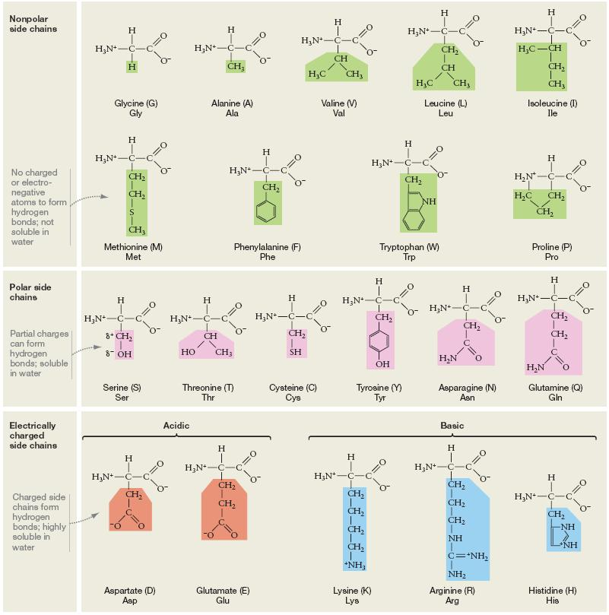

Slide 14
Nutritional Classification
Based on the requirement of amino acids for growth and health.
Essential amino acids
Non-essential amino acids

Slide 15
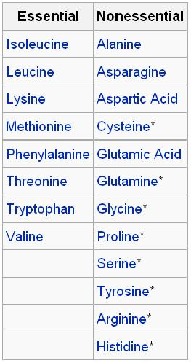
List of names

Slide 16
Properties of Amino Acids:
Solubility of amino acids
Melting point
Taste
Amino acids shows two type of isomerism
Ionization of amino acids

Slide 17
pKa value express the Strength of Weak acids
The net charge on an amino acid is algebraic sum of all positive and negative charged groups depends upon the pKa value of its functional groups and on the pH of the surrounding medium.
At Isoelectric pH, and amino acid bears no net charge
pKa value vary with environment
Solubility of amino acid reflects their ionic concentration

Slide 18
Primary Structure Of Proteins
The sequence of amino acids in a protein is called primary structure of proteins.
Understanding of primary structure of proteins is important because many genetic diseases results from protein with abnormal amino-acid sequence.

Slide 19
a) Peptide Bond:
In proteins amino acids are joined covalently by peptide bonds.
Established between a-carboxyl group of one amino acid and a-amino group of another.
Peptide bonds are not broken by conditions that denature proteins such as
Heating
High concentrations of urea
Prolonged exposure to a strong acid or base at elevated temperature is required to hydrolyzed these bonds non-enzymatically.

Slide 20
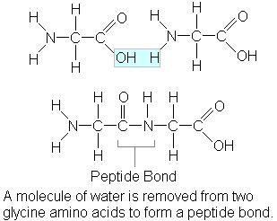
Formation Of Peptide bond

Slide 21
1) Free amino end of the peptide chain is written on the left and free carboxyl end is written to the right.
All amino acid sequence are read from the N- to the C-terminal of the peptide.
Linkage of amino acids through peptide bonds result in an unbranched chain is called as polypeptide
Each component amino acid in a polypeptide chain is called as “residue” and “moiety”
2)Characteristics of the peptide bond:
Peptide bond has a partial double bond characteristics
Rigid and planar
Peptide bond generally a trans-bond

Slide 22
3)Polarity of peptide bond:
Like all amide linkages, the –C=O and –NH groups of the peptide bond are un-charged.
pH range 2-12
B) Determination of the amino acid composition of a polypeptide:
1) determine the primary structure (identification and quantitate its constituent amino acids).
First hydrolyze by the strong acid at 110c for 24 hours.
This treatment cleaves the peptide bonds, and release individual amino acids.
Cation-exchange chromatography
Quantitated by heating with ninhydrin.
Amino acid analyzer
C)Sequencing of amino acid from N-terminal end

Slide 23
Beginning at the N-terminal end
Phenylisothiosyanate, known as Edman’s reagent
D) Cleavage of the peptide into smaller fragments:
Many polypeptides have primary structure composed of 100 of amino acids.
Such molecules cant be sequenced directly from end to end.
E) Determination of protein primary structure by DNA sequencing:

