Slide 1
Photosynthesis and Respiration
…an introduction

Slide 2
Let’s start with… Photosynthesis

Slide 3
The 5 W’s of Photosynthesis
Who?
The major players are:
Carbon dioxide, water, glucose, oxygen, sunlight, and ATP

Slide 4
The 5 W’s of Photosynthesis
What?
Photosynthesis = you tell me!
2 types of reactions:
Light-dependent = converting sunlight energy to chemical energy (ATP)
Light-independent = uses chemical energy to produce simple sugars

Slide 5
The big equation…
light
6 CO₂ + 6 H₂O C₆H₁₂O₆ + 6 O₂

Slide 6
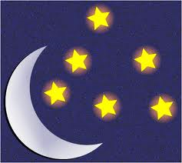
The 5 W’s of Photosynthesis
When?
Light-dependent
Light-independent

Slide 7
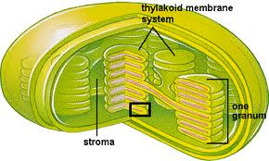
The 5 W’s of Photosynthesis
Where?
Plant cells!
Key words: chloroplast, chlorophyll (pigment), thylakoid membrane, photosystems
Notes:
Chloroplast thylakoid membranes contain chlorophyll pigments

Slide 8
The 5 W’s of Photosynthesis
Why?
Let’s review the 5 requirements for living things:
Orderly structure
Reproduce
Adapt to their environment
*Grow and develop*
*Require energy*

Slide 9
The 5 W’s of Photosynthesis
How?
Light-dependent reactions:
Light = energy
Excites electrons in chlorophyll
Move down electron transport chain (proteins) in thylakoid membrane
Each stair step down chain releases energy to:
Break H₂O to release oxygen and new electrons,
Pump H⁺ in to create NADPH, and
Bind P to ADP, forming ATP
Photolysis →

Slide 10
Light-Dependent Reactions
Figure 9.5 (Sect 9.2)

Slide 11
The 5 W’s of Photosynthesis
How? cont’d
Light-independent reactions:
Calvin Cycle in stroma of chloroplast
CO₂ in & 6-carbon sugars (glucose) out

Slide 12
And now… Respiration

Slide 13
The 5 W’s of Respiration
Who?
The major players are:
Carbon dioxide, water, glucose, oxygen, and ATP
Does this look familiar?

Slide 14
The Respiration Equation
C₆H₁₂O₆ + 6O₂ 6CO₂ + 6H₂O + Energy

Slide 15
The 5 W’s of Respiration
What?
Cellular respiration = the break down of food molecules to produce ATP
3 stages:
Glycolysis = breaks down glucose to pyruvic acid
Citric acid cycle (aka Krebs cycle) = similar to the Calvin cycle; produces CO₂ and ATP
Electron transport chain = energy released in steps to produce ATP and H₂O

Slide 16
The 5 W’s of Respiration
When?
Glycolysis = anaerobic (anytime)
Citric acid cycle and electron transport chain = aerobic (needs __________)
oxygen

Slide 17
The 5 W’s of Respiration
Where?
In all living cells!
Glycolysis: in cytoplasm
Citric acid cycle: in mitochondria
Electron transport chain: in inner membrane of mitochondria
Where are these places? …

Slide 18
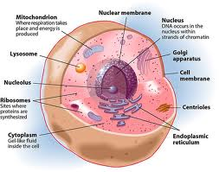
A quick tour of the cell…
Let’s zoom in a little further…

Slide 19
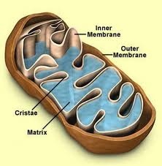
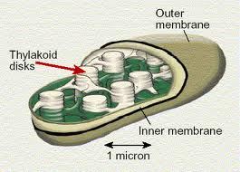
The Mitochondria
aka the “Power house” of the cell
Does this structure remind you of anything we talked about earlier?
The Chloroplast!

Slide 20
The 5 W’s of Respiration
Why?
2nd step in releasing energy for the organism
Remember the requirements of life!

Slide 21
The 5 W’s of Respiration
How?
3 stages:
Glycolysis = breaks down glucose to pyruvic acid
*Fermentation
Citric acid cycle (aka Krebs cycle) = similar to the Calvin cycle; produces CO₂ and ATP
Electron transport chain = energy released in steps to produce ATP and H₂O

Slide 22
Electron transport chain
FYI…
Figure 9.11

Slide 23
The 5 W’s of Respiration
How? Cont’d
Fermentation = occurs, for example, during heavy exercise when cells are lacking oxygen
Oxygen is the final electron acceptor in the electron transport chain. Without it, energy (ATP) cannot be produced
Definition: Anaerobic means of creating ATP
(supplies energy when oxygen is scarce)
2 types:
Lactic acid
Alcoholic

Slide 24
Lactic acid fermentation
Forms lactic acid in muscles
Alcoholic fermentation
Used by yeast cells and bacteria to produce CO₂ and alcohol (i.e. bread)

Slide 25
Let’s make some comparisons:
Figure 9.12

Slide 26
Review
Table 9.1

Slide 27
Video time!
The Light Reactions
Bill Nye Plant Pigments
Cowboy Respiration

