Slide 1
Photosynthesis
C483 Spring 2013

Slide 2
1. What structural feature is most responsible for chlorophyll's ability to absorb light?
A) The magnesium ion.
B) The conjugated double-bonds in the tetrapyrrole ring.
C) The phytol side chain.
D) An aromatic side chain attached to the tetrapyrrole ring.
2. Rank the reduction potential of these molecules from greatest to least:
P680, P680⁺, P680*
P680⁺, P680, P680*
P680*P680, P680⁺
P680⁺, P680*, P680
3. Which statement concerning cyclic photosynthesis is false?
It can produce more ATP per molecule of O₂ produced.
It can product more ATP per photon absorbed.
It involves recycling of electrons through PSII.
It comes at the expense of NADPH production.

Slide 3
4. In the ultimate sense, the electrons that end up on NADPH come from
Water
Oxygen
The special pair
Ubiquinol
5. The energy needed to promote an electron in the special pair comes from
Photons absorbed by the special pair
Photons absorbed by antenna chlorophylls
Photons absorbed by accessory pigments
More than one of the above

Slide 4
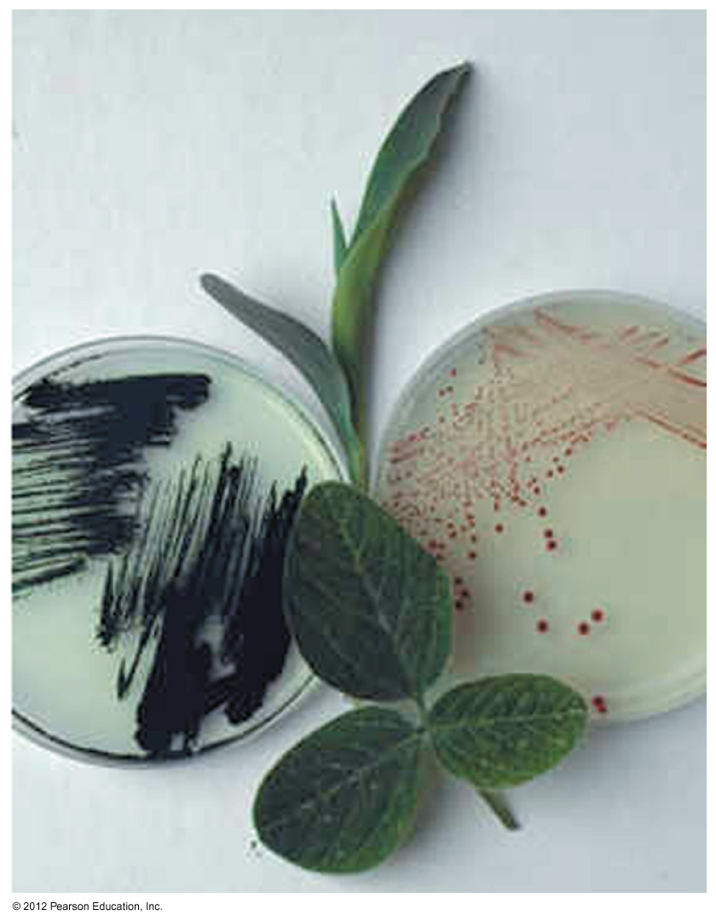
Photoorganisms
Plants
Cyanobacteria
Purple bacteria
We will discuss bacterial photosynthesis, but the principles are similar for all

Slide 5
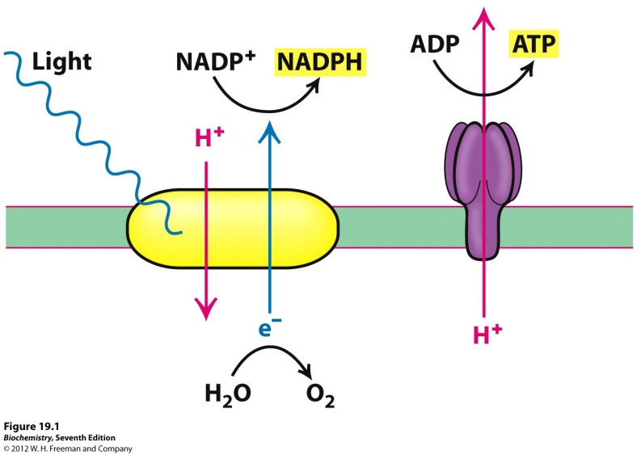
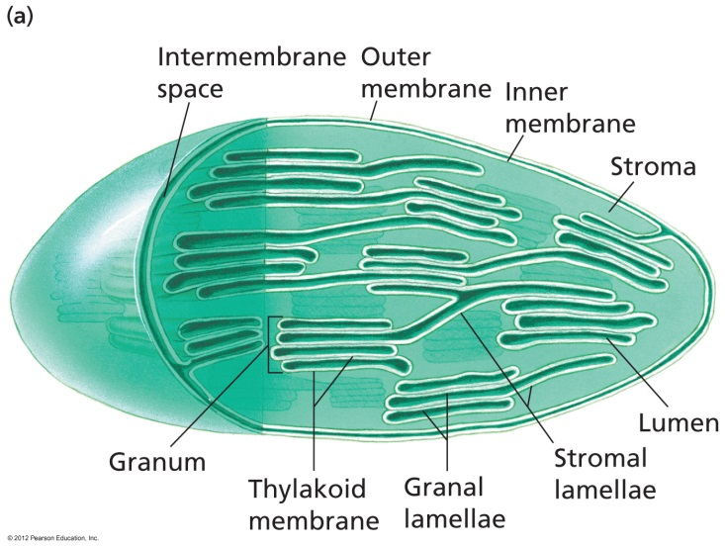
Overview
Same principles as respiration, but backwards
Electron flow from water to NADPH
ENERGY INPUT!
Takes place in chloroplasts
Stroma = matrix
Thylakoid lumen = intermembrane space

Slide 6
Overview
Harvesting light energy
Electron flow and net equation
PSII and PSI
How many ATP/photon
Take home message: A well ordered, multicomponent system that traps light energy utilizing an electron transport chain to create reducing power and a proton gradient

Slide 7
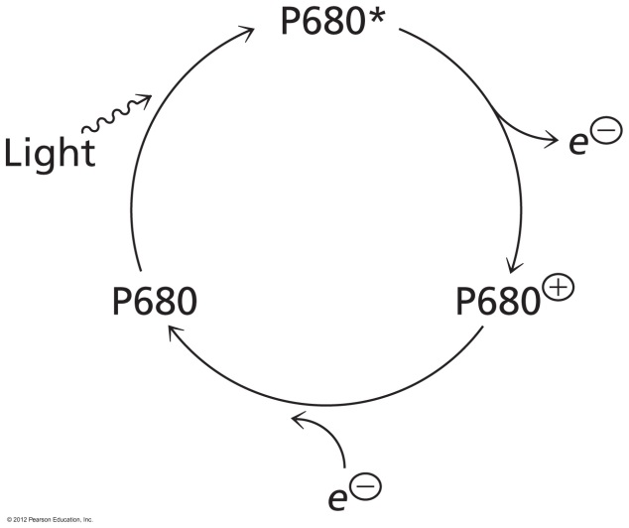
Light Gathering Pigments
Chlorophyll
P680, P680*, and P680⁺

Slide 8
Special Pair and Antenna

Slide 9
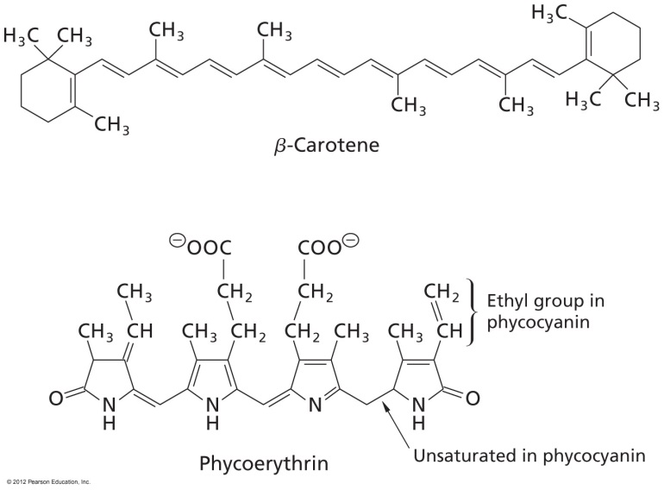
Accessory Pigments maximize absorption
Chlorophylls don’t absorb green!

Slide 10
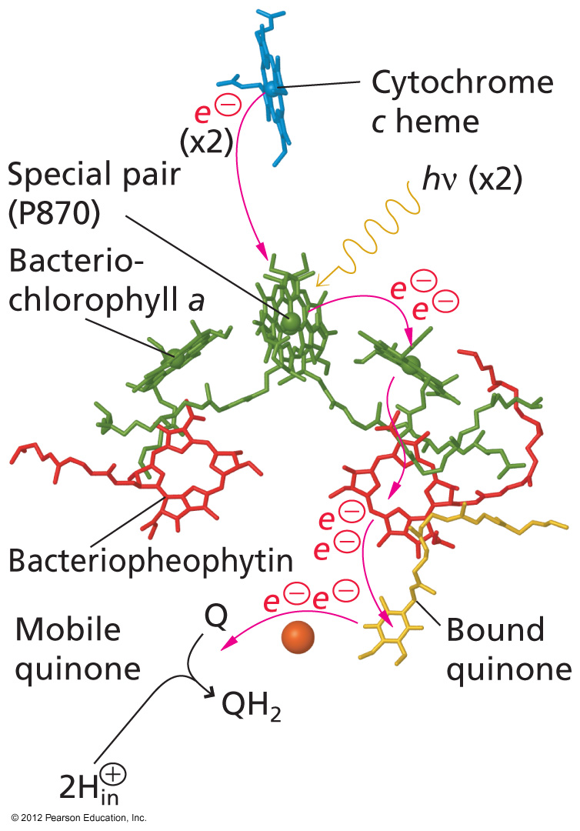
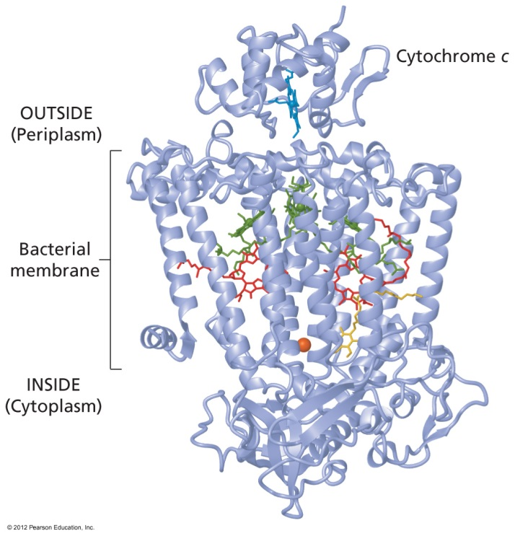
Electron Chain
High energy electron travels down chain of redox reagents within a Photosystem

Slide 11
Z-Scheme
1. Excited e- travels down chain, gets excited again, travels down chain to NADPH
2. E⁻ from water fills in empty electron space
Actually P680⁺

Slide 12
Net Reaction
2 H₂O + 4 NADP⁺ + 8 photons → O₂ + 4 NADPH

Slide 13
Photosystem II and I
Take home messages: A well ordered, multicomponent system that traps light energy utilizing an electron transport chain to create reducing power and a proton gradient

Slide 14
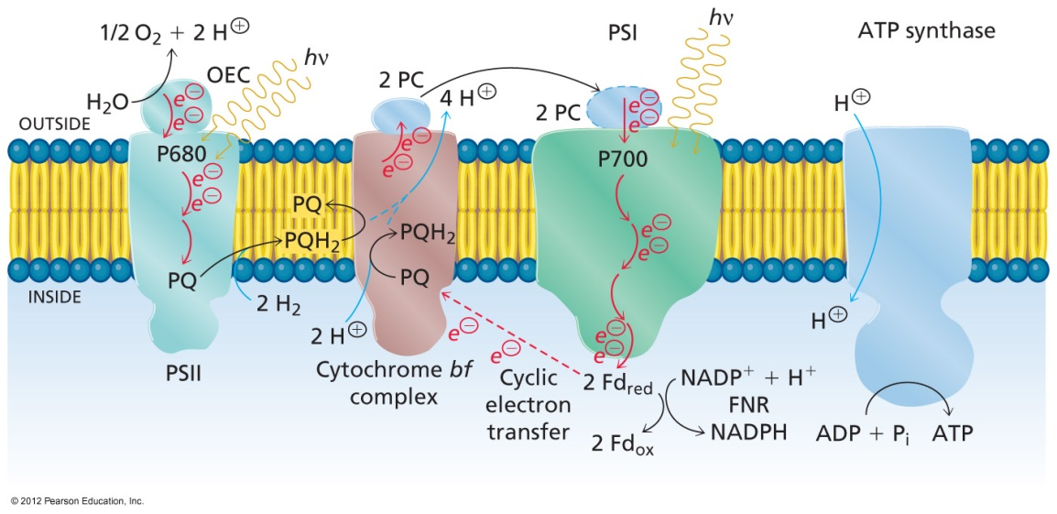
Proton Gradient
For every ONE O₂
4 e⁻ passed
8 photons absorb
12 H⁺ pumped
In plants, 12 H⁺ required to turn ATP synthase
3 ATP made
Quantum yield is 3 ATP/8 photons or ATP/2.7 photon

Slide 15
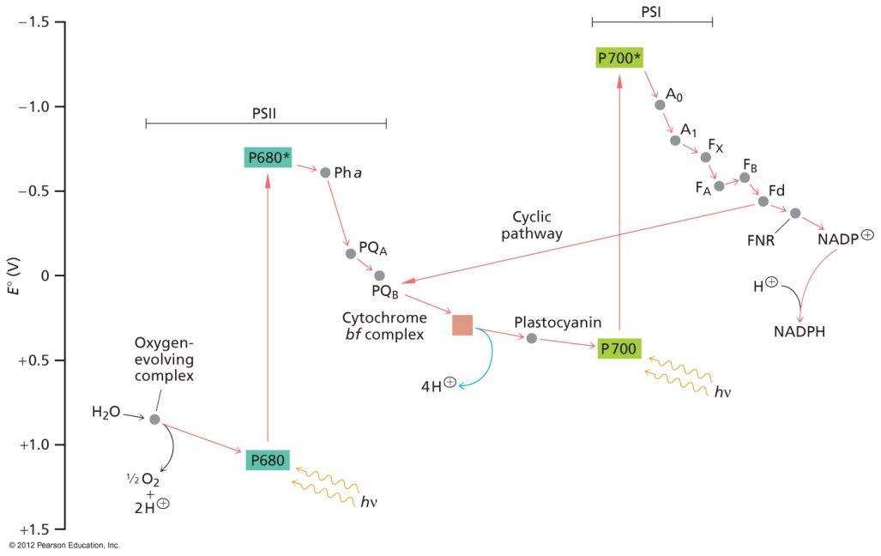
Cyclic System
If we give up NADPH production, electrons can be recycled through PSI
4 photons used to pump 8 H+
2 ATP/4 photons or ATP/2 photons
More efficient ATP synthesis

Slide 16
Answers
B
B
C
A
D

