Slide 1
Carbohydrate Metabolism in Plants
C483 Spring 2013

Slide 2
1. Which molecule is the CO2 acceptor in the first step of the Calvin cycle?
A) Rubisco.
B) Ribulose 1,5-bisphosphate.
C) 3-phosphoglycerate.
D) Glyceraldehyde-3-phosphate.
2. How many ATP molecules are required for the fixation of one CO2 molecule via the Calvin cycle to a triose phosphate?
A) 3
B) 6
C) 9
D) 12
3. Starting with carbon dioxide fixation, which is the correct order for the stages of the Calvin cycle?
A) Carboxylation → Reduction → Regeneration.
B) Regeneration → Carboxylation → Reduction.
C) Carboxylation → Regeneration → Reduction.
D) Reduction → Carboxylation → Regeneration.

Slide 3
4. Which is not an intermediate in the biosynthesis of sucrose in plants?
A) ADP-glucose.
B) Glucose 6-phosphate.
C) Fructose 6-phosphate.
D) UDP-glucose
5. Which of the following plant carbohydrate metabolism reactions will happen in the dark?
Carbon dioxide fixation
Formation of starch from glucose
Formation of glucose from sucrose
Conversion of 3C sugars to 5C sugars

Slide 4
Dark Reactions
Photosynthesis can be split into two parts
Light reactions: light→ ATP + NADPH
Dark Reactions: CO2 + ATP +NADPH → carbs
Overall: light + CO2 → carbohydrates
Dark reactions don’t happen in dark; they do not directly require light

Slide 5
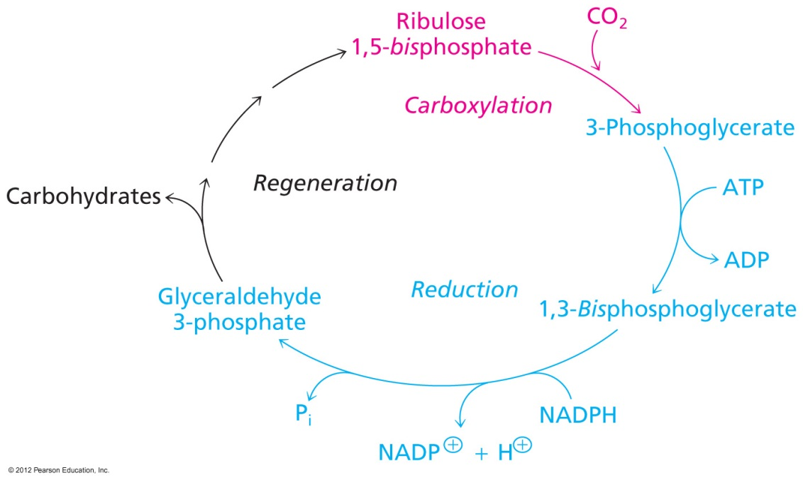
Calvin Cycle
Fixing CO₂ (carboxylation)
Reductive synthesis of carbohydrates
Regeneration of cycle

Slide 6
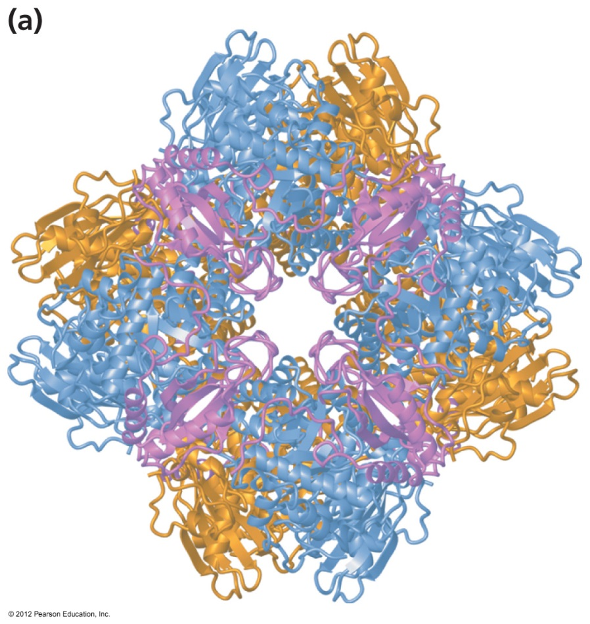
1. Carboxylation: Rubisco
Carboxylation of Ribulose
Production of 3-phosphoglycerate
Not an efficient enzyme
Inactive in dark (when there is no proton gradient, pH changes conformation)

Slide 7
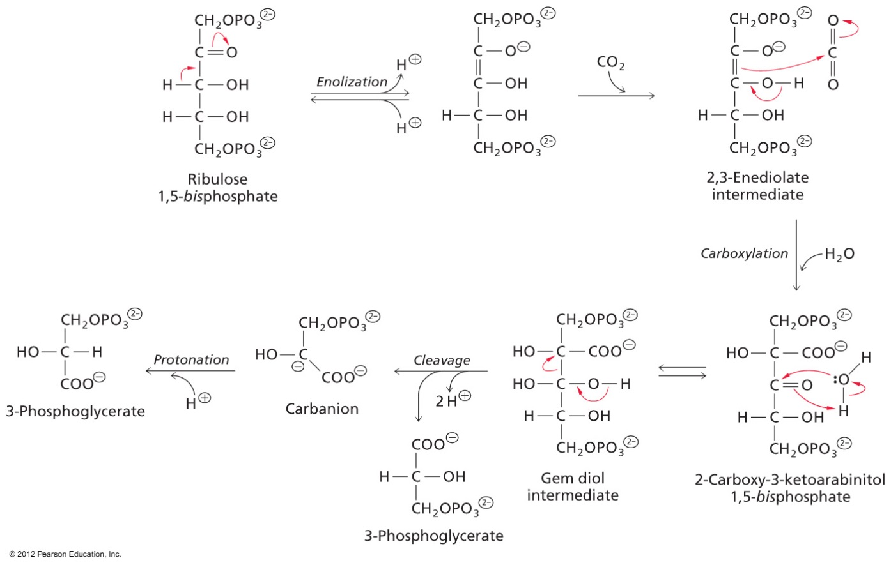
Take home: 5C + CO2 → two 3C
Not useful yet…where does ribulose come from? And 3-phosphoglycerate is not a fuel yet.

Slide 8
2. Reductive Stage
Major expenditure of ATP and NADPH
Now in the oxidation state to make storable fuel
Still a problem: where did ribulose come from?
From here, we see gluconeogenesis

Slide 9
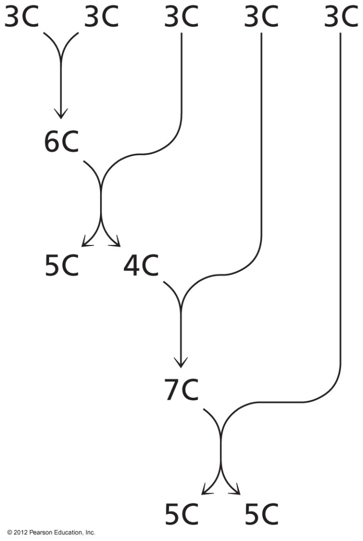
3. Regeneration Stage
Take some of the 3-carbon sugars and remake ribulose
Regeneration of 5C sugars, but also a net formation of 3 carbon sugars. Consider…
Start with 3 ribulose and 3 CO₂, you will make six 3-carbon sugars

Slide 10
Net Reaction
The net reaction of al three stages looks simple…
But is quite complex stepwise…

Slide 12
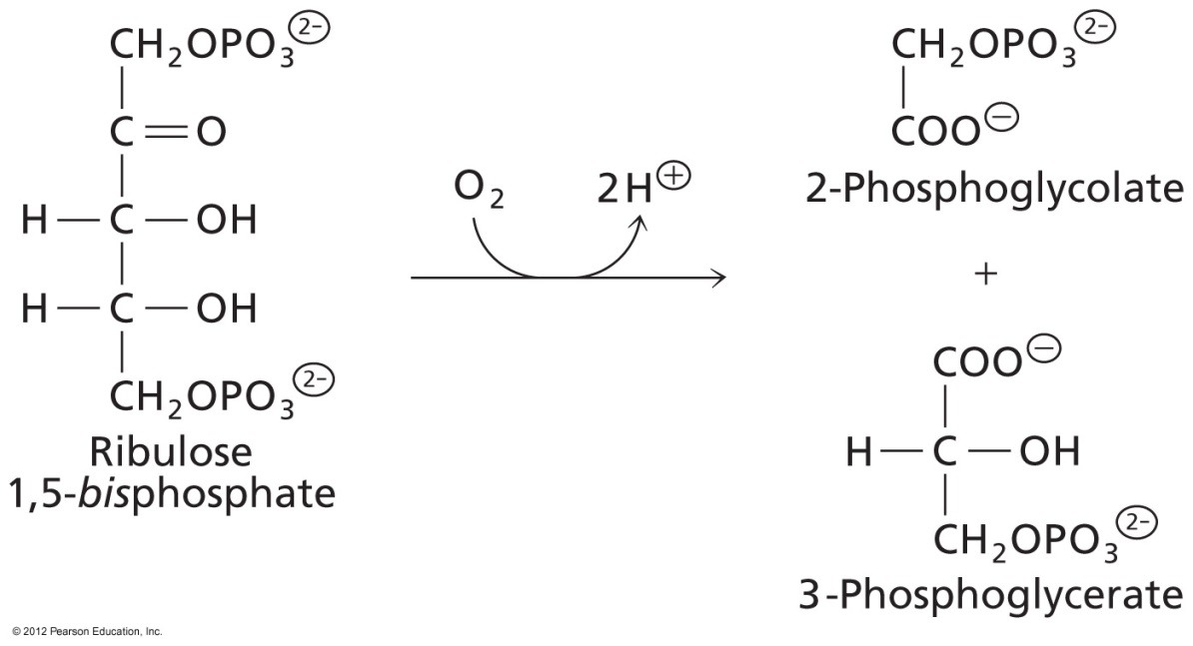
Photorespiration
Rubisco has a “wasteful” side reaction
“Fixes” oxygen
For every two ribulose destroyed, 9 carbons can be salvaged

Slide 13
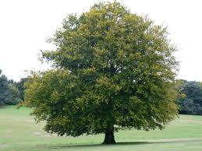
Carbohydrate Storage and Utilization
Why do plants make glucose and carbs?
Structural polymers
Storage of fuel
Starch
Sucrose
Plants need to live in the dark and in winter!
Plants have cells that are not photosynthetic

Slide 14
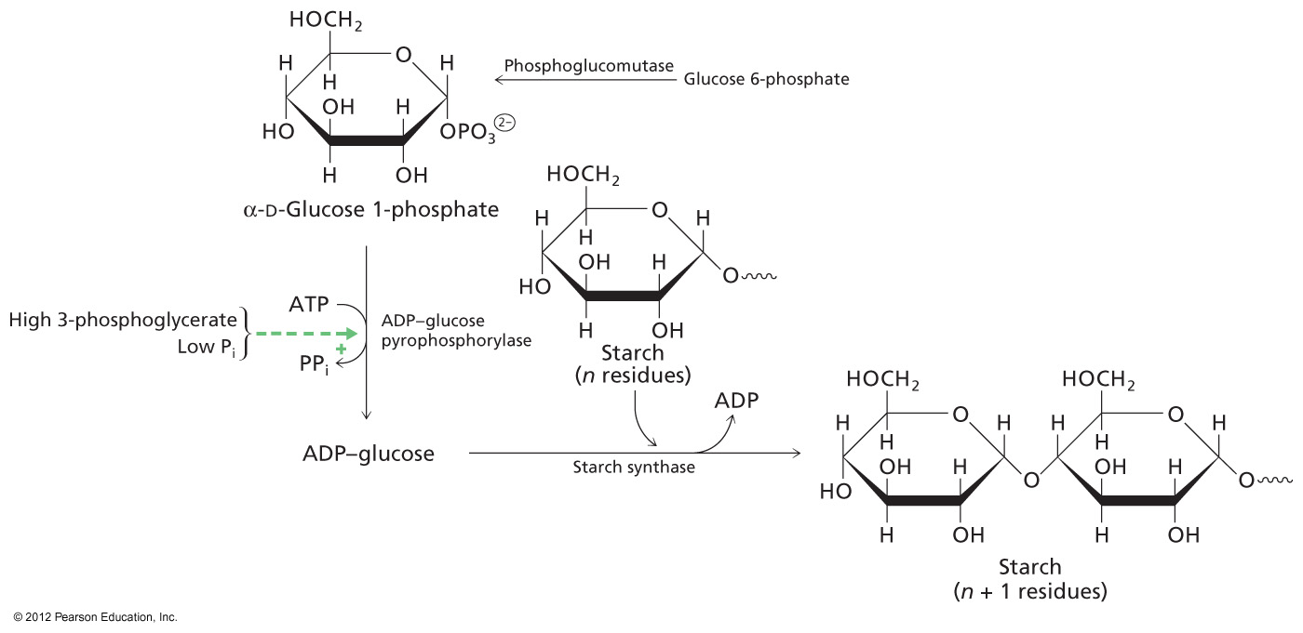
Starch
Similar to glycogen synthesis, but ADP-glucose is intermediate
Synthesized in light, Utilized in the dark

Slide 15
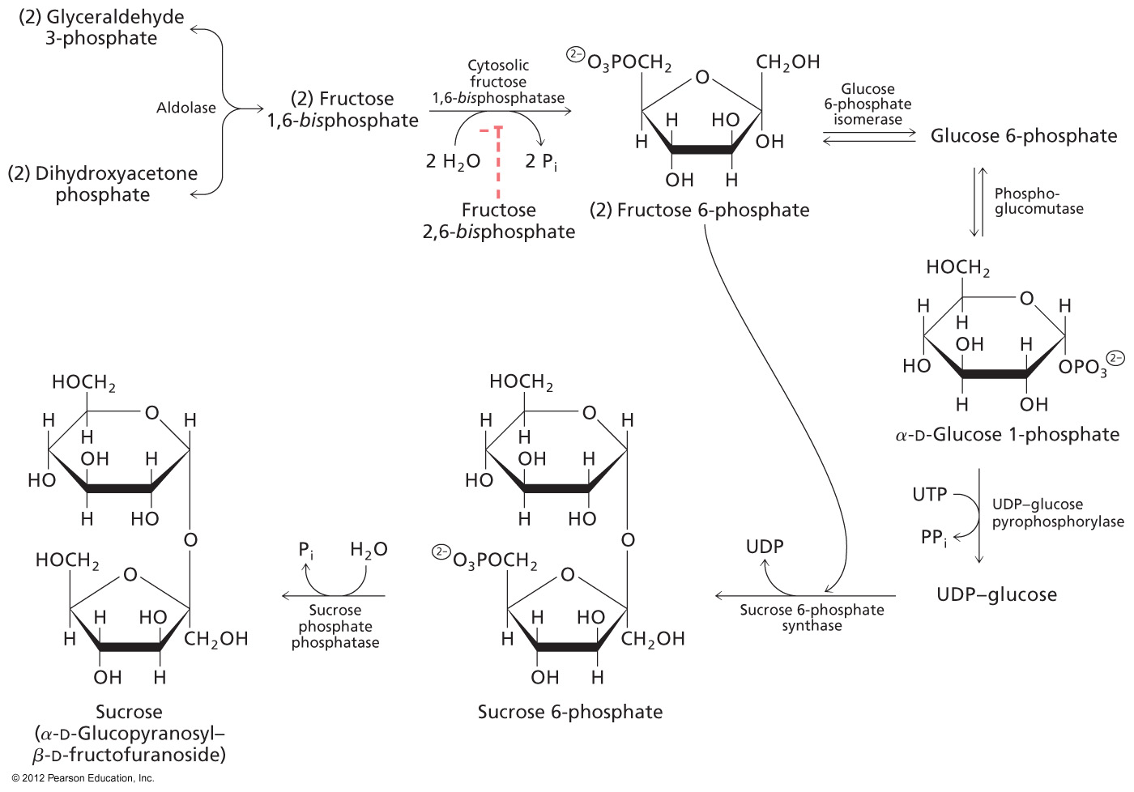
Sucrose
Mobile fuel source (blood sugar for plants)

Slide 16
Answers
B
A
A
A
C

