Slide 1
Lipid Biosynthesis
C483 Spring 2013

Slide 2
Which of these is NOT a difference between fatty acid synthesis and beta oxidation?
Synthesis requires an enzyme with a biotin cofactor, but oxidation does not.
Synthesis utilizes NADP+/NADPH, but oxidation uses NAD+/NADH.
Synthesis takes place in the mitochondria, but oxidation takes place in cytosol.
Synthesis is conducted on an enzyme complex, but oxidation enzymes are not associated.
2. Which of the following is not a stage of fatty acid synthesis?
A) Condensation of precursors.
B) Rearrangement.
C) Reduction.
D) Dehydration.
3. Which of the following is the regulated step of fatty acid synthesis in eukaryotes?
A) Carboxylation of acetyl CoA.
B) Transportation of mitochondrial acetyl CoA into the cytosol.
C) Assembly of the fatty acid chain.
D) All of the above.

Slide 3
4. Drugs called statins lower cholesterol levels because they ________.
A) degrade HMG-CoA reductase
B) bind serum cholesterol
C) inhibit HMG-CoA reductase
D) bind bile salts
Essential fatty acids
Are those which are required for cell survival.
Are required for synthesis of cholesterol.
Must be acquired by diet because they contain an odd number of carbon atoms.
Cannot be synthesized by humans because we lack enzymes necessary to make them.

Slide 4
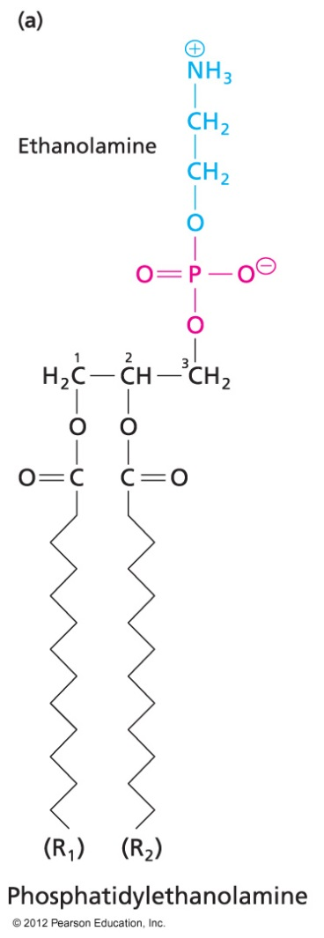
Roles of Lipids
Triacylglyerides as fuels
Glycerophospholipids in membrane
Prostaglandins as signal molecules
Cholesterol and derivatives

Slide 5
Fatty Acid Synthesis
Opposite of beta oxidation in the sense that 2-carbon acetate units are linked to form even-chain, saturated fatty acids
Differs from Fatty acid degradation
In cytoplasm, not matrix
Acyl carrier protein rather than CoA
Enzymes linked in a complex
Utilizes NADPH
Unique pathways (unlike glycolysis/ gluconeogenesis)

Slide 6
Activation of Acetyl Group
Acetyl CoA carboxylase (analogous to pyruvate carboxylase of gluconeogenesis)
Requires biotin, ATP
Regulation step—shifts fuel away from CAC

Slide 7
Acetyl CoA Carboxylase and Regulation
Strict control of fatty acid biosynthesis at key step
Local, hormone, and gene regulation
Involved in regulation of beta oxidation
When fuel is high, acetyl CoA is plentiful, and malonyl CoA is produced
Malonyl CoA may decrease appetite
Malonyl CoA inhibits acylcarnitine transferase
No Fatty acids can get into mitochondria for oxidation
See section 16.9 for detail if interested

Slide 8
Transfer to Acyl Carrier Protein

Slide 9
Four Step Elongation
Step 1: Condensation
Loss of CO2 drives reaction to completion
All happens on enzyme complex
Mechanism:

Slide 10
Steps 2-4: Opposite of beta Oxidation
Input of 2 NADPH

Slide 11
Synthesis of Palmatate
16-carbon fatty acid produced in major synthesis complex
Elongations possible with other enzymes
Many organisms can make odd-chain Fatty acids

Slide 12
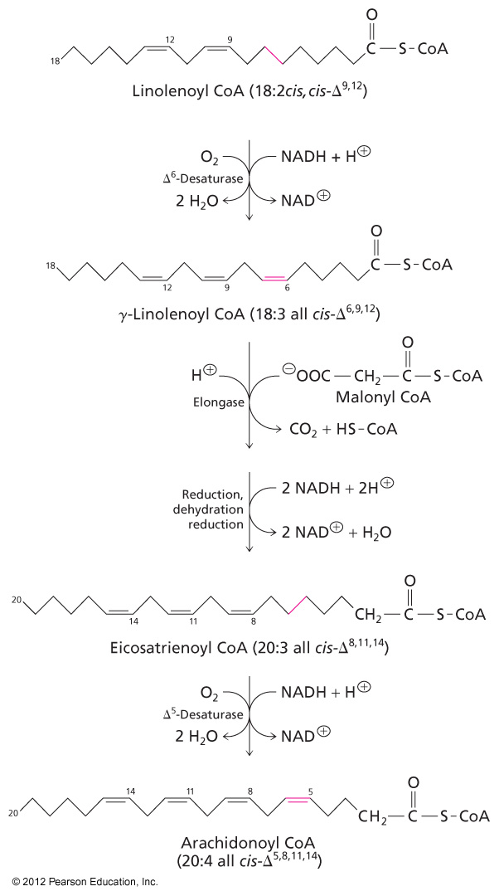
Synthesis of Unsaturated Fats
Nomenclature of unsaturation
Omega-3 and Omega-6 FA are “essential” in humans

Slide 13
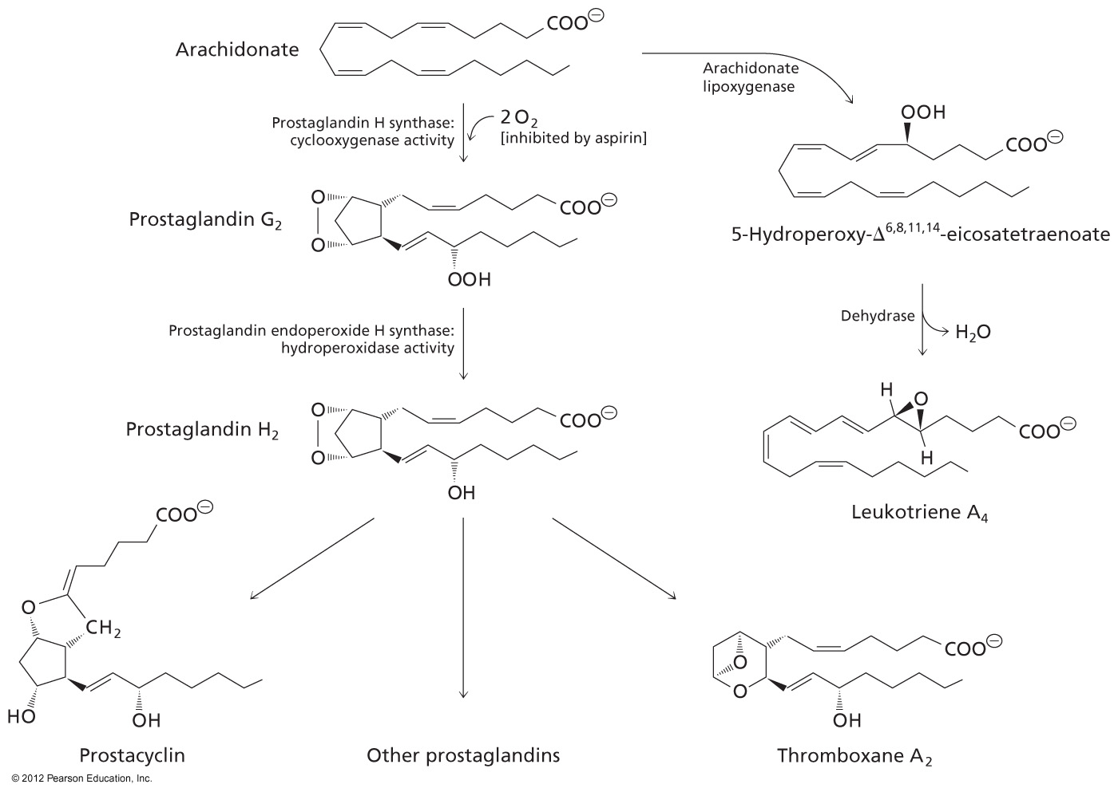
Prostaglandins and COX Inhibitors

Slide 14
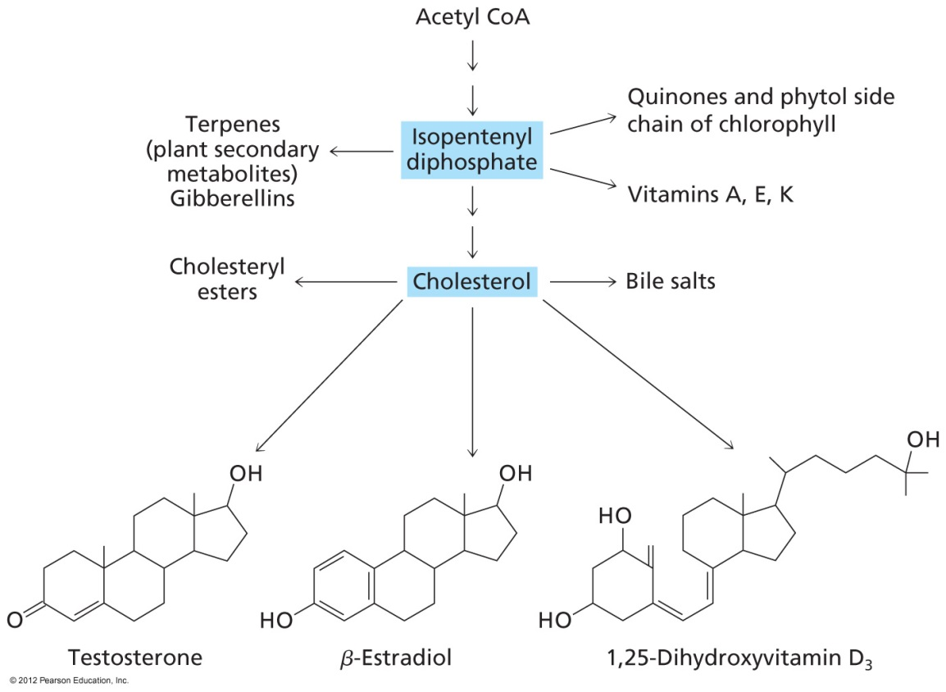
Cholesterol Biosynthesis
Three Stages: Acetyl CoA→Isopentyl diphosphate→Squalene→Cholesterol

Slide 15
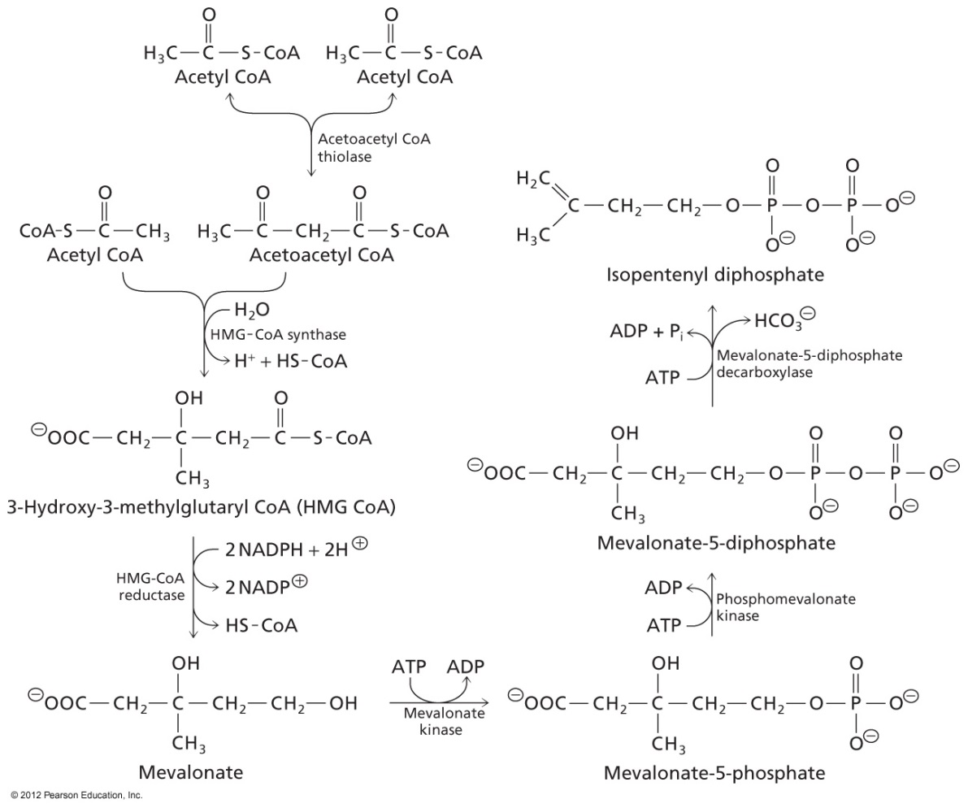
Medical Applications
Statins inhibit HMG-CoA Synthase
Same enzyme as ketone body biosynthesis, but cholesterol made in cytosol
Another strategy is to trap bile salts in intestine so that cholesterol is diverted

Slide 16
Medical Applications
Parasites like malaria make isopentenyl diphosphate through a different mechanism
A competitive inhibitor can selectively kill malaria

Slide 17
Answers
C
B
A
C
D

