Slide 1
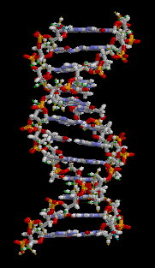
Mitochondrial
Disease and
Autism
Bridging the Gap
Fran D. Kendall, M.D.
Virtual Medical Practice, LLC
Biochemical Genetics, Pediatrics
Metabolic, Mitochondrial & Inherited Disorders
© Copyright 2011 Fran D Kendall. All rights reserved

Slide 2
Objectives
To provide basic background information on
Mitochondrial Disease, its clinical features,
diagnosis, treatment, prognosis, inheritance
and to discuss its association with
Autistic Spectrum Disorders (ASD).
Disclaimer
Dr Kendall and Virtual Medical Practice have no financial interest in any laboratory.
© Copyright 2011 Fran D Kendall. All rights reserved

Slide 3
The Big Questions
What are Mitochondria?
What is Mitochondrial Disease?
© Copyright 2011 Fran D Kendall. All rights reserved

Slide 4
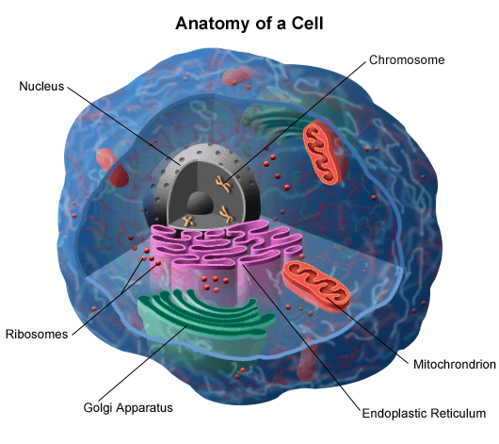
Our Bodies Cells
Smallest functioning unit of our bodies
Many cells together make up tissues
Many sheets of tissues make up our organs
© Copyright 2011 Fran D Kendall. All rights reserved

Slide 5
The Powerplants
Located inside our body cells
Composed of an inner and outer membrane
The energy producing pathway is the respiratory chain
The respiratory chain consists of 5 complexes (groups of chemicals) that produce ATP
© Copyright 2011 Fran D Kendall. All rights reserved

Slide 6
The Respiratory Chain
Oxygen & phosphate used to make energy
Composed of five complexes or groups of chemicals with a total of ~90 subunits
Energy packets are known as ATP
© Copyright 2011 Fran D Kendall. All rights reserved

Slide 7
Electron Transport Chain
© Copyright 2011 Fran D Kendall. All rights reserved

Slide 8
Mitochondrial Energy Disorders
Found in 1 in 4,000 individuals
Carrier rate of common mtDNA mutations may be as high as 1 in 200
Caused by an alteration in our inherited blueprint (gene mutation) or “toxic” affect of external factor such as medication
Results in decreased energy production and localized or widespread problems
© Copyright 2011 Fran D Kendall. All rights reserved

Slide 9
The Genetics of Mito Disease
There are hundreds of genes involved in coding for the various proteins and other compounds involved in OXIDATIVE PHOSPHORYLATION or mitochondrial energy production
These genes are contributed by two sets of inherited genetic material; the nuclear genes located inside the nucleus of our body cells and mitochondrial genes found inside the mitochondria of our cells
Nuclear genes are inherited from both parents and contribute the vast majority of the information needed for energy production
Mitochondrial genes are inherited EXCLUSIVELY through mom and contribute the remaining information
© Copyright 2011 Fran D Kendall. All rights reserved

Slide 10
Features of
Mitochondrial Nuclear Genes
Approximately 850 proteins are encoded for by the nuclear mitochondrial genes
Many of these proteins are responsible for the control of electron transport chain structure and function and assembly
Autosomal recessive inheritance of nuclear gene defects is probably the most common etiology of pediatric patients with mitochondrial disorders.
© Copyright 2011 Fran D Kendall. All rights reserved

Slide 11
Features of
Mitochondrial DNA (mtDNA)
Inherited exclusively through the maternal line
Circular molecule, a number of copies in each mitochondrium (5-10 copies typical)
16,569 bases or pieces and 37 genes
Mutated mtDNA may be present in varying amounts with wild type DNA (heteroplasmy)
© Copyright 2011 Fran D Kendall. All rights reserved

Slide 12
Mitochondrial DNA
© Copyright 2011 Fran D Kendall. All rights reserved

Slide 13
Heteroplasmy of mtDNA
© Copyright 2011 Fran D Kendall. All rights reserved

Slide 14
Symptoms I – listed on www.virtualmdpractice.com
Brain
Developmental Delays
Migraines
Seizures
Dementia
Autistic Features
Atypical Cerebral Palsy
Neuro-psychiatric Disturbances
Mental Retardation
Strokes
© Copyright 2011 Fran D Kendall. All rights reserved

Slide 15
Symptoms II – listed on www.virtualmdpractice.com
Nerves
Absent reflexes
Fainting
Neuropathic pain
Weakness (may be intermittent)
Dysautonomia - temperature instability & other dysautonomic problems
Pancreas & Other Glands
Diabetes and exocrine pancreatic failure (inability to make digestive enzymes)
Parathyroid failure (low calcium)
© Copyright 2011 Fran D Kendall. All rights reserved

Slide 16
Symptoms III – listed on www.virtualmdpractice.com
Muscles
Weakness
Cramping
Hypotonia
Muscle pain
Gastrointestinal Problems
Pseudo-obstruction
Dysmotility
Irritable bowel syndrome
Gastroesophogeal reflux
Diarrhea or constipation
© Copyright 2011 Fran D Kendall. All rights reserved

Slide 17
Symptoms IV – listed on www.virtualmdpractice.com
Kidneys
Renal tubular acidosis or wasting
Heart
Cardiomyopathy
Cardiac conduction defects (heart blocks)
Liver
Liver failure
Hypoglycemia (low blood sugar)
© Copyright 2011 Fran D Kendall. All rights reserved

Slide 18
Symptoms V – listed on www.virtualmdpractice.com
Ears & Eyes
Visual loss & blindness
Ptosis
Ophthalmoplegia
Optic atrophy
Hearing loss and deafness
Acquired strabismus
Retintis pigmentosa
Systemic
Failure to gain weight
Chronic Fatigue
Unexplained vomiting
Short stature
Respiratory problems
© Copyright 2011 Fran D Kendall. All rights reserved

Slide 19
Common Problems in
Mitochondrial Energy Disorders
Central Nervous system (Brain) problems such as developmental delays including AUTISM AND AUTISTIC FEATURES, loss of function, seizures, hypotonia & weakness
Failure to thrive
Chronic fatigue
Gastrointestinal issues such as chronic constipation
Autonomic dysfunction such as irregular heart rate and blood pressure and temperature instability with heat intolerance.
© Copyright 2011 Fran D Kendall. All rights reserved

Slide 20
Clinical Features Suggestive of
Mitochondrial Energy Disorders
Typical brain changes suggestive of Leigh disease or abnormalities in white matter
Persistent, significant elevations in lactate (especially if in the brain) and other specific biochemical features
Problems in many body systems suggestive of mitochondrial disease
Strong family history of mitochondrial disease
© Copyright 2011 Fran D Kendall. All rights reserved

Slide 21
How is Mitochondrial Disease
Diagnosed? Traditional Evaluation
Clinical features, physical findings and minimal laboratory/radiographic studies, example specific brain lesions as seen in Leigh disease
Clinical phenotype consistent with one of the well described subtypes of mitochondrial disease, such as MELAS and confirmed by gene test.
Clinical features and findings suggestive of mitochondrial disease – tissue studies completed.
© Copyright 2011 Fran D Kendall. All rights reserved

Slide 22
Leigh Disease MRI Lesions
© Copyright 2011 Fran D Kendall. All rights reserved

Slide 23
Diagnosis of
Mitochondrial Energy Disorders
Abnormalities in mitochondrial structure/size/shape/number on tissue biopsy
Enzymatic abnormalities on testing of the energy producing system (respiratory chain or electron transport chain)
Specific DNA changes that cause mitochondrial disease
© Copyright 2011 Fran D Kendall. All rights reserved

Slide 24
Ragged Red Fibers
© Copyright 2011 Fran D Kendall. All rights reserved

Slide 25
Examples of
Nuclear Gene Mito Disease
Complex I nuclear gene mutations - example NDUFV1 patients with leukodystrophy and myoclonic epilepsy
Complex IV assembly gene mutations - example SURF1 mutations associated with Leigh disease
© Copyright 2011 Fran D Kendall. All rights reserved

Slide 26
Examples of mtDNA Disease
MELAS (Mitochondrial Encephalomyopathy Lactic Acidosis and Stroke Like Episodes) due to tRNA 3243 mtDNA mutation
MERRF (Myoclonic Epilepsy and Ragged Red Fibers) due to tRNA 8344 mutation
© Copyright 2011 Fran D Kendall. All rights reserved

Slide 27
Prognosis of
Mitochondrial Energy Disorders
Quite variable but typically progressive over time
Patients can face severe disabilities and early death
Many patients stabilize or show improvements with institution of care
Problems typically worsen with stressors such as illness and surgery
© Copyright 2011 Fran D Kendall. All rights reserved

Slide 28
Current Treatment of
Mitochondrial Energy Disorders
Symptomatic – treat existing problems
Preventative – early detection of associated problems
Therapeutics very limited and include use of Coenzyme Q10
© Copyright 2011 Fran D Kendall. All rights reserved

Slide 29
Inheritance of
Mitochondrial Energy Disorders
Autosomal Recessive Inheritance
© Copyright 2011 Fran D Kendall. All rights reserved

Slide 30
Inheritance of
Mitochondrial Energy Disorders
Maternal Inheritance
© Copyright 2011 Fran D Kendall. All rights reserved

Slide 31
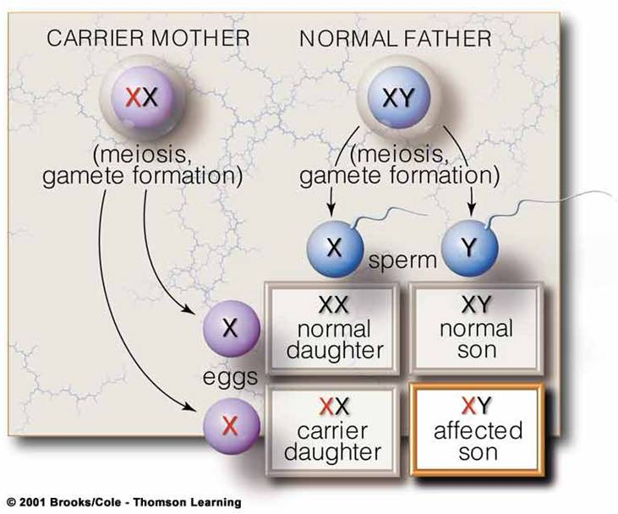
Inheritance of
Mitochondrial Energy Disorders
Autosomal Dominant forms
Sporadic
X-linked
© Copyright 2011 Fran D Kendall. All rights reserved

Slide 32
Advancements And the Future
Edison Pharma EPI 743 trial for Leigh Disease and MELAS patients
Hemopoietic stem cell transplant for MNGIE
Elimination of mtDNA mutation with nuclear transplant into healthy egg cells
New less invasive testing including buccal swab enzyme testing and expanded gene panels to identify hundreds of the known mito genes
© Copyright 2011 Fran D Kendall. All rights reserved

Slide 33
Hot Topic in Mitochondrial Disease…
Autism and Mito
© Copyright 2011 Fran D Kendall. All rights reserved

Slide 34
What is Autism?
A complex neurobiological disorder that typically lasts throughout a person’s lifetime, is a part of a group of disorders known as autism spectrum disorders (ASD) and affects the ability to communicate and relate to others
Also associated with rigid routines and repetitive behaviors
1 in 90 individuals is diagnosed with autism making it more common that pediatric cancer, diabetes and AIDS combined
Occurs in all racial, ethnic and social groups and is 4 times more likely to affect boys than girls.
An underlying diagnosis is established in only 2% - 36% of cases
© Copyright 2011 Fran D Kendall. All rights reserved

Slide 35
Mito Disorders and Autism
One 2005 population based study in Portugal suggested that 7.2 out of 100 patients with ASD have an underlying mito disorder.
A 2007 study by the same group revised their population figures and noted 4.1 out of 100 patients with autism had underlying mitochondrial disease.
Although mito appears to be a rare cause of autism, it is one of the more common definable causes of ASD.
© Copyright 2011 Fran D Kendall. All rights reserved

Slide 36
Case Study: One
One study evaluated five patients with ASD and family histories of mitochondrial DNA diseases.
Three patients had isolated autistic features and two had additional neurological findings.
Two patients had the common MELAS A3243G mutation.
One patient had mtDNA depletion.
© Copyright 2011 Fran D Kendall. All rights reserved

Slide 37
Case Study: Two
Weissman et al reported the association of ASD with the mtDNA A4295G mutation in a 15 year old with a number of other neurological findings including hearing loss.
© Copyright 2011 Fran D Kendall. All rights reserved

Slide 38
UC Davis Study –
Giulivi ET.AL. JAMA, November 2010
Children with ASD are far more likely to have a defect in their ability to produce energy than typically developing children
Discovered widespread reduced mitochondrial enzyme function among autistic children, affecting complex I in 60% of the patients
Association established utilizing WBC (lymphocyte) testing
© Copyright 2011 Fran D Kendall. All rights reserved

Slide 39
Rossignol & Frye –
Molecular Psychiatry, January 2011
Children on the autism spectrum also reside along a spectrum of mitochondrial dysfunction of varying severity
Emphasized the need for ASD children to be screened for possible mitochondrial dysfunction citing improvements in children with ASD & mito dysfunction after initiation of mito disease management
© Copyright 2011 Fran D Kendall. All rights reserved

Slide 40
Conclusion of Studies
The link between mitochondrial dysfunction and autism is greater than suspected
It remains uncertain if this association is due to a primary defect in mitochondrial functioning due to gene mutations or dysfunction caused by other factor(s).
Mitochondrial disease should be considered when associated with other neurological and body system complications and/or a family history of mitochondrial disease.
© Copyright 2011 Fran D Kendall. All rights reserved

Slide 41
Recommended evaluation
for ASD patients
TIER 1 – basic work up recommended for all patients
Chromosome microarray studies
complete metabolic panel, cbc, cpk
ammonia level
lactate and pyruvate levels
carnitine, plasma total and free
coenzyme q10 level
plasma and urine amino acids
urine organic acids
plasma acylcarnitines
thyroid function tests
list is located on our website, www.virtualmdpractice.com
© Copyright 2011 Fran D Kendall. All rights reserved

Slide 42
Recommended evaluation
for ASD patients
TIER 2 – depends on clinical features & results of Tier 1 testing
Mitochondrial enzyme and/or dna testing
rett syndrome dna testing
pten mutational analysis
nlgn3, nlgn4x, shank3, snrpn gene testing
lysosomal enzyme testing
peroxisome disease testing (vlcfas)
csf studies for lactate and pyruvate, amino acids and neurotransmitters
brain mri
list is located on our website, www.virtualmdpractice.com
© Copyright 2011 Fran D Kendall. All rights reserved

Slide 43
Why is it important to know
if an ASD patient has mito?
For implementation of treatment & protocols
Monitoring in affected individuals
To determine recurrence risks for future children
To determine risk for other family members
© Copyright 2011 Fran D Kendall. All rights reserved

Slide 44
Mito, Autism, and Vaccines
Vaccines
Mito
Autism
???
© Copyright 2011 Fran D Kendall. All rights reserved

Slide 45
THANK YOU!
and
you can follow us on Facebook!
www.facebook.com/DrKendallVMP
www.virtualmdpractice.com
info@virtualmdpractice.com
404.720.0820 Voice | 404.601.9931 fax
© Copyright 2011 Fran D Kendall. All rights reserved

